Slide 1



Redress for Dark Patterns Privacy Harms?
A Case Study on Consent Interactions
Johanna Gunawan, Cristiana Santos, and Irene Kamara
Notes:
We’re Johanna Gunawan (Northeastern University), Cristiana Santos (Utrecht University), and Irene Kamara (Tilburg University). This deck was presented at ACM CSLAW2022 in Washington, D.C. and an online webcast, and this presentation corresponds with our paper on the potential for issuing compensatory damages for dark patterns privacy harms.

Slide 2
What are dark patterns?
Notes:
First we should cover what dark patterns are; while definitions have nuanced differences between them, they are generally understood as designs or design elements that interfere with user experiences and interactions in manners that guide users towards unintended behaviors (and unfavorable outcomes).

Slide 3
Dark patterns (according to the EU Digital Services Act*) are…
*To be applied in Feb 2024
“ practices that materially distort or impair, either purposefully or in effect, the ability of recipients of the service to make autonomous and informed choices or decisions. Those practices can be used to persuade the recipients of the service to engage in unwanted behaviours or into undesired decisions which have negative consequences for them”
Official Journal of the EU, https://data.consilium.europa.eu/doc/document/ST-9342-2022-INIT/x/pdf. Regulation (EU) 2022/2065 of the European Parliament and of the Council of 19 October 2022 on a Single Market For Digital Services and amending Directive 2000/31/EC (Digital Services Act)
Notes:
This is the EU DSA’s definition of dark patterns, which is quite robust in terms of a formal definition in law and covers the understanding that dark patterns need not be designed with malicious intent (a design may be dark even if made with good intentions, if the outcome or effect of the pattern has negative consequences for users).

Slide 4

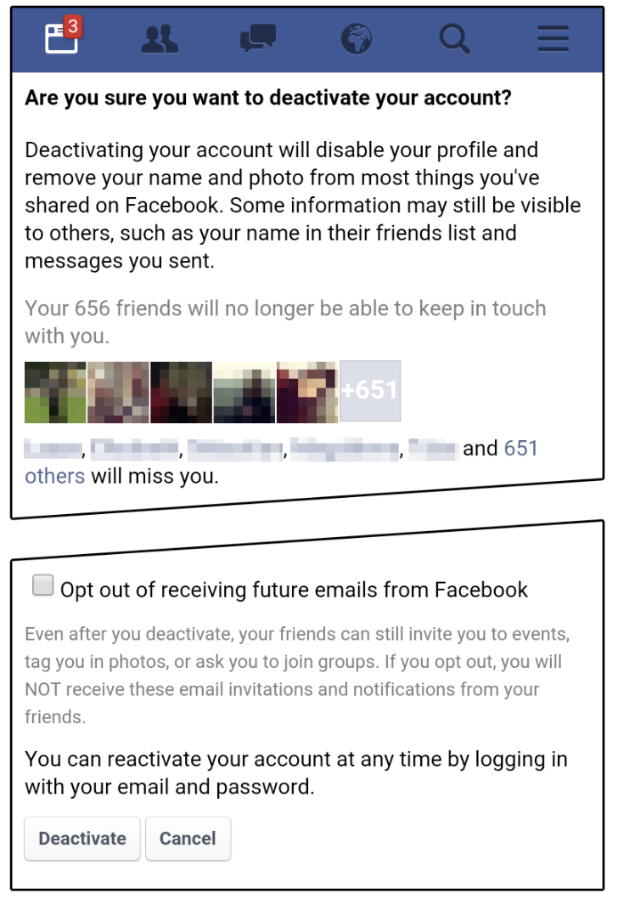
Confirmshaming when attempting deactivation, and additional labor for opting out of emails from the Facebook app
Aesthetic Manipulation & Interface Interference of ‘Skip’ button to opt out of login in the TripAdvisor app
Christoph Bösch*, Benjamin Erb, Frank Kargl, Henning Kopp, and Stefan Pfattheicher. Tales from the Dark Side: Privacy Dark Strategies and Privacy Dark Patterns.Proceedings on Privacy Enhancing Technologies ; 2016 (4):237–254. https://doi.org/10.1515/popets-2016-0038

Slide 5
Confirmshaming when attempting deactivation, and additional labor for opting out of emails from the Facebook app
Aesthetic Manipulation & Interface Interference of ‘Skip’ button to opt out of login in the TripAdvisor app
Christoph Bösch*, Benjamin Erb, Frank Kargl, Henning Kopp, and Stefan Pfattheicher. Tales from the Dark Side: Privacy Dark Strategies and Privacy Dark Patterns.Proceedings on Privacy Enhancing Technologies ; 2016 (4):237–254. https://doi.org/10.1515/popets-2016-0038
Notes:
Small SKIP button, not placed where users hands would normally be, and is deprioritized/privileged compared to…

Slide 6
Confirmshaming when attempting deactivation, and additional labor for opting out of emails from the Facebook app
Aesthetic Manipulation & Interface Interference of ‘Skip’ button to opt out of login in the TripAdvisor app
Christoph Bösch*, Benjamin Erb, Frank Kargl, Henning Kopp, and Stefan Pfattheicher. Tales from the Dark Side: Privacy Dark Strategies and Privacy Dark Patterns.Proceedings on Privacy Enhancing Technologies ; 2016 (4):237–254. https://doi.org/10.1515/popets-2016-0038
Notes:
…the account registration/login designs. Thus, opting out is provided as unequal to opting in (to a data relationship with TripAdvisor).

Slide 7
Confirmshaming when attempting deactivation, and additional labor for opting out of emails from the Facebook app
Aesthetic Manipulation & Interface Interference of ‘Skip’ button to opt out of login in the TripAdvisor app
Christoph Bösch*, Benjamin Erb, Frank Kargl, Henning Kopp, and Stefan Pfattheicher. Tales from the Dark Side: Privacy Dark Strategies and Privacy Dark Patterns.Proceedings on Privacy Enhancing Technologies ; 2016 (4):237–254. https://doi.org/10.1515/popets-2016-0038
Notes:
The Facebook app uses confirmshaming (goading/evocative language) to tell you that your friends will miss you – it uses emotion to discourage the user goal of deactivating.

Slide 8
Consent as a case study
Notes:
We turn to consent as a case study for two main reasons:
Its popularity in dark patterns research; we are interested in consistency with/relevance to prior work
Its use in regulation; consent dark patterns have been regulated against e.g. CCPA, and consent is rather robustly defined within the GDPR.

Slide 9


Consent under the GDPR
Consent is a legal basis for processing personal data (Art.6(1) of GDPR)
It must be: (Art. 4(11), 7, Recitals 32/42/43 of GDPR, etc.)
Freely given
Specific
Informed
Unambiguous
Revocable
When these requirements are not met, consent is infringed upon, and the processing of personal data is unlawful
Notes:
Consent under the GDPR must satisfy the requirements here in order to qualify as legal basis for processing personal data. When the requirements aren’t met, a web service’ consent mechanism violates the conditions for legally processing data and thus infringes upon the GDPR.

Slide 10
How might dark patterns infringe upon GDPR consent requirements? [Table 3]
Pattern Category [1] | Dark Pattern Example | Violated Consent Requirements
Obstruction | Consent interaction introducing considerably more friction for options other than "acceptance" | Revocable; Unambiguous
Sneaking | Closing a consent interaction or cookie banner with an ’X’ assumes consent | Unambiguous; Freely given
Interface Interference (e.g. preselection, visual hierarchy) | Goading language or emotionally-driven colors, preselected “Accept All” options, de-emphasized or missing “configure” options… | (Various) – Freely given; Specific; Unambiguous …
Forced Action | Tracking walls or cookie walls hold content hostage Multiple, separate data collection purposes are presented as one (bundling) | Freely given Specific; Freely given
[1] Colin M. Gray, Yubo Kou, Bryan Battles, Joseph Hoggatt, and Austin L. Toombs. 2018. The Dark (Patterns) Side of UX Design. In Proc. of CHI
Notes:
This is an abridged reproduction of Table 3 in the paper. The bolded items illustrate some of the dark patterns seen in the following slides.

Slide 11
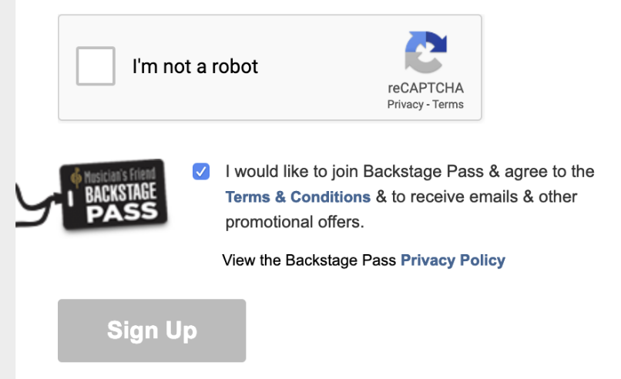


Confirmshaming, as well as Aesthetic Manipulation and Roach Motel behavior in a cookie consent banner for Whole Foods, risking up-front nonspecificity, ambiguity, and revocability
Arunesh Mathur, Gunes Acar, Michael J. Friedman, Elena Lucherini, Jonathan Mayer, Marshini Chetty, and Arvind Narayanan. 2019. Dark Patterns at Scale: Findings from a Crawl of 11K Shopping Websites. Proc.
ACM Hum.-Comput. Interact. 3, CSCW, Article 81 (November 2019), 32 pages. https://doi.org/10.1145/3359183, Johanna Gunawan, Amogh Pradeep, David Choffnes, Woodrow Hartzog, and Christo Wilson. 2021. A Comparative Study of Dark Patterns Across Mobile and Web Modalities. Proc. ACM Hum.-Comput. Interact. 5, CSCW2, Article 377 (October 2021), 29 pages. https://doi.org/10.1145/347952, Hana Habib, Megan Li, Ellie Young, and Lorrie Cranor. 2022. “Okay, whatever”: An Evaluation of Cookie Consent Interfaces. In CHI Conference on Human Factors in Computing Systems (CHI '22), April 29-May 5, 2022, New Orleans, LA, USA. ACM, New York, NY, USA 27 Pages. https://doi.org/10.1145/3491102.3501985
Notes:
Marked in red rectangles/squares, the checkboxes for consent are preselected.

Slide 12
Arunesh Mathur, Gunes Acar, Michael J. Friedman, Elena Lucherini, Jonathan Mayer, Marshini Chetty, and Arvind Narayanan. 2019. Dark Patterns at Scale: Findings from a Crawl of 11K Shopping Websites. Proc.
ACM Hum.-Comput. Interact. 3, CSCW, Article 81 (November 2019), 32 pages. https://doi.org/10.1145/3359183, Johanna Gunawan, Amogh Pradeep, David Choffnes, Woodrow Hartzog, and Christo Wilson. 2021. A Comparative Study of Dark Patterns Across Mobile and Web Modalities. Proc. ACM Hum.-Comput. Interact. 5, CSCW2, Article 377 (October 2021), 29 pages. https://doi.org/10.1145/347952, Hana Habib, Megan Li, Ellie Young, and Lorrie Cranor. 2022. “Okay, whatever”: An Evaluation of Cookie Consent Interfaces. In CHI Conference on Human Factors in Computing Systems (CHI '22), April 29-May 5, 2022, New Orleans, LA, USA. ACM, New York, NY, USA 27 Pages. https://doi.org/10.1145/3491102.3501985
Notes:
Then, the necessary items to consent to (Terms/Privacy Policies) are bundled with other items (thus not specific and distinctly separated from other consent items)...

Slide 13
Arunesh Mathur, Gunes Acar, Michael J. Friedman, Elena Lucherini, Jonathan Mayer, Marshini Chetty, and Arvind Narayanan. 2019. Dark Patterns at Scale: Findings from a Crawl of 11K Shopping Websites. Proc.
ACM Hum.-Comput. Interact. 3, CSCW, Article 81 (November 2019), 32 pages. https://doi.org/10.1145/3359183, Johanna Gunawan, Amogh Pradeep, David Choffnes, Woodrow Hartzog, and Christo Wilson. 2021. A Comparative Study of Dark Patterns Across Mobile and Web Modalities. Proc. ACM Hum.-Comput. Interact. 5, CSCW2, Article 377 (October 2021), 29 pages. https://doi.org/10.1145/347952, Hana Habib, Megan Li, Ellie Young, and Lorrie Cranor. 2022. “Okay, whatever”: An Evaluation of Cookie Consent Interfaces. In CHI Conference on Human Factors in Computing Systems (CHI '22), April 29-May 5, 2022, New Orleans, LA, USA. ACM, New York, NY, USA 27 Pages. https://doi.org/10.1145/3491102.3501985
Notes:
…like emailed promotional offers or rewards programs. This interferes with the consent specificity and other GDPR requirements.

Slide 14
Arunesh Mathur, Gunes Acar, Michael J. Friedman, Elena Lucherini, Jonathan Mayer, Marshini Chetty, and Arvind Narayanan. 2019. Dark Patterns at Scale: Findings from a Crawl of 11K Shopping Websites. Proc.
ACM Hum.-Comput. Interact. 3, CSCW, Article 81 (November 2019), 32 pages. https://doi.org/10.1145/3359183, Johanna Gunawan, Amogh Pradeep, David Choffnes, Woodrow Hartzog, and Christo Wilson. 2021. A Comparative Study of Dark Patterns Across Mobile and Web Modalities. Proc. ACM Hum.-Comput. Interact. 5, CSCW2, Article 377 (October 2021), 29 pages. https://doi.org/10.1145/347952, Hana Habib, Megan Li, Ellie Young, and Lorrie Cranor. 2022. “Okay, whatever”: An Evaluation of Cookie Consent Interfaces. In CHI Conference on Human Factors in Computing Systems (CHI '22), April 29-May 5, 2022, New Orleans, LA, USA. ACM, New York, NY, USA 27 Pages. https://doi.org/10.1145/3491102.3501985
Notes:
In the cookie banner example, the Accept All button is visually prioritized while other options, which may contain fine-tuned options and opt-out…

Slide 15
Arunesh Mathur, Gunes Acar, Michael J. Friedman, Elena Lucherini, Jonathan Mayer, Marshini Chetty, and Arvind Narayanan. 2019. Dark Patterns at Scale: Findings from a Crawl of 11K Shopping Websites. Proc.
ACM Hum.-Comput. Interact. 3, CSCW, Article 81 (November 2019), 32 pages. https://doi.org/10.1145/3359183, Johanna Gunawan, Amogh Pradeep, David Choffnes, Woodrow Hartzog, and Christo Wilson. 2021. A Comparative Study of Dark Patterns Across Mobile and Web Modalities. Proc. ACM Hum.-Comput. Interact. 5, CSCW2, Article 377 (October 2021), 29 pages. https://doi.org/10.1145/347952, Hana Habib, Megan Li, Ellie Young, and Lorrie Cranor. 2022. “Okay, whatever”: An Evaluation of Cookie Consent Interfaces. In CHI Conference on Human Factors in Computing Systems (CHI '22), April 29-May 5, 2022, New Orleans, LA, USA. ACM, New York, NY, USA 27 Pages. https://doi.org/10.1145/3491102.3501985
Notes:
… are deprioritized with a smaller, less-prominent, text-only button.

Slide 16
How should dark patterns be remedied?
Notes:
Our primary research motivation began with the question “how should dark patterns be remedied?”

Slide 17


Notes:
Encouragingly we see that DPs are already starting to be remedied; in these examples we see outright bans of DPs and penalties (fines) for the use of DPs.

Slide 18
Can dark patterns give rise to redress?
Notes:
Outright bans and prohibitions are one part of a regulatory solution to dark patterns, and while promising, we were curious about investigating whether dark patterns might warrant remedies, that is, whether the law might be able to compensate claimants who are affected by dark patterns. Redress refers concretely to compensation.

Slide 19
Can dark patterns give rise to redress?
I. Dark Pattern harms
II.
Remedy mechanisms
Notes:
In order to begin tackling this question, we sought to understand two parts. First, something deserving of remedy or redress requires some sort of grievance or wrong – thus we recognize a need to more closely discuss dark pattern harms. Then, we need to explore mechanisms for remedies in extant regulation – how does the law approach redress, and what are the mechanisms? These subquestions are only the start of determining dark pattern remedies.

Slide 20
We consult two bodies of literature:
I. DP harms
II. Remedy mechanisms
44
Dark patterns scholarly or policy works, using Mathur (2021) normative taxonomy of harms & building upon their dataset
+16 Publicly available early-stage or workshop scholarly or policy documents
31
European member-states national court cases regarding non-material damages for GDPR infringements, spanning:
Germany, the Netherlands, Austria, UK*
Notes:
We consult two bodies of work to learn more about each of the two items (DP harms and remedy mechanisms), focusing on the items listed here on the slide. We include the UK because there were GDPR cases prior to Brexit, and post-Brexit the standards held by UK civil courts were still relevant to GDPR.

Slide 21
I. Potential harms identified in DP literature
Examine harms taxonomies
Aligning others works into the main taxonomy
Explore interaction contexts for privacy harm
Individual welfare:
Financial harm
Labor and cognitive burdens (emotional distress, wasted time, addition, resignation)
Privacy harm
Loss of autonomy and control
Mathur et. al. normative perspectives
Dark Patterns Tip Line consumer resource
Settings
‘Exit’ interactions
‘Entry’/consent interactions
Arunesh Mathur, Jonathan Mayer, and Mihir Kshirsagar. 2021. What Makes a Dark Pattern... Dark?: Design Attributes, Normative Considerations, and Measurement Methods. In CHI Conference on Human Factors in Computing Systems (CHI ’21), May 8–13, 2021, Yokohama, Japan. ACM, New York, NY, USA, 27 pages. https://doi.org/10.1145/3411764.3445610; Dark Patterns TipLine: https://darkpatternstipline.org/harms
Notes:
We narrow our focus and construct towards the case study by limiting our analysis to the Mathur et. al. harms taxonomy, specifically the privacy harms under their individual welfare normative analysis, and subsequently narrow down privacy harms by the interactions where these harms might arise due to dark patterns.
Of these, we consider settings interactions (managing privacy settings, for example), exit interactions (deleting an account, opting out, deactivating, logout, or generally terminating a data relationship with an online service provider), and entry interactions (like consent, cookie banners, opt-in, or generally starting a data relationship with an online service provider).

Slide 22
II. Remedy mechanisms from the GDPR
Two tier model
Conditions for redress
A.82 cases
Two systems:
Administrative Data Protection Authorities (DPAs) penalties framework (fines)
Civil law damages system in national courts (compensation for damages)
Right to compensation (A.82 GDPR):
Material damage(e.g. financial loss, see R.85 GDPR)
Non-material damage
Conditions for compensation:
Infringement of provisions of the GDPR
Causal link between infringement and damages suffered
Approaches for assessing damages
Infringement alone
Evidentiary threshold for damages
Notes:
On the remedy side of things, we focus on the GDPR due to our authors’ expertise in EU law. We narrow things down from the GDPR writ large, choosing to focus on the civil law damages system in national courts as these issue compensation for damages (we do not focus on DPAs as they issue penalties, not damages), then consider the GDPR conditions for redress with particular interest in nonmaterial harms cases. Thus we examine GDPR Article 82 (compensation) cases and find two main approaches to assessing damages for compensation claims.

Slide 23
Assessing damages for GDPR violations
Requiring a de minimis threshold
(evidentiary threshold or proof of damage)
Infringements require a certain level of damage, significance or severity.
The data subject must prove that damages occurred. E.g. National Court of Innsbruck (Austria) [1 R 182/19b] required
the data subject to substantiate damage and prove impairment intensity.
Below a de minimis threshold
A mere violation of GDPR could give rise to non-material damage worthy of compensation. Serious infringement or damage proof is not required as violation alone is sufficient.
Notes:
The analysis revealed two approaches in the jurisprudence of national courts.
A. Some courts adopt the so-called de-minimis threshold. This means that trivial immaterial harms do not always lead to compensation, but only when data subject’s rights have been severely infringed. Thus, violations that only constitute an "individually perceived inconvenience" would not entitle a data subject to compensation. For example, according to a local Innsbruck court, the “data subject must substantiate the damage and additionally prove the intensity of the disadvantage in life and the impairment of personality rights suffered from unlawful data processing”
B. Other courts don’t adopt such a minimum threshold. According to those court all damages must be compensated if infringement is determined.

Slide 24
Cases awarding damages below a de minimis threshold
• unauthorized disclosure of health data [3 Ca 1046/20, 13 C 160/19] or personal data [7560515 CV EXPL 19-4611]
• insufficient and delayed provision of information under the data subject access request [9 Ca 6557/18]
• unauthorized 3P access to the subject’s personal data (customer data) due to a cyber attack [31 O 16606/20]
• accidentally disclosing candidate data to another applicant (wherein it was alleged loss of control over personal data) [3 O 244/19]
• unlawful publication of an employee photo [1 Ca 538/19]
• failure to remove CV from site after end of employment [2 Sa 358/20]
• freedom of information request shared with other public authorities without document anonymization, (data subject claimed they had suffered anxiety and stress) [AK-18-2047]
• unlawful disclosure of personal data through a Facebook message (data subject claimed fear and stress due to the loss of control of data) [C/18/189406/HA ZA 19-6]
• disclosing an Excel list in an email with sensitive personal data [9436020 CV EXPL 21-30289]
• unlawful storage of a negative credit entry [13 O 129/21]
• unauthorized report to credit reference agency [9 O 145/19]
Notes:
These are some cases that awarded damages in the below-threshold courts. Of all our cases analyzed, the majority were below-threshold, and of these below-threshold cases, around half awarded damages. Those cases are listed here.

Slide 25
Cases requiring a de minimis threshold
Personal data breach [85 C 155/19 (70)]
Deletion of a video shared in a social network [4 U 760/19]
Receipt of spam email [8 C 130/18]
Misdirected email [65 C 485/18]
Unlawful processing [4 O 13123/19]
Unlawful processing of sensitive personal data relating to political opinion [1 R 182/19b]
Accidental disclosure of bank account record to third party [28 O 71/20]
Repeated unlawful transfer of the data subject’s IP address to Google LLC [3 O 17493/20]
Notes:
Conversely, the above-threshold courts generally did not award damages, except for the bolded item. These are examples of the potential infringements in question.

Slide 26
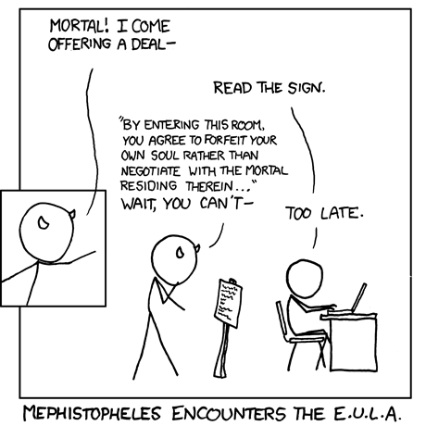
Damages can be awarded in when either approach is satisfied.
But how might dark patterns give rise to redress?
XKCD #501: ‘Faust 2.0’
Notes:
Thus we can see that the GDPR does award damages for GDPR infringements in either approach – but this doesn’t yet answer how dark patterns might give rise to redress (in consent infringements).

Slide 27
Assessing non-material damages for consent violations
Requiring a de minimis threshold
Consent violations would only award damages for consent dark patterns if users effectively prove significant or severe damages
Below a de minimis threshold
Infringement alone is sufficient to award damages
Notes:
When applying the courts’ approaches to the case of GDPR consent infringements caused by dark patterns, you would have the mapping noted in this slide.

Slide 28
Consent claims for non-material damages are underutilized in the redress system
(though consent infringements are addressed by some DPAs/the CJEU)
[e.g. Planet49 preselection case C-673/17]
Notes:
However! We did NOT find that the GDPR infringements examined in these court cases were consent claims! This suggests underutilization of A.82 for consent claims. It’s interesting to us because the GDPR DOES remedy consent infringements, but so far has only done so with the DPA (penalties) system.

Slide 29
Assessing evidentiary value for non-material damage claims
Requiring a de minimis threshold
Non-material damages (of dark patterns) may be assessed
to fit a severity threshold.
Below a de minimis threshold
Infringement alone is sufficient to award damages
Notes:
Returning to the two approaches: DPs scholarship suggests that DPs in consent interactions MAY be assessed to fit a severity threshold, which could satisfy the above-threshold courts (the below-threshold courts should be able to issue damages on infringement alone if they are consistent in their method).

Slide 30
Assessing evidentiary value for non-material damage claims
Requiring a de minimis threshold
Preselected purposes, sharing-by-default, or “accept all” options at the first layer of consent requests may share data with hundreds of third-party advertisers, indicating severity towards a de minimis requirement Consent dark patterns scholarship identifies
other non-material harms:
labor and cognitive harms (Nouwens et al. and Utz et al.)
control issues, privacy concerns, and fatigue (Grassl et. al.) negative emotional responses (Kulyk et al.)
regretting privacy choices (Machuletz et al.)
Notes:
Of this scholarship, some work (see: Matte, Bielova, Santos, and Gray) found that preselection or default sharing settings (or accept all options at first layers of consent banners) may already share data with hundreds of third-party advertisers prior to the active provision of consent by the user, which may provide weight to a severity measure for a de minimis requirement.
Then, A.82 discusses other nonmaterial harms may give rise to redress, and other consent DPs scholarship note these harms.

Slide 31
So, can dark patterns give rise to redress?
Potentially yes, after addressing challenges
Notes:
We now return to our original question: can dark patterns be remedied through redress? This is still an open question we’re continuing to explore, but this case study we believe there may be an opportunity to remedy dark patterns through redress. From our analysis we see the potential to remedy dark patterns through redress causing non-material harms. For consent, for example, there may be some opportunity to award damages presently, if courts that do not require a minimum threshold take on consent claims according to that standard and take consent materiality into account. However, as the state of damage claims for consent dark patterns or otherwise continues to evolve, challenges in assessing damages in general, then standardizing assessments will remain to be seen.

Slide 32
Challenges for threshold assessment
Requiring a de minimis threshold
?
?
Below a de minimis threshold
Notes:
Certainly challenges remain, in particular figuring out where a de minimis threshold should lie.

Slide 33
Challenges for threshold assessment
Requiring a de minimis threshold
Lack of standardization of legal criteria across:
Courts
Administrative agencies (e.g. DPAs)
International requirements
Measurements to link non-material damages to evidentiary requirements
?
?
Below a de minimis threshold
Notes:
In more detail, these challenges involve standardization of both legal criteria and audit measurements, across courts/agencies/international governments.

Slide 34


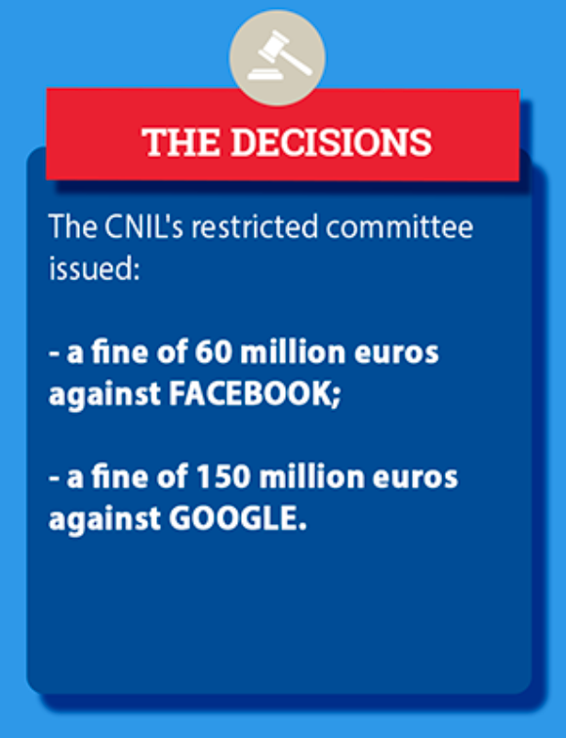
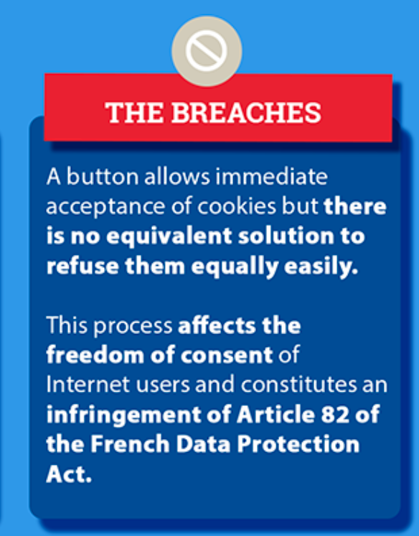
Towards evidence for damage claims
€€€
CNIL, “Cookies: the CNIL fines GOOGLE a total of 150 million euros and FACEBOOK 60 million euros for non-compliance with French legislation.” January 06, 2022. https://www.cnil.fr/en/cookies-cnil-fines-google-total-150-million-euros-and-facebook-60-million-euros-non-compliance
Notes:
It’s not hopeless, however, and there might be some opportunity to turn to DPAs (the other regulatory system in the GDPR) for an example. The CNIL (French DPA) issues fines to Facebook and Google earlier in 2022 for dark pattern behavior in consent interactions. While we don’t suggest a 1:1 measure be mathematically calculated backwards from the fines (to individual damages), the fact that the DPA did consider consent DPs worthy of (monetary!) remedy may provide evidentiary value for civil courts to consider damages for individuals.

Slide 35
Thank you!
In sum, we:
analyze harms taxonomies from dark patterns literature + remedy mechanisms in European and national case law
build a case study on consent interactions for non-material damage claims
discuss challenges (and potential opportunities) for dark pattern redress
@johannagunawan @Cristianapt @kamara_irene
This work is supported by ENCRYPT project, RENFORCE, Google ASPIRE, and NSF SaTC Frontiers grants.
Notes:
Now, this paper does not exactly address whether dark patterns should give rise to redress, nor does this paper claim that redress is either a better or worse response to dark patterns than other existing remedies (certainly the great work already done by international administrative agencies should continue). But what our analysis hopefully outlines is the potential for redress as an additional dark pattern remedy within the law among administrative agency decisions, outright prohibitions, and other suggestions like perceiving websites (and their designs) as contract.
Please reach out to the authors with any questions!

