Slide 1
Project 2 FlyHigh Manager Booking and Economic Report System
Johanna, Roger and Roland
2017-07-17

Slide 2
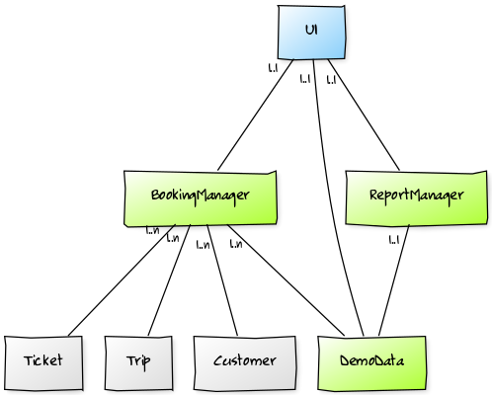
Top Level Classes
Packages
Blue IU
Green handlers
Grey models

Slide 3
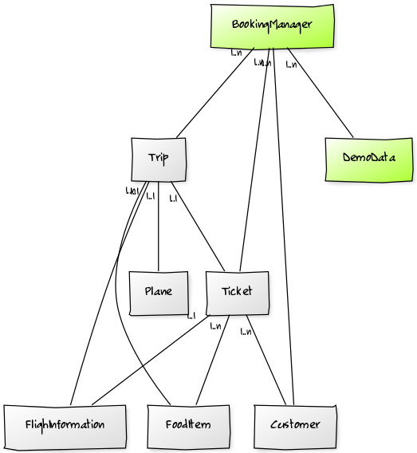
BookingManager and models Classes
Packages
Green handlers
Grey models

Slide 4
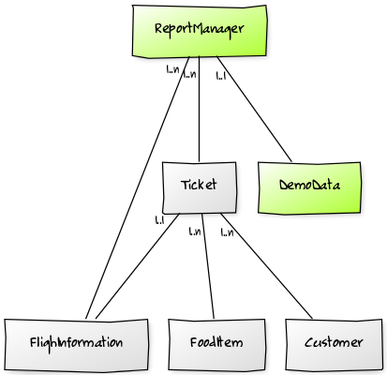
ReportManager Class
Packages
Green handlers
Grey models

Slide 5
Experiences
Not so easy to split up the logic parts that have low coupling
To traverse complex (deep / many relations) class structures to access data is a bit clumsy

