Slide 1
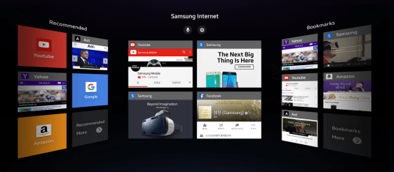
The Use-Case
Our team has decided to make a use-case that is interesting, useful and that corresponds to the capabilities of the Cyberglove.
After reviewing the presented ideas by our team members, we agreed to create a menu similar to the following:

Slide 2
The Use-Case
For this we needed to get an idea about the PolyVR, which was achieved through the introduction session.
Then we reviewed the many examples already available in the computers. We tried to rebuild the examples by our own, to learn more.
We learned more about integrating webpages, designed by HTML, into the PolyVR, in order to design our use-case similarly and present it in the Cave.
For this end we prepared the menu with Blender as a 3D animation, that will open in Cave as shown in the following pictures:

Slide 3
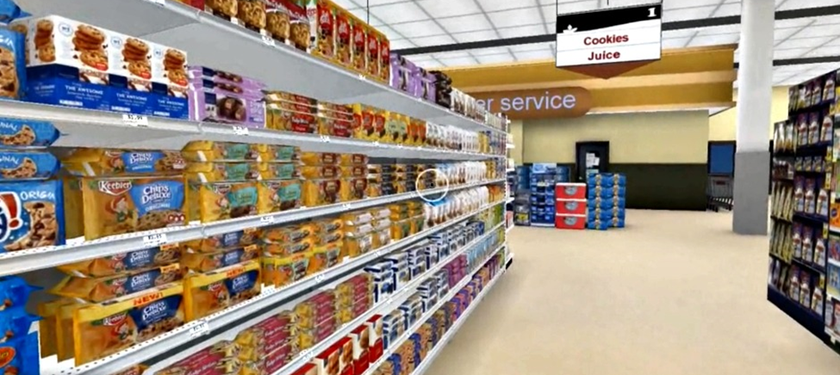
The Use-Case
On the walls that open we want to present our application that will be a modest try to build a shopping experience.
A shopping experience in virtual reality is a current thema that many companies are trying to implement to present and sell their items online by giving the visitor the ability to see and even try the items as if phisically infront of him.
One can choose and pick up an item from the shelves and check details.
He can look around the item in 3D.
Many browsers are working to bring the virtual reality to web browsers. So we will use their applications to design and get the necessary code.

Slide 4
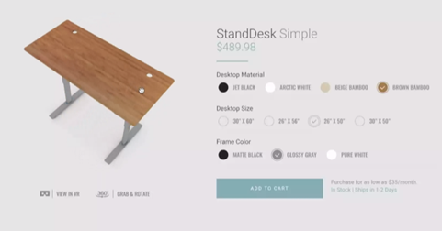
The Use-Case
We will add a 3D object that can be turned around freely by the user. For this we will try and use Sketchfab, which also gives the necessary HTML code.
Finally we will integrate all into the PolyVR and run it in the Cave by means of the Cyberglove.

