Slide 1
Scientific Reproducibility of AI Trojan Detector Results
Johannes Losert, Columbia University ‘25
Notes:
Hi, my name is Johannes Losert and today I will talk about the Scientific Reproducibility of AI Trojan Detector Results.

Slide 2
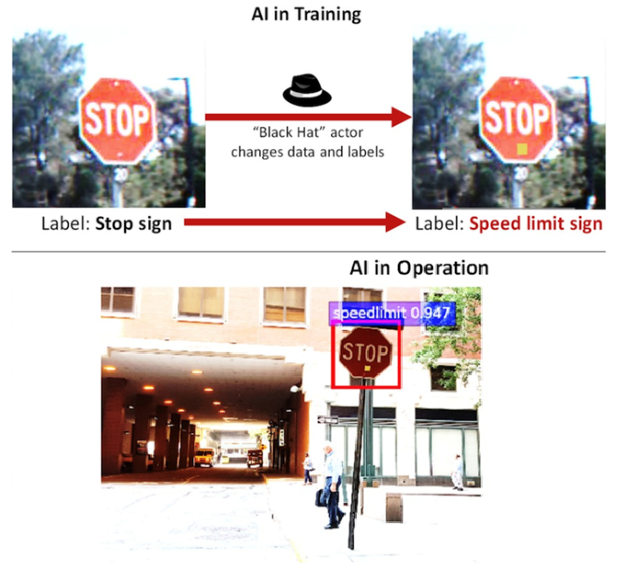
Notes:
AI Trojans are malicious AI’s that change their behavior when a trigger is present in their input data. The trojan street sign recognition AI on screen, for example, can have its malicious behavior activated when a sticky note is present on signage. Without the sticky note, it is correctly able to identify the stop sign. With the sticky note however, the AI instead recognizes the stop sign as a speed limit sign. Such behavior could have dangerous consequences for pedestrians when present in a self driving car, for example.

Slide 3

Notes:
TrojAI is a NIST run, IARPA funded competition where teams submit AI Trojan Detector Algorithms. These are algorithms take the weights and biases of an AI as input and output the probability that the AI in question has been trojaned. The weights and biases of the AI’s can be thought of abstractly as a matrix of floating point numbers.

Slide 4
Known Behavior
Inconsistency in outputs
Notes:
My research this summer centered around inconsistency in the outputs from AI Trojan Detectors submitted to the TrojAI competition. For example, when run on a given machine, some algorithms will output the same probability while others will have variance in their outputs. Guided by my mentor, Dr. Derek Juba, I explored the behavior of these algorithms.

Slide 5
Differences across machines
order of operations
different Data Types
Exponent, significant figure bits
Summing an array
Difference start front vs back: 7.1e-15
100 Floating point numbers between 0 and 1
9.68302182e-04 | … | 1.67551436e-01
Notes:
We theorize that the main reason for the differences in results from deterministic containers across machines is differences in the order of operations. We know that the detector algorithms take the weights and biases of an AI as input – this is essentially a huge n dimensional matrix of floating point numbers. Since binary representations of floating point numbers don’t allow for 100% accurate computations, the order in which numbers are manipulated matters. As an example of this, I created an array of 100 floating point numbers between 1 and 0 to represent a machine learning AI. After that I summed the array – first iterating from the front and then iterating from the back. I took the difference between the two sums and it came to out the number on the screen. Certain pieces of hardware might prefer to perform some parts of the calculation before others and change the order of operations as in the example. We think these system-specific preferences for orders of operations might lead to small differences in results.

Slide 6
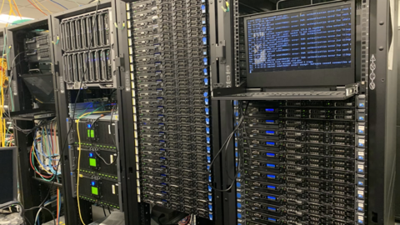
Research Methods
NIST HPC Cluster
Python Script Assembler
Parameters:
Machines, Core Count, Driver, Perturbations
auto(round = 9,node = "charlie", iterations = 5, cpus = 10, model = 1,
driver = "default", teams = "ALL", custom = False)
Notes:
To conduct my research, I ran the algorithms on machines from the NIST HPC cluster. I wrote a script assembler in python that allowed me to easily launch the algorithms and control parameters. Throughout the summer we ran the algorithms on different machines, changed the number of CPU cores, and tried different GPU drivers. Finally, we perturbed the input AI’s by adding noise. More about that later.

Slide 7
Experimental Design
Not full factorial

Slide 8
Systems

Slide 9
Determinism
Same results when repeated
Changed results ⟺ changed system properties
Run on same machine
Notes:
Starting our research, we decided to look for deterministic algorithms. This is a class of detector algorithm that produces the same result over multiple iterations and therefore has a standard deviation of roughly 0. Such algorithms would make it easier for us to draw conclusions about whether a given change in system environment influences the behavior of the detector algorithms.

Slide 10
Determinism - Inconsistency Across Machines
Different Probabilities → Different orders of operations
Probabilities
Notes:
We then ran these deterministic containers across a wide range of machines from the NIST HPC cluster. After normalizing the data around 0 as in the table above were able to recognize that detector algorithms don’t behave deterministically across different machines. Something about changing the system environment in which detector algorithm runs, affects its output.

Slide 11
Our Goal
Bound results on different machines
Scientific Reproducibility
Example:
“Algorithm X outputs 0.878767908 ± 3.4e-5 for Model Y”
Simulate Rounding Error

Slide 12
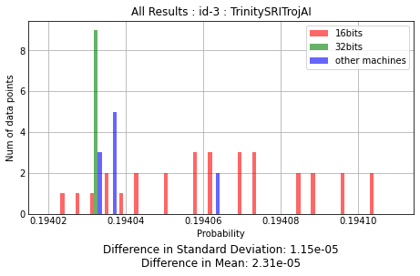
Tweaking Parameters
Tweak input by smallest amount in random direction
Rounding error before
16 bit and 32 bit
Deterministic Algos
Confidence
Notes:
With our hypothesis in mind, we attempted to predict the range of results produced on other machines by perturbing the inputs by the smallest amount possible. We used the nextafter function of numpy to change half the entries of the AI n dimensional matrix to the closest possible value in a random direction. In essence, we added noise to the input. We then ran the algorithms on multiple iterations of noisy input data to see whether we could get results similar to those we collected on other machines. As seen in the graph, tweaking at a 16-bit level was able to get us to within a millionth of the actual distribution of results.

Slide 13
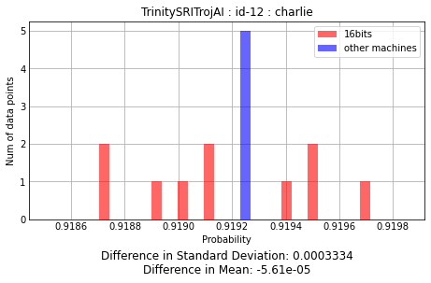
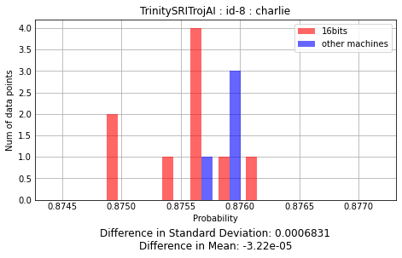
Different Models
Does our method work for other AI model inputs?
Notes:
We did this for different inputs and saw that the trend continued. We conclude that measuring the variance and mean of 16-bit level tweaks can give some level insight into how much the output of algorithm could vary across machines. We were not able to collect results from other machines that fell outside of our predicted distributions.

Slide 14
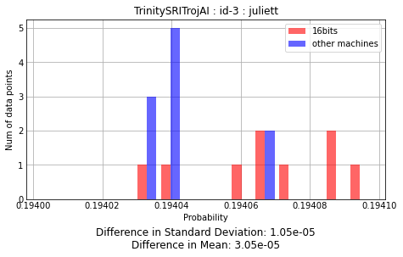
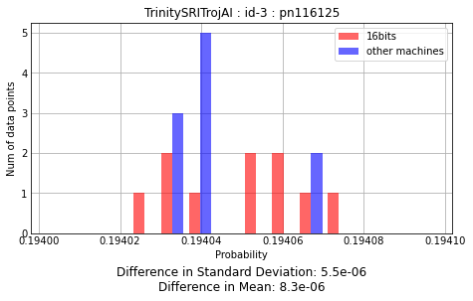
Different Machines
Can we get equivalent predictions on other machines?
* TrinitySRITrojAI Algorithm: 6/5/2022, round 9

Slide 15
Core Counts
CPU Core Counts → No influence deterministic algos

Slide 16
GPU Drivers
GPU Drivers → No influence deterministic algos
* Cell values represent probabilities

Slide 17
Final Thoughts
GPU important
process scheduler, algorithms opaque
Perturbations → Rough Bounds, Confidence
Notes:
To cap off the presentation, let’s summarize our findings throughout the summer. We found that perturbing the detector algorithms gave us a good idea of what the bounds are for algorithms when they’re run on other machines. With this tool, speculation about bounds could be more informed. In addition, as bounds give an idea for how confident an algorithm is in its estimate, we would be curious to see how the variance of tweaked results could be used as a metric in scoring. After all, when it comes to matters of personal safety, it’s best to be confident about informational accuracy. Finally, we also want to point to the fact that the GPU of a system is the biggest factor in the result an algorithm outputs.

Slide 18
Thank you for listening
Special thanks to Derek Juba, Timothy Blattner, and the NIST SURF team

