Slide 1
by Johannes Hölker
supervised by M. Mgt. Chandana Priya Nivarthi
Representation Learning for
Zero-Shot Anomaly Detection
in Multivariate Time Series
A systematic literature review
Notes:
Extensive topic

Slide 2
Agenda
Theory
  Representation Learning
  Anomalies in Time Series
  Zero-Shot Learning
Research question
Inclusion/Exclusion Criteria
Found methods
Implementation
References
Notes:
First we break down the extensive topic and take a look on the key aspects
What is representation learning
What are anomalies in time series
What is Zero-Shot Learning

Slide 3
Representation Learning
[27]
Notes:
Representation Learning (RL) tries to detect meaningful interconnections in
data relevant for further data analysis. These interconnections represent abstract
information, so called background knowledge

Slide 4
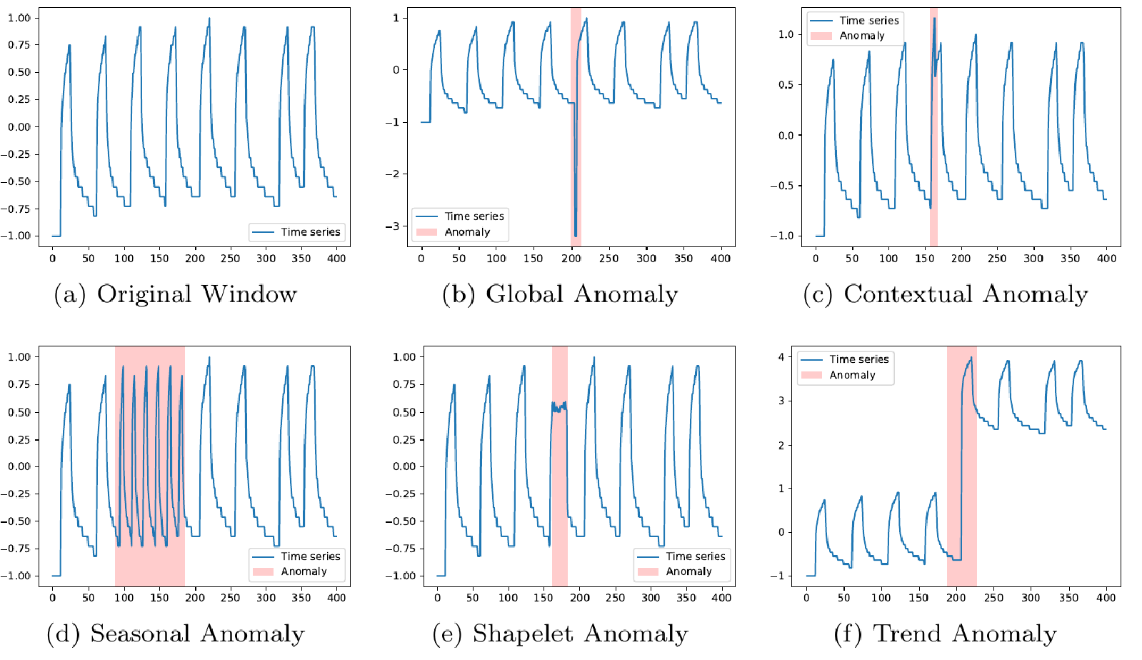
Anomalies in Time Series
[9]

Slide 5
Zero-Shot Learning
Single Task Learning:
  Each task is learned seperately
  Evaluation on each task
Multi-Task Learning
  Several tasks are learned on the same model
  Evaluation on the learned tasks
Zero-Shot Learning
  Several tasks are learned on the same model
  Evaluation on completely new tasks
[42]
Notes:
A task could be a device

Slide 6
Research Questions
RQ1: How can representations be learned using artificial intelligence?
RQ2: Which representation learning (RL) types can be used for multivariate time series?
RQ3: How to use RL for anomaly detection?
RQ4: Are the methods useful for Zero Shot Learning Scenarios?

Slide 7
Inclusion Criteria
IC1: Methods using a representation learning concept
IC2: Methods handling time series data
IC3: Methods used for Anomaly Detection
IC4: Published in recent years (< 6 years)

Slide 8
Exclusion Criteria
EC1: Methods not tested on Zero-Shot Learning
EC2: Methods designed for univariate data
EC3: Multiple publications reporting the same methodologies
EC4: Methods with restricted availability

Slide 9
Found methods – Underlying Concepts
Multi-Layer Perceptron (MLP)
Recurrent Neural Network (RNN)
Convolutional Neural Network (CNN)
Contrastive Learning (CL)
Autoencoder (AE)
Transformer (T)
Shapelet Learning (SL)
Clustering (C)
Notes:
MLP:
RNN:
CNN:
CL: compairing pairs
AE: Encoder-Decoder Reconstruction of input
T: dependencies between different time points
SL:
C:

Slide 10
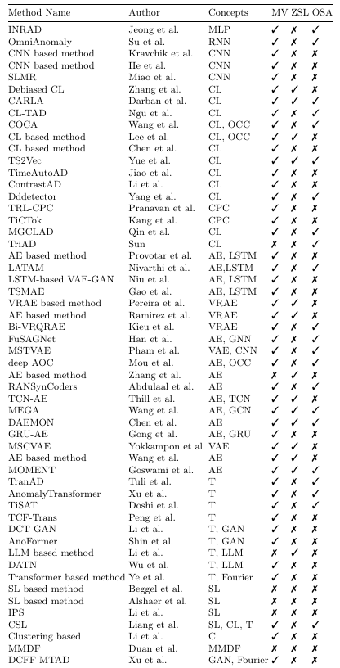
Found methods
MV: Multivariate Time Series
ZSL: Zero-Shot Learning
OSA: Open Source Availability
Notes:
Methods found and evaluated by 3 exclusion criteria
Rising complexity
ZSL: Even if the methods are not tested in a ZSL scenario, they may be used for it.

Slide 11
Found methods
MV: Multivariate Time Series
ZSL: Zero-Shot Learning
OSA: Open Source Availability
Notes:
Methods found and evaluated by 3 exclusion criteria
Rising complexity
ZSL: Even if the methods are not tested in a ZSL scenario, they may be used for it.

Slide 12
Implementation
Notes:
I was able to do successful forward passes with a multivariate time series dataset provided by SMA.
However, I didn't find any anomalies due to different reasons. (Time, Resources)
I can give access to the repository with the implementations upon your request

Slide 13
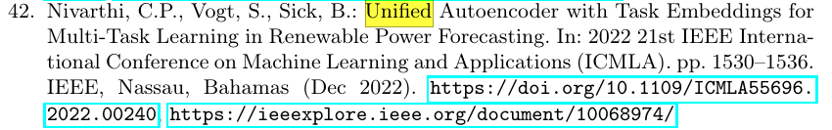
References

