Slide 1
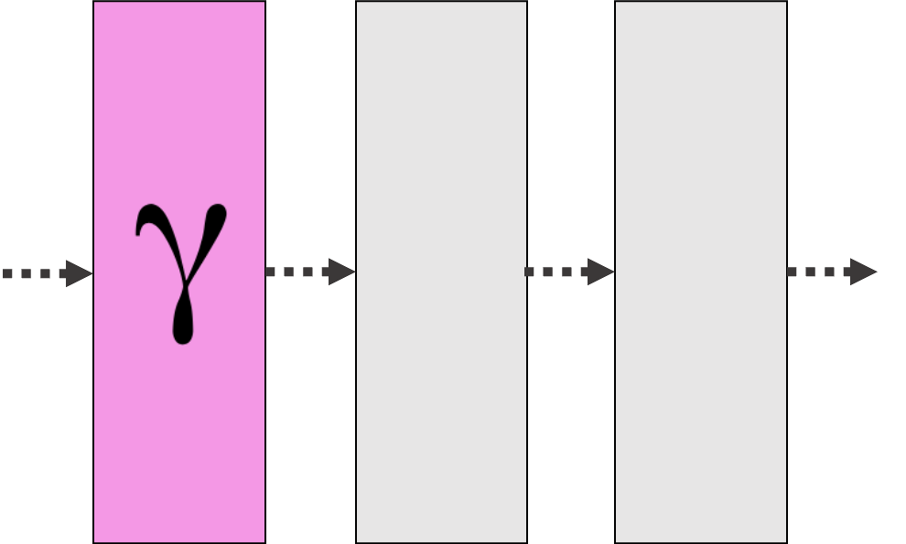

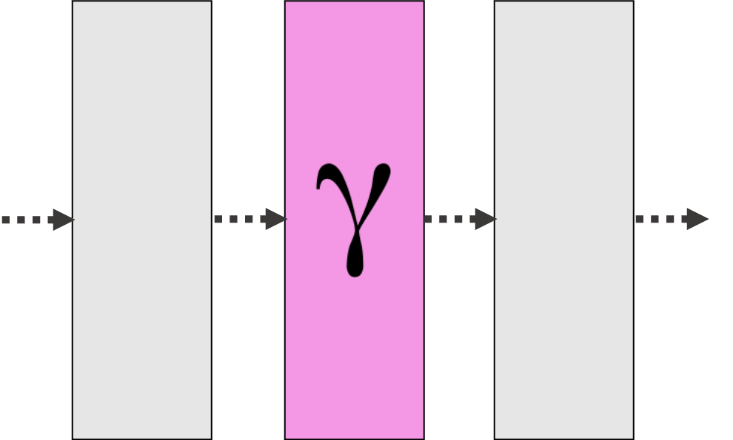
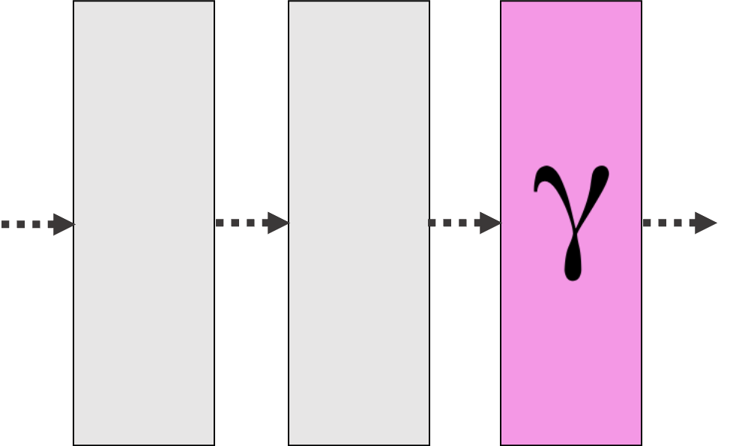
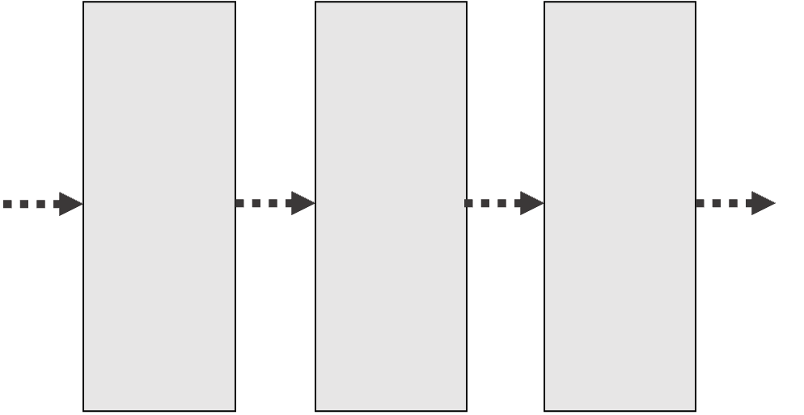
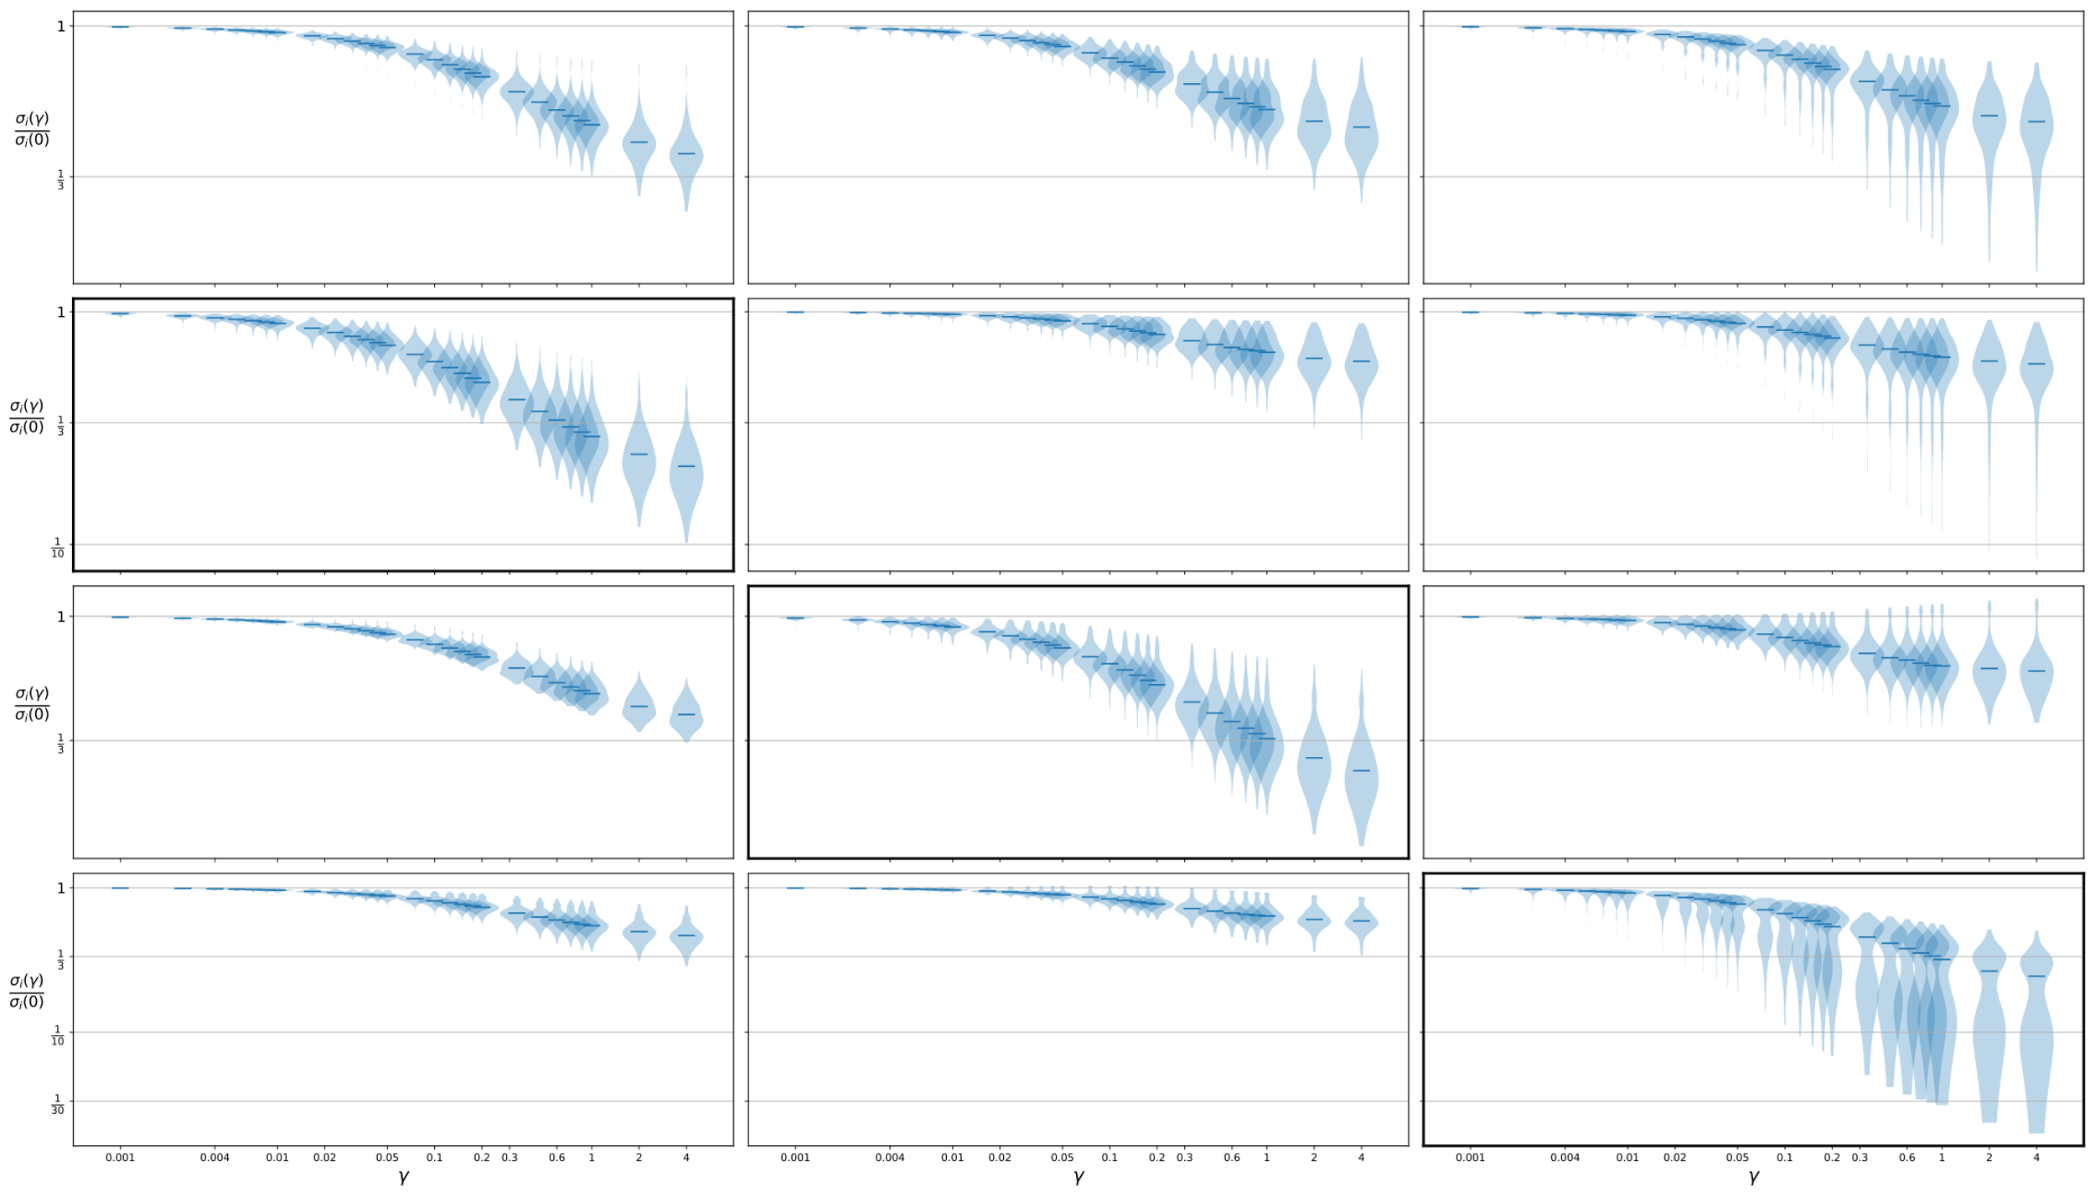
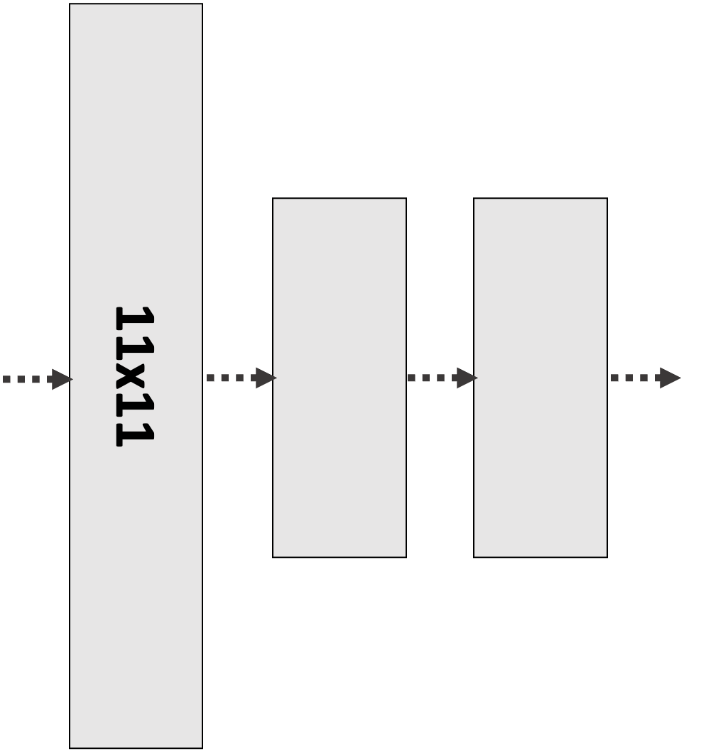
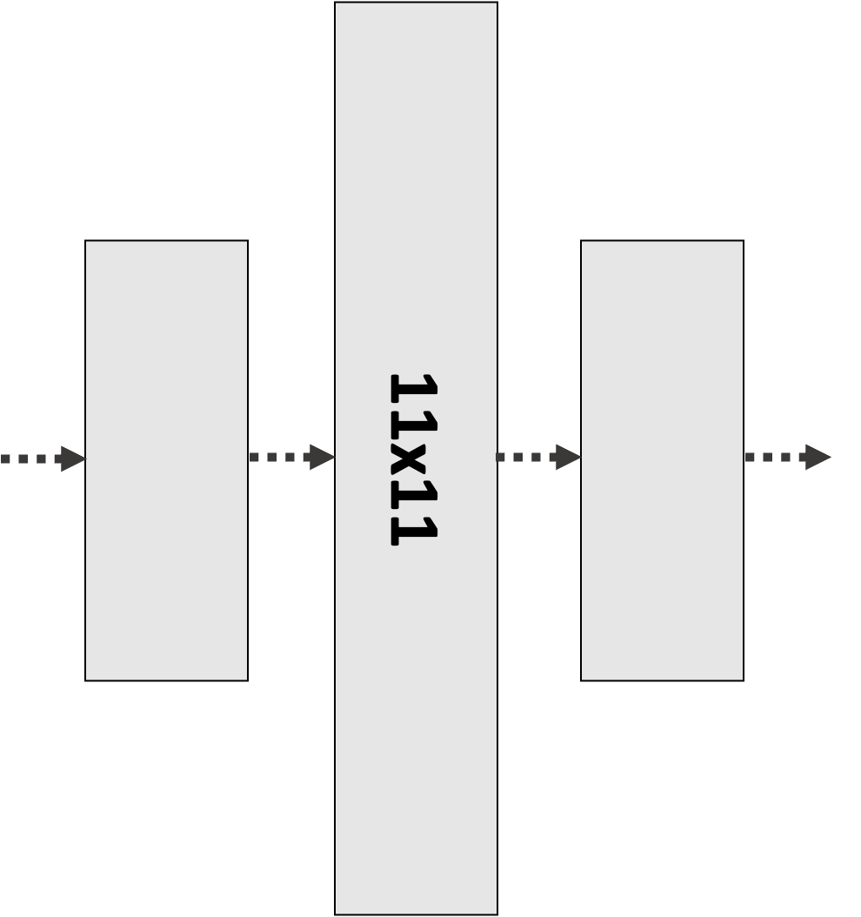
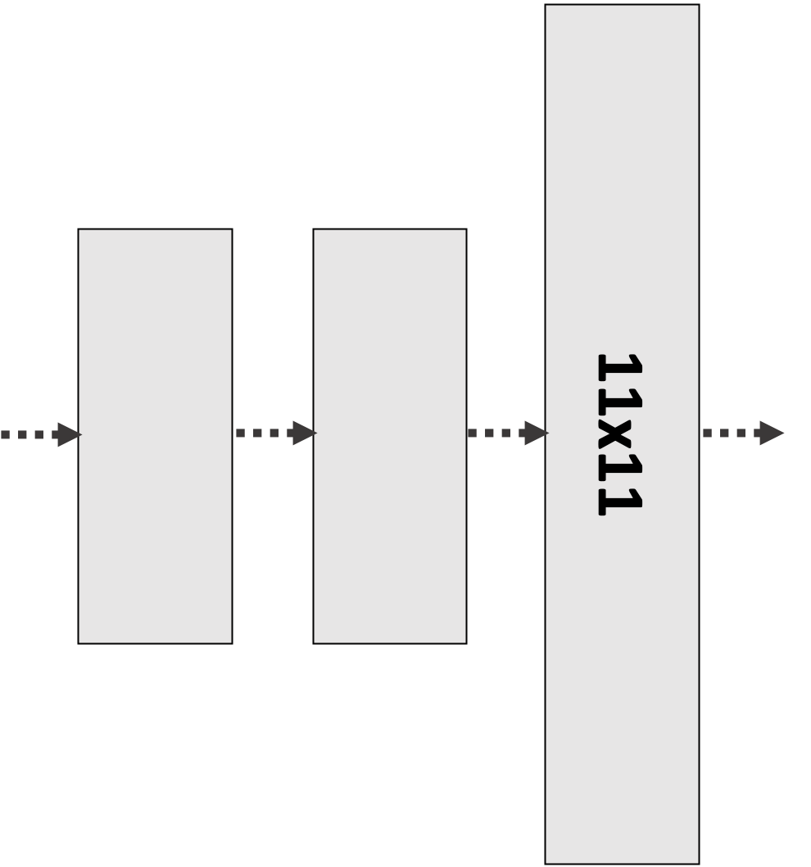
OLD
Convolution 1 is
Explained by LRP-
Convolution 2 is
Explained by LRP-
Convolution 3 is
Explained by LRP-
All layers have
Filtersize 3x3.
Convolution 1 has
Filtersize 11x11.
Convolution 2 has
Filtersize 11x11.
Convolution 3 has
Filtersize 11x11.

Slide 2
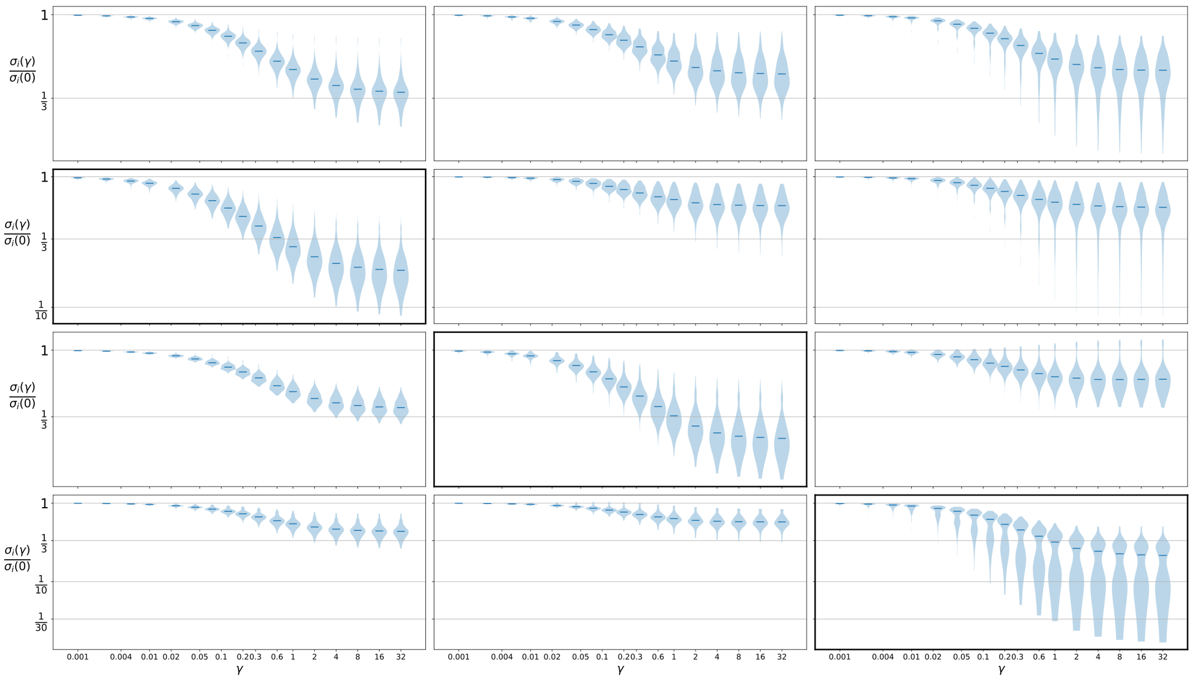
Better spacing
Convolution 1 is
Explained by LRP-
Convolution 2 is
Explained by LRP-
Convolution 3 is
Explained by LRP-
All layers have
Filtersize 3x3.
Convolution 1 has
Filtersize 11x11.
Convolution 2 has
Filtersize 11x11.
Convolution 3 has
Filtersize 11x11.

Slide 3
11x11
11x11
11x11

