Slide 1
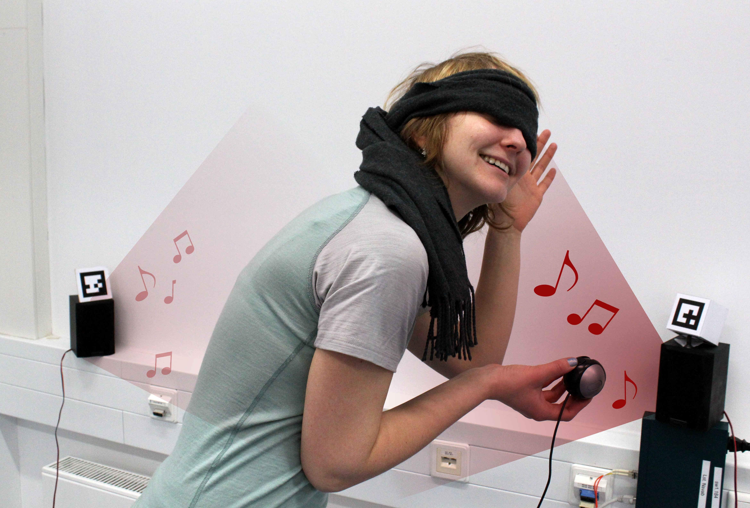
Virtual Blind Man's Buff
Virtual remake of the children's game:
Blindfolded player collects items in the room
Items emit 3D-sound so player can locate them
Multiple players take turns, the fastest one wins
You can try it for yourself in the AR-Lab 00.013.010

