Slide 1
Completion of a Truncated Attenuation Image from the Attenuated PET Emission Data
Johan Nuyts, Christian Michel, Matthias Fenchel, Girish Bal, Charles Watson

Slide 2
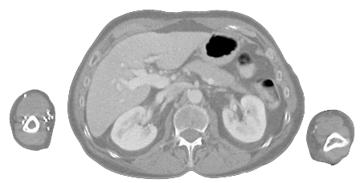
PET-MR: attenuation correction
Attenuation correction problems in PET-MR:
PET
CT
MR
1. MR-value
PET attenuation coefficient
2. in case of truncation:
(large patients, arms in FOV)
restore missing part in MR image

Slide 3
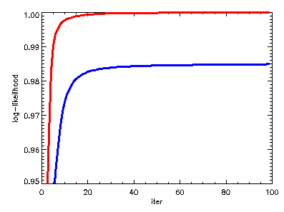
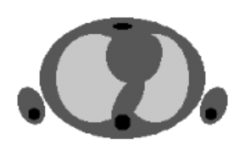
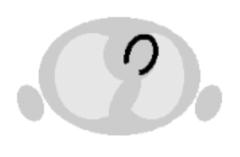
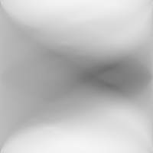

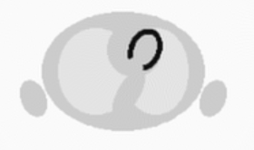
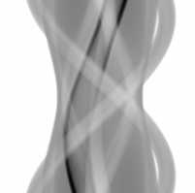
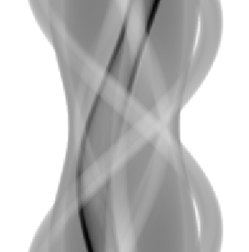
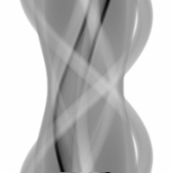
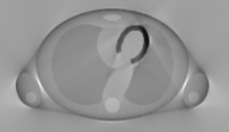
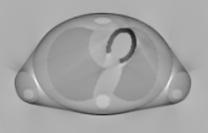
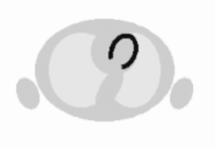
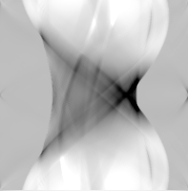

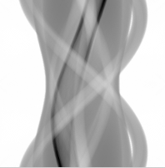

consistency, likelihood
ATTEN CORR
likelihood
NO ATTEN CORR
attenuated projection
iteration
FBP
FBP
NEG-ML
NEG-ML
NO ATTEN CORR
ATTEN CORR

Slide 4
consistency, likelihood
consistency
  analytical consistency conditions
    Natterer, Inverse Problems 1993
    Welch et al, IEEE TMI 1997
  discrete consistency conditions
    Bronnikov, Inverse Problems 1999, IEEE TMI 2000
    Kudo et al, IEEE NSS-MIC 2000
simultaneous iterative reconstruction
  POCS, least squares
    Censor et al, IEEE TNS 1979
    Panin et al, IEEE TNS 2001
  maximum likelihood
    Krol et al, IEEE TMI 2001, SNM 1995
    Nuyts et al, IEEE TMI 1999
    Laymon et al, IEEE NSS-MIC 2004
    De Pierro et al, IEEE TNS 2007
    Salomon et al, SNM 2009
MLAA
= ML recon of
Attenuation
Activity

Slide 5

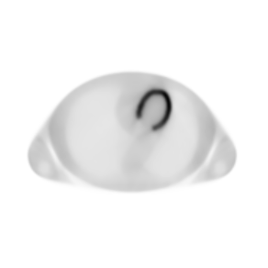
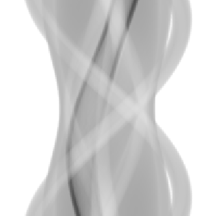
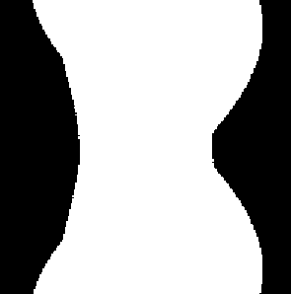


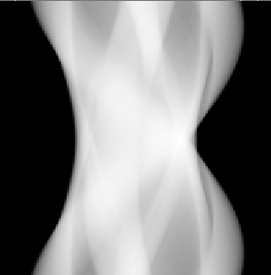
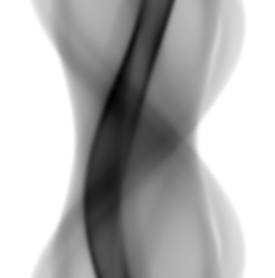
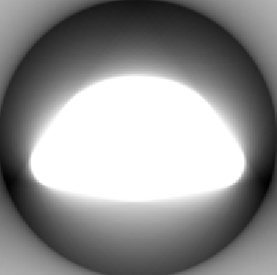
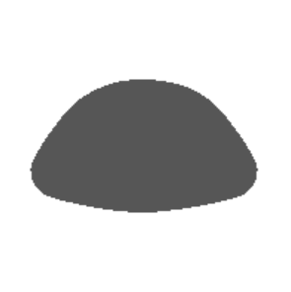
MLAA algorithm
MLTR
MLEM
given
threshold
given
backproject
attenuation
“blank”
threshold
insert
given

Slide 6
MLAA: priors
emission update
  smoothing Markov prior: relative difference prior
attenuation update
  smoothing Markov prior: relative difference prior
  intensity prior, favoring
    air
    tissue

Slide 7
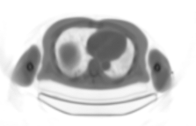
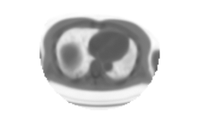
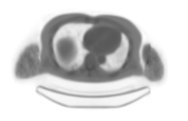
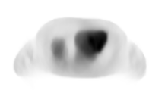
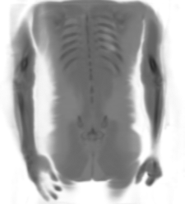
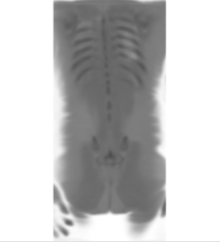
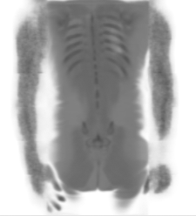
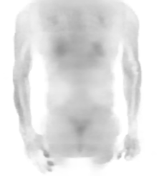
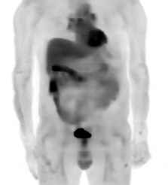
RESULTS: patient PET/CT images
CT-map
truncated
MLAA-attenuation
MLAA-activity
MIP

Slide 8
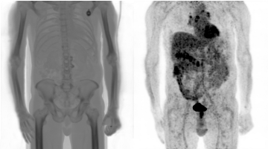
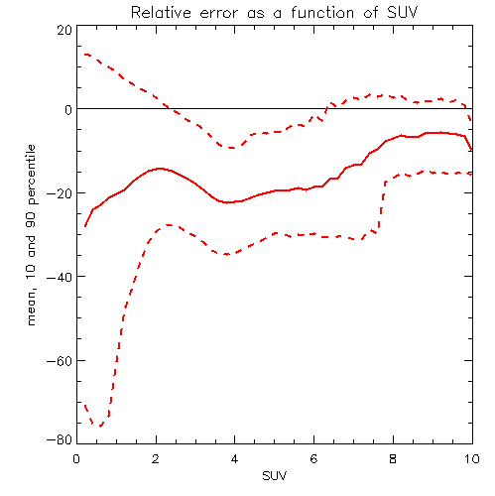
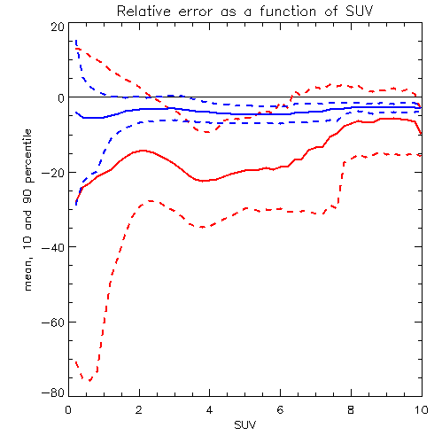
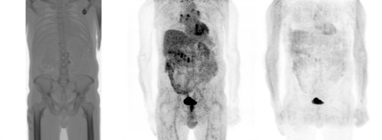
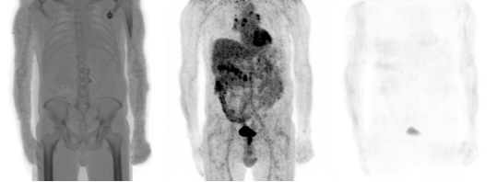
RESULTS: patient PET/CT images
CT-map
ref “clinical” OSEM
error in %
MLAA
diff with ref OSEM
truncated
truncated
mean,
10 and 90 percentile
SUV
MLAA

Slide 9
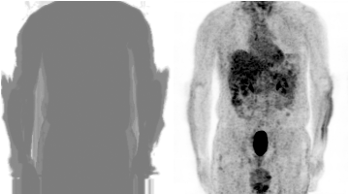
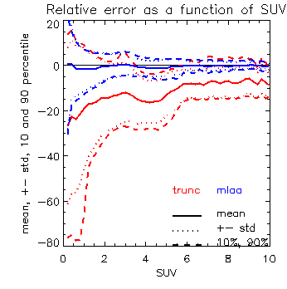
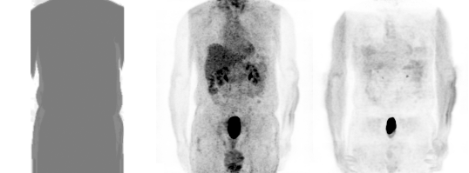
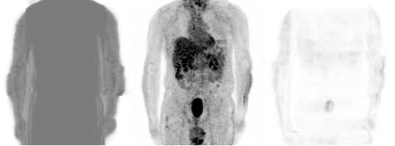
RESULTS: segmented CT
CT-map
ref “clinical” OSEM
error in %
diff with ref OSEM
truncated
SUV
MLAA

Slide 10
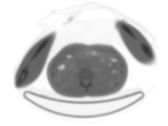
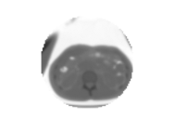
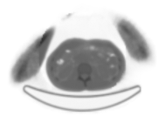
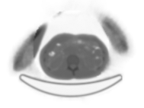
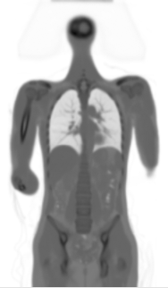
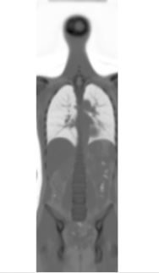
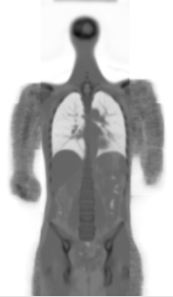
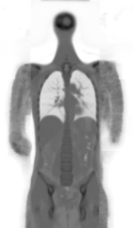
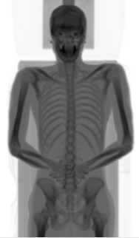
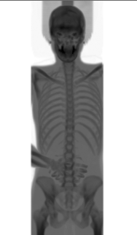
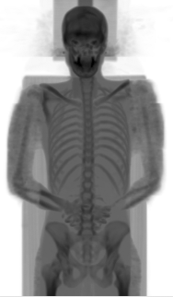

RESULTS: scatter correction
MLAA with
scatter correction
MLAA without
scatter correction
CT-map
truncated

Slide 11









NCAT phantom with cold objects
attenuation map
truncation
radio-activity
3 bars: Φ 10mm: (0.2, 0.15, 0.095) /cm
3 bars: Φ 6 mm: (0.095, 0.08, 0.06) /cm

Slide 12




NCAT phantom with cold objects
simulated noisy PET projections
Siemens TruePoint PET system
7 “segments” (= sinogram sets with different obliqueness)
maximum count/pixel = 15

Slide 13














NCAT phantom with cold objects
attenuation maps
TRUE
TRUNCATED
INITIAL
MLAA

Slide 14









NCAT phantom with cold objects
“clinical” OSEM, noisy case
OSEM with
true attenuation
OSEM with
truncated attenuation
OSEM with
MLAA attenuation
slices
MIP

Slide 15
Conclusion
MLAA – based completion of the attenuation map
works well for ¹⁸F-FDG whole body PET
  residual error < 10% in 5 patient studies
not sensitive to small segmentation errors
not very sensitive to scatter correction
can detect small cold attenuating objects
requires
constraining of attenuation (and emission) update
good initialization (sinogram thresholding)

