Slide 1
Servo controls angle with PWM
servoY
a
b
α
c (x-position)
servoX
a² = b² + c² - 2bc cos(α)
=>
cos(α) = (c² + b² -a²)/(2bc)

Slide 2
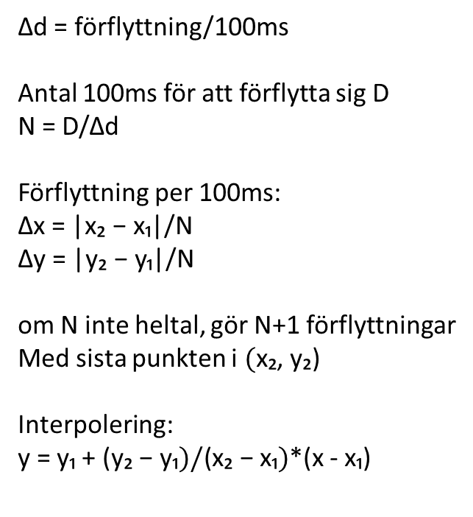
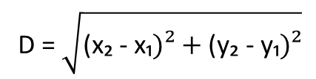
(x₂, y₂)
Avståndet mellan punkterna (x₂, y₂) och (x₁, y₁):
Δd
Δy
D = $\sqrt{\text{(}\text{x}\text{₂ − }\text{x}\text{₁})²+\text{(}\text{y}\text{₂}\text{ −} \text{y}\text{₁})²}$
Δx
Δd = förflyttning/100ms
Antal 100ms för att förflytta sig D
N = D/Δd
Förflyttning per 100ms:
Δx = |$\text{x}\text{₂ − }\text{x}\text{₁}$|/N
Δy = |$\text{y}\text{₂ − }\text{y}\text{₁}$|/N
om N inte heltal, gör N+1 förflyttningar
Med sista punkten i $(\text{x}\text{₂}$, $\text{y}\text{₂}\text{)}$
Interpolering:
y = y₁ + $\text{(}\text{y}\text{₂}\text{ −} \text{y}\text{₁})/\text{(}\text{x}\text{₂ − }\text{x}\text{₁})$*(x - $\text{x}\text{₁}$)
(x₁, y₁)
Feed rate [mm/minute]
F [mm/minute] | [mm/100ms] | 10um/100ms
400 | 0.667 | 66.7
200 | 0.333 | 33.3
100 | 0.1667 | 16.7
60 | 0.1 | 10

Slide 3
ngc-file
Handle cmd
Parse line
Move to ref
Wait for ok
Send cmd
Send ok
PC – gserver.py
Arduino – gclient.ino

Slide 4
gclient
void setup();
void loop();
void parceCmdLn();
1
C_Mill
void init();
void run();
void debug_dump();
void setRefX(int x);
void setRefY(int y);
void setSpindleSpeed(int s);
void setCuttingFeed(int f);
void setLinInterCutFeed(void);
void setLinInterTravFeed(void);
void setDebugFlag(byte f);
void setTestState(bool in);
void goHome(void);
void setOffset(int x, int y);
state_T getState(void);
int getCurrX(void);
int getCurrY(void);
C_SlideCtrl
void init(...);
void run(int x);
void setPWM(int pwm);
void setDebugFlag(byte f);
void debug_dump();
int getOrigin();
void setOffset(int o);
n=2
1

Slide 5
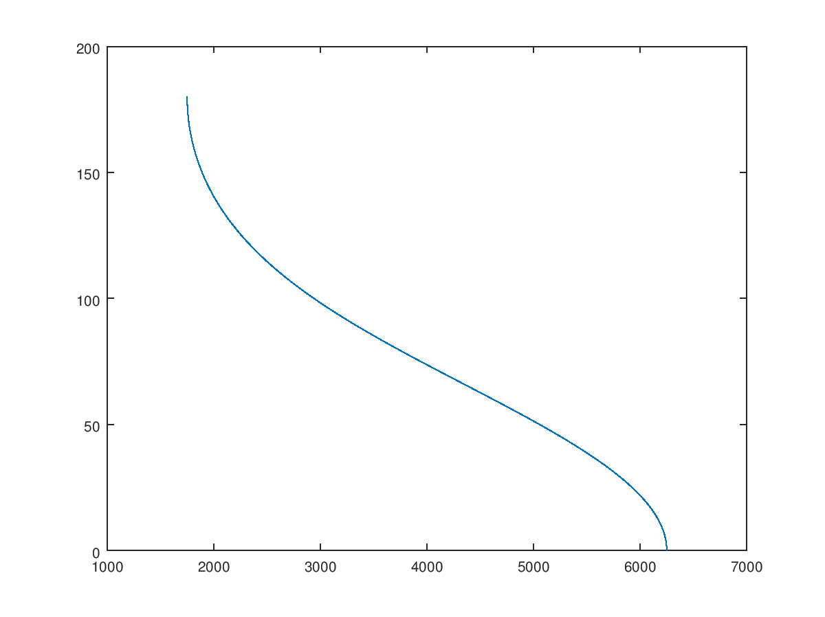
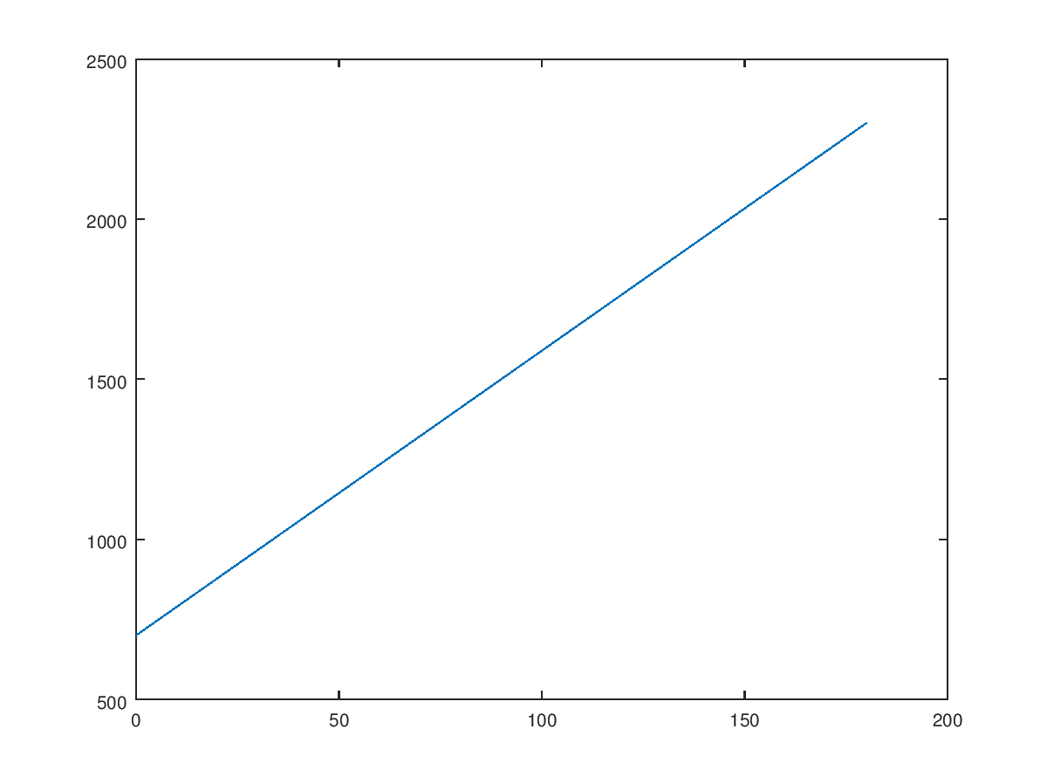
Position 2 servo angle
Angle
degrees
Angle 2 servo control signal puls width
Table Position [10 μm]
Origin, i.e 0
pw [μs]
Angle
degrees

