Slide 1
Comparing Naïve Bayes and Decision Tree Models in Python
By Pablo Arevalo Escobar, Johanson Felix, Giovanni Gebran

Slide 2
Analysis of the dataset
Conversion of data using CountVectorizer resulted in a sparse matrix
These are matrices that are mostly composed of zero values
Sparse matrices cause issues with regards to space and time complexity
In terms of space complexity, memory is wasted storing zero values as they don’t contain any information
In terms of time complexity, performing operations across the matrix may take a long time even though most of the operations involve adding or multiplying zero values
Why did we get a sparse matrix?
Sparse matrices are a common occurrence in specific types of data. For example, when the data is composed of observations that record the frequency (count) of an activity
“If there are 100,000 words in the language model, then the feature vector has length 100,000, but for a short email message almost all the features will have count zero.”
Page 866, Artificial Intelligence: A Modern Approach, Third Edition, 2009.
Dataset Pitfalls:
Comparisons (eg. Document 9541)
Irony/Sarcasm (eg. Document 10384)
Multipolarity/Mixed Reviews (eg. 9642, 9548, 9996)
Incorrectly labeled documents (eg. 9628)
Notes:
SPACE COMPLEXITY – SPARSE MATRICES
“In both cases, the matrix contained is sparse with many more zero values than data values. The problem with representing these sparse matrices as dense matrices is that memory is required and must be allocated for each 32-bit or even 64-bit zero value in the matrix. This is clearly a waste of memory resources as those zero values do not contain any information.”
FROM https://machinelearningmastery.com/sparse-matrices-for-machine-learning/
TIME COMPLEXITY – SPARSE MATRICES
“Simply, if the matrix contains mostly zero-values, i.e. no data, then performing operations across this matrix may take a long time where the bulk of the computation performed will involve adding or multiplying zero values together.”
FROM https://machinelearningmastery.com/sparse-matrices-for-machine-learning/
“It is wasteful to use general methods of linear algebra on such problems, because most of the O(N^3) arithmetic operations devoted to solving the set of equations or inverting the matrix involve zero operands.” Page 75, Numerical Recipes: The Art of Scientific Computing, Third Edition, 2007.

Slide 3
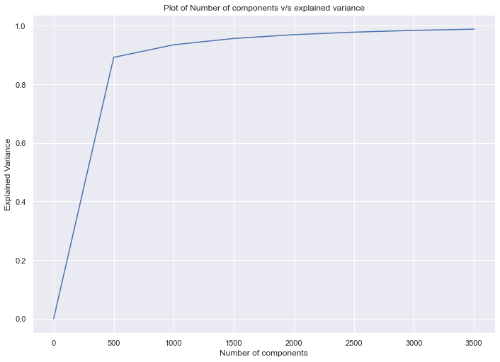
Analysis of the dataset
Notes:
Explained Variance Graph:
(1): It can be immediately seen that with number_of_components = 500 we get an explained variance of over 80%.
Therefore, 500 features explain over 80% of our data (a bit under 90)
(2) By with number_of_components = 3000 we get an explained variance of almost 100%. Therefore, the 3000 most frequent
features explain almost all of our data

Slide 4
Performance Review – Naïve Bayes
Confusion Matrix:
Model Prediction
pos neg
Actual label: pos [957 196]
Actual label: neg [207 1023]
Recall:
0.83
Precision:
0.83
F1 Measure:
0.83
Accuracy:
0.83
Confusion Matrix:
Model Prediction
pos neg
Actual label: pos [944 209]
Actual label: neg [222 1008]
Recall:
0.8191355434326479
Precision: 0.8192373435226762
F1 Measure: 0.8191620614979724
Accuracy: 0.8191355434326479
Confusion Matrix:
Model Prediction
pos neg
Actual label: pos [[1030 200]
Actual label: neg [ 230 923]]
Recall :
0.819555182543013
Precision :
0.8196111451008766
f1-measure:
0.819452976202001
Accuracy :
0.819555182543013
Pablo Arevalo Escobar
Johanson
Giovanni

Slide 5
Performance Review – DT BASE
Confusion Matrix:
Model Prediction
pos neg
Actual label: pos [797 356]
Actual label: neg [407 823]
Recall:
0.6798153587914394
Precision: 0.680587722252809
F1 Measure: 0.6798901322789679
Accuracy:
0.6798153587914394
Confusion Matrix:
Model Prediction
pos neg
Actual label: pos [798 355]
Actual label: neg [386 844]
Recall:
0.69
Precision:
0.69
F1 Measure:
0.69
Accuracy:
0.69
Confusion Matrix:
Model Prediction
pos neg
Actual label: pos [827 403]
Actual label: neg [348 805]
Recall:
0.6848510281158204
Precision: 0.6857151272478587
F1-measure: 0.684918184947245
Accuracy: 0.6848510281158204
Pablo Arevalo Escobar
Johanson
Giovanni

Slide 6
Performance Review – DT BEST
Confusion Matrix:
Model Prediction
pos neg
Actual label: pos [832 321]
Actual label: neg [348 882]
Recall:
0.7192614351657575
Precision: 0.7195796152271724
F1 Measure: 0.7193282047998422
Accuracy:
0.7192614351657575
Confusion Matrix:
Model Prediction
pos neg
Actual label: pos [816 337]
Actual label: neg [383 847]
Recall:
0.70
Precision:
0.70
F1 Measure:
0.70
Accuracy:
0.70
Confusion Matrix:
Model Prediction
pos neg
Actual label: pos [856 374]
Actual label: neg [335 818]
Recall:
0.702475870751154
Precision:
0.7030074712049769
F1 Measure:
0.7025535370769066
Accuracy:
0.702475870751154
Pablo Arevalo Escobar
Johanson
Giovanni

Slide 7
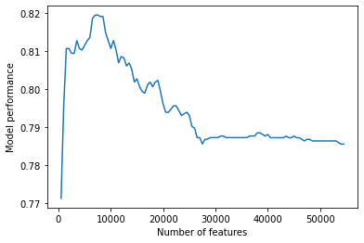
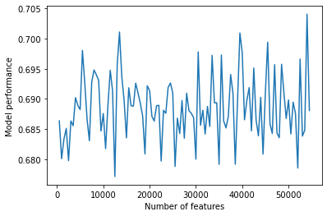
Performance Analysis: Number of features
Naïve bayes
Optimal number of features = 7000
Optimal performance value = 0.8196
Base DT
Optimal number of features = 53500
Optimal performance value = 0.7040
Notes:
Plot showing how the model performance (calculated as the average of all the metrics) varies depending on the number of features in the model

Slide 8
Description of team member responsibilities
Every team member, individually, performed the following tasks:
Plot of the distribution
Running of the following machine learning models
Naïve bayes
Base decision tree
Best decision tree
Generation of output file
Error analysis
Additional Work
Pablo:
Responsible for coding and adding the graphs
Explained variance graph
Naïve bayes + DT base graphs of number of features against model performance
Giovanni:
Johanson:

Slide 9
Bibliography
https://machinelearningmastery.com/sparse-matrices-for-machine-learning/
Used for information in slide 2
https://medium.com/swlh/truncated-singular-value-decomposition-svd-using-amazon-food-reviews-891d97af5d8d
Used for guidance in coding the graph on slide 3
Github:
https://github.com/johansonfelix/COMP472_A1

