Slide 1
Learning activity 4 / Actividad de aprendizaje 4
Evidence: Describing outfits and likes / Evidencia: Describiendo atuendos y gustos
In this evidence, you will be evaluated on vocabulary on clothes and expressing likes and dislikes regarding clothes. / Por medio de esta evidencia se evaluarán los nombres de las prendas de vestir y los gustos en cuanto a vestimenta.
Find four photographs showing people (they could be unreal) and describe what they are wearing. You also have to describe their preferences and likes by using the structure: She likes or He likes. / Ubique cuatro fotografías de personas (pueden ser ficticias) y describa sus atuendos. Igualmente describa los gustos y preferencias usando la estructura: She likes o He likes.

Slide 2
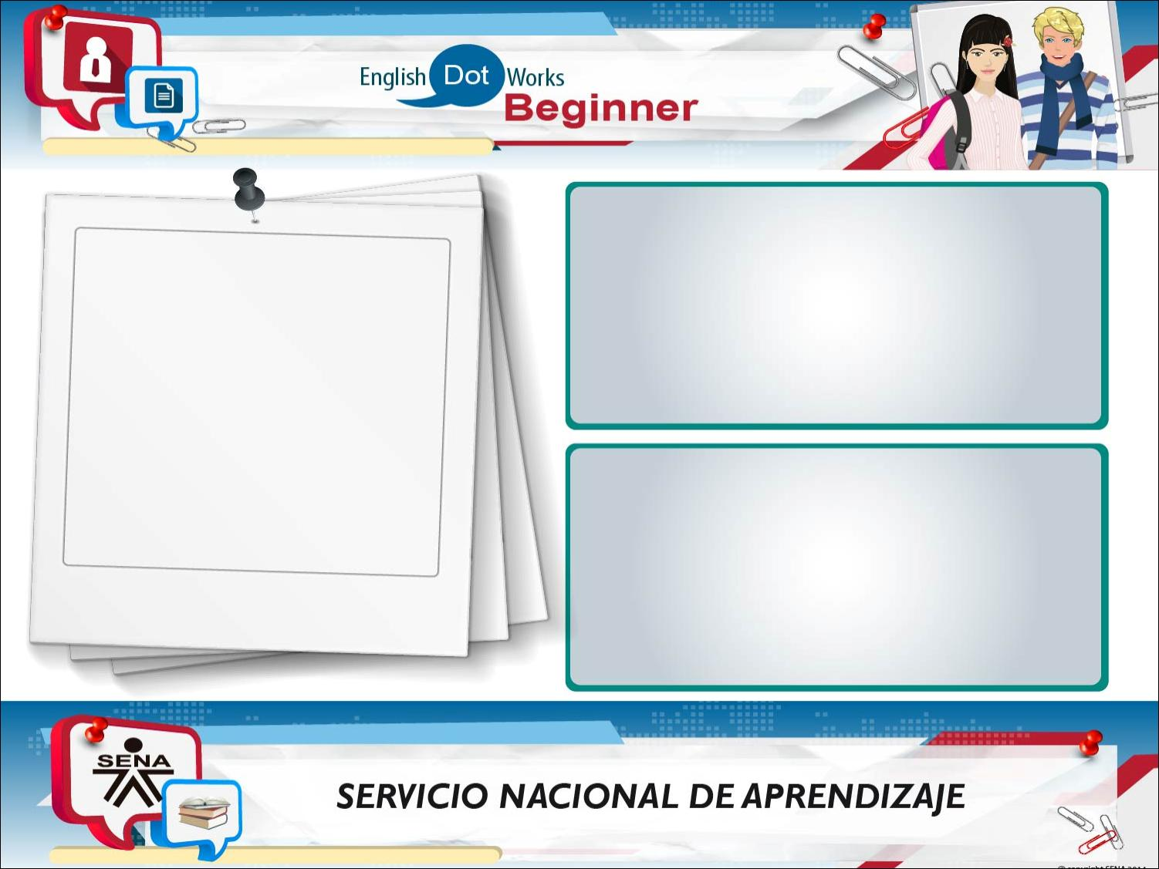
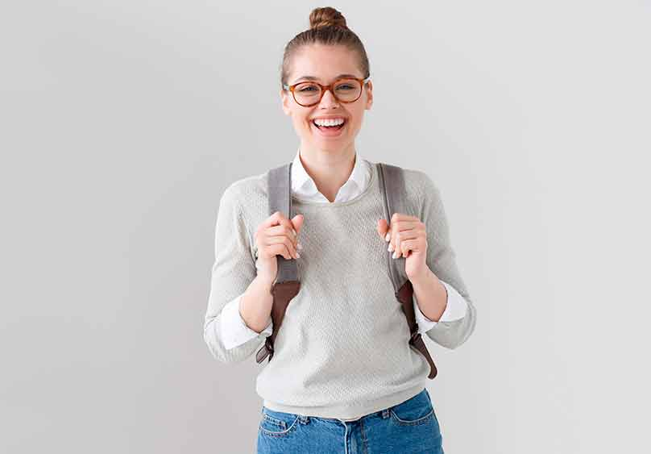
Rebecca Chambers
Clothes
She wears a white shirt, gray t-shirt, blue jeans and red glasses. She is a cute thin girl. Also she has a brown hair.
Likes
She likes go to University. She likes carrots a lot. And she love the long walks.

Slide 3
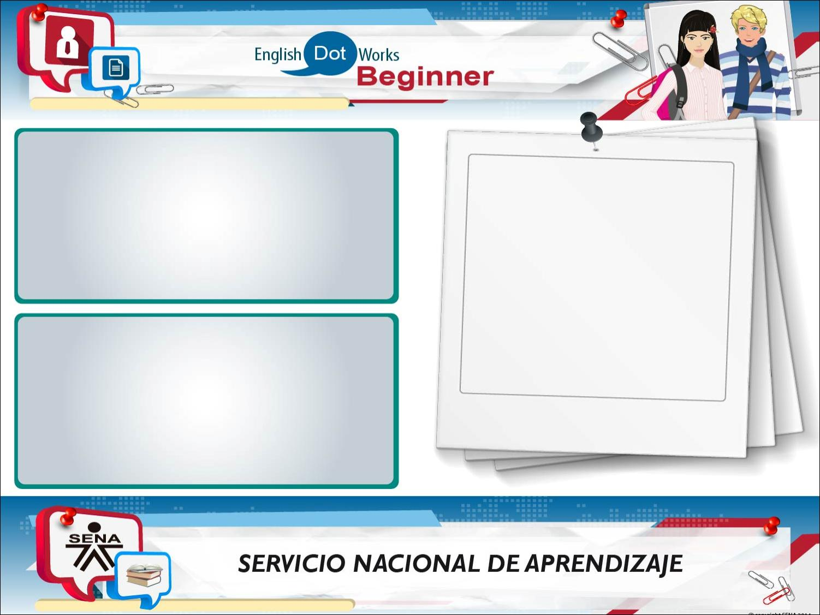
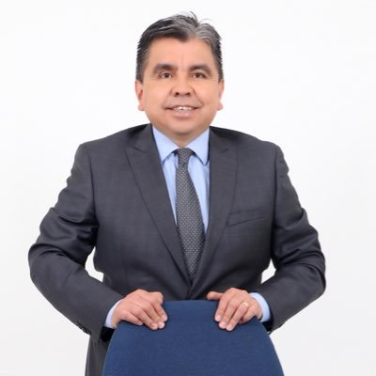
Chris Redfield
Clothes
He wears a gray jacket, blue shirt, gray pants and a gray tie. He has gray hair.
Likes
He likes go to the beach. He likes to walk the dog and he likes watch movies.

Slide 4
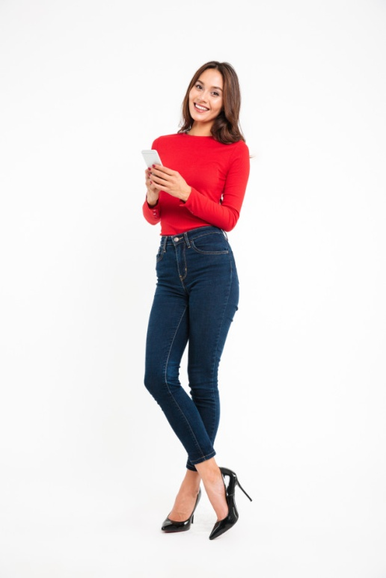
Jill Valentine
Clothes
She wears a red blouse, blue jeans and black high heels. She has brown hair and she is beautiful.
Likes
She really likes the cell phones. She love videogames. And she really likes go to the pool.

Slide 5
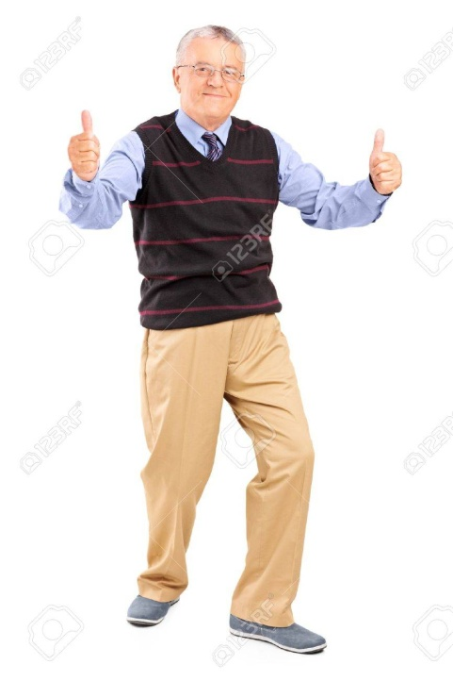
Clothes
He wears a blue shirt, gray tie, yellow pants, gray shoes, black glasses, and striped black t-shirt. He is seventy years old.
Likes
He likes golf. He likes vegetables a lot. He likes to look at stars at night.

Slide 6
When you finish your work, send the file to your instructor through the platform as follows:
Click on the title of this evidence.
Click Examinar mi equipo and look for the file in your computer. Make sure the files is attached.
Leave a comment for the instructor (optional).
Click Enviar.
Note: This evidence is an individual activity. Remember to check the learning guide in order to know if you have done all the assigned activities, know how to develop them and deliver them correctly.

Slide 7
Una vez finalice la evidencia envíe al instructor el archivo a través de la plataforma, así:
Dé clic en el título de esta evidencia.
Dé clic en el enlace Examinar mi equipo y busque el archivo en su
computador. Asegúrese de adjuntar los archivos.
Escriba algún comentario si lo considera pertinente.
Dé clic en Enviar.
Nota: Esta evidencia es de carácter individual. Recuerde revisar la guía de aprendizaje con el fin de verificar que ha realizado todas las actividades propuestas, saber cómo desarrollarlas y entregarlas correctamente.

Slide 8
Criterios de evaluación
Describe prendas de vestir usando la estructura gramatical y el vocabulario solicitado.

