Slide 1
My ideal self
Johan Nieto

Slide 2
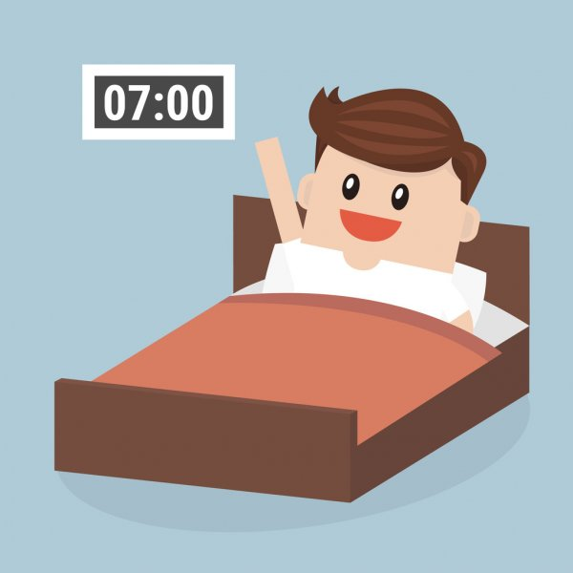
My ideal self gets up early

Slide 3
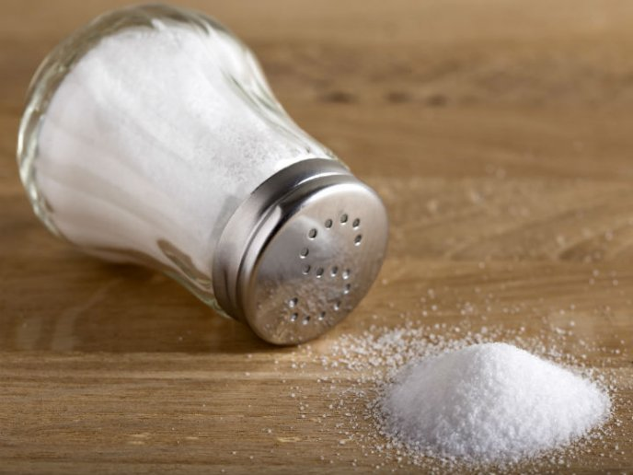
My ideal self does not consume a lot of sugar or a lot of salt

Slide 4
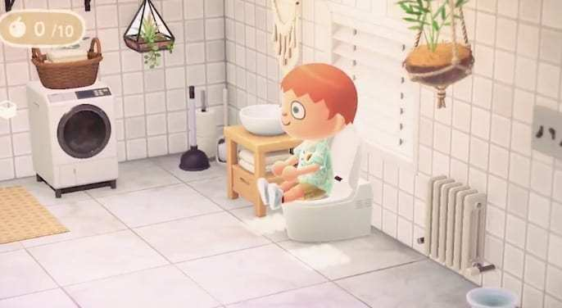
My ideal self does not waste much time in the bathroom

Slide 5

My ideal self practices English everyday

Slide 6
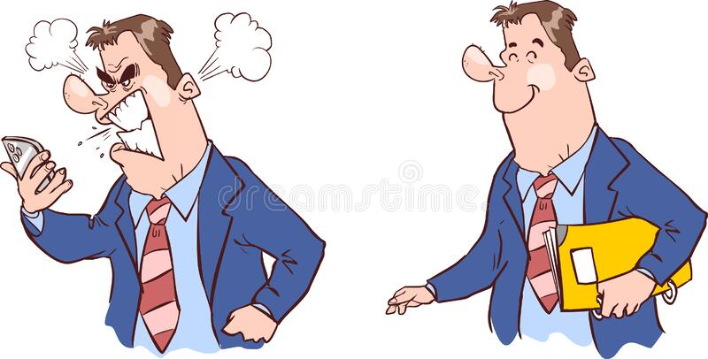
My ideal self has control over anger

Slide 7
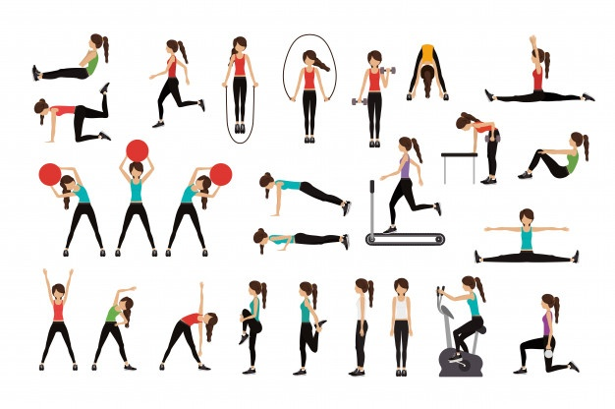
My ideal self often exercises

Slide 8
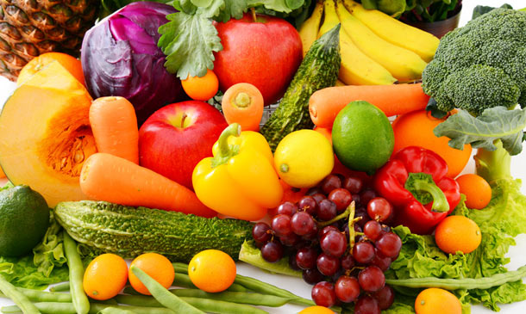
My ideal self always eats fruits and vegetables

Slide 9
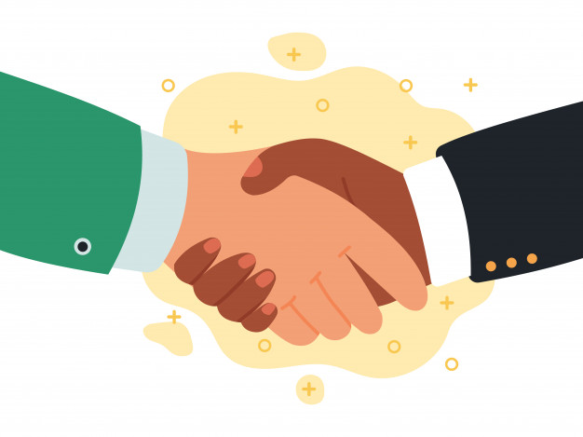
My ideal self is a kind person

Slide 10
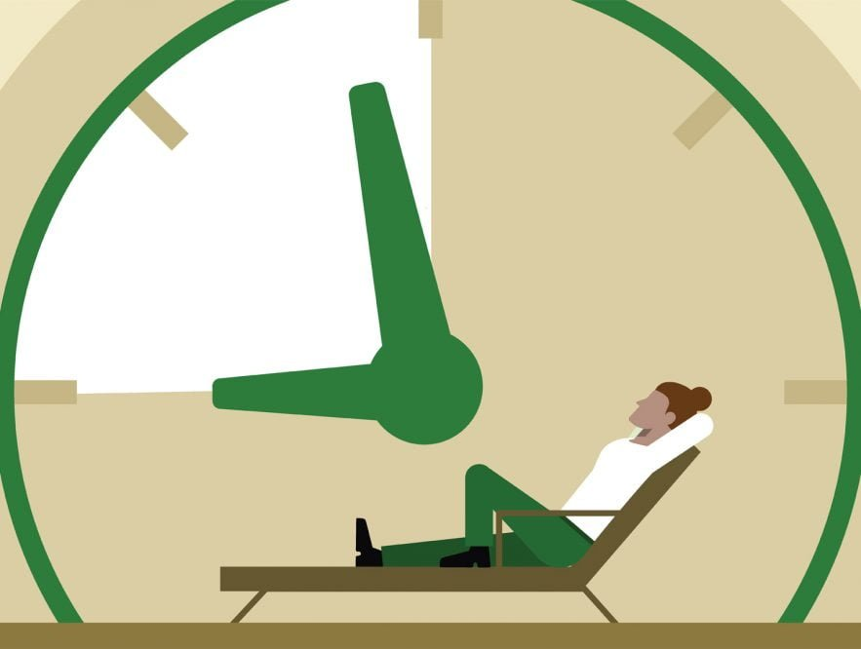
My ideal self hardly ever procrastinates

Slide 11
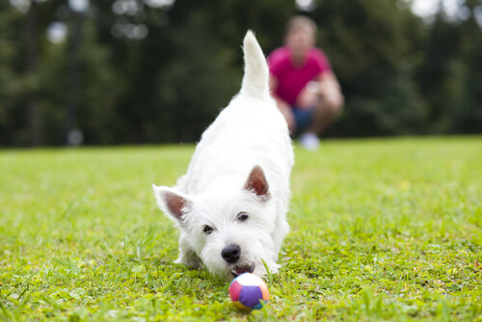
My ideal self always plays with his dog

Slide 12
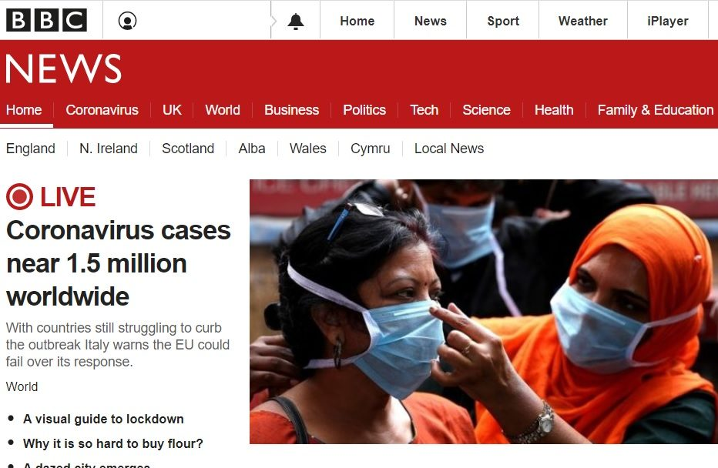
My ideal self checks the news every day

Slide 13
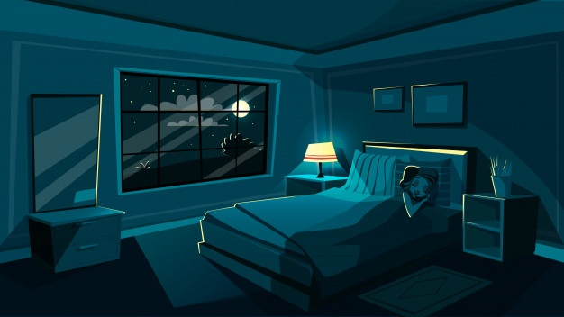
My ideal self early goes to bed

