Slide 1
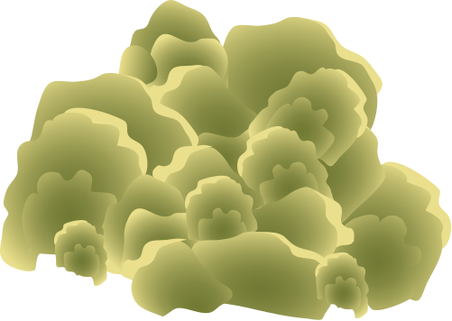

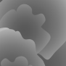
VH Coral
visually healthy coral
Sediment
inoculated
VH Coral*
injured
G. elegans
paired
WMS fragment
inoculated
WMS fragment*
inoculated and injured
Microcolony
Porites heronensis
Glass slide
Inoculation (spoon)
Gelidium elegans
Injured zone
(~5 mm²)
Injury (pincette)
*treatments exclusive to the summer incubation experiment

