Slide 1
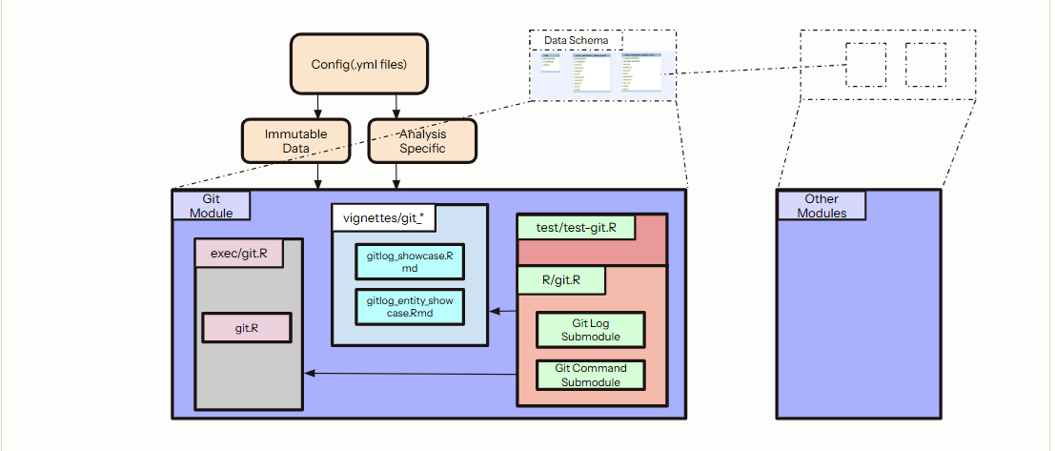

Slide 2
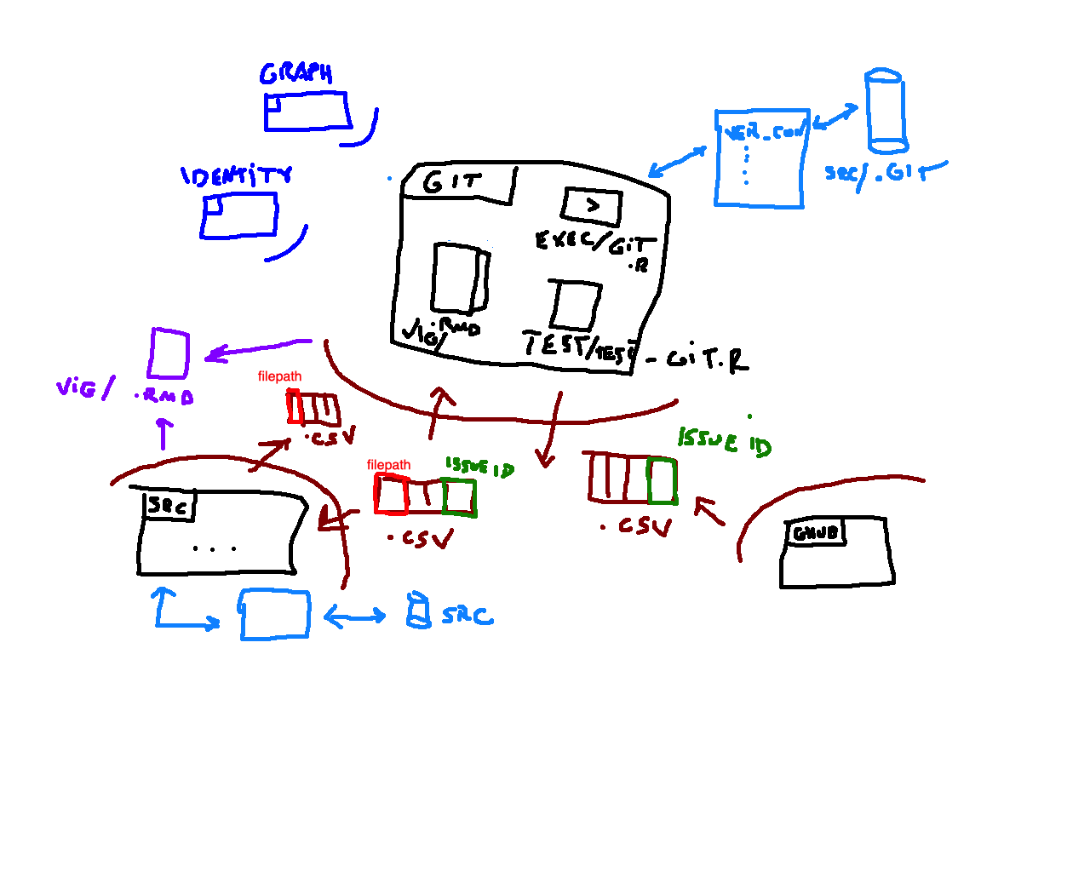

Slide 3
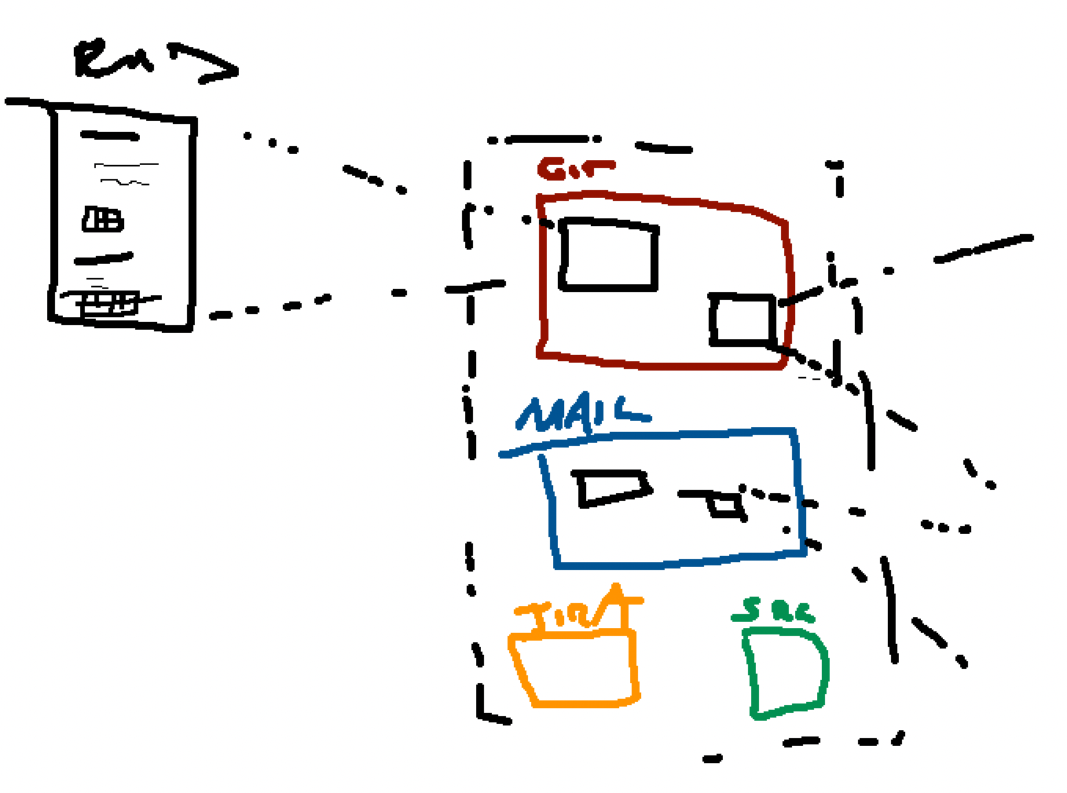

Slide 4
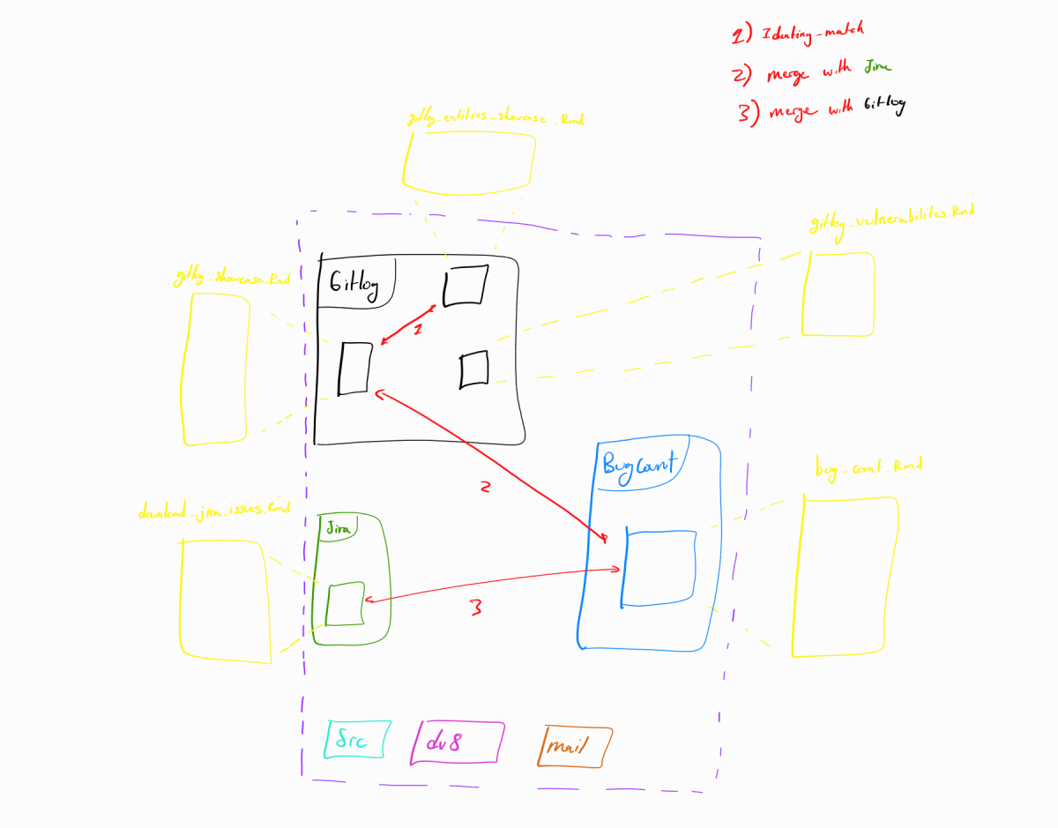

Slide 5
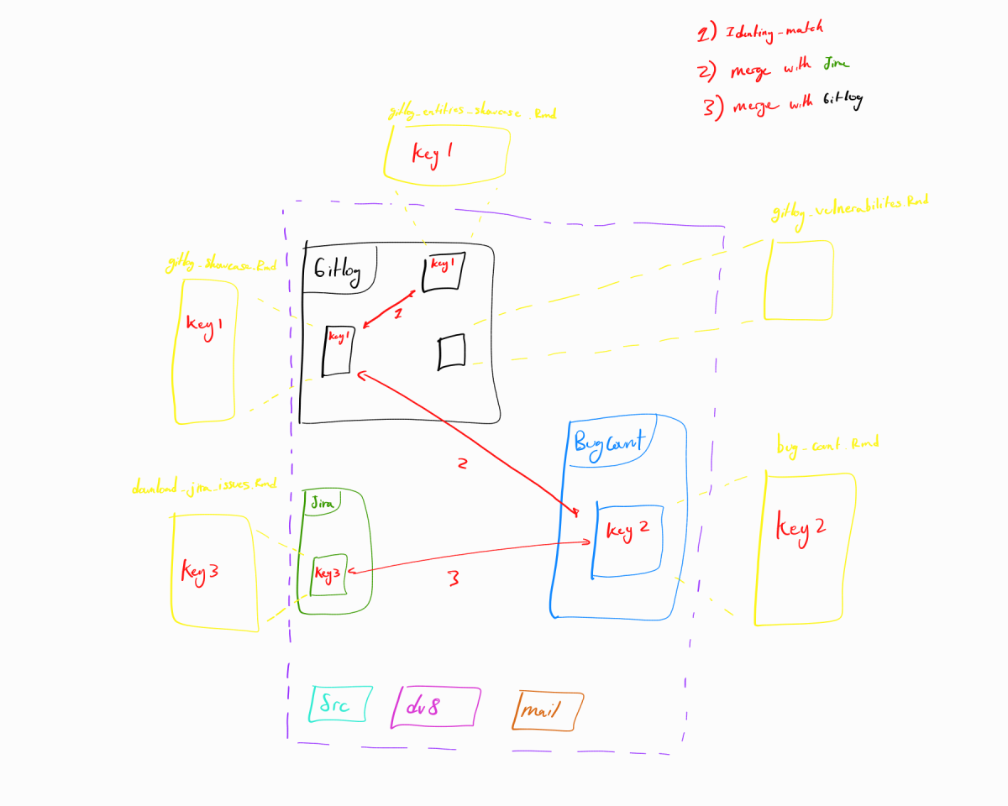

Slide 6
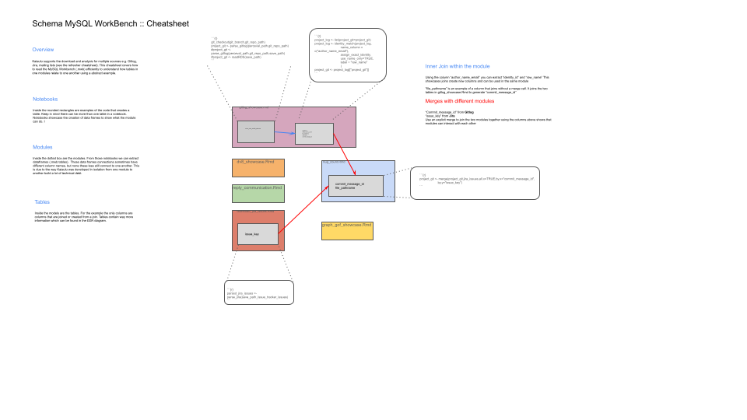

Slide 7
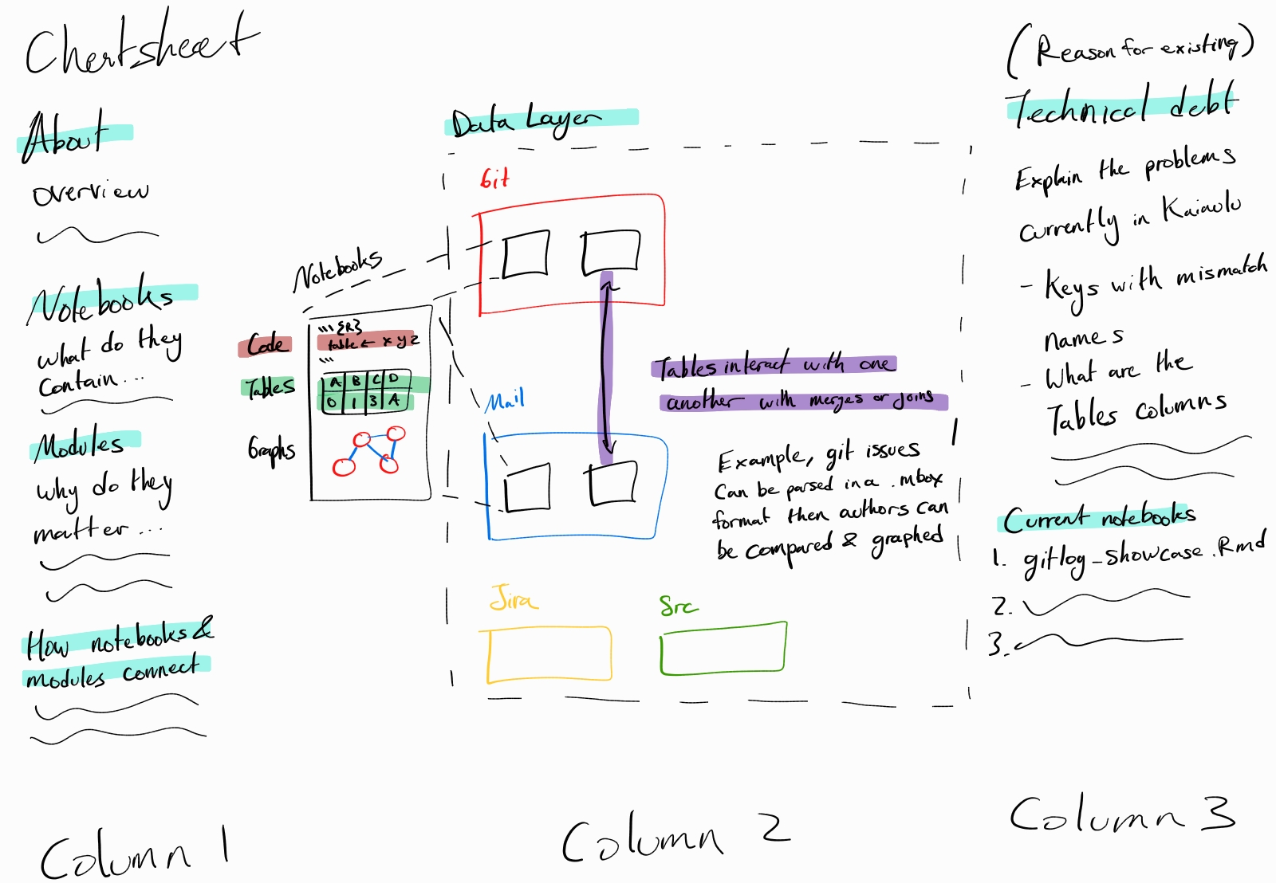

Slide 8
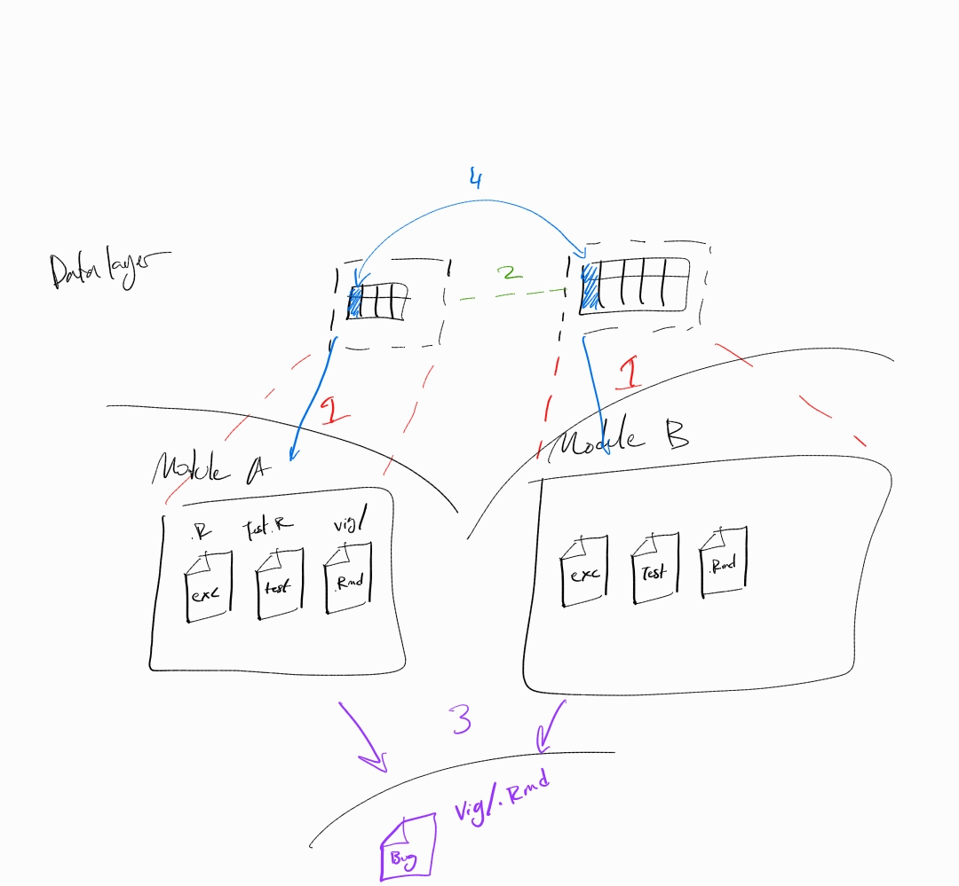

Slide 9


MySQL Workbench: : CHEAT SHEET
About
Kaiaulu supports the download of Kaiaulu supports the download and analysis for multiple sources e.g. Gitlog, Jira, mailing lists (see the refresher cheat sheet). This cheatsheet covers how to read the MySQL Workbench (.mwb) efficiently to understand how tables in one modules relate to one another using an abstract example.
```{r} project_log <- identity_match(project_log,
name_column = c("author_name_email"),
assign_exact_identity,
use_name_only=TRUE,
label = "raw_name"
) ```
Inner Join within a Module (blue)
```{r} project_git <- parse_gitlog(perceval_path, git_repo_path) ```
Using the columns “author_name_email” and “identity_id”, “raw_name” can be extracted. This showcases joins ability create new columns also how joins can be used in the same module “file_pathname” is an example of a column that joins without a merge call. It joins the two tables in gitlog_showcase.Rmd to generate “commit_message_id”.
Notebooks
Inside the rounded rectangles are examples of the code that creates a table. Keep in mind there can be more than one table in a notebook. Notebooks showcase the creation of data frames to show what the module can do.
Modules
Inside the dotted box are the modules. From those notebooks we can extract data frames (.mwb tables). These data frames connections sometimes have different column names, but none these less still connect to one another. This is due to the way Kaiaulu was developed in isolation from one module to another build a lot of technical debt.
Gitlog_showcase.Rmd
Inner Join different Module (red)
identity_id author_name_email file_pathname raw_name commit_message_id
author_name_email file_pathname
“commit_message_id” from Gitlog and “issue_key” from Jira with an explicit merge can join the two modules together. This showcases that modules can interact and join with each other.
Tables
reply_communication.Rmd
dv8_showcase.Rmd
Inside the models are the tables. For the example the only columns are columns that are joined or created from a join. Tables contain way more information which can be found in the EER diagram.
download_jira_issues.Rmd
bug_count.Rmd
Issue_key
commit_message_id file_pathname
```{r}
parsed_jira_issues <- parse_jira(save_path_issue_tracker_issues) ```
```{r}
project_git <- merge(project_git,jira_issues,all.x=TRUE,by.x="commit_message_id",
by.y="issue_key")
```
Kaiāulu
CC BY SA Ruben Jacobo, Waylon Ho, Carlos Paradis • Kaiaulu package version 0.0.0.9600 (in development) • Updated: 2026-4

Slide 10
MySQL Workbench: : CHEAT SHEET
About
Data Layer Workflow Overview
Kaiaulu supports the download and analysis for multiple sources e.g. Gitlog, Jira, mailing lists. This cheat sheet covers how to efficiently to understand how data interacts internally and within different modules using an abstract example.
Notebook A
Accidental Architecture
Module A
Due to the nature Kaiaulu was build in isolation overtime the program has accrued a good amount of technical debt. Examples are as following
Keys 1. Do not share the same name 2. Hidden without any explicit reference in the code or notebooks Data
3. What are the table’s columns
4. What data type are said columns
Merges
5. What modules relate to one another
6. What columns are used for a merge remain unclear
Notebooks
Notebooks showcase the creation of table or data frame. Inside the rounded rectangles are examples of the code that creates a table. A notebook can create more than one or more table/s.
Table B
Table C
Modules
Inside the dotted box are the modules. They are grouped by date source, so they contain many different tables.
Notebook B
Tables
Module B
Inside the models are the tables. They contain columns that can be joined or created from a join.
Graphs
Table D
Table E
Current Support
Table F
Currently MySQL Workbench EER Diagram supports these notebooks 1. gitlog_showcase 2. gitlog_entites_showcase 3. understands_showcase
4. depends_showcase
5. kaiaulu_architecture 6. line_metrics_showcase 7. graph_gof_showcase 8. download_jira_issues 9. download_mail 10. bug_count 11. reply_communication_showcase 12. dv8_showcase 13. gitlog_vulnerabilities_showcase
Graphs are special tables that can be used to showcase Kaiaulu’s ability to have manipulatable node edge graphs
Arrows
Graph
Black arrows are tables created by the notebook Yellow arrows are tables created by other tables Red arrows are tables in different modules combined Blue arrows are tables that can be graphed
Node
Edge
Kaiāulu
CC BY SA Ruben Jacobo, Waylon Ho, Carlos Paradis • Kaiaulu package version 0.0.0.9600 (in development) • Updated: 2026-4

Slide 11



MySQL Workbench: : CHEAT SHEET
About
Data Layer Workflow Overview
Kaiaulu supports the download and analysis for multiple sources e.g. Gitlog, Jira, mailing lists. This cheat sheet covers how to efficiently to understand how data interacts internally and within different modules using an abstract example.
Returns a graph of merged modules
User
Accidental Architecture
User Calls Notebook
Due to the nature Kaiaulu was build in isolation overtime the program has accrued a good amount of technical debt. Examples are as following
Keys 1. Do not share the same name 2. Hidden without any explicit reference in the code or notebooks Data
3. What are the table’s columns
4. What data type are said columns
Merges
5. What modules relate to one another
6. What columns are used for a merge remain unclear
Terminal
.Rmd
Notebooks Calls Modules
Data Layer
Git Module
Src Module
Files
Tables
Files
Tables
.Rmd Test Files exec R/.
.Rmd Test Files exec R/.
Graphs
Graphs
Notebooks creates a .csv in the data layer
Current Support
Currently MySQL Workbench EER Diagram supports these notebooks 1. gitlog_showcase 2. gitlog_entites_showcase 3. understands_showcase
4. depends_showcase
5. kaiaulu_architecture 6. line_metrics_showcase 7. graph_gof_showcase 8. download_jira_issues 9. download_mail 10. bug_count 11. reply_communication_showcase 12. dv8_showcase 13. gitlog_vulnerabilities_showcase
User Calls .csvs
Github Module
Functions
Graph()
Graph ()
Identity ()
Merges .csvs using Identity()
Bbg_count Notebook
Kaiāulu
CC BY SA Ruben Jacobo, Waylon Ho, Carlos Paradis • Kaiaulu package version 0.0.0.9600 (in development) • Updated: 2026-4

Slide 12
MySQL Workbench: : CHEAT SHEET
About
Data Layer Workflow
Kaiaulu supports the download and analysis of multiple sources, such as Git, Jira, and Src. This cheat sheet covers how to efficiently understand how data interacts internally and within different modules using an abstract example.
Returns a graph of merged modules to the user
Solution
User
Instead of running the module showcases, users can read the MySQL Workbench to have a better understand the data layer.
User calls notebook
Abstraction
Terminal
MySQL Workbench
Kaiaulu was built with abstraction as a priority. This allows users without much technical background to focus on the features, rather than the details that make the system work. In this case, that abstraction is the data layer, which ends up being a black box to users where they call a function and receive an output.
.Rmd
Module A
Module B
Notebooks calls modules
User
Tables
Tables
Data Layer
Git Module
Jira Module
User
Data Layer
Graph
Files
Tables
Files
Tables
.Rmd Test Files exec
R/.
.Rmd Test Files exec
R/.
Implicit Join
Graphs
Graphs
Unintended Complexity
When merges/joins don’t work, abstraction makes it much harder to trace where the error is due to the added complexity. Additionally, Kaiaulu's heavy abstraction has led to joins that are not even referenced in the code. The only way to figure out these joins is to run the module's showcase and analyze the table's output.
Notebooks in the modules creates a .csv in the data layer which is unknown to the user
Current Support
Currently MySQL Workbench EER Diagram supports these notebooks 1. gitlog_showcase 2. gitlog_entites_showcase 3. understands_showcase
4. depends_showcase
5. kaiaulu_architecture 6. line_metrics_showcase 7. graph_gof_showcase 8. download_jira_issues 9. download_mail 10. bug_count 11. reply_communication_showcase 12. dv8_showcase 13. gitlog_vulnerabilities_showcase
User
Data Layer
Graph
User calls the CSVs
Github Module
Functions
Graph()
Src Module
Graph ()
Identity ()
Merges CSVs using Identity()
bug_count Notebook
Kaiāulu
CC BY SA Ruben Jacobo, Waylon Ho, Carlos Paradis • Kaiaulu package version 0.0.0.9600 (in development) • Updated: 2026-4

Slide 13
Data Pipeline: : CHEAT SHEET
About
Data Pipeline
Kaiaulu supports the download and analysis of multiple sources, such as Git, Jira, and Github using tables that are controlled by modules.
Raw Data
Lowest level where all the tables store their data.
Raw Data
Data Tables
Unstructured Chaos
Connection
Raw data from many different sources with different formats like sparse matrices, CSVs, and .mbox.
Tables can be used to connect modules based on columns seen with the dark blue row. Kaiaulu uses .csv format for the tables with plans to expand other formats later.
Tables
Layer
Notebooks
Grant’s users' access to the modules and the ability to export the analysis preformed
Table Types
Git Module
Jira Module
Tabes are not limited to just column and rows. Because all data is wrapped into tables nodes and edges for graphs are tables. Sparse matrices are tables and generally contain a key.
Capabilities
exec
test
.Rmd
exec
test
.Rmd
Notebooks follow the extract, transform, and load pipeline where users can automatically parse and standardize the raw data from a source in a tables. Tables can be graph by multiple format a few being bipartite, temporal, co-change then be exported CSVs
Data Layer
Container
Tables live separate from the modules to prevent users from directly changing the tables.
Graphs
Graphs
Current Support
Modules
Are like bins that hold files that use the same source. These range from executables, data testing, and notebooks.
Currently MySQL Workbench EER Diagram supports these notebooks 1. gitlog_showcase 2. gitlog_entites_showcase 3. understands_showcase
4. depends_showcase
5. kaiaulu_architecture 6. line_metrics_showcase 7. graph_gof_showcase 8. download_jira_issues 9. download_mail 10. bug_count 11. reply_communication_showcase 12. dv8_showcase 13. gitlog_vulnerabilities_showcase
Internal files
Notebooks are not limited to .Rmd files. Others include fake data generators, auto exec, and data testing functions.
External Files
File can exist outside modules which multiple modules can use. Examples being the functions that turn CSVs to graphs and identity_match to match columns from the same or different module.
bug_count.Rmd
vig/ .Rmd
Kaiāulu
CC BY SA John Flinn, Carlos Paradis • Kaiāulu package version 0.0.0.9700 (in development) • Updated: 2026-04

Slide 14
Data Pipeline: : CHEAT SHEET
About
Data Pipeline
Table Types
Kaiaulu supports the download and analysis of multiple sources, such as Git, Jira, and Github using tables that are controlled by modules.
Tables are how data is wrapped for transformations and exports
Raw Data
Internal Tables
Downloaders
Connection
Tables are not limited to just column and rows. Because all data is wrapped into tables nodes and edges for graphs are tables. Sparse matrices are tables and generally contain a key.
Raw data handles many different sources with different formats like sparse matrices, CSVs, and .mbox.
Download raw data: cheatsheets/refresher-cheatsheet.pdf
Tables
External Tables
Data Layer
Tables can exist outside a module when called by an external notebook.
Git Module
Jira Module
Capabilities
Data Tables
Vignettes/git_*
Vignettes/Jira_*
Users can automatically parse and standardize the raw data from a source in a tables. Tables can be graph by multiple format a few being bipartite, temporal, co-change then be exported CSVs
Can be used to connect modules based on columns seen with the dark blue row. Kaiaulu uses .csv format for the tables with plans to expand other formats later.
.Rmd
.Rmd
.Rmd
Files
Git.R
Jira.R
Used by users or internal to manipulate the tables
Data Layer
Container
Data layer acts as insulation to separate tables from the modules to prevent users from directly changing the tables.
exec
test
exec
test
Internal files
Notebooks are not limited to .Rmd files. Others include transforms, auto exec, and data testing functions
Graphs
Transform
Graphs
Transform
Modules
External Files
Like bins that hold files that use the same source. These range from executables, data testing, and notebooks.
Certain files can exist outside modules which multiple modules can use. Examples being the functions that turn CSVs to graphs, identity_match to match columns from the same or different modules.
Examples of external files functions
1. identity_match()
Matchtes tables based on column “author_name_email” 2. bipartite_graph_projection()
Performs bipartite projection on multimodal graphs.
Notebooks
Idenitiy_match()
Grant’s users' access to the modules and the ability to export the analysis preformed
vig/ .Rmd
bug_count.Rmd
Kaiāulu
CC BY SA John Flinn, Carlos Paradis • Kaiāulu package version 0.0.0.9700 (in development) • Updated: 2026-04

Slide 15
Data Table: : CHEAT SHEET
About
Data Pipeline
Capabilities
Kaiāulu supports the download and analysis of multiple sources, such as Git, Jira, and Github, using tables that are controlled by modules.
Parsers: Automatically normalize diverse raw sources into uniform, structured R tables that are reusable across multiple transformations. Transformations: utilize functions-such as bipartite, temporal, and multimodal-to reshape tables into nodes, edges, and complex relationships.
Constructors: Generate general graphs from these tables, regardless of the underlying data source
Projections: Output final data and analytical results directly to the terminal or console.
Raw Data
Data Ingestion
Data Layer
Connection
Handles diverse raw data formats such as CSV, gitlog, and Mbox from local or network sources, then loads them as initial R structures for standardization.
Download raw data: cheatsheets/refresher-cheatsheet.pdf
Tables
Git Module
Jira Module
Internal Tables
Data Layer
Vignettes/git_*
Vignettes/Jira_*
Standardized R data structures. These are not limited to simple tables; they can represent sparse matrices, graph edge lists, and more- all interconnected by key columns.
Feed specific standardized R tables to modules while protecting the raw ingested data. This layer defines the linking columns used between all modules.
.Rmd
.Rmd
.Rmd
External Tables
Data Tables
Git.R
Jira.R
Core units of connection between modules. They are linked by columns -indicated by the dark blue row within a common R data structure. Support for other formats is planned.
Container
Processed R tables can be called by, or passed between, modules and notebooks outside of a specific module context.
exec
test
exec
test
Internal Files
Modules
Graphs
Transform
Graphs
Transform
R resources-including .Rmd files, .R scripts, and functions that are internal to a module and operate consistently on standardized internal R tables. Example of internal file’s function bipartite_graph_projection()
Performs bipartite projection on multimodal graphs.
Reusable containers for R scripts (.R files), functions, transforms, and notebooks (showcases). They ingest and process standardized tables to generate graphs, metrics, and transformed data for analysis.
Notebooks
Acting as the user interface. these .Rmd files call specific modules- passing and receiving standardized R tables to create final analyses and exports.
External Files
Idenitiy_match()
Reusable R scripts and functions. Example of external file’s function
identity_match()
Matchtes tables based on column “author_name_email”
vig/ .Rmd
bug_count.Rmd
Kaiāulu
CC BY SA John Flinn, Carlos Paradis • Kaiāulu package version 0.0.0.9700 (in development) • Updated: 2026-04

Slide 16
Data Table: : CHEAT SHEET
About
Data Pipeline
Capabilities
Kaiāulu supports the download and analysis of multiple sources, such as Git, Jira, and Github, using tables that are controlled by modules.
Parsers: Automatically normalize diverse raw sources into uniform, structured R tables that are reusable across multiple transformations. Transformations: utilize functions-such as bipartite, temporal, and multimodal-to reshape tables into nodes, edges, and complex relationships.
Constructors: Generate general graphs from these tables, regardless of the underlying data source
Projections: Output final data and analytical results directly to the terminal or console.
Raw Data
Data Ingestion
Data Layer
Connection
Handles diverse raw data formats such as CSV, gitlog, and Mbox from local or network sources, then loads them as initial R structures for standardization.
Download raw data: cheatsheets/refresher-cheatsheet.pdf
Tables
Git Module
Jira Module
Internal Tables
Data Layer
Vignettes/git_*
Vignettes/Jira_*
Standardized R data structures. These are not limited to simple tables; they can represent sparse matrices, graph edge lists, and more- all interconnected by key columns.
Feed specific standardized R tables to modules while protecting the raw ingested data. This layer defines the linking columns used between all modules.
.Rmd
.Rmd
.Rmd
External Tables
Data Tables
Git.R
Jira.R
Core units of connection between modules. They are linked by columns -indicated by the dark blue row within a common R data structure. Support for other formats is planned.
Container
Processed R tables can be called by, or passed between, modules and notebooks outside of a specific module context.
exec
test
exec
test
Internal Files
Modules
Graphs
Transform
Graphs
Transform
R resources-including .Rmd files, .R scripts, and functions that are internal to a module and operate consistently on standardized internal R tables. Example of internal file’s function bipartite_graph_projection()
Performs bipartite projection on multimodal graphs.
Reusable containers for R scripts (.R files), functions, transforms, and notebooks (showcases). They ingest and process standardized tables to generate graphs, metrics, and transformed data for analysis.
Notebooks
Acting as the user interface. these .Rmd files call specific modules- passing and receiving standardized R tables to create final analyses and exports.
External Files
Idenitiy_match()
Reusable R scripts and functions. Example of external file’s function
identity_match()
Matchtes tables based on column “author_name_email”
vig/ .Rmd
bug_count.Rmd
Kaiāulu
CC BY SA John Flinn, Carlos Paradis • Kaiāulu package version 0.0.0.9700 (in development) • Updated: 2026-04

Slide 17
Table Structure : : CHEAT SHEET
About
Data Pipeline
Kaiāulu supports the download and analysis of multiple sources, such as Git, Jira, and Github. Table's structure changes depending on how many sources are used.
Raw Data
Raw Data
Handles diverse raw data formats such as CSV, gitlog, and Mbox from local or network sources, then loads them as initial R structures for standardization. Data can exist outside a module when merging multiple sources.
Connecting Modules
Tables are used as the sole connection between modules. Modules or raw data sources do not interact directly. Modules connect by table’s columns - indicated by the dark blue row within a common R data table structure.
Git Module
Jira Module
Src Module
External Tables
Connection
Tables can be called by files outside of a specific module’s scope when two modules with different sources intersect.
Downloaders
Downloaders
Capabilities
Github Module
Modules
Downloaders: Loads the raw data into the module by call of the notebook.
Parsers
Parsers
Reusable containers for R scripts (.R files), functions, and notebooks for a specific source only. They ingest and process standardized tables to generate graphs, metrics, and transformed data for analysis.
Parsers: Automatically normalize diverse raw sources into uniform, structured R tables that are reusable across multiple transformations.
Transformations: utilize functions-such as bipartite, temporal, and multimodal-to reshape tables into nodes, edges, and complex relationships.
Transformers
Transformers
Transformers
Module Functions
Tables use standardized R data structures. These are not limited to simple tables; they can represent sparse matrices, graph edge lists, and more- all interconnected by key columns. File use R resources-including .Rmd files, .R scripts, and functions that are internal to a module and operate consistently on standardized internal R tables. Example of internal file’s function bipartite_graph_projection()
Performs bipartite projection on multimodal graphs.
Executable: Output final data and analytical results directly to the terminal or console.
Executable
Executable
Notebook
Downloaders
Parsers
Transformers
Executable
Executable
Notebooks
Acting as the user interface. These .Rmd files call specific modules- passing and receiving standardized R tables to create final analyses and exports.
bug_count.Rmd
Kaiāulu
CC BY SA John Flinn, Carlos Paradis • Kaiāulu package version 0.0.0.9700 (in development) • Updated: 2026-04

Slide 18






Data Schema: : CHEAT SHEET
About
Data Pipeline
Kaiāulu supports the download and analysis of multiple sources, such as Git, Jira, and Github. With abstraction users shouldn’t need to understand how sources connect. When merges do not work abstraction as leads to the columns that connect between sources are not always explicit which is what the table layer MySQL work
Git Data
Jira Data
Data Layer
…
.json
Git Tables
Jira Tables
Table layer
Structure
Users access a specific module depending on the source (Jira, gitlog, mailing list) either by writing code in a notebook (.Rmd) or command line interface (exec). Modules are an abstraction of files (.R, .Rd and .Rmd) that manipulate the same source. Each module generates tables from the raw data corresponding the source (.git, .json, .mobx). Tables have columns that are used to connect between sources (modules). Because these columns are used to connect between modules if analyzing a single module these columns might not seem important.
Git Module
Jira Module
…
.R
Src Module
…
Module Layer
User Space
Github Module
.Rmd
exec
…
Connecting Sources
User Layer
Modules are connected across in the table layer using special notebooks.
Tables can exist outside a module if they combine two different sources.
Kaiāulu
CC BY SA John Flinn, Carlos Paradis • Kaiāulu package version 0.0.0.9700 (in development) • Updated: 2026-04

Slide 19
Network Transform: : CHEAT SHEET
About
Network Transform Pipeline
Graph Constructors
Data transformations produce standardized S3 graph objects encoding directionality, weight, and bipartiteness. New analyses can be added as S3 methods that automatically work with any graph the existing transforms produce, without rewriting upstream code.
A graph structure generalizes different types of graphs, regardless of their data source.
1. model_unimodal_graph()
Represents a unimodal graph.
2. model_multimodal_graph()
Represents a multimodal graph.
Raw Data
.git
.json
.mbox
Downloaders
Tabular Data
Download raw data: cheatsheets/refresher-cheatsheet.pdf
S3 Functions
Node/
Edgelist
S3 methods execute the correct behavior based on the graph's class, regardless of the data's origin.
Examples of S3 Generic Functions:
1. bipartite_graph_projection()
Performs bipartite projection on multimodal graphs.
2. temporal_graph_projection()
Performs temporal projection on multimodal graphs.
3. community_oslom()
Runs OSLOM community detection on a graph.
4. graph_to_dsmj()
Exports graph to a .dsmj file.
Example of S3 Auxiliary Functions:
5. subset_bipartite_from_multimodal()
Slices a bipartite graph from a multimodal graph.
5. get_bidirected_edges()
Returns all mutual edge pairs from a graph.
Parsers
Parse functions normalize raw data into structured tables reusable across multiple transforms.
1. parse_gitlog()
Parses a git repository into a commit table.
2. parse_jira_replies()
Parses Jira issue comments into a reply table.
3. parse_mbox()
Parses mbox files into a reply table.
S3 Graph Class
S3 Graph API
Transformers
Transform functions construct S3 graph objects from parsed tables by defining nodes, edges, and relationships.
1. transform_gitlog_to_bipartite_network()
Git Log commit table → bipartite graph.
2. transform_gitlog_to_multimodal_network()
Git Log commit table → multimodal graph.
3. transform_gitlog_to_temporal_network()
Git Log commit table → temporal projection graph.
4. transform_reply_to_bipartite_network()
Reply table → person-issue bipartite graph.
Graph Export
External Weight Integration
.dsmj
The S3 class system allows new analyses like sentiment metric weight schemes to be added without modifying any existing transforms.
1. transform_reply_to_bipartite_network(weight, …)
2. transform_gitlog_to_bipartite_network(weight, …)
Kaiāulu
CC BY SA Jared Seto, Carlos Paradis • Kaiāulu package version 0.0.0.9700 (in development) • Updated: 2026-04

Slide 20
Data Schema : : CHEAT SHEET
About
Data Pipeline
Raw Data
Kaiāulu supports the download and analysis of multiple sources, such as Git, Jira, and Github. Table's structure changes depending on how many sources are used.
Git Data
Jira Data
Handles diverse raw data formats such as CSV, json, and Mbox from local or network sources, then loads them as initial R structures for standardization.
Data Layer
Connecting Modules
.json
.json
Tables are used as the sole connection between modules. Modules or raw data sources do not interact directly. Merging tables adds the column to the destination table.
Git Tables
Jira Tables
Table layer
.git
.json
.mbox
Merge Tables
Tables
Specialized tables created by a parse or download with the ability to be combined with other sources.
Git Module
Jira Module
Module Layer
Processed R tables that can be called by files outside of a specific module’s scope when two modules with different sources intersect.
Connection
Src Module
.R
.R
Modules
.Rmd
bug_count.Rmd
.Rmd
.R
Specialized R scripts (.R files) that run through the command line interface to allow users server-side execution. See Kaiaulu Executables cheat sheet.
Github Module
Non-local Markdown
.Rmd
exec
.Rmd
exec
Specialized .Rmd files that can either generate specialized tables or parse already existing tables to combine tables (data) from different formats (sources).
.Rmd
.R
Notebooks
Acting as the user interface. These .Rmd files call specific modules- passing and receiving standardized R tables to create final analyses and exports.
Module A
Module B
.R (exec)
.R (exec)
.R (exec)
Exec Filess
User Layer
Reusable containers for R scripts (.R) and notebooks (.Rmd) for a specific source only. They ingest and process standardized tables to generate graphs, metrics, run exec, test data, and transformed data for analysis.
.R
.Rmd
.R
Kaiāulu
CC BY SA John Flinn, Carlos Paradis • Kaiāulu package version 0.0.0.9700 (in development) • Updated: 2026-04

Slide 21
Data Schema: : CHEAT SHEET
About
Data Pipeline
Raw Data
Kaiāulu supports combining of multiple sources, such as Git, Jira, and GitHub for analysis.
Stores diverse raw data formats such as CSV, json, and Mbox from local or network sources, then loads them as initial R structures for standardization.
Table Creation
Git Data
Jira Data
Each module generates a set of tables. All tables are not created equal; some tables are used to join separate modules.
…
Data Layer
.git
Module Layer
Data B
Git Tables
Jira table
.git
.json
.mbox
Data A
…
Table layer
Tables
Processed R tables that can be called by files (.R and .Rmd) inside a specific module. Or outside of a specific module’s scope when two modules with different sources intersect.
Merge Tables
Git Module
Jira module
Modules cannot directly be joined they have to traverse the data layer where tables are directly connected.
…
Module Layer
.R
Data Layer B
Src Module
Modules
Data Layer A
Connection
…
Module Layer
Reusable containers for R scripts (.R files), functions, and notebooks for a specific source only. They ingest and process standardized tables to generate graphs, metrics, and transformed data for analysis.
.Rmd
bug_count.Rmd
…
exec
Github Module
Merged Table
…
Generated tables that have multiple data sources cannot exist within either module.
Exec Files
Either specialized R scripts (.R files) that run through the command line interface to allow users server-side execution. See Kaiaulu Executables cheat sheet. Or standard or merge notebooks (.Rmd).
Module Layer
Notebook
Data layer B
Table C
User layer
Data layer A
notebook
Creation
Kaiāulu
CC BY SA John Flinn, Carlos Paradis • Kaiāulu package version 0.0.0.9700 (in development) • Updated: 2026-04

Slide 22
Table Structure : : CHEAT SHEET
About
Data Pipeline
Kaiāulu supports the download and analysis of multiple sources, such as Git, Jira, and Github. Table's structure changes depending on how many sources are used.
Raw Data
Git Data
Jira Data
Handles diverse raw data formats such as CSV, gitlog, and Mbox from local or network sources, then loads them as initial R structures for standardization. Data can exist outside a module when merging multiple sources.
Connecting Modules
Tables are used as the sole connection between modules. Modules or raw data sources do not interact directly. Modules connect by table’s columns - indicated by the dark blue row within a common R data table structure.
…
.git
Git Tables
Jira table
External Tables
Connection
Tables can be called by files outside of a specific module’s scope when two modules with different sources intersect.
…
Capabilities
Jira module
Modules
Downloaders: Loads the raw data into the module by call of the notebook.
GitHub Module
Git Module
Reusable containers for R scripts (.R files), functions, and notebooks for a specific source only. They ingest and process standardized tables to generate graphs, metrics, and transformed data for analysis.
…
…
Parsers: Automatically normalize diverse raw sources into uniform, structured R tables that are reusable across multiple transformations.
.R
Transformations: utilize functions-such as bipartite, temporal, and multimodal-to reshape tables into nodes, edges, and complex relationships.
Module Functions
exec
.Rmd
Tables use standardized R data structures. These are not limited to simple tables; they can represent sparse matrices, graph edge lists, and more- all interconnected by key columns. File use R resources-including .Rmd files, .R scripts, and functions that are internal to a module and operate consistently on standardized internal R tables. Example of internal file’s function bipartite_graph_projection()
Performs bipartite projection on multimodal graphs.
Executable: Output final data and analytical results directly to the terminal or console.
Notebook
Downloaders
Parsers
Transformers
Executable
Notebooks
notebook
Acting as the user interface. These .Rmd files call specific modules- passing and receiving standardized R tables to create final analyses and exports.
Kaiāulu
CC BY SA John Flinn, Carlos Paradis • Kaiāulu package version 0.0.0.9700 (in development) • Updated: 2026-04

Slide 23
Data Schema: : CHEAT SHEET
About
Kaiāulu supports combining of multiple sources, such as Git, Jira, and GitHub for analysis. This cheat sheet showcases a data schema for Kaiāulu that facilitates identifying how to combine data sources of interest to the user.
Kaiaulu Architecture
Raw Data
Connecting Modules
Handles diverse raw data formats such as CSV, gitlog, and Mbox from local or network sources, then loads them as initial R structures for standardization. Data can exist outside a module when merging multiple sources.
Tables are used as the sole connection between modules. Modules or raw data sources do not interact directly. Modules connect by table’s columns - indicated by the dark blue row within a common R data table structure.
.json
Data Layer
.json
.git
.json
Git Schema
JIRA Schema
External Tables
Connection
Tables can be called by files outside of a specific module’s scope when two modules with different sources intersect.
Table layer
…
Capabilities
Jira module
Modules
Downloaders: Loads the raw data into the module by call of the notebook.
Git Module
Reusable containers for R scripts (.R files), functions, and notebooks for a specific source only. They ingest and process standardized tables to generate graphs, metrics, and transformed data for analysis.
…
Parsers: Automatically normalize diverse raw sources into uniform, structured R tables that are reusable across multiple transformations.
Transformations: utilize functions-such as bipartite, temporal, and multimodal-to reshape tables into nodes, edges, and complex relationships.
Module Layer
.R
bug_count.Rmd
Module Functions
Tables use standardized R data structures. These are not limited to simple tables; they can represent sparse matrices, graph edge lists, and more- all interconnected by key columns. File use R resources-including .Rmd files, .R scripts, and functions that are internal to a module and operate consistently on standardized internal R tables. Example of internal file’s function bipartite_graph_projection()
Performs bipartite projection on multimodal graphs.
Executable: Output final data and analytical results directly to the terminal or console.
exec/*.R
*.Rmd
Notebook
Downloaders
Parsers
Transformers
Executable
Notebooks
Acting as the user interface. These .Rmd files call specific modules- passing and receiving standardized R tables to create final analyses and exports.
User layer
Kaiāulu
CC BY SA John Flinn, Carlos Paradis • Kaiāulu package version 0.0.0.9700 (in development) • Updated: 2026-04

Slide 24
Data Schema: : CHEAT SHEET
About
Kaiaulu Architecture
MySQL Workbench
Kaiāulu supports combining of multiple sources, such as Git, Jira, and GitHub for analysis. This cheat sheet showcases the data schema for Kaiāulu that facilitates identifying how to combine data sources of interest to the user.
Table to Notebook
Tables can exist and access modules externally when they contain multiple sources. To view these connection is the same as table to table.
Layers
Data Layer
.json
.json
.git
.json
User Layer
Kaiāulu uses exec or .Rmd files for users to interface to the program.
Git Schema
JIRA Schema
Module Layer
Schema layer
…
Abstraction on how files are grouped based on data source.
Schema Layer
Jira module
Parsed or generated from the raw data using file/s from the modules. Tables are a standard csv that is used as the sole connection between modules.
Git Module
…
Module Layer
Module API
Data Layer
.R
bug_count.Rmd
Knowing the schema, you know the modules since they are 1-1. Knowing the modules you know what functions in the code use what data table form what source.
Supports diverse raw data formats such as .csv, .gitlog, and .mbox from local or network sources
MySQL Workbench
Table to Table
exec/*.R
*.Rmd
With the .mwb to locate the columns the table’s use for connections one just needs to hover over the connection or table.
User layer
Kaiāulu
CC BY SA John Flinn, Carlos Paradis • Kaiāulu package version 0.0.0.9700 (in development) • Updated: 2026-04

Slide 25
Data Schema: : CHEAT SHEET
About
Kaiaulu Architecture
MySQL Workbench
Kaiāulu supports combining of multiple sources, such as Git, Jira, and GitHub for analysis. This cheat sheet showcases the data schema for Kaiāulu that facilitates identifying how to combine data sources of interest to the user.
Table to Notebook
Tables can exist and access modules externally when they contain multiple sources. To view these connection is the same as table to table.
Layers
Data Layer
.json
.json
.git
.json
User Layer
Kaiāulu uses exec or .Rmd files for users to interface to the program.
Git Schema
JIRA Schema
Module Layer
Schema layer
…
Abstraction on how files are grouped based on data source.
Schema Layer
Jira module
Parsed or generated from the raw data using file/s from the modules. Tables are a standard csv that is used as the sole connection between modules.
Git Module
…
Data Layer
Module API
Supports diverse raw data formats such as .csv, .gitlog, and .mbox from local or network sources
Module Layer
.R
bug_count.Rmd
Knowing the schema, you know the modules since they are 1-1. Knowing the modules you know what functions in the code use what data table form what source.
MySQL Workbench
Table to Table
exec/*.R
*.Rmd
With the .mwb to locate the columns the table’s use for connections one just needs to hover over the connection or table.
User layer
Kaiāulu
CC BY SA John Flinn, Carlos Paradis • Kaiāulu package version 0.0.0.9700 (in development) • Updated: 2026-04

Slide 26
Data Schema: : CHEAT SHEET
About
Kaiaulu Architecture
MySQL Workbench
Kaiāulu supports combining of multiple sources, such as Git, Jira, and GitHub for analysis. This cheat sheet showcases the data schema for Kaiāulu that facilitates identifying how to combine data sources of interest to the user.
Table to Table
With the .mwb to locate the columns the table’s use for connections one just needs to hover over the connection or table.
Layers
Data Layer
.json
.json
.git
.json
Data Layer
Supports diverse raw data formats such as .csv, .gitlog, and .mbox from local or network sources
Git Schema
JIRA Schema
Schema Layer
Schema layer
…
Parsed or generated from the raw data using file/s from the modules. Tables are a standard csv that is used as the sole connection between modules.
Jira module
Table to Notebook
Git Module
Tables can exist and access modules externally when they contain multiple sources. To view these connection is the same as table to table.
…
Module Layer
Module Layer
.R
bug_count.Rmd
Abstraction on how files are grouped based on data source.
exec/*.R
*.Rmd
Module API
Knowing the schema, you know the modules since they are 1-1. Knowing the modules you know what functions in the code use what data table form what source.
User Layer
User layer
Kaiāulu uses exec or .Rmd files for users to interface to the program.
Kaiāulu
CC BY SA John Flinn, Carlos Paradis • Kaiāulu package version 0.0.0.9700 (in development) • Updated: 2026-04

Slide 27
Data Schema: : CHEAT SHEET
About
Kaiaulu Architecture
MySQL Workbench
Kaiāulu supports combining of multiple sources, such as Git, Jira, and GitHub for analysis. This cheat sheet showcases the data schema for Kaiāulu that facilitates identifying how to combine data sources of interest to the user.
Table to Table
With the .mwb to locate the columns the table’s use for connections one just needs to hover over the connection or table.
Layers
Data Layer
.json
.json
.git
.json
Data Layer
Supports diverse raw data formats such as .csv, .gitlog, and .mbox from local or network sources
Git Schema
JIRA Schema
Schema Layer
Schema layer
…
Parsed or generated from the raw data using file/s from the modules. Tables are a standard csv that is used as the sole connection between modules.
Jira module
Table to Notebook
Git Module
Tables can exist and access modules externally when they contain multiple sources. To view these connection is the same as table to table.
Module Layer
…
Abstraction on how files are grouped based on data source.
User Layer
Module Layer
.R
bug_count.Rmd
Kaiāulu uses exec or .Rmd files for users to interface to the program.
exec/*.R
*.Rmd
Module API
Knowing the schema, you know the modules since they are 1-1. Knowing the modules you know what functions in the code use what data table form what source.
User layer
Kaiāulu
CC BY SA John Flinn, Carlos Paradis • Kaiāulu package version 0.0.0.9700 (in development) • Updated: 2026-04

Slide 28
Data Schema: : CHEAT SHEET
About
Kaiāulu Architecture
MySQL Workbench
Kaiāulu supports combining of multiple sources, such as Git, Jira, and GitHub for analysis. This cheat sheet showcases the data schema for Kaiāulu that facilitates identifying how to combine data sources of interest to the user.
Identifying Connections
Within the .mwb file, locating the columns used to connect tables is straightforward. Hovering the cursor over a connection or a table reveals the necessary column details.
Data Layer
.json
.json
Layers
.git
Data Layer
.json
Kaiāulu Data Layer represents the various types of raw data associated to different software development infrastructure (Mail, JIRA, GitHub). This dataset is generally difficult to connect to other data sources or is not easily readable in table form for data exploration.
Git Schema
JIRA Schema
Schema layer
…
External Module Connections
JIRA Module
When tables incorporate data from multiple sources, they can connect to external modules. Viewing these external module connections follows the exact same process as viewing internal table relationships.
Schema Layer
Git Module
In Kaiāulu, raw data sources are represented as tables. This facilitates both data exploration and connect tables containing common columns. Kaiaulu standardizes the nomenclature of columns from different data sources, and the data schema facilitates identifying what columns can be combined for different analysis (e.g. bug_count.Rmd).
…
Module Layer
.R
bug_count.Rmd
Module Layer
In Kaiāulu, files are traditionally separated by their file type, such as functions (.R), documentation (.Rd), and Notebooks (.Rmd). However, the reference API site and MySQL Workbench structure information by grouping it based on the data source. The benefit of this approach is to simplify the process by limiting the scope of files needed for a given analysis.
exec/*.R
*.Rmd
Module API
Due to the direct 1-to-1 relationship between the data schema and the modules, understanding the schema clarifies the modules themselves. Familiarity with these modules allows users to easily identify which functions in the code interact with specific tables from any given data source.
User Layer
The User Layer provides everyday tools, like Notebooks and exec scripts, that act as accessible entry points to the tools within the Module Layer. This connection lets users easily run analyses without needing to navigate the complex underlying code.
User layer
Kaiāulu
CC BY SA John Flinn, Carlos Paradis • Kaiāulu package version 0.0.0.9700 (in development) • Updated: 2026-04

Slide 29
Data Schema: : CHEAT SHEET
About
Kaiāulu Architecture
MySQL Workbench
Kaiāulu supports combining of multiple sources, such as Git, Jira, and GitHub for analysis. This cheat sheet showcases the data schema for Kaiāulu that facilitates identifying how to combine data sources of interest to the user.
Identifying Connections
Within the .mwb file, the columns used to connect tables can be located by hovering the cursor over a connection or a table to reveal the necessary details.
Data Layer
.json
.json
Layers
.git
Data Layer
.json
Kaiāulu Data Layer represents the various types of raw data associated to different software development infrastructure (Mail, JIRA, GitHub). This dataset is generally difficult to connect to other data sources or is not easily readable in table form for data exploration.
Git Schema
JIRA Schema
Schema layer
…
External Module Connections
JIRA Module
When tables incorporate data from multiple sources, they can connect to external modules. Viewing these external module connections follows the exact same process as viewing internal table relationships.
Schema Layer
Git Module
In Kaiāulu, raw data sources are represented as tables. This facilitates both data exploration and connect tables containing common columns. Kaiaulu standardizes the nomenclature of columns from different data sources, and the data schema facilitates identifying what columns can be combined for different analysis (e.g. bug_count.Rmd).
…
Module Layer
.R
bug_count.Rmd
Module Layer
In Kaiāulu, files are traditionally separated by their file type, such as functions (.R), documentation (.Rd), and Notebooks (.Rmd). However, the reference API site and MySQL Workbench structure information by grouping it based on the data source. The benefit of this approach is to simplify the process by limiting the scope of files needed for a given analysis.
exec/*.R
*.Rmd
Module API
Due to the direct 1-to-1 relationship between the data schema and the modules, understanding the schema clarifies the modules themselves. Familiarity with these modules allows users to easily identify which functions in the code interact with specific tables from any given data source.
User Layer
The User Layer provides tools, like Notebooks and exec scripts, that act as accessible entry points to the tools within the Module Layer. This connection lets users easily run analyses without needing to navigate the complex underlying code.
User layer
Kaiāulu
CC BY SA John Flinn, Carlos Paradis • Kaiāulu package version 0.0.0.9700 (in development) • Updated: 2026-04

Slide 30
Data Schema: : CHEAT SHEET
About
Kaiāulu Architecture
MySQL Workbench
Kaiāulu supports multiple sources, such as Git, Jira, and GitHub, for analysis. This cheat sheet shows how the data schema (.mwb) for commonly used tables in Kaiāulu’s notebooks can be combined and the overall R package architecture.
Identifying Connections
Data Layer
.json
.json
Within the .mwb file, the columns used to connect tables can be located by hovering the cursor over a connection or a table to reveal columns to combine.
.git
.json
Layers
Git Schema
JIRA Schema
Data Layer
Schema layer
…
Kaiāulu Data Layer represents the various types of raw data associated to different software development infrastructure (Mail, JIRA, GitHub). This dataset is generally difficult to connect to other data sources or is not easily readable in table form for data exploration.
Git Module
JIRA Module
External Module Connections
…
The schema connections can be utilized to identify data sources needed for cross-module notebooks.
Schema Layer
Kaiaulu adopts a simple tabular representation of data, which standardizes column nomenclature across different data sources. A subset of these tables is captured in the schema (.mwb), facilitating data exploration and connecting tables with common columns.
Module Layer
R/*.R
bug_count.Rmd
Module Layer
Modules in Kaiaulu encapsulate a set of functions (R/*.R), executable scripts (exec/*.R), and notebooks (vignettes/*.Rmd), which users can use to create their own analyses, build server-side data pipelines, or learn capabilities, respectively. Each module is represented in a schema section to facilitate identifying commonly used data.
exec/*.R
*.Rmd
Module API
As the schema (.mwb) is divided into sections per module, users can more easily identify what tables would allow combining different data sources, both from a data and API standpoint.
User Layer
proj.yml
analysis.yml
Users can utilize Kaiaulu by reusing existing configuration files (conf/.*yml) or creating new ones. In the configuration files, users specify the location of project data sources or analysis parameters for tools, ensuring reproducibility. Depending on data sources needs, different modules from Kaiaulu can be utilized. The schema (.mwb) can also be used to identify how to combine data.
User layer
GitHub
Mail
Kaiāulu
CC BY SA John Flinn, Carlos Paradis • Kaiāulu package version 0.0.0.9700 (in development) • Updated: 2026-04

