Slide 1
ZamMarket
A Progressive Web App for Local Charcoal Trading in Lusaka with a Tamper-Evident Seller Trust Score
Final Year Project Presentation
John Chola · 2021422054
Supervisor: Mr. Martin Phiri
University of Zambia
School of Natural and Applied Sciences
Department of Computing and Informatics
2026
Final Year Project • Academic Year 2026 1
Notes:
Good morning. My name is John Chola, computer number 2021422054, and my supervisor is Mr. Martin Phiri. My project is ZamMarket: a mobile web app that helps people in Lusaka find charcoal sellers near them, and gives every seller a trust score that cannot be quietly edited.

Slide 2
Project Overview
Member | Computer No. | Primary Role / Responsibilities
John Chola | 2021422054 | Sole developer: requirements, literature review, design, full-stack implementation, testing and report
4
8
86
24
agile sprints + a
stabilisation period
system modules
automated tests,
all passing
Lusaka-area places
supported
Supervisor: Mr. Martin Phiri · Individual project
Final Year Project • Academic Year 2026 2
Notes:
This was an individual project, so I did all of the work myself, under Mr. Phiri's supervision. In numbers: four agile sprints plus a stabilisation period, eight modules, and 86 automated tests that all pass. It is live at zam-market-khaki.vercel.app. The app covers twenty-four Lusaka-area places.

Slide 3
Problem Statement
Sellers
Buyers
Existing tools
Reach only the people who walk past their stall
Have no record of good conduct to show new buyers
Cannot easily find a nearby seller or compare prices
Cannot judge whether a stranger will deliver as promised
WhatsApp and Facebook: no verifiable seller record; posts can be edited
E-commerce: trust depends on online payment and a steady connection
The problem: no tool combines local discovery of sellers, a verifiable trust record, cash trading and poor connectivity.
Final Year Project • Academic Year 2026 3
Notes:
Sellers can only reach passers-by and have no way to prove they are reliable. Buyers cannot find nearby sellers or judge a stranger. WhatsApp and Facebook help with discovery but keep no record a buyer can check. Online marketplaces build trust through escrow payments, which informal cash traders do not use. So the problem is the missing combination: local discovery, verifiable trust, cash trading and poor connectivity.

Slide 4
Project Objectives
1
Listing creation and neighbourhood-based discovery, with neighbourhood, price and quantity filters
2
Voice-based listing creation in English with the Web Speech API, pre-filling the form for review
3
A seller trust score backed by a SHA-256 hash chain, with ratings only from buyers who contacted the seller
4
Real-time buyer–seller messaging and offline support: cached browsing and queued messages
5
Evaluation through functional testing, tamper-detection testing and a usability assessment
Objective 2 originally included Nyanja and Bemba; narrowed to English during development.
Final Year Project • Academic Year 2026 4
Notes:
Five objectives. Note objective 2: my proposal also promised Nyanja and Bemba. During development I found that no browser offers speech recognition for those languages, so I narrowed it to English. I will come back to this under limitations.

Slide 5
Research / Knowledge Gap
 | Local discovery | Verifiable trust | Works with cash | Works offline
B-ne | — | — | — | —
Kaymu (now Jumia) | — | ✓ | ✗ | —
TreeMarket | ✓ | — | ✓ | —
Egatee | ✗ | — | ✗ | —
ZamMarket | ✓ | ✓ | ✓ | ✓
— = not documented in the sources reviewed
No reviewed platform combines all four. ZamMarket was designed for that combination.
Final Year Project • Academic Year 2026 5
Notes:
This table is the gap in one picture. Each platform covers part of the problem; none covers all four columns. ZamMarket covers all four: browsing, messages and even new listings with photos keep working offline and are sent when the connection returns.

Slide 6
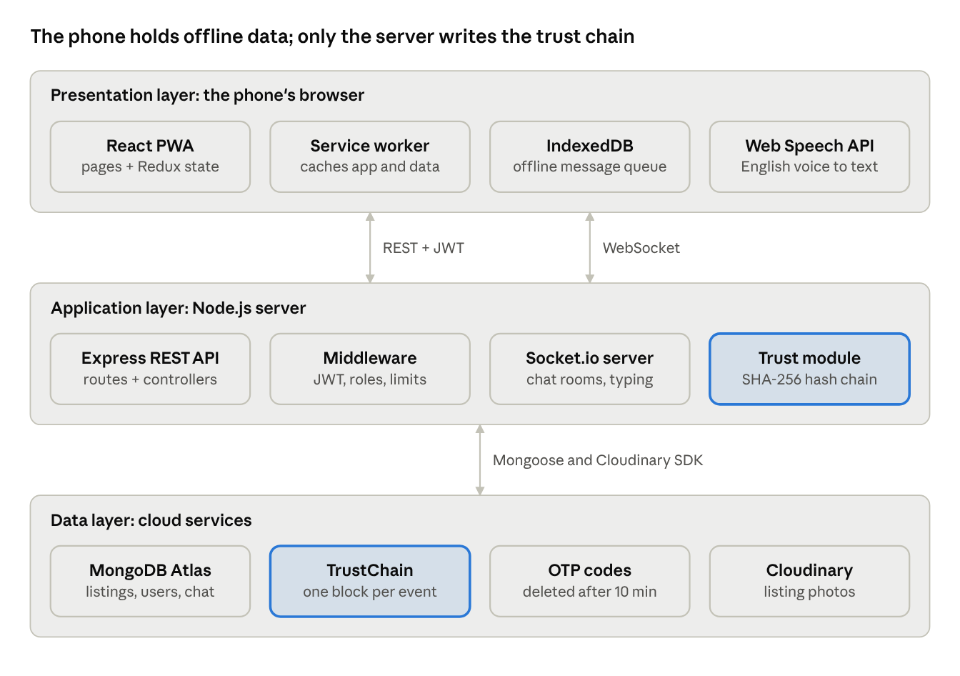
System Architecture
Presentation: React PWA on the phone, with offline cache and message queue.
Application: Express REST API and Socket.io server. Only the server writes trust blocks.
Data: MongoDB Atlas (seven collections) and Cloudinary for photos.
Highlighted: the trust module and TrustChain collection.
Final Year Project • Academic Year 2026 6
Notes:
Three layers. The phone runs the React app, which can cache data and queue messages offline. It talks to the Express API over REST and to the chat server over WebSockets. Only the server can write to the trust chain, which is stored in MongoDB.

Slide 7
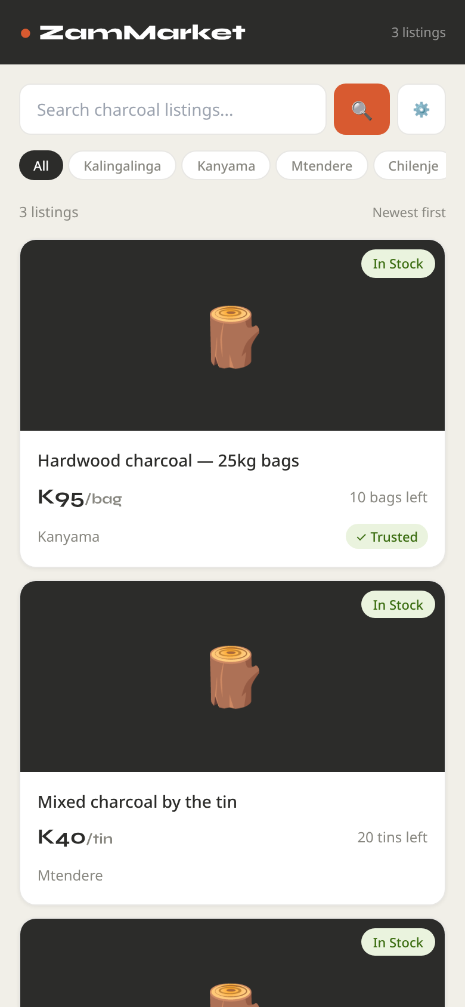
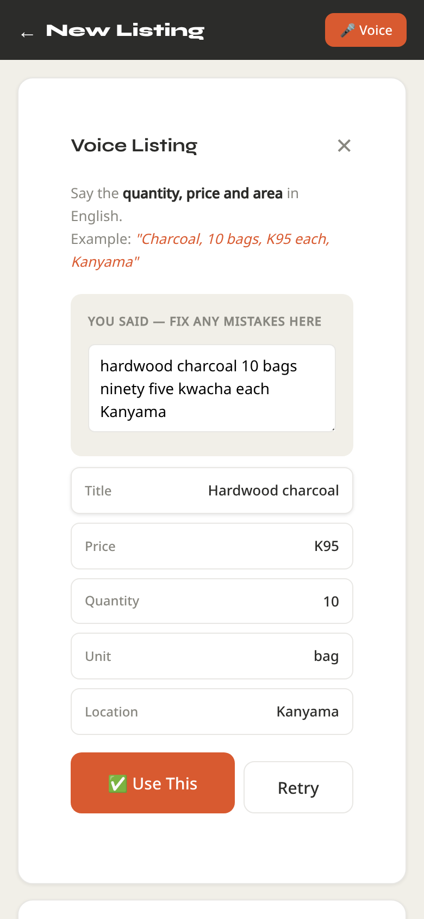
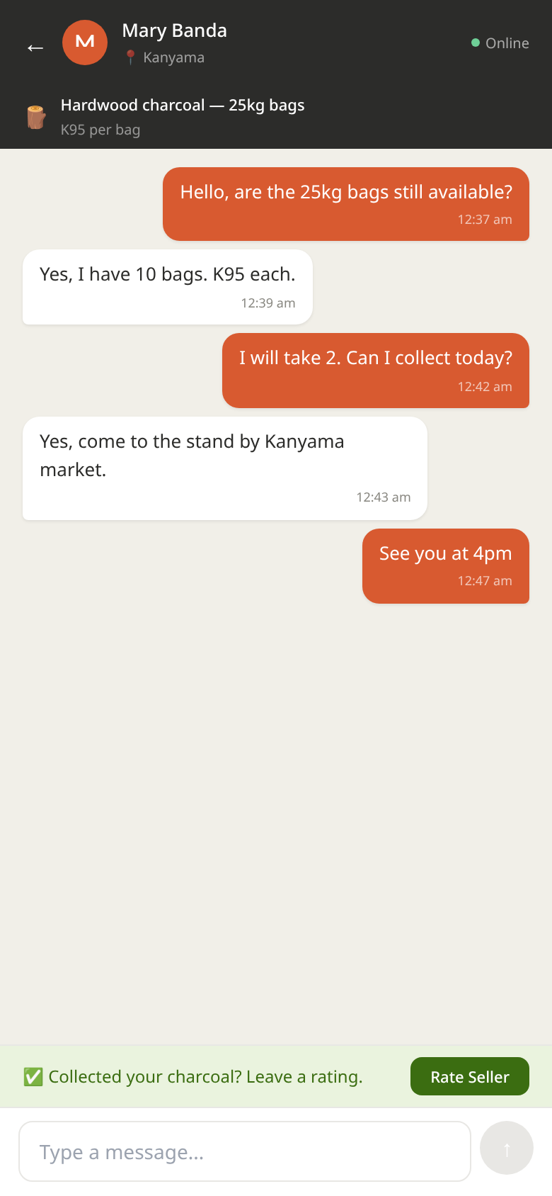
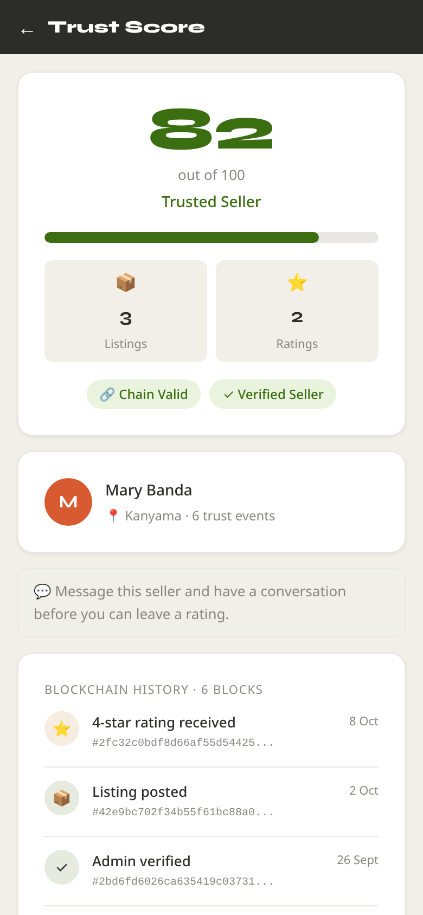
Interface / Interaction Design
Browse with filters
Voice listing
Chat + rating prompt
Trust score
Final Year Project • Academic Year 2026 7
Notes:
Four key screens, mobile-first. Browse has neighbourhood pills and filters. The voice panel shows what was heard, which the seller can correct, and the fields it extracted. Chat shows the 'collected your charcoal?' rating prompt. And the trust page shows the score and whether the chain is valid. These screenshots are from the real app running locally with sample data.

Slide 8
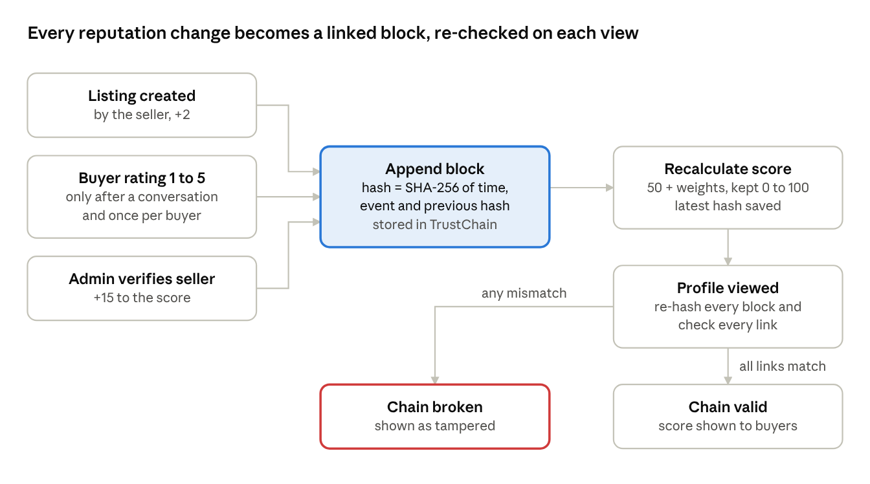
Algorithms / Models / Technical Design
Block hash: SHA-256 of time, event and previous hash.
Verify: re-hash every block, check every link, compare the last hash with the one stored on the seller.
Score: 50 + event weights, kept between 0 and 100. Verified +15, 5★ +8, listing +2, 1★ −5.
Voice parser: number words to digits, then price, quantity, unit and area by pattern.
Why not a real blockchain? One operator, no need for consensus; a hash chain gives tamper evidence at no cost.
Final Year Project • Academic Year 2026 8
Notes:
This is the core algorithm. Every event becomes a block whose hash covers the previous block's hash. When a profile is viewed, the server re-hashes everything and checks every link, and checks the last block against the hash stored on the seller. If anything was changed, the chain shows as broken. I chose a hash chain over a real blockchain because there is a single operator, so distributed consensus would add cost without benefit.

Slide 9
Challenges and Solutions
Challenge | Solution
Every chain showed as tampered, though none was | Re-hash only the original fields
An edited last block could not be detected | Check it against the hash stored on the seller
Anyone could sign up as an administrator | Sign-up limited to buyer and seller; admin created by a script
An admin could verify twice (+15 again) or demote another admin | Verify once only; admins protected; every action logged with a reason
Browsers cannot recognise Nyanja or Bemba | Scope narrowed to English, stated openly
Voice parser missed "ninety five" and "at 100" | Rewritten as a separate, tested module
Deployment failed (July and September 2026) | Found and fixed four causes; live since 12 October 2026
Final Year Project • Academic Year 2026 9
Notes:
Some honest challenges. The most interesting: I found a security hole myself during polishing. Anyone could register as an administrator by sending the word 'admin' to the API. Now sign-up only allows buyer or seller, and administrators are created by a script. Deployment failed twice; I traced it to four causes, fixed all four, and the system is now live.

Slide 10
Test Results
ID | Test case | Expected | Result
B06 | Sign up with role "admin" | Rejected (400) | PASS
B11 | Rate a seller without a conversation | Rejected (403) | PASS
B12 | Rate the same conversation twice | Rejected (409) | PASS
B16 | Edit, delete or reorder a block | Chain invalid | PASS
B17 | Edit the most recent block | Caught by stored head hash | PASS
B08 | Two trust events at the same moment | Second retried, no fork | PASS
V05 | "ninety five kwacha ten bags" | K95, 10 bags | PASS
V10 | "25kg bags, 6 bags, K200 each" | K200, 6 (25kg is the size) | PASS
All 73 backend and 13 voice-parser tests pass; the live system passed its phone tests. Full tables: Report Tables 6.1 to 6.3.
Final Year Project • Academic Year 2026 10
Notes:
A selection of the automated results. All pass. B17 is the important one: editing the most recent block is caught by comparing it with the hash stored on the seller's account.

Slide 11
Objective-by-Objective Evaluation
1. Discovery and filters
Implemented; pages checked in the browser
Achieved
2. English voice listing
13/13 parser tests; dictation tested on a phone
Achieved (English)
3. Tamper-evident trust score
73/73 tests incl. most recent block
Achieved
4. Messaging and offline
Chat, offline queue, offline listing drafts
Achieved
5. Evaluation
Tests in CI; live system tested; SUS pending
Partly achieved
Final Year Project • Academic Year 2026 11
Notes:
Four objectives fully achieved, including offline support: listings created without a connection are saved with their photo and posted automatically on reconnection. Objective 5 is partly achieved until the usability study is done.

Slide 12
Limitations
No user study yet: usability and real-world benefit are not yet measured
English-only voice: excludes some sellers who would gain most
Tamper-evident, not tamper-proof: someone with full database access could rewrite a whole chain
Rating gate: checks that a conversation happened, not that a sale did
No paid SMS: registration codes go to the server log; real SMS is built in and is one setting away
Implication: the results show technical feasibility, not yet adoption or real-world benefit.
Final Year Project • Academic Year 2026 12
Notes:
The limitations, honestly. The biggest is that there has been no user study. The trust chain is tamper-evident, not tamper-proof: someone with full database access could rebuild a whole chain. Anchoring the latest hash outside the database would fix that, and it is in my recommendations.

Slide 13
Recommendations
1
Run the usability study with sellers and buyers before wider release
2
Switch on real SMS through Africa's Talking (MTN, Airtel, Zamtel)
3
Anchor each seller's latest hash outside the database
4
Calibrate the score weights with real rating data
5
Record seller forestry licences before verification
Final Year Project • Academic Year 2026 13
Notes:
Five recommendations, in priority order. The first is about evidence: test it with real users. The second costs a small top-up, because every SMS provider charges per message.

Slide 14
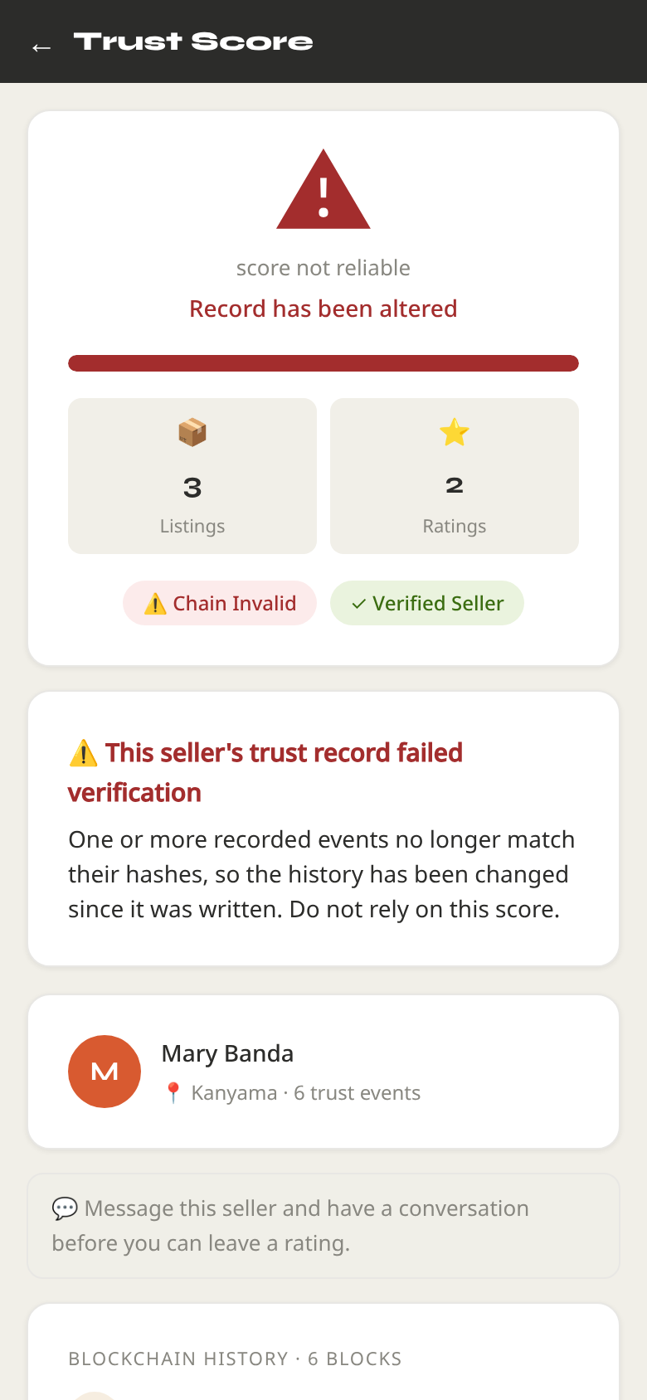
Demonstration Plan
1
Buyer
Browse and filter by neighbourhood and price
2
Seller
Post a listing by voice: "ten bags, ninety five kwacha, Kanyama"
3
Both
Chat; go offline, send a message and post a listing, then reconnect
4
Buyer
Rate the seller after collection; score updates
5
Tamper
Edit a block in MongoDB Atlas: a red "Record has been altered" warning
6
Admin
Integrity tab flags the altered record; verify a seller: +15
Live: zam-market-khaki.vercel.app · Backup if the network fails: screenshots in the report.
Final Year Project • Academic Year 2026 14
Notes:
DEMO SCRIPT (about 4 minutes). Two minutes before: open the Render /api/health link to wake the server, and keep Render Logs open for registration codes. Have two browser windows open before you start: a buyer logged in on one, the seller on the other (or a phone). 1) As buyer: Browse, tap Kanyama, set a price range. 2) As seller: New Listing, Voice, say 'Hardwood charcoal, ten bags, ninety five kwacha each, Kanyama'; show the fields, tap Use This, post. 3) As buyer: open the listing, Message Seller; reply as seller. Turn on airplane mode, send a message and post a listing with a photo; show both waiting (My Listings shows 'Waiting to post'); turn data back on and show both delivered. 4) As buyer: Rate Seller, 5 stars; open the trust page and show the new block. 5) In MongoDB Atlas, edit one trustchains document (change a rating type); refresh the trust page: the score turns into a red 'Record has been altered' warning. 6) As admin: open the Integrity tab; the same seller is flagged and the tab shows a red badge. Undo the edit in Atlas, run the check again and show it clear. Then open the Verify tab and verify a seller; their score rises by 15, and the action appears in the Activity tab. If anything fails, fall back to the screenshots.

Slide 15
Questions and Discussion
Thank you
ZamMarket: local charcoal trading with a tamper-evident seller trust score
John Chola · 2021422054
zam-market-khaki.vercel.app · github.com/john-chola/ZamMarket
Questions?
Final Year Project • Academic Year 2026 15
Notes:
Thank you. I am happy to take questions.

