Slide 1
ZamMarket
A Progressive Web App for Local Charcoal Trading in Lusaka
John Chola
2021422054
Final Year Project Presentation
University of Zambia
School of Natural and Applied Sciences
Department of Computing and Informatics
2026
Final Year Project • Academic Year 2026 1
Notes:
Good morning. My name is John Chola, computer number 2021422054, and my supervisor is Mr. Martin Phiri. My project is ZamMarket: a mobile web app that helps people in Lusaka find charcoal sellers near them, and gives every seller a trust score that cannot be quietly edited.

Slide 2
Team Roles and Responsibilities
Member | Computer No. | Primary Role / Responsibilities
John Chola | 2021422054 | Sole developer: requirements, literature review, design, full-stack implementation, testing and report
4
8
86
24
agile sprints + a
stabilisation period
system modules
automated tests,
all passing
Lusaka-area places
supported
Supervisor: Mr. Martin Phiri · Individual project
Final Year Project • Academic Year 2026 2
Notes:
This was an individual project, so I did all of the work myself, under Mr. Phiri's supervision. In numbers: four agile sprints plus a stabilisation period, eight modules, and 86 automated tests that all pass. It is live at zam-market-khaki.vercel.app. The app covers twenty-four Lusaka-area places.

Slide 3
Presentation Overview
Background and Context
System Analysis and Design
Implementation / Development
Testing, Results and Evaluation
Discussion
Conclusion
System Demonstration
Final Year Project • Academic Year 2026 3
Notes:
About ten minutes of slides, following the report, then a four-minute live demonstration.

Slide 4
Background and Context
Charcoal is the main cooking fuel for most urban Zambian households, even those with electricity.
It is sold informally, face to face and in cash; buyers find sellers by walking around and asking.
Trust is the gap: sellers have no record of good conduct, and buyers cannot judge strangers.
Who benefits: charcoal sellers, charcoal buyers, and the administrators who keep the market honest.
44%
of urban households cook mainly with charcoal alone
A further 38% combine charcoal and electricity
Tembo, Mulenga & Sitko (2015), IAPRI
Aim: a mobile web app that connects charcoal sellers and buyers by neighbourhood, lets sellers list by voice, works on poor connections, and gives every seller a tamper-evident trust score.
Final Year Project • Academic Year 2026 4
Notes:
Charcoal is the most common cooking fuel in urban Zambia: 44 percent of urban households cook mainly with it. It is sold informally and in cash. Buyers find sellers by walking and asking, and cannot judge a stranger; sellers cannot prove they are reliable. WhatsApp posts can be edited, and online shops build trust through online payment, which these traders do not use. My aim: a mobile web app for local discovery with a trust score that cannot be quietly edited. (About 1 minute.)

Slide 5
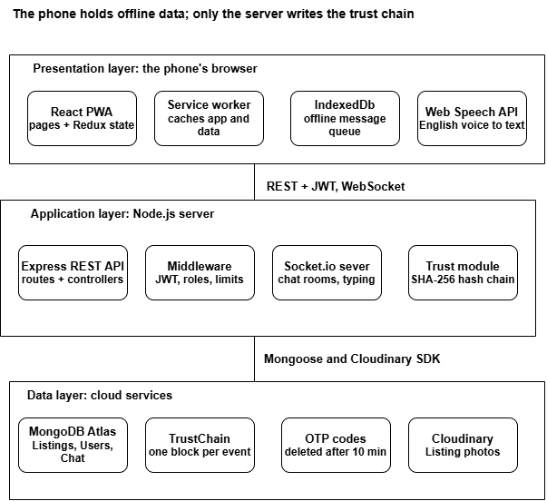
System Architecture
Presentation: React PWA on the phone, with offline cache and message queue.
Application: Express REST API and Socket.io server. Only the server writes trust blocks.
Data: MongoDB Atlas (seven collections) and Cloudinary for photos.
Final Year Project • Academic Year 2026 5
Notes:
Three layers. The phone runs the React app, which can cache data and queue messages offline. It talks to the Express API over REST and to the chat server over WebSockets. Only the server can write to the trust chain, which is stored in MongoDB.

Slide 6
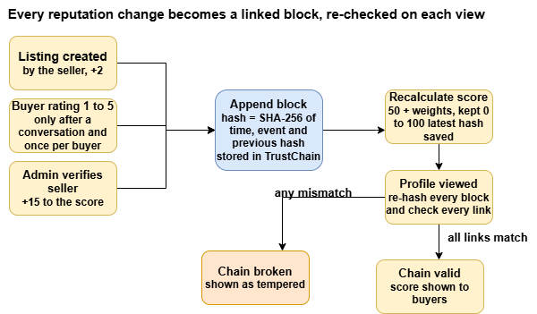
Algorithms / Models / Technical Design
Block hash: SHA-256 of time, event and previous hash.
Verify: re-hash every block, check every link, compare the last hash with the one stored on the seller.
Score: 50 + event weights, kept between 0 and 100. Verified +15, 5★ +8, listing +2, 1★ −5.
Voice parser: number words to digits, then price, quantity, unit and area by pattern.
Why not a real blockchain? One operator, no need for consensus; a hash chain gives tamper evidence at no cost.
Final Year Project • Academic Year 2026 7
Notes:
This is the core algorithm. Every event becomes a block whose hash covers the previous block's hash. When a profile is viewed, the server re-hashes everything and checks every link, and checks the last block against the hash stored on the seller. If anything was changed, the chain shows as broken. I chose a hash chain over a real blockchain because there is a single operator, so distributed consensus would add cost without benefit.

Slide 7
Database / Data Design
Collection | Key fields | Design decision
User | phone (unique), role, neighbourhood, trustScore {score, chainHash} | Head hash of the chain stored here
Listing | seller, price, unit, quantity, neighbourhood, image, status | Index on (neighbourhood, status, date)
Conversation | listing, buyer, seller, lastMessage, unread counts | One per buyer per listing (unique)
Message | conversation, sender, text, readAt | Index on (conversation, date)
TrustChain | seller, blockIndex, timestamp, event, previousHash, hash | Unique (seller, blockIndex): no forks
OTP | phone, code, attempts, expiresAt | Auto-deleted after 10 minutes (TTL)
AdminLog | admin, action, target, reason, time | Every admin action is accountable
One seller has many listings and many trust blocks; a conversation links one buyer, one seller and one listing.
Final Year Project • Academic Year 2026 6
Notes:
Seven MongoDB collections. Two design decisions to point out: each trust block is its own document, with a unique index on seller and position so two simultaneous events cannot fork the chain; and the latest hash is also stored on the user, which lets us detect edits to the most recent block.

Slide 8
Development Environment
Operating system: Windows on the development laptop; Android with Chrome for mobile and voice testing
Programming language: JavaScript (Node.js 18+ and React JSX)
Frameworks: React 19, Redux Toolkit, Express 4, Socket.io
Database: MongoDB Atlas (free tier) via Mongoose
IDE / development tools: VS Code, Chrome DevTools, Nodemon, ESLint
Version control / deployment: Git and GitHub, GitHub Actions, Vercel and Render
Final Year Project • Academic Year 2026 8
Notes:
Standard, free tools. I tested mobile behaviour and voice input on an Android phone in Chrome, because that is what most sellers would use.

Slide 9
System Components / Modules
Authentication
Listings
Browse
Voice input
OTP sign-up, JWT login, roles; admin by script
Create, edit, pause, sell; photo upload
Neighbourhood, keyword, price, quantity
Speech to text, parsed into the form
Chat
Offline
Trust
Administration
Socket.io rooms, typing, unread counts
Service worker cache, IndexedDB queue
Hash chain, score, rating rules
Verify queue, integrity check, logged moderation
Final Year Project • Academic Year 2026 9
Notes:
Eight modules. Most are standard for a marketplace. The two highlighted ones are what make ZamMarket different: voice input, and the trust chain.

Slide 10
Key Implementation Details
Read the last block, link to its hash, save. A unique index rejects a clash; the write is retried.
Appending a block
Rebuild exactly what was hashed, so database fields (_id, __v) never cause false alarms.
Verifying a chain
"ninety five kwacha" → K95. The best of three recognition guesses is used; the seller can correct it.
Voice parsing
Queued messages are sent in order when the connection returns, each removed only once confirmed.
Offline replay
bcrypt, JWT, rate limits on login, OTP and sign-up; search text escaped; admins only by script.
Security
Final Year Project • Academic Year 2026 10
Notes:
Five details I am proud of. One: a race condition. If two trust events arrived at the same moment, they could both claim the same position and fork the chain; a unique index plus a retry fixes that. Two: early on, every chain looked tampered, because MongoDB adds its own fields; I fixed that by re-hashing exactly what was originally hashed. Three: the voice parser understands spoken numbers.

Slide 11
Challenges and Solutions
Challenge | Solution
Every chain showed as tampered, though none was | Re-hash only the original fields
An edited last block could not be detected | Check it against the hash stored on the seller
Anyone could sign up as an administrator | Sign-up limited to buyer and seller; admin created by a script
An admin could verify twice (+15 again) or demote another admin | Verify once only; admins protected; every action logged with a reason
Browsers cannot recognise Nyanja or Bemba | Scope narrowed to English, stated openly
Uploads failed with “stale request” as the laptop’s clock was off | Solved by syncing the clock and adding a diagnostic check
Deployment failed (July 2026) | Found and fixed causes; live since 12 October 2026
Final Year Project • Academic Year 2026 11
Notes:
Some honest challenges. The most interesting: I found a security hole myself during polishing. Anyone could register as an administrator by sending the word 'admin' to the API. Now sign-up only allows buyer or seller, and administrators are created by a script. Deployment failed twice; I traced it to four causes, fixed all four, and the system is now live.

Slide 12
Test Results
ID | Test case (live system, Android phone) | Expected | Result
TC-01 | Register with a Zambian number and a one-time code | Account created | PASS
TC-04 | Seller posts a listing with a photo | Listing appears in Browse | PASS
TC-06 | Seller dictates a listing in Chrome on Android | Form filled from speech | PASS
TC-07 | Buyer and seller chat | Message arrives instantly | PASS
TC-14 | Admin verifies a seller | Badge shown; score +15 | PASS
TC-17 | Hosted app (Vercel + Render) on mobile data | Pages load; chat connects | PASS
TC-22 | Install the app from Chrome on Android | Opens from the home screen | PASS
B17 | Edit the most recent trust block (automated) | Caught by stored head hash | PASS
Final Year Project • Academic Year 2026 12
Notes:
These are system tests I ran on the live system with an Android phone on mobile data, plus B17, the most important automated test: editing the most recent trust block is caught by the hash stored on the seller. All 86 automated tests run on every push to GitHub. (About 1 minute.)

Slide 13
Discussion of Findings
Trust
RQ1: Yes
Discovery
Achieved
A hash chain on an ordinary database detects any edited, deleted or reordered event, cheaply.
Neighbourhood filters match how residents describe location, with no GPS needed.
Voice
RQ2: Partly
Connectivity
RQ3: Largely
Works for English sentences, but Nyanja and Bemba speakers are not served.
Reading, messaging and new listings survive drops; ratings need a connection.
Most important finding: verifiable trust is possible without online payment.
Final Year Project • Academic Year 2026 13
Notes:
The most important finding: you can give informal cash traders a verifiable reputation without online payment and without a real blockchain. Research questions 1 and 3 are answered largely yes; question 2 partly, because of the language limit.

Slide 14
Limitations
No user study yet: usability and real-world benefit are not yet measured
English-only voice: excludes some sellers who would gain most
Tamper-evident, not tamper-proof: someone with full database access could rewrite a whole chain
Rating gate: checks that a conversation happened, not that a sale did
No paid SMS: registration codes go to the server log; real SMS is built in and is one setting away
Final Year Project • Academic Year 2026 14
Notes:
The limitations, honestly. The biggest is that there has been no user study. The trust chain is tamper-evident, not tamper-proof: someone with full database access could rebuild a whole chain. Anchoring the latest hash outside the database would fix that, and it is in my recommendations.

Slide 15
Conclusion
Objectives
Next steps
1. Discovery and filters
Achieved
1. Usability study with sellers and buyers
2. Switch on real SMS (Africa's Talking)
3. Anchor the latest hash outside the database
4. Nyanja and Bemba voice input
2. English voice listing
Achieved
3. Tamper-evident trust score
Achieved
4. Messaging and offline support
Achieved
5. Evaluation (user study pending)
Partly
Verifiable trust for cash traders is possible without online payment, and ZamMarket is live at zam-market-khaki.vercel.app.
Final Year Project • Academic Year 2026 15
Notes:
Four of the five objectives are achieved; the fifth is partly achieved because the user study is still to be run, which is my first next step. Real SMS needs only a paid account and one setting. The main conclusion: a simple hash chain gives informal cash traders a verifiable reputation without online payment, and the system is live. Now I will show it. (About 1 minute.)

Slide 16
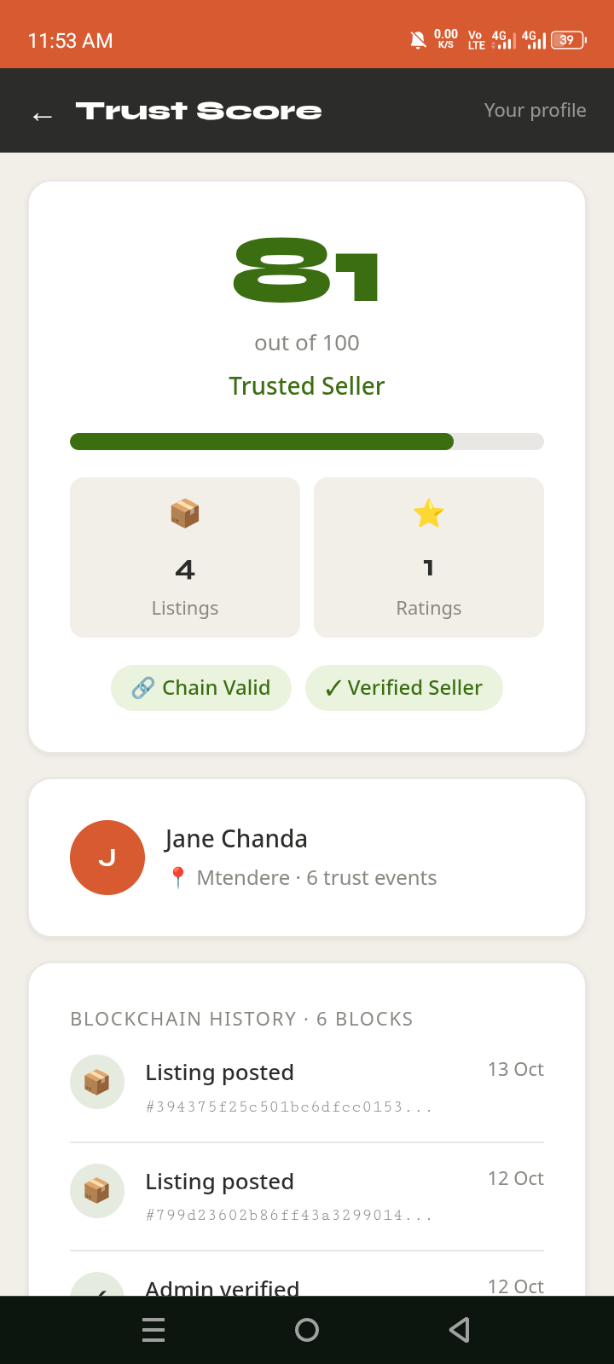
Demonstration Plan
1
Buyer
Browse and filter by neighbourhood and price
Post a listing by voice: "ten bags, ninety five kwacha, Kanyama"
2
Seller
Chat; go offline, send a message and post a listing, then reconnect
3
Both
4
Buyer
Rate the seller after collection; score updates
Edit a block in MongoDB Atlas: a red "Record has been altered" warning
5
Tamper
6
Admin
Integrity tab flags the altered record; verify a seller: +15
Live: zam-market-khaki.vercel.app
Final Year Project • Academic Year 2026 16
Notes:
DEMO SCRIPT (about 4 minutes). Two minutes before: open the Render /api/health link to wake the server, and keep Render Logs open for registration codes. Have two browser windows open before you start: a buyer logged in on one, the seller on the other (or a phone). 1) As buyer: Browse, tap Kanyama, set a price range. 2) As seller: New Listing, Voice, say 'Hardwood charcoal, ten bags, ninety five kwacha each, Kanyama'; show the fields, tap Use This, post. 3) As buyer: open the listing, Message Seller; reply as seller. Turn on airplane mode, send a message and post a listing with a photo; show both waiting (My Listings shows 'Waiting to post'); turn data back on and show both delivered. 4) As buyer: Rate Seller, 5 stars; open the trust page and show the new block. 5) In MongoDB Atlas, edit one trustchains document (change a rating type); refresh the trust page: the score turns into a red 'Record has been altered' warning. 6) As admin: open the Integrity tab; the same seller is flagged and the tab shows a red badge. Undo the edit in Atlas, run the check again and show it clear. Then open the Verify tab and verify a seller; their score rises by 15, and the action appears in the Activity tab. If anything fails, fall back to the screenshots.

Slide 17
Questions and Discussion
Thank you
Questions?
zam-market-khaki.vercel.app · github.com/john-chola/ZamMarket
Final Year Project • Academic Year 2026 16
Notes:
Thank you. I am happy to take questions.

