Slide 1
ZamMarket
A Progressive Web App for Local Charcoal Trading in Lusaka with a Tamper-Evident Seller Trust Score
Final Year Project Presentation
John Chola · 2021422054
Supervisor: Mr. Martin Phiri
University of Zambia
School of Natural and Applied Sciences
Department of Computing and Informatics
2026
Final Year Project • Academic Year 2026 1
Notes:
Good morning. My name is John Chola, computer number 2021422054, and my supervisor is Mr. Martin Phiri. My project is ZamMarket: a mobile web app that helps people in Lusaka find charcoal sellers near them, and gives every seller a trust score that cannot be quietly edited.

Slide 2
Project Overview
Member | Computer No. | Primary Role / Responsibilities
John Chola | 2021422054 | Sole developer: requirements, literature review, design, full-stack implementation, testing and report
4
8
35
11
agile sprints + a
stabilisation period
system modules
automated tests,
all passing
Lusaka neighbourhoods
supported
Supervisor: Mr. Martin Phiri · Individual project
Final Year Project • Academic Year 2026 2
Notes:
This was an individual project, so I did all of the work myself, under Mr. Phiri's supervision. In numbers: four agile sprints plus a stabilisation period, eight modules, and 35 automated tests that all pass. The app covers eleven named Lusaka neighbourhoods.

Slide 3
Presentation Overview
Introduction
Literature Review / Related Work
Methodology
System Analysis and Design
Implementation / Development
Testing, Results and Evaluation
Individual Contribution
Discussion
Conclusion, Recommendations and Future Work
System Demonstration
Final Year Project • Academic Year 2026 3
Notes:
I will follow the structure of the report, and finish with a live demonstration of the system.

Slide 4
Background and Context
Charcoal is the main cooking fuel for most urban Zambian households, even those with electricity.
It is sold informally: roadside stalls, neighbourhood depots and bicycles, face to face and in cash.
Buyers find sellers by walking around and asking neighbours.
Smartphones are common, but mobile data is costly and connections drop.
Who benefits: charcoal sellers, charcoal buyers, and the administrators who keep the market honest.
44%
of urban households cook mainly with charcoal alone
A further 38% combine charcoal and electricity
Tembo, Mulenga & Sitko (2015), IAPRI
Final Year Project • Academic Year 2026 4
Notes:
Charcoal is the most common cooking fuel in urban Zambia: an IAPRI study found 44 percent of urban households cook mainly with charcoal alone, and another 38 percent mix it with electricity. Almost all of it is sold informally, in cash. Buyers find sellers by walking and asking. Phones are everywhere, but data is expensive and unreliable.

Slide 5
Problem Statement
Sellers
Buyers
Existing tools
Reach only the people who walk past their stall
Have no record of good conduct to show new buyers
Cannot easily find a nearby seller or compare prices
Cannot judge whether a stranger will deliver as promised
WhatsApp and Facebook: no verifiable seller record; posts can be edited
E-commerce: trust depends on online payment and a steady connection
The problem: no tool combines local discovery of sellers, a verifiable trust record, cash trading and poor connectivity.
Final Year Project • Academic Year 2026 5
Notes:
Sellers can only reach passers-by and have no way to prove they are reliable. Buyers cannot find nearby sellers or judge a stranger. WhatsApp and Facebook help with discovery but keep no record a buyer can check. Online marketplaces build trust through escrow payments, which informal cash traders do not use. So the problem is the missing combination: local discovery, verifiable trust, cash trading and poor connectivity.

Slide 6
Project Aim
To design, develop and evaluate a mobile-first progressive web application that connects charcoal sellers and buyers within Lusaka neighbourhoods and gives each seller a tamper-evident trust score.
Tamper-evident: any change to a seller's recorded history can be detected.
Final Year Project • Academic Year 2026 6
Notes:
The aim in one sentence. 'Tamper-evident' is the key term: it means that if anyone changes a seller's history, the system can tell.

Slide 7
Project Objectives
1
Listing creation and neighbourhood-based discovery, with neighbourhood, price and quantity filters
2
Voice-based listing creation in English with the Web Speech API, pre-filling the form for review
3
A seller trust score backed by a SHA-256 hash chain, with ratings only from buyers who contacted the seller
4
Real-time buyer–seller messaging and offline support: cached browsing and queued messages
5
Evaluation through functional testing, tamper-detection testing and a usability assessment
Objective 2 originally included Nyanja and Bemba; narrowed to English during development.
Final Year Project • Academic Year 2026 7
Notes:
Five objectives. Note objective 2: my proposal also promised Nyanja and Bemba. During development I found that no browser offers speech recognition for those languages, so I narrowed it to English. I will come back to this under limitations.

Slide 8
Scope of the Project
In scope
Out of scope
Phone + OTP registration; buyer, seller, admin roles
Charcoal listings with photos
Filters: neighbourhood, price, quantity
English voice listing
Real-time chat with offline queue
Hash-chain trust score and rating rules
Administrator panel
Online payment, escrow or mobile money
Delivery and logistics
Nyanja / Bemba speech recognition
Real SMS delivery of OTP codes
Areas outside Lusaka; goods other than charcoal
A public or distributed blockchain
Boundary: settlement stays in person and in cash, by design.
Final Year Project • Academic Year 2026 8
Notes:
In scope on the left, out of scope on the right. The most important boundary: ZamMarket does not handle money. Buyer and seller still meet and pay cash; the app handles discovery, communication and trust.

Slide 9
Literature Review
Final Year Project • Academic Year 2026 9
Notes:
Literature review.

Slide 10
Key Concepts and Theories
Progressive Web App
Web Speech API
Hash chains
Service worker caches the app and data
IndexedDB stores offline messages
Installs from the browser, no app store
Browser speech-to-text
Languages set by each browser
Chrome needs a connection
Each record stores the previous record's SHA-256 hash
Changing one record breaks every later link
Haber & Stornetta (1991)
Why: works on costly, unreliable data
Why: sellers can speak a listing
Why: tamper-evident reputation without a blockchain network
Design guided by agile iteration (Beck et al., 2001), a layered architecture, and SOLID / GRASP principles (Martin, 2008; Larman, 2004).
Final Year Project • Academic Year 2026 10
Notes:
Three technical foundations. A progressive web app behaves like an installed app and keeps working offline. The Web Speech API turns speech into text in the browser. And a hash chain links records by their hashes, so changing one breaks all the links after it. That is the idea behind blockchains, without the network.

Slide 11
Existing Systems / Related Work
Platform | What it is | Strength | Limitation for this problem
B-ne | Free Zambian classifieds (mobile and web) | Free; wide audience | No documented trust; current Zambian use unconfirmed
Kaymu (now Jumia) | C2C / B2C marketplace, 17 African countries | Seller ratings; escrow (2016) | Needs online payment; no longer standalone
TreeMarket | Zambian app, district-based, meet in person | Local and face to face | No documented trust or offline support
Egatee | B2B cross-border platform (2022) | Logistics and payments | Serves businesses, not individuals
Sources: public descriptions, company profiles and app-store listings, not hands-on testing. Full comparison: Report Table 2.1.
Final Year Project • Academic Year 2026 11
Notes:
I reviewed four platforms. TreeMarket is closest in spirit: local, meet in person, but it has no trust mechanism. Kaymu had ratings and escrow, but escrow needs online payment, and Kaymu has since been absorbed into Jumia. I based this on public descriptions, not on testing the apps myself.

Slide 12
Research / Knowledge Gap
 | Local discovery | Verifiable trust | Works with cash | Works offline
B-ne | — | — | — | —
Kaymu (now Jumia) | — | ✓ | ✗ | —
TreeMarket | ✓ | — | ✓ | —
Egatee | ✗ | — | ✗ | —
ZamMarket | ✓ | ✓ | ✓ | Partial
— = not documented in the sources reviewed
No reviewed platform combines all four. ZamMarket was designed for that combination.
Final Year Project • Academic Year 2026 12
Notes:
This table is the gap in one picture. Each platform covers part of the problem; none covers all four columns. Offline support for ZamMarket is marked partial, honestly: browsing and messages work offline, but creating a listing needs a connection.

Slide 13
Methodology
Final Year Project • Academic Year 2026 13
Notes:
Methodology.

Slide 14
Research / Development Approach
Why agile? Some requirements could only be settled by building them. Whether Nyanja and Bemba voice input was feasible only became clear once a prototype ran in real browsers.
How it was organised: four sprints from May 2026, then a stabilisation period (June to September) for fixes, security hardening and automated tests.
Each sprint: plan user stories → build → test → review, with defects fixed in place.
Evidence: the Git history on GitHub records every increment.
Agile
Short sprints, each ending in a working, tested increment
Final Year Project • Academic Year 2026 14
Notes:
I chose agile over waterfall because I could not know everything up front. The best example is voice input: only by building a prototype did I discover that browsers cannot recognise Nyanja or Bemba. Each sprint produced a working increment that I tested before moving on.

Slide 15
Project Workflow
Sprint 1
Sprint 2
Sprint 3
Sprint 4
Stabilise
Registration, OTP, login and roles
Listings, photos, browse and filters, voice input
Real-time chat, offline queue, hash-chain trust score
Admin panel, mobile-first styling
Fixes, voice parser rewrite, security, tests and CI
May 2026 → June to September 2026
Inside every sprint: requirements as user stories → design → implementation → testing → review
Report and evaluation ran alongside, using the same Git history and test results.
Final Year Project • Academic Year 2026 15
Notes:
The project ran in four sprints, then a long stabilisation period. Sprint 3 was the heart of the project: chat, offline support and the trust chain. The stabilisation period is where the system matured: I rewrote the voice parser, fixed security issues and added automated tests.

Slide 16
Tools and Technologies
Frontend
Offline / PWA
Backend
React 19, Redux Toolkit, React Router 7, Vite
Service worker, IndexedDB, web app manifest
Node.js, Express 4, Socket.io for chat
Data
Security
Quality
MongoDB Atlas, Mongoose, Cloudinary for photos
JWT, bcrypt (12 rounds), rate limiting, SHA-256
Git, GitHub Actions, ESLint, node:test, Playwright
Language: JavaScript throughout · Hosting: Vercel (frontend) and Render (backend)
Final Year Project • Academic Year 2026 16
Notes:
One language, JavaScript, across the whole system: React for the app, Node and Express for the API, Socket.io for real-time chat, MongoDB for data. For quality I used ESLint, Node's built-in test runner, Playwright for browser checks, and GitHub Actions to run all of it on every push.

Slide 17
Data Collection / Requirements
Where requirements came from
Ethical and legal considerations
Observation of informal charcoal trading in Lusaka
Review of four existing platforms (Chapter 2)
The project proposal approved by the supervisor
Recorded as user stories, prioritised each sprint
No formal survey was done: a stated limitation
Minimal data: phone, name, neighbourhood, role
Phone numbers masked on public profiles
Passwords stored only as bcrypt hashes
Voice: only the chosen text is stored, never audio
Future user study: informed consent, anonymised
Charcoal licensing not verified: recommended
Final Year Project • Academic Year 2026 17
Notes:
Requirements came from observation, the platform review and my proposal. I did not run a formal survey, and I state that as a limitation. On ethics: I collect very little data, mask phone numbers, never store audio, and I note that charcoal trading is licensed in Zambia, which the app does not yet check.

Slide 18
System Analysis and Design
Final Year Project • Academic Year 2026 18
Notes:
System analysis and design.

Slide 19
Stakeholders and Users
S
B
A
Seller
Buyer
Administrator
Needs: Reach nearby buyers; build a reputation; list quickly
Needs: Find a nearby seller at a fair price; judge trust before meeting
Needs: Keep listings genuine; verify sellers; remove abuse
Constraints: Low-end Android phones, costly data; some find typing hard
Constraints: Intermittent connection; pays in cash
Constraints: Needs an overview without database access
Final Year Project • Academic Year 2026 19
Notes:
Three user groups. Sellers want reach and reputation; buyers want to find someone nearby they can trust; administrators keep the marketplace honest. The constraints, cheap phones and expensive data, drove the decision to build a lightweight web app instead of a native app.

Slide 20
Functional and Non-Functional Requirements
Functional (12 in total, key ones)
Non-functional (8)
FR1 Register with a Zambian number + OTP
FR4 Browse by neighbourhood, price, quantity
FR5 Dictate a listing in English
FR6 Every listing, rating and verification is chained
FR8 Rate only after a conversation, once per conversation
FR10 Offline messages sent on reconnect
FR12 Admin: verify, suspend, remove
Usability: SUS score ≥ 70
Performance: Lighthouse ≥ 70 (mobile)
Security: bcrypt, JWT, rate limits
Integrity: any change to a trust event is detectable
Availability: reading works offline
Privacy: phone numbers masked
Final Year Project • Academic Year 2026 20
Notes:
Twelve functional requirements; these are the key ones. Notice FR8: a rating is only accepted from someone who actually spoke to the seller, once per conversation. The non-functional requirement that matters most is integrity: any change to a trust event must be detectable.

Slide 21
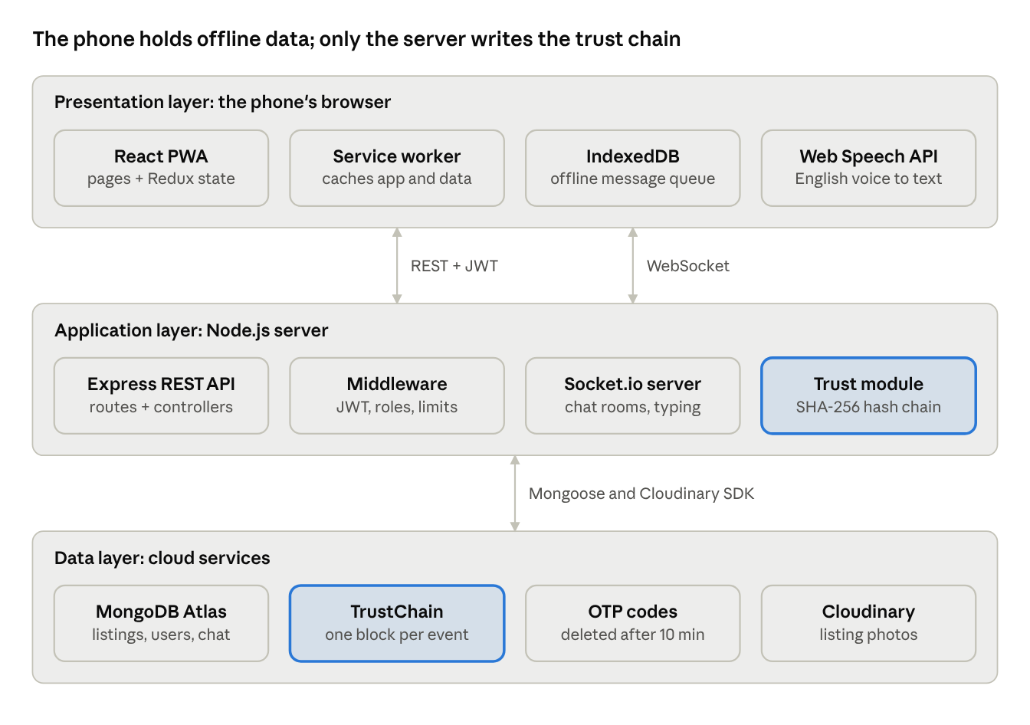
System Architecture
Presentation: React PWA on the phone, with offline cache and message queue.
Application: Express REST API and Socket.io server. Only the server writes trust blocks.
Data: MongoDB Atlas (six collections) and Cloudinary for photos.
Highlighted: the trust module and TrustChain collection.
Final Year Project • Academic Year 2026 21
Notes:
Three layers. The phone runs the React app, which can cache data and queue messages offline. It talks to the Express API over REST and to the chat server over WebSockets. Only the server can write to the trust chain, which is stored in MongoDB.

Slide 22
Database / Data Design
Collection | Key fields | Design decision
User | phone (unique), role, neighbourhood, trustScore {score, chainHash} | Head hash of the chain stored here
Listing | seller, price, unit, quantity, neighbourhood, image, status | Index on (neighbourhood, status, date)
Conversation | listing, buyer, seller, lastMessage, unread counts | One per buyer per listing (unique)
Message | conversation, sender, text, readAt | Index on (conversation, date)
TrustChain | seller, blockIndex, timestamp, event, previousHash, hash | Unique (seller, blockIndex): no forks
OTP | phone, code, attempts, expiresAt | Auto-deleted after 10 minutes (TTL)
One seller has many listings and many trust blocks; a conversation links one buyer, one seller and one listing.
Final Year Project • Academic Year 2026 22
Notes:
Six MongoDB collections. Two design decisions to point out: each trust block is its own document, with a unique index on seller and position so two simultaneous events cannot fork the chain; and the latest hash is also stored on the user, which lets us detect edits to the most recent block.

Slide 23
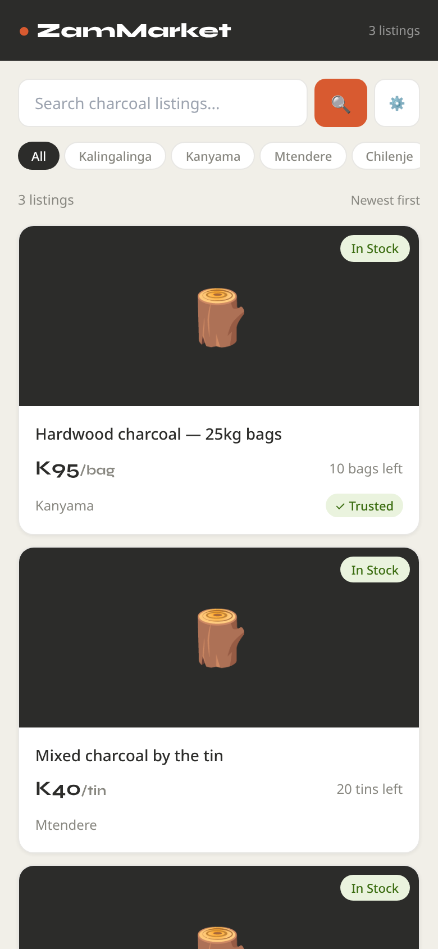
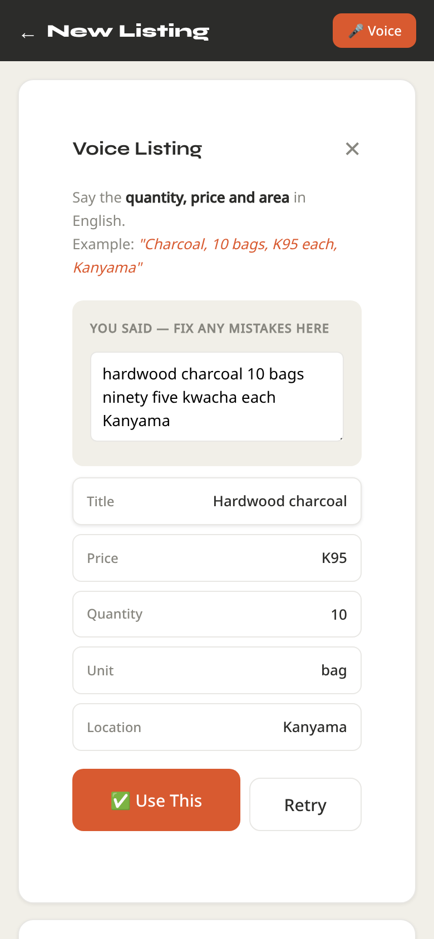
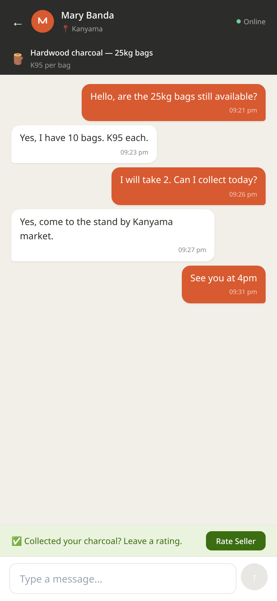
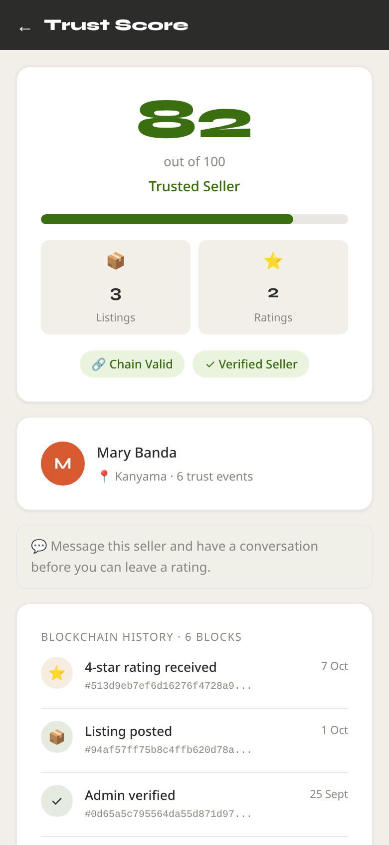
Interface / Interaction Design
Browse with filters
Voice listing
Chat + rating prompt
Trust score
Final Year Project • Academic Year 2026 23
Notes:
Four key screens, mobile-first. Browse has neighbourhood pills and filters. The voice panel shows what was heard, which the seller can correct, and the fields it extracted. Chat shows the 'collected your charcoal?' rating prompt. And the trust page shows the score and whether the chain is valid. These screenshots are from the real app running locally with sample data.

Slide 24
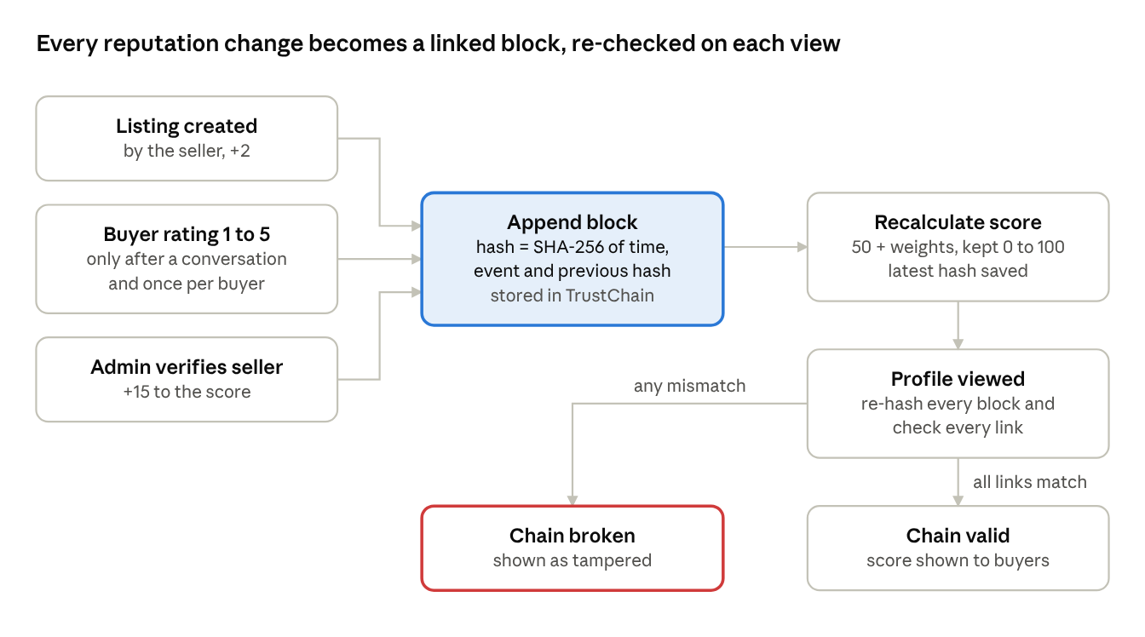
Algorithms / Models / Technical Design
Block hash: SHA-256 of time, event and previous hash.
Verify: re-hash every block, check every link, compare the last hash with the one stored on the seller.
Score: 50 + event weights, kept between 0 and 100. Verified +15, 5★ +8, listing +2, 1★ −5.
Voice parser: number words to digits, then price, quantity, unit and area by pattern.
Why not a real blockchain? One operator, no need for consensus; a hash chain gives tamper evidence at no cost.
Final Year Project • Academic Year 2026 24
Notes:
This is the core algorithm. Every event becomes a block whose hash covers the previous block's hash. When a profile is viewed, the server re-hashes everything and checks every link, and checks the last block against the hash stored on the seller. If anything was changed, the chain shows as broken. I chose a hash chain over a real blockchain because there is a single operator, so distributed consensus would add cost without benefit.

Slide 25
Implementation
Final Year Project • Academic Year 2026 25
Notes:
Implementation.

Slide 26
Development Environment
Hardware: laptop for development; Android phone with Chrome for mobile and voice testing
Programming language: JavaScript (Node.js 18+ and React JSX)
Frameworks: React 19, Redux Toolkit, Express 4, Socket.io
Database: MongoDB Atlas (free tier) via Mongoose
Development tools: VS Code, Chrome DevTools, Nodemon, ESLint
Version control / deployment: Git and GitHub, GitHub Actions, Vercel and Render
Final Year Project • Academic Year 2026 26
Notes:
Standard, free tools. I tested mobile behaviour and voice input on an Android phone in Chrome, because that is what most sellers would use.

Slide 27
System Components / Modules
Authentication
Listings
Browse
Voice input
OTP sign-up, JWT login, roles; admin by script
Create, edit, pause, sell; photo upload
Neighbourhood, keyword, price, quantity
Speech to text, parsed into the form
Chat
Offline
Trust
Administration
Socket.io rooms, typing, unread counts
Service worker cache, IndexedDB queue
Hash chain, score, rating rules
Statistics, verify, suspend, remove
Highlighted: the two distinctive modules.
Final Year Project • Academic Year 2026 27
Notes:
Eight modules. Most are standard for a marketplace. The two highlighted ones are what make ZamMarket different: voice input, and the trust chain.

Slide 28
Key Implementation Details
Appending a block
Read the last block, link to its hash, save. A unique index rejects a clash; the write is retried.
Verifying a chain
Rebuild exactly what was hashed, so database fields (_id, __v) never cause false alarms.
Voice parsing
"ninety five kwacha" → K95. The best of three recognition guesses is used; the seller can correct it.
Offline replay
Queued messages are sent in order when the connection returns, each removed only once confirmed.
Security
bcrypt, JWT, rate limits on login, OTP and sign-up; search text escaped; admins only by script.
Final Year Project • Academic Year 2026 28
Notes:
Five details I am proud of. One: a race condition. If two trust events arrived at the same moment, they could both claim the same position and fork the chain; a unique index plus a retry fixes that. Two: early on, every chain looked tampered, because MongoDB adds its own fields; I fixed that by re-hashing exactly what was originally hashed. Three: the voice parser understands spoken numbers.

Slide 29
Challenges and Solutions
Challenge | Solution
Every chain showed as tampered, though none was | Re-hash only the original fields
An edited last block could not be detected | Check it against the hash stored on the seller
Anyone could sign up as an administrator | Sign-up limited to buyer and seller; admin created by a script
Browsers cannot recognise Nyanja or Bemba | Scope narrowed to English, stated openly
Voice parser missed "ninety five" and "at 100" | Rewritten as a separate, tested module
Deployment failed (July and September 2026) | Found four causes (hard-coded addresses, CORS, cache, routing) and fixed them
Final Year Project • Academic Year 2026 29
Notes:
Some honest challenges. The most interesting: I found a security hole myself during polishing. Anyone could register as an administrator by sending the word 'admin' to the API. Now sign-up only allows buyer or seller, and administrators are created by a script. Deployment failed twice; I traced it to four causes and fixed all four.

Slide 30
Testing and Results
Final Year Project • Academic Year 2026 30
Notes:
Testing and results.

Slide 31
Testing Strategy
1
2
3
4
5
Unit
Browser
System
Security
Usability
35 automated tests, run on every push by GitHub Actions
Playwright drives the real app: voice panel, main pages
17 test cases through the UI on Chrome and Android
Role checks, rate limits, rating rules, tamper tests
System Usability Scale (target ≥ 70) and Lighthouse
Tools: node:test, Playwright with Chromium, GitHub Actions, Chrome DevTools, ESLint
Final Year Project • Academic Year 2026 31
Notes:
Five levels of testing. The unit tests run automatically on every push to GitHub, so a change that breaks the trust chain or the voice parser is caught immediately. Usability testing is planned with the System Usability Scale.

Slide 32
Test Results
ID | Test case | Expected | Result
B06 | Sign up with role "admin" | Rejected (400) | PASS
B11 | Rate a seller without a conversation | Rejected (403) | PASS
B12 | Rate the same conversation twice | Rejected (409) | PASS
B16 | Edit, delete or reorder a block | Chain invalid | PASS
B17 | Edit the most recent block | Caught by stored head hash | PASS
B08 | Two trust events at the same moment | Second retried, no fork | PASS
V05 | "ninety five kwacha ten bags" | K95, 10 bags | PASS
V10 | "25kg bags, 6 bags, K200 each" | K200, 6 (25kg is the size) | PASS
All 23 backend and 12 voice-parser tests pass. Full tables: Report Tables 6.1 to 6.3.
Final Year Project • Academic Year 2026 32
Notes:
A selection of the automated results. All pass. B17 is the important one: editing the most recent block is caught by comparing it with the hash stored on the seller's account.

Slide 33
Performance / Experimental Results
23/23
12/12
~3 ms
0
backend tests pass
voice-parser tests pass
to verify a 1,000-block chain
lint errors (from 23)
What this means: verifying a whole chain on every profile view adds no noticeable delay. A seller would need a thousand listings and ratings to reach 1,000 blocks.
Voice parser: passed 4 of 6 test phrases before the rewrite; all cases pass now.
Final Year Project • Academic Year 2026 33
Notes:
The headline numbers. Verifying a thousand-block chain takes about three milliseconds, so checking every chain on every view is affordable. The voice parser went from four of six phrases to passing everything. Lighthouse scores will be added once the system is redeployed.

Slide 34
User Evaluation
Planned, not yet run
Planned study
What has been checked so far
At least 5 sellers and 5 buyers in one or two neighbourhoods
Tasks: find a seller, post by voice, message, rate
System Usability Scale: 10 items, score 0 to 100
Target: mean score of at least 70
Every screen works at phone width (390 px)
Voice flow in the browser with simulated speech
Errors shown clearly: microphone denied, offline, missing fields
Seller must confirm every field before posting
Final Year Project • Academic Year 2026 34
Notes:
I want to be upfront: the user study has not been run yet. I have designed it, with the System Usability Scale and a target score of 70, and it is my first recommendation. What I have checked is that every screen works at phone width and that errors are explained clearly.

Slide 35
Objective-by-Objective Evaluation
1. Discovery and filters
Implemented; pages checked in the browser
Achieved
2. English voice listing
12/12 parser tests; real-microphone test pending
Achieved (English)
3. Tamper-evident trust score
23/23 tests incl. most recent block
Achieved
4. Messaging and offline
Chat, offline queue, cached browsing
Mostly achieved
5. Evaluation
Automated tests in CI; SUS and Lighthouse pending
Partly achieved
Final Year Project • Academic Year 2026 35
Notes:
Three objectives fully achieved. Objective 4 is mostly achieved: chat and browsing work offline, but creating a listing still needs a connection. Objective 5 is partly achieved until the usability study is done.

Slide 36
Individual Contribution
✓
Analysis
Problem analysis, platform review, requirements
✓
Design
Architecture, data model, trust-chain algorithm, UI
✓
Implementation
Frontend, backend, chat, offline, voice parser, trust
✓
Testing
35 automated tests, CI, browser checks, system test plan
✓
Documentation
Report, README, deployment checklist, this presentation
Individual project: all work by John Chola, supervised by Mr. Martin Phiri. Open-source libraries are acknowledged in the report.
Final Year Project • Academic Year 2026 36
Notes:
Because this was an individual project, every part of the work is mine, from analysis to testing and documentation. Open-source libraries such as React and Express are acknowledged in the report.

Slide 37
Discussion
Final Year Project • Academic Year 2026 37
Notes:
Discussion.

Slide 38
Discussion of Findings
Trust
RQ1: Yes
Discovery
Achieved
A hash chain on an ordinary database detects any edited, deleted or reordered event, cheaply.
Neighbourhood filters match how residents describe location, with no GPS needed.
Voice
RQ2: Partly
Connectivity
RQ3: Partly
Works for English sentences, but Nyanja and Bemba speakers are not served.
Reading and messaging survive drops; creating records needs a connection.
Most important finding: verifiable trust is possible without online payment.
Final Year Project • Academic Year 2026 38
Notes:
The most important finding: you can give informal cash traders a verifiable reputation without online payment and without a real blockchain. Research question 1 is answered yes. Questions 2 and 3 are answered partly.

Slide 39
Project Contributions
Technical
Practical
A reusable pattern for tamper-evident reputation on a normal database, with head-hash checking.
A working, installable marketplace for a large, under-served informal trade.
Research
Societal
Evidence that browser speech recognition cannot yet serve Zambian languages.
Helps small sellers build a reputation that travels with them.
Final Year Project • Academic Year 2026 39
Notes:
Four kinds of contribution. Technically, the trust-chain pattern can be reused by any small platform. And a useful research result: browser speech recognition cannot yet handle Zambian languages, which future projects should plan for.

Slide 40
Limitations
No user study yet: usability and real-world benefit are not yet measured
English-only voice: excludes some sellers who would gain most
Tamper-evident, not tamper-proof: someone with full database access could rewrite a whole chain
Rating gate: checks that a conversation happened, not that a sale did
Not yet redeployed: deployment fixes are in the code, but not yet verified on the hosted system
Implication: the results show technical feasibility, not yet adoption or real-world benefit.
Final Year Project • Academic Year 2026 40
Notes:
The limitations, honestly. The biggest is that there has been no user study. The trust chain is tamper-evident, not tamper-proof: someone with full database access could rebuild a whole chain. Anchoring the latest hash outside the database would fix that, and it is in my recommendations.

Slide 41
Conclusion
Final Year Project • Academic Year 2026 41
Notes:
Conclusion.

Slide 42
Project Summary
Problem
Charcoal buyers cannot find or trust nearby sellers
Approach
Agile: four sprints and a stabilisation period
Solution
A mobile web app with voice listing, chat, offline support and a hash-chain trust score
Results
35 of 35 automated tests pass; any tampering is detected
Contribution
Verifiable trust for cash traders, without online payment
Final Year Project • Academic Year 2026 42
Notes:
The whole project in five lines.

Slide 43
Achievement of Objectives
Objective 1
Discovery and filters
Achieved
Objective 2
English voice listing, including spoken numbers
Achieved
Objective 3
Tamper detection covers every block, including the most recent
Achieved
Objective 4
Chat and offline reading; offline listing creation not provided
Mostly
Objective 5
Automated tests in CI; usability study pending
Partly
Final Year Project • Academic Year 2026 43
Notes:
Three achieved, one mostly achieved, one partly achieved, pending the user study.

Slide 44
Recommendations
1
Redeploy and verify the hosted system using the deployment checklist
2
Run the usability study with sellers and buyers before wider release
3
Anchor each seller's latest hash outside the database
4
Calibrate the score weights with real rating data
5
Replace simulated OTP with an SMS provider; record seller licences
Final Year Project • Academic Year 2026 44
Notes:
Five recommendations, in priority order. The first two are about evidence: get it hosted, and test it with real users.

Slide 45
Future Work
Local-language voice
Offline listing drafts
A Nyanja / Bemba speech model on a server, validated by native speakers
Save listings with photos offline; submit on reconnection
Mobile-money option
Beyond charcoal
Optional payment confirmation for transaction-verified ratings
Other goods traded locally in cash: vegetables, building sand
Final Year Project • Academic Year 2026 45
Notes:
The most valuable future work is local-language voice input, which needs a speech model trained on Nyanja and Bemba. The design also generalises to other goods traded locally in cash.

Slide 46
System Demonstration
Final Year Project • Academic Year 2026 46
Notes:
Now a short live demonstration.

Slide 47
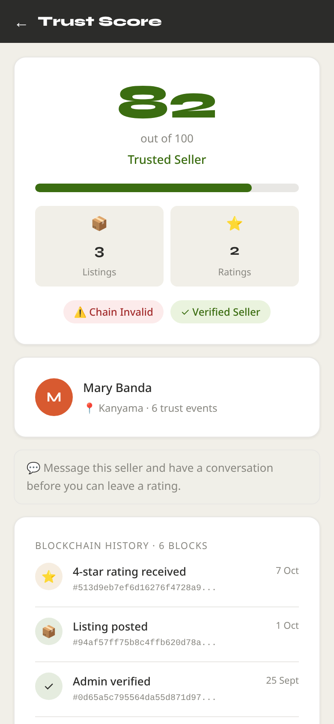
Demonstration Plan
1
Buyer
Browse and filter by neighbourhood and price
2
Seller
Post a listing by voice: "ten bags, ninety five kwacha, Kanyama"
3
Both
Real-time chat; send a message offline, then reconnect
4
Buyer
Rate the seller after collection; score updates
5
Tamper
Edit a block in MongoDB Atlas: "Chain Invalid" appears
6
Admin
Verify the seller: +15 and a badge
Backup if the network fails: screenshots on slide 23 and in the report.
Final Year Project • Academic Year 2026 47
Notes:
DEMO SCRIPT (about 4 minutes). Have two browser windows open before you start: a buyer logged in on one, the seller on the other (or a phone). 1) As buyer: Browse, tap Kanyama, set a price range. 2) As seller: New Listing, Voice, say 'Hardwood charcoal, ten bags, ninety five kwacha each, Kanyama'; show the fields, tap Use This, post. 3) As buyer: open the listing, Message Seller; reply as seller. Turn on airplane mode, send a message, show it queued; turn data back on and show it delivered. 4) As buyer: Rate Seller, 5 stars; open the trust page and show the new block. 5) In MongoDB Atlas, edit one trustchains document (change a rating type); refresh the trust page: 'Chain Invalid'. Undo the edit afterwards. 6) As admin: verify the seller; score rises by 15. If anything fails, fall back to the screenshots.

Slide 48
Questions and Discussion
Thank you
ZamMarket: local charcoal trading with a tamper-evident seller trust score
John Chola · 2021422054
github.com/john-chola/ZamMarket
Questions?
Final Year Project • Academic Year 2026 48
Notes:
Thank you. I am happy to take questions.

