Slide 1
Context-Driven English to Japanese Translation
Johnathan Dewey
B.S. Computer Science

Slide 2
Syntax Trees
In Linguistics, syntax trees are hierarchical structures that represent language structure and grammar in a visual tree. Their structure is formed by phrase rules in a generative grammar
Verb Phrase
Grammar Rules
VP → NP VP
VP → V Adj
NP → N
Noun Phrase
Verb Phrase
Noun
Verb
Adjective
I
am
happy
Disclaimer!
I use a much more complicated generative grammar in this translator

Slide 3
X-bar Phrase Representation
A theory for universal phrase structure for all parts of speech in all languages
XP
the root node of a phrase
(Optional) phrases that come before the head
<specifier>
X’
establishes a close connection between X and it’s complement.
the head or POS that carries the most meaning
X
<complement>
(Optional) phrases that come after the head.
VP
NP
NP
V’
NP
N’
N’
went
NP
N’
Monday
John
N’
upcoming
home

Slide 4
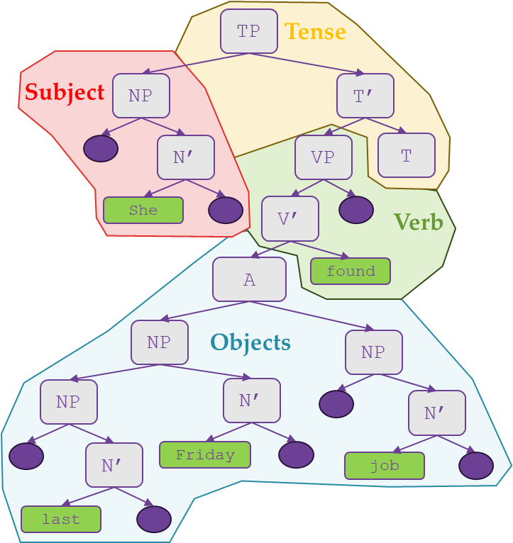

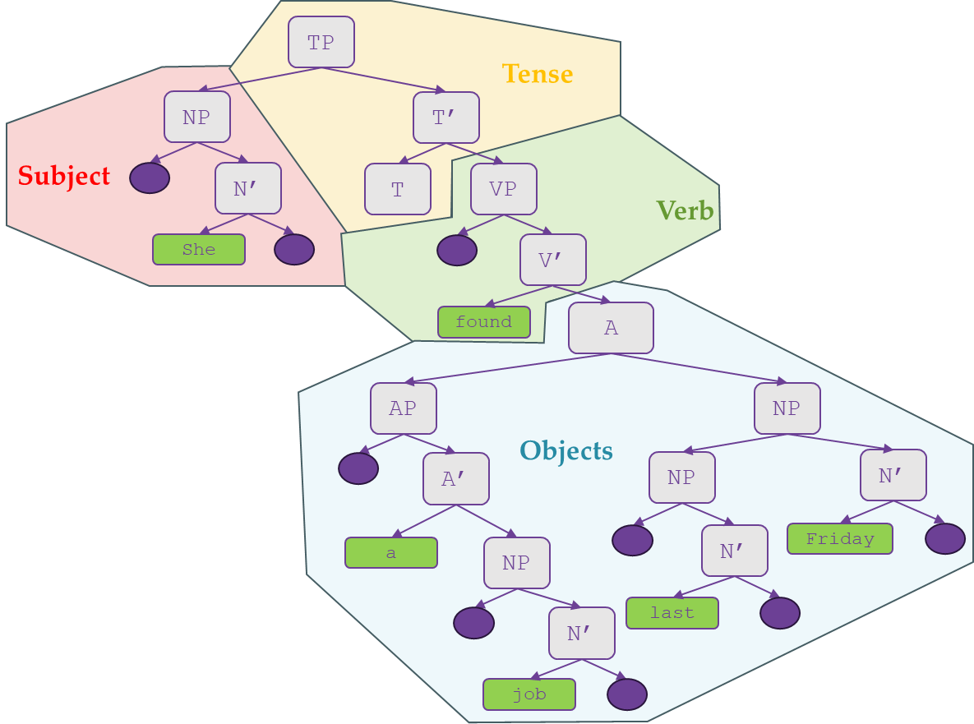
The Algorithm Process
My translator essentially constructs syntax tree and modifies the nodes and terminals of the tree to attain Japanese phrase structure
Tree Build
Node Manipulation
Terminal Manipulation
Classify string into list of nodes
Build a tree from nodes based of phrase rules
Removes unwanted lexical items
Reorders nodes
Transfer English text to Japanese
verify or construct conjugations
verify or construct particles

Slide 5
Building the Tree: Classification
Through a database lookup we can get a word’s part of speech (POS)
“She found a job last Friday.”
[“She”, “found”, “a”, “job”, “last”, “Friday”]
Word
Classifier
Noun
Verb
Determiner
Noun
Noun
Noun
“She”
“found”
“a”
“job”
“last”
“Friday”

Slide 6
Building the Tree
Tense Phrase (TP): Head node of the sentence tree
TP
[“She,” “found,” “a,” “job,” “last,” “Friday” ]
|
Splits the subject from other constituents of the sentence
Phrase Node (XP): Node representing a sub-phrase within the TP, can take a specifier if needed
NP
[“She”]
N’
[“She”]
Bar Node (X’): Node representing a relationship between the head and complement of a phrase
Terminal Node (X): Node representing the head of a phrase
She

Slide 7
Building the Tree
TP
[“She,” | “found,” “a,” “job,” “last,” “Friday” ]
Tense Bar (T’): Level of abstraction to accommodate tense information
NP
T’
[“found,” “a,” “job,” “last,” “Friday” ]
Tense Terminal (T): Holds past and present tense information
N’
T
[“found,” “a,” “job,” “last,” “Friday” ]
Sends all constituents to the tense terminal to record tense features and modal auxiliaries
She
Only one tense feature found:
Past Tense derived from verb “found”

Slide 8
Building the Tree
TP
NP
T’
[“found” “a,” “job,” “last,” “Friday” ]
N’
T
VP
[ “found” “a,” “job,” “last,” “Friday” ]
|
Verb Phrase (VP) splits a verb and phrase constituents from potential verb specifiers
She
V’
|
[ “found,” “a,” “job,” “last,” “Friday” ]
Verb Bar (V’) splits a verb from the remaining phrase constituents
found

Slide 9
Building the Tree
TP
NP
T’
|
N’
T
VP
She
V’
[ “found” | “a,” “job,” “last,” “Friday” ]
found
Adj
[ “a,” “job,” “last,” “Friday” ]
|
Adjunct Node (Adj) splits the remaining nodes into sub-phrases that are interpreted as arguments to the verb “found”
Articles such as “a” take precedence over nouns
AP
[ “a,” “job”]
A’
[ “a,” “job”]
Article Bar (A’) splits article from other constituents
|
a
NP
[“job”]
Can’t produce a specifier for “job”
N’
[“job”]
job

Slide 10
Building the Tree
TP
NP
T’
N’
T
VP
She
V’
[ “found” | “a,” “job,” “last,” “Friday” ]
found
Adj
[ “a,” “job,” | “last,” “Friday” ]
A phrase consisting of a doublet (two nouns) are organized sequentially
AP
NP
|
[ “last,” “Friday” ]
A’
NP
[“last”]
N’
[“Friday”]
a
NP
N’
Friday
N’
last
job

Slide 11
Building the Tree
Following the construction, we now have an English syntax tree that divides and organizes the subject, tense, verb, and objects of a sentence
TP
Tense
NP
T’
Subject
N’
T
VP
Verb
She
V’
found
A
AP
NP
Now we have defined an hierarchical structure of lexical items that can be manipulated and modified to achieve a Japanese phrase structure.
Objects
A’
NP
N’
The remainder of the algorithm while manipulate the tree using POS as context to drive our decisions.
a
NP
N’
Friday
N’
last
job

Slide 12
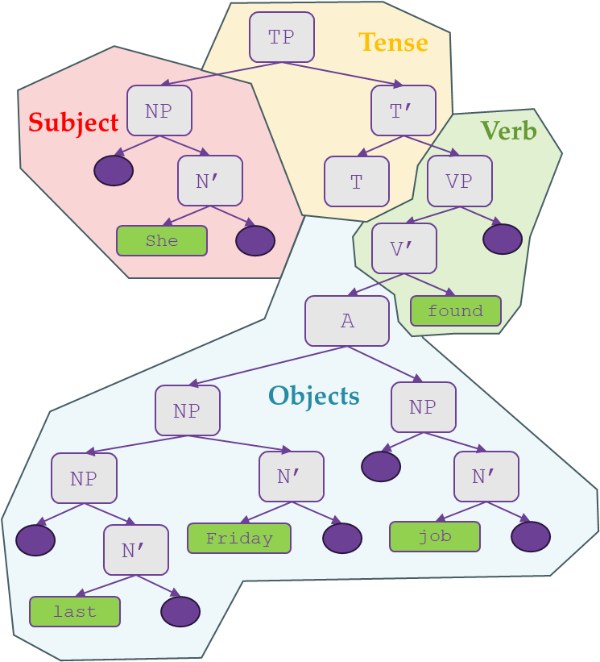
Node Manipulations
Using the tree, we strive to match a Japanese representation of phrases
The first task is the stripping of unwanted lexical items from the tree
The second task is to reorder nodes based on POS context
Using a visitor that visits every node

Slide 13
Node Manipulations
Current Task:
Strip Lexical Items
TP
NP
T’
N’
T
VP
She
V’
found
Adj
AP
NP
In this tree, articles like “a” and “the” do not have equivalents in Japanese
NP
N’
A’
a
NP
N’
Friday
So we need to connect its child to the AP’s parent which is the adjunct node
N’
last
job

Slide 14
Node Manipulations
Current Task:
Strip Lexical Items
TP
NP
T’
N’
T
VP
She
V’
found
A
NP
Removal of the Article Phrase (AP)
AP
Severed Connections
NP
N’
A’
NP
N’
Friday
a
N’
last
job

Slide 15
Node Manipulations
Current Task:
Strip Lexical Items
TP
NP
T’
N’
T
VP
She
V’
found
A
Rejoining of the Article Phrase’s complement to the Article Phrase’s former parent
NP
NP
N’
NP
N’
job
N’
Friday
last

Slide 16
Node Manipulations
The next step is reordering particular node’s children
TP
English uses SVO, whereas Japanese uses SOV word order
NP
T’
By visiting each node we can make context-dependent decisions to reorder node’s children
N’
T
VP
She
V’
found
A
NP
NP
N’
NP
N’
job
N’
Friday
last

Slide 17
Node Manipulations
Current Task:
Reorder Nodes
TP
NP
T’
TP needs to be reorder so tense information comes last
N’
T
VP
She
V’
found
A
NP
NP
N’
NP
N’
job
N’
Friday
last

Slide 18
Node Manipulations
Current Task:
Reorder Nodes
TP
NP
T’
N’
VP
T
VP needs to be reordered so that the verb comes last
She
V’
found
A
NP
NP
N’
NP
N’
job
N’
Friday
last

Slide 19
Node Manipulations
Current Task:
Reorder Nodes
TP
NP
T’
N’
VP
T
She
V’
For the same reason V’ gets reordered
found
A
NP
NP
N’
NP
N’
job
N’
Friday
last

Slide 20
Node Manipulations
Current Task:
Reorder Nodes
TP
NP
T’
N’
VP
T
She
V’
A
found
Adjunct gets reordered so that the object “job” is next to the verb “found”
NP
NP
N’
NP
N’
job
N’
Friday
last

Slide 21
The Resulting Tree
TP
NP
T’
N’
VP
T
She
V’
A
found
NP
NP
NP
N’
N’
N’
Friday
job
last

Slide 22
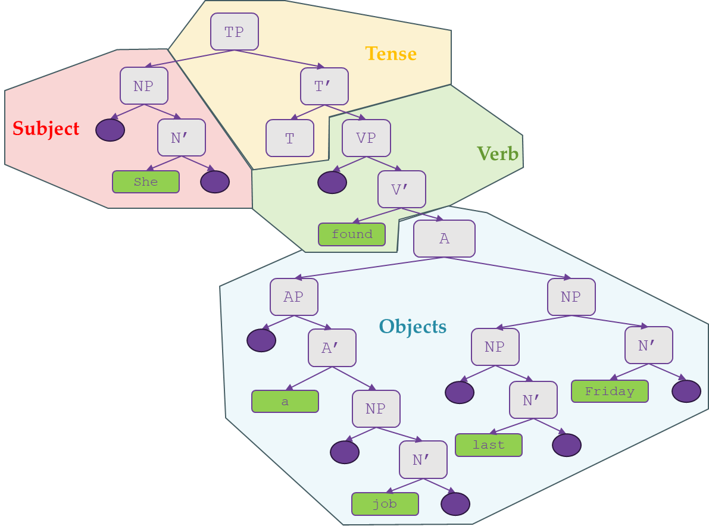
Node Manipulations
We now have an English sentence in a Japanese phrase structure
TP
Tense
Original Tree in English
Subject
NP
T’
N’
VP
T
She
V’
Verb
A
found
NP
Objects
NP
NP
N’
N’
N’
Friday
job
last

Slide 23
Terminal Manipulation
To complete Translation we have to:
Transfer English text to Japanese, verify or construct Japanese Conjugations, and verify or construct Japanese Particles
TP
All of which can be completed by visiting the terminals of the tree.
NP
T’
N’
VP
T
She
V’
A
found
NP
NP
NP
N’
N’
N’
Friday
job
last

Slide 24
Terminal Manipulation
To complete Translation we have to:
Transfer English text to Japanese, verify or construct Japanese Conjugations, and verify or construct Japanese Particles
Uses a Parallel Corpus in conjunction with POS context
TP
NP
T’
X-bar: the head of the TP’s left child is the subject
N’
VP
T
In Japanese 「は」 is used to denote the subject of a sentence
彼女
V’
She
彼女は
A
found
見つけた
NP
NP
The head of any constituent phrase in Japanese requires a particle
NP
N’
N’
X-bar: the head of a verb’s specifier is the direct object
Recognizes the next phrase in sequence is another noun phrase
job
金曜日
仕事
In Japanese 「に」 is used、among others, are used to reference a specific location or point in time
N’
Friday
In Japanese 「を」 is used to denote the object of a sentence
So, we add a 「の」 to denote this relationship
金曜日に
仕事を
last
最後
最後の

Slide 25
Terminal Manipulation
We now have a Japanese sentence in a Japanese phrase structure
TP
Tense
Subject
NP
T’
N’
VP
T
彼女は
V’
Verb
A
見つけた
NP
Objects
NP
NP
N’
N’
N’
金曜日に
仕事を
最後の

Slide 26
Important Tools: Linguistic Corpora
Linguistic Corpora:
Knowledgebase of linguistic information usually acquired by parsing and grabbing information from literary texts, media, or speech data. The most important tool in Statistical Machine Translation
Benefit of Linguistic Corpora:
Primary Corpus Data
English Word | POS
finish | Verb
slow | Adjective
early | Adverb
morning | Noun
Parts of Speech (POS) Tagging: The key inhibitor that allows context-dependent decisions based on grammatical context to be made in this my translator.
Secondary Corpus Data
Modified Form | Concrete Form | POS
finished | finish | Verb
slowest | slow | Adjective
earlier | early | Adverb
mornings | morning | Noun
Word Form Information: Modified forms of words are mapped to their concrete forms which allows for different usages of a word to be represented
Parallel Corpus Data
English Word | Japanese Word | POS
finished | 終えた | Verb
slow | 遅い | Adjective
earlier | 先に | Adverb
morning | 朝 | Noun
Parallel Corpus Information: English and Japanese words and word forms are listed so that word-level translation involves a fast lookup through data query

Slide 27
Important Tools: Visitor Pattern
Visitor Pattern:
A design pattern that separates object structure (XP, X’, X) from the algorithm. Used in the context of problems requiring unrepeated functions pertaining to a group of similar kind of objects.
tree.accept(newEnglishPrintVisitor( ));
TP
I
am
livid
How to use Visitor Pattern:
Visitor: An object which recognized and performs operations on objects in the tree.
NP
T’
Visitable: A interface which, when implemented for an object, can be recognized by a visitor.
N’
T
VP
Visit: A function in which defines the operations to be performed when a visitor receives a node.
I
V’
Benefit of Visitor Pattern:
am
AP
Clean Code: Treats required objects as function calls rather than producing loop functions
A’
Open-Closed Principle: Adding a new item to the system is simple—requires only a change in the visitor object
Simple Tree Walks: Easy to produce a preorder tree transversal—only with two lines of code for each node
livid

Slide 28
Sample Translations
Excerpt from Test Data
English | 日本語
I went to the store. | 私は店に行った。
They were playing soccer yesterday. | 彼らは昨日サッカーを遊んでいた。
They are enjoying their vacation in Hawaii. | 彼らはハワイで休暇を楽しんでいます。
I will visit my parents next weekend. | 私は次の週末私の両を親訪ねる。
Problems
Particle Population
Language-Specific Use of Meanings
Some particles in Japanese are hard to discern based off POS context alone
Some English words like “take” cover a wide variety of topics but is represented as one word. In Japanese, some of these uses of take are different words.
We have no system for discerning 「が」 and「を」
We have no system for discerning discrepancies between English and Japanese speech.

Slide 29
Future Work
Integrating Machine Learning (ML) Models
Word Embeddings: Word embeddings are multidimension vectors containing word data. We can see if words—especially verbs—are similar if they have a similar vector representation.
Idiom Recognition: Idiomatic language follows dissimilar language conventions—making it hard to translate. The translator must recognize and mange idiomatic language. ML can train on Japanese and English idioms to recognize them, and compare for equivalent idiomatic phrases
Expanding the Corpus Data
Primary and Secondary Corpus: Data is derived from Corpus of Contemporary American English (COCA) and the free student service allotted only 5050 lemmas—English contains millions of lemmas
Japanese and English Parallel Corpus: Unfortunately, data concerning the direct mapping of English and Japanese lemma was seemingly non-existent after exhaustive searches. Therefore, dataset was handmade.

Slide 30
Thank You
質問が
ありますか？
ご清聴ありがとうございました。
Any Questions?

