Slide 1


Rakhi Sharma, River Bellamy,
John SJ, Karina Q, Sneh Khatri

Slide 2
Statement 2
​Each jurisdiction in California has a different building code that developers have to follow to construct new housing creating a fragmented and confusing space for new housing to be built. Is it possible to create a system that can clearly organize and display differences in building codes? It would be an immense help to affordable housing construction and policy change!
Systematic Analysis of
Building Code Variations for
More Affordable Housing
Development

Slide 3

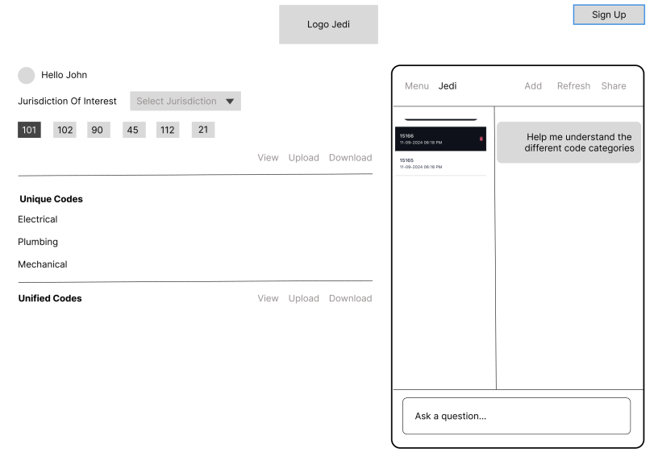
Architecture
An AI-powered, multi-modal, multi-argentic, RAG based platform for house developers
Fetch.ai - AgentVerse
uAgent
uAgent
Alice
Bob
ChatBot
LLM
LLama 3.2
Vector DB
Chroma DB
Text
Document
Images

Slide 4
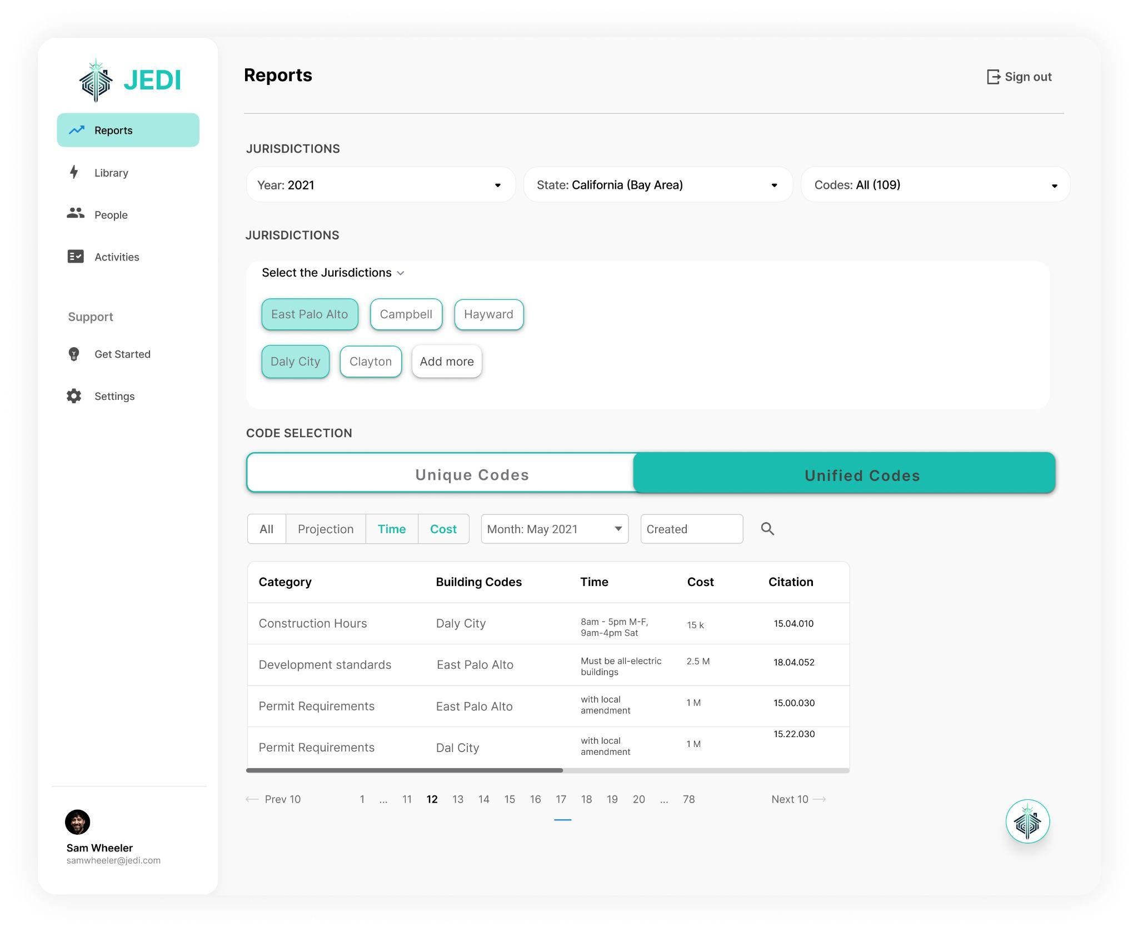

Slide 5
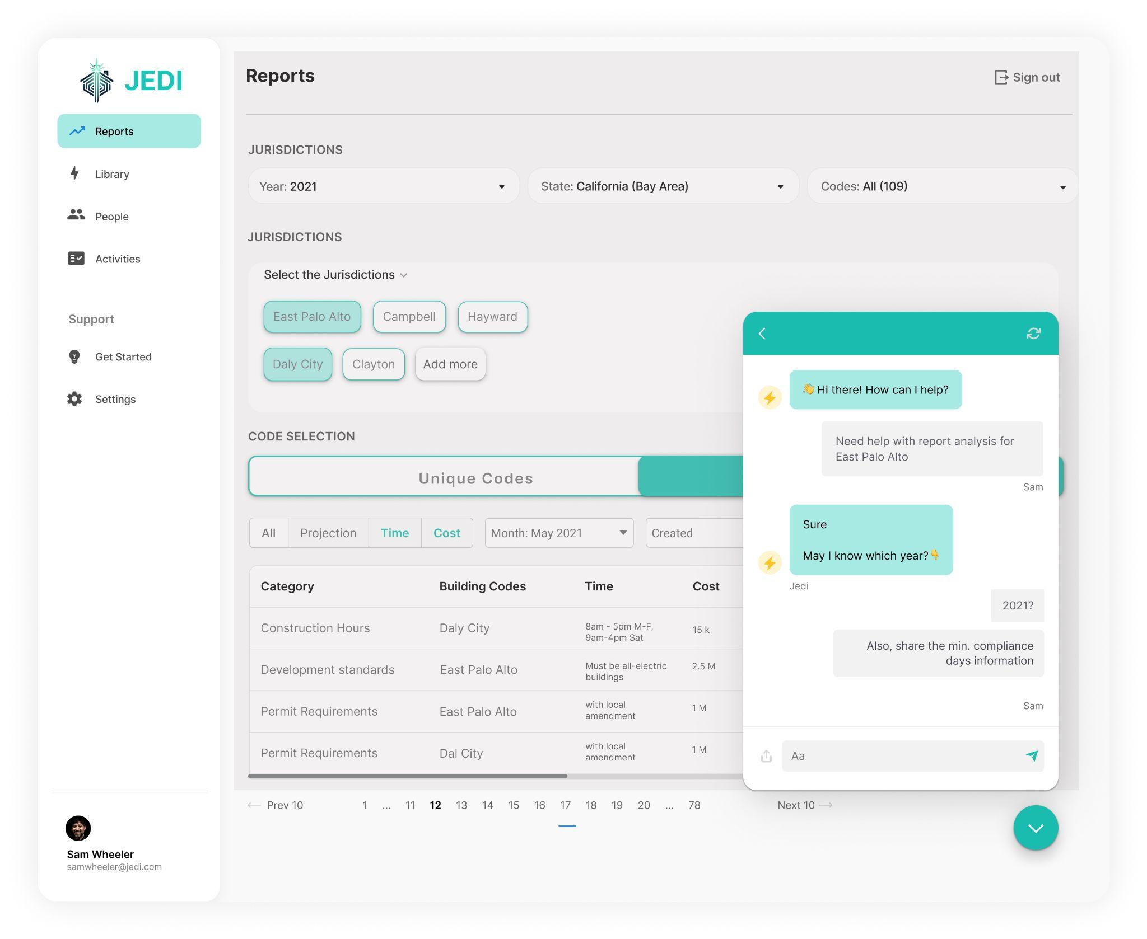

Slide 7
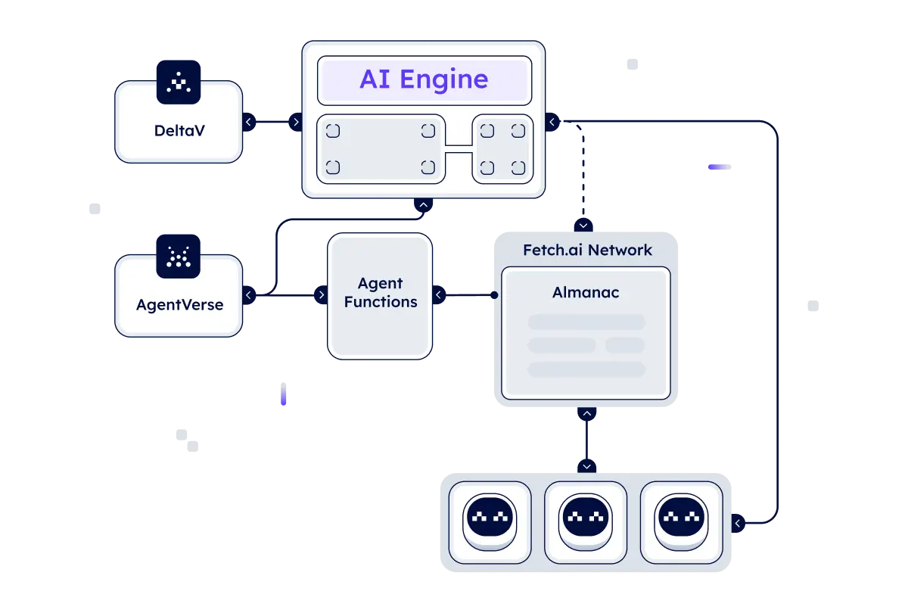
Fetch.ai
Courtsey: https://fetch.ai/docs/concepts/introducing-fetchai

Slide 8
Architecture
Frontend
React App (UI/UX), ResAPI
(Fetch.ai uAgents - Alice, Powered by LLama 3.2)
Backend -
Fetch.ai uAgents Bob, Powered by RAG, Embedded by the LLama 3.2)
Vector DB - ChromaDB
Running
Locally
LLM interfaced by Langchain
An AI-powered, multi-modal and multi-argentic platform for house developers, integrating data from multiple sources to clarify complex building codes across jurisdictions and streamline development processes.

