Slide 1
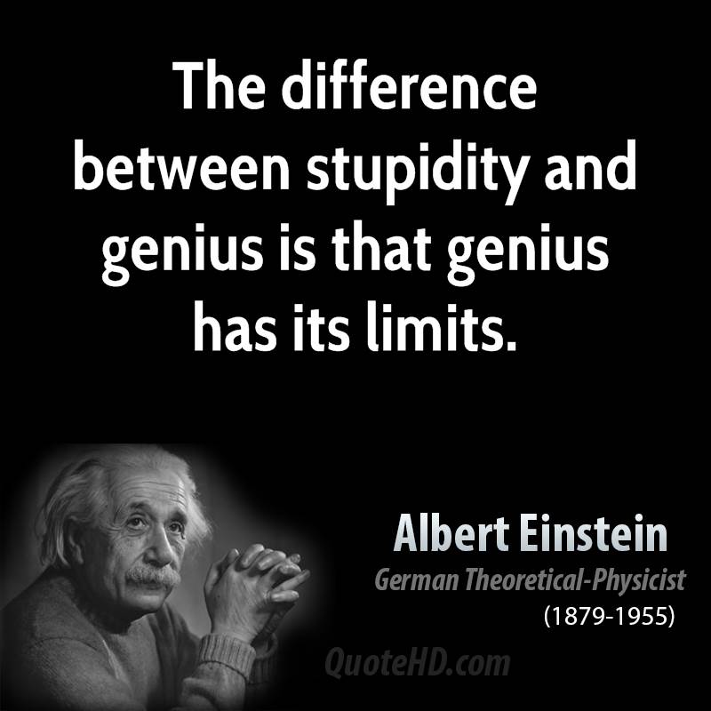
How Stupid Do You Have To Be?
A Lesson in stupidity, Anonymous, why LOIC is never a good idea and the lifesaving doom that is Disney Cruises (also very basic computer forensics, hospital security, hacktivism, etc)

Slide 2

Boston Children’s Hospital
* Hospital devoted to helping children
* Helped save baby John
* Amazingly benevolent place

Slide 3

“Patient A” (briefly)
* Teenage girl taken into protective custody
* Questionable evidence and “not right” in some people’s opinions
* Seen on Twitter

Slide 4
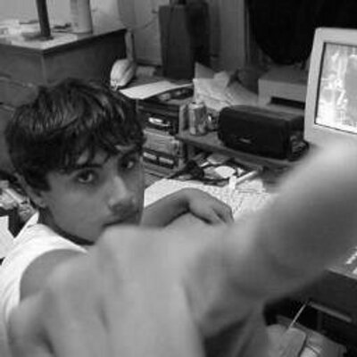
Martin Gottesfeld
* Biotech systems engineer by day
* Anon
* Idiot (on many hilarious levels)
* Used internet to gather support and a few followers

Slide 5

The Attack
* Located the hospital’s server
* Congregated information to ping server on his own website
  * Spread word through YouTube video
* Infected 40,000 routers (including several in BCH) to viciously ping the server
  * had routers report directly to his house

Slide 6

The Defense
* Website dramatically slowed
* Boston-hospitals’ network greatly affected
* Restricted access to email server, databases, etc
* Contacted FBI and examined network logs...

Slide 7
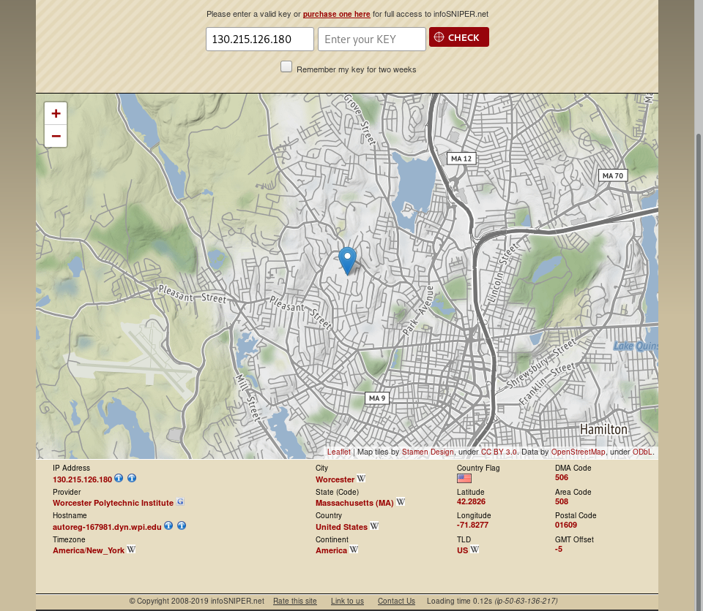
I Wonder Who’s Attacking US
* Found Gottesfeld’s IP address everywhere in the network logs
* Taced the IP to Somerville
  * Did not need warrant bc stupid
* “Not feeling well”

Slide 8
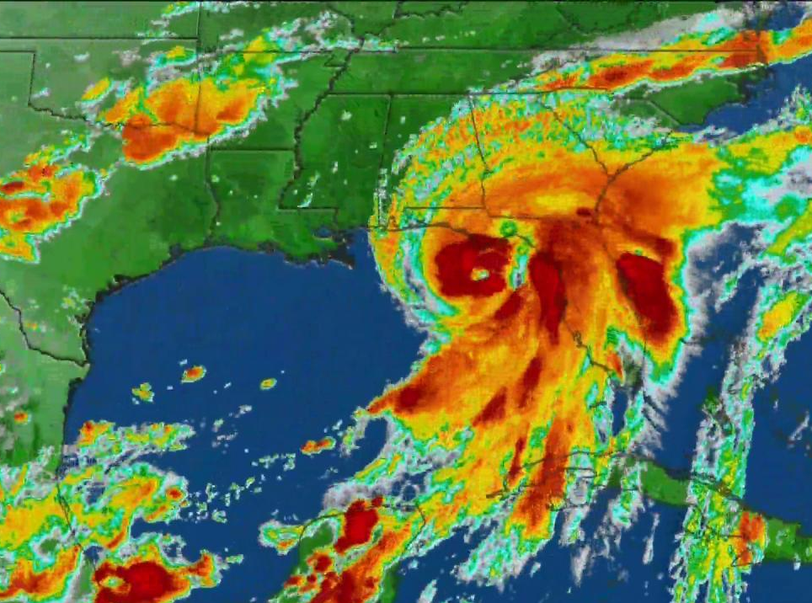
Escape to Cuba
* Had one week head-start
* Bought power boat in
* No idea how to navigate
  * Beginning of hurricane season
* Story needs hero...

Slide 9

Disney Cruises To the Rescue
* Recieved distess call
* Did not go to Cuba
* Arrested in Miami

Slide 10
Sentancing
* Represented self
* “My only regret is that I didn’t do more”
* Boston Children’s Hospital unnable to prove that his actions affected any child’s health
  * But to be clear the hospital’s ability to care for patients was dramatically affected and could easily have been MUCH worse
* 10 years - damaging protected computers
  * paid at least $340,000 to BCH

Slide 11
Questions? Comments (I have a few)
* Attack was in 2015, but sentencing happened 3 weeks ago
* Hacktivism is not the answer
* Many members of Anonymous Tweeted that they do not support attacking hospitals
* Hospital security in general
  * Frequently attacked
  * Consequences can be devastating
  * Good $ and good work in hospital security

