Slide 1
How to HAX this CTF

Slide 2
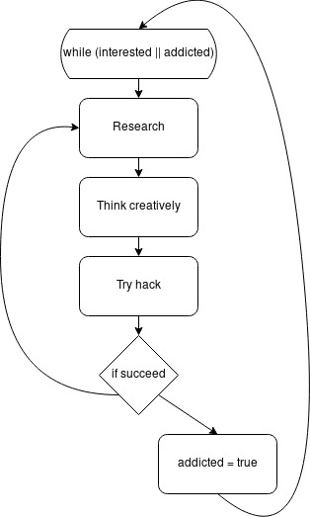
Hacking Mindset
(yes I’m keeping these titles)
Think creatively
Find a way in
  Unlike a normal CTF there is not just one way
Do research

Slide 3
Linux/terminal
Powerful tool for scripting and exploits
<command> <file>
Directory tree/path traversal
linux.wpi.edu example:
How can I practice/work on this?
  Get a VM – VirtualBox + OSboxes.org
  Read the man pages/search engine/CSC Slack if lost

Slide 4
Reverse Engineering
Take CS-2011
Code we write → executable
SEE JUSTIN

Slide 5
Reversing

Slide 6
Whirlwind tour
If the source code for a software is unavailable, we generally reverse engineer the binary
Common that you’ll have the executable but not the source
If it’s on your computer you’re golden

Slide 7
Whirlwind tour
(Free) Tools
GDB, Radare2
There are also paid tools…. Not worth.

Slide 8
Quick and painless demo
Using R2

Slide 9

Code/Web Injections
Stuffing code into input fields
  Frequently seen in SQL injections
Useful in many different exploits
Lazy Python code example:

Slide 10
Encryption
(see Nicole’s computer/USB – the slides are here but LibreOffice cannot handle them)

Slide 11
Port Scanning
Do NOT do while on WPI’s network
Port is network communication endpoint
  65535
Many applications/ports tied
Nmap

Slide 12
CTF Practice/resources
Read about some fun pen-testing stories
  Rapid7
PicoCTF – beginner, available year-round
RootMe – fun CTF challenges
Bomblab – available on Github and CS-2011
Bandit Overthewire

