Slide 1

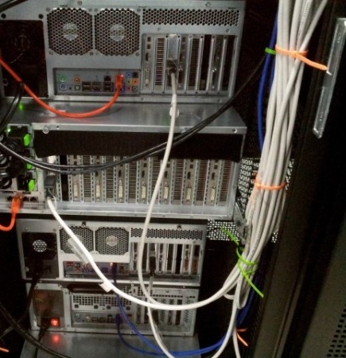
Gotta Crack ‘em All
The tale of my summer hack-scripting adventures, cracking my way through the Commonwealth’s passwords

Slide 2
IMPORTANT DISCLAIMER
I WILL NOT BE EXPLAINING TO ANY OF YOU THE VULNERABILITIES OF THE MASSACHUSETTS GOVERNMENT
NOR WILL I BE REVEALING ANY INFORMATION THAT COULD BE USED TO GAIN UNAUTHORIZED ACCESS TO OUR NETWORKS
THIS TALK IS FOR EDUCATIONAL PURPOSES ONLY, SO THAT YOU ALL WILL HAVE A BETTER UNDERSTANDING OF HOW TO HELP KEEP YOUR ORGANIZATIONS SAFE

Slide 3
Passwords are stored in hashes
Networked logins – active directory
Not sent in clear text
  nor traditional key-based crypto
Passed through 1-way hashing algorithm
https://www.tobtu.com/lmntlm.php
message doctor

Slide 4
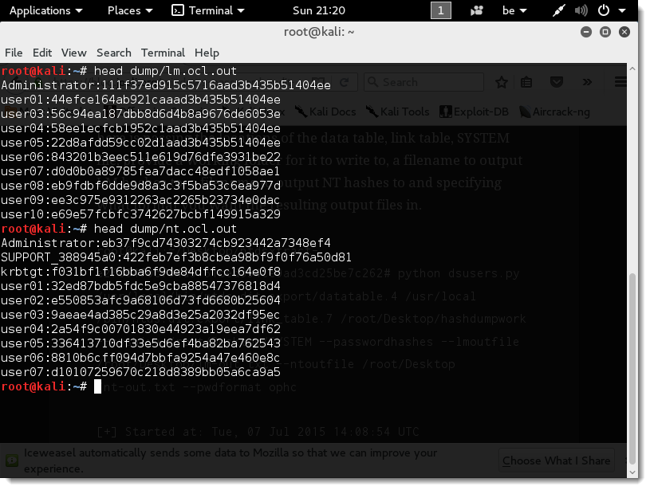

Slide 5
Haystack entropy (the no bs BASICS)
Password creation is predictable
Base-word-rarity * modifications

Slide 6
Haystack entropy (the no bs BASICS)
Password creation is predictable
- Thank you breaches
base-word-rarity * modifications
“Winter1!” = 1000 * 2 * 10 * 12 = 200000
  < 10 seconds (remotely on the network)

Slide 7
Haystack entropy (the no bs BASICS)
Password creation is predictable
- Thank you breaches
base-word-rarity * modifications
“Winter1!” = 1000 * 2 * 10 * 12 = 200000
  < 10 seconds (remotely on the network)
“.muLb3rry” = 20000 * 8 * (20 * 2) * 5 = 3.2*10^7

Slide 8
Wordlists
Use base-words
Common password words
Organization-related words
Local-area words (sports teams, places, etc)

Slide 9
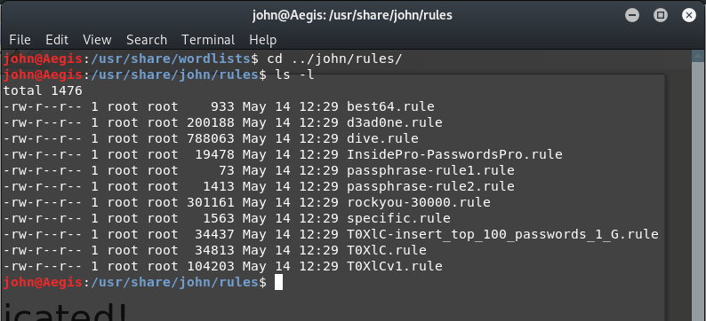
Rule-sets
They’re complicated!
Mimic the user:
  Numbers
  Capitalizations
  “leet-speak”
  /usr/share/john/rules

Slide 10
Demonstration
(wish me luck)
~/Projects/password-cracking

Slide 11
Demonstration
(wish me luck)
~/Projects/password-cracking
General internship advice/challenges

Slide 12
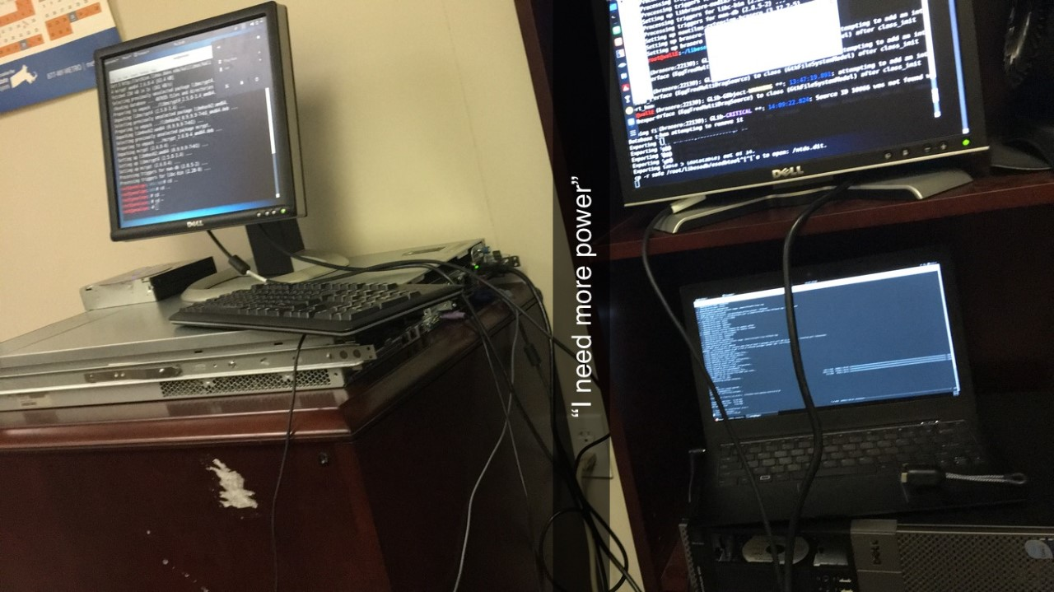
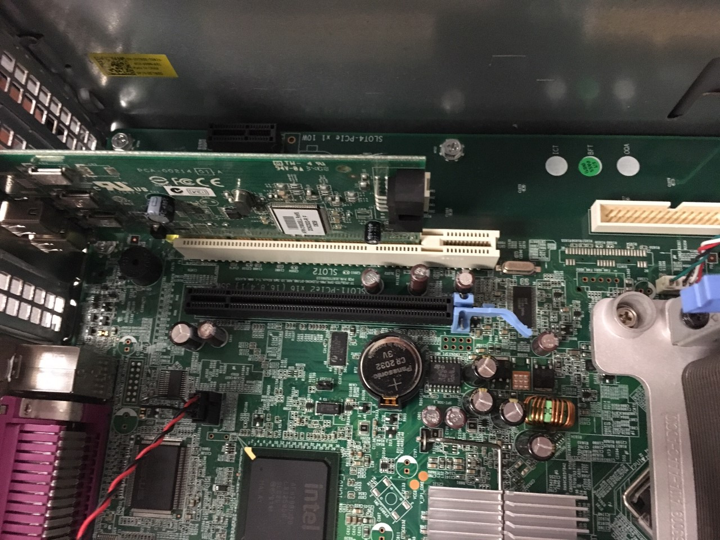
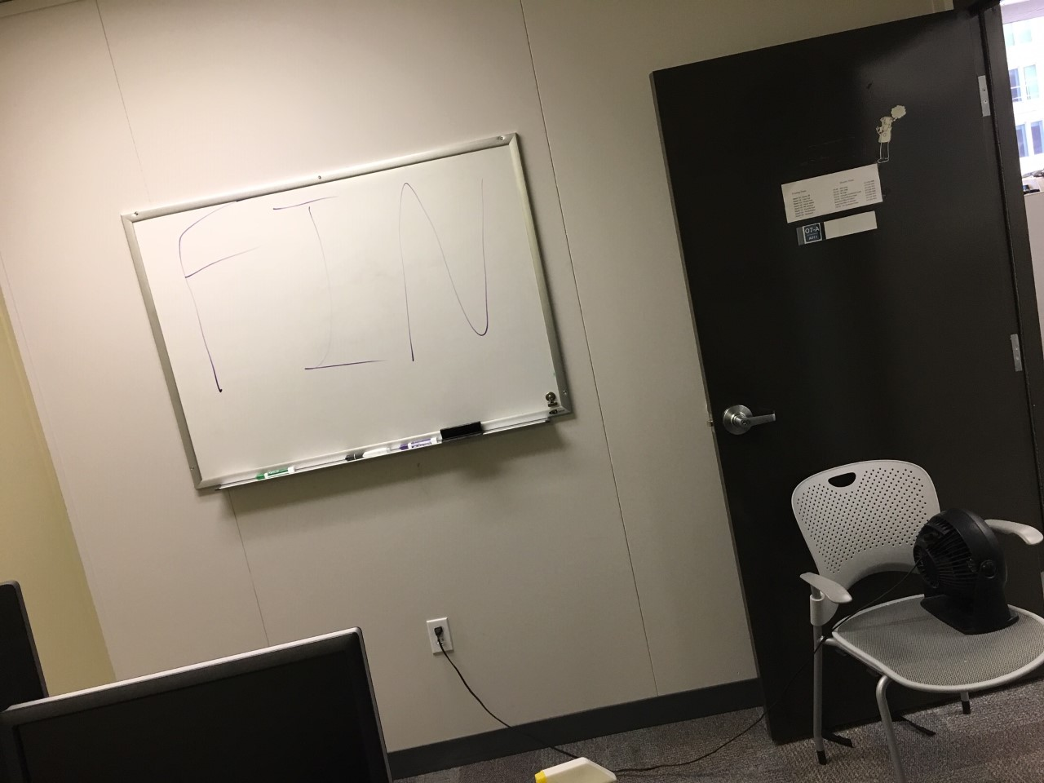
Other challenges
Powerfulish server
More computers
beowulf cluster
My boss saw my masterpiece...

Slide 13
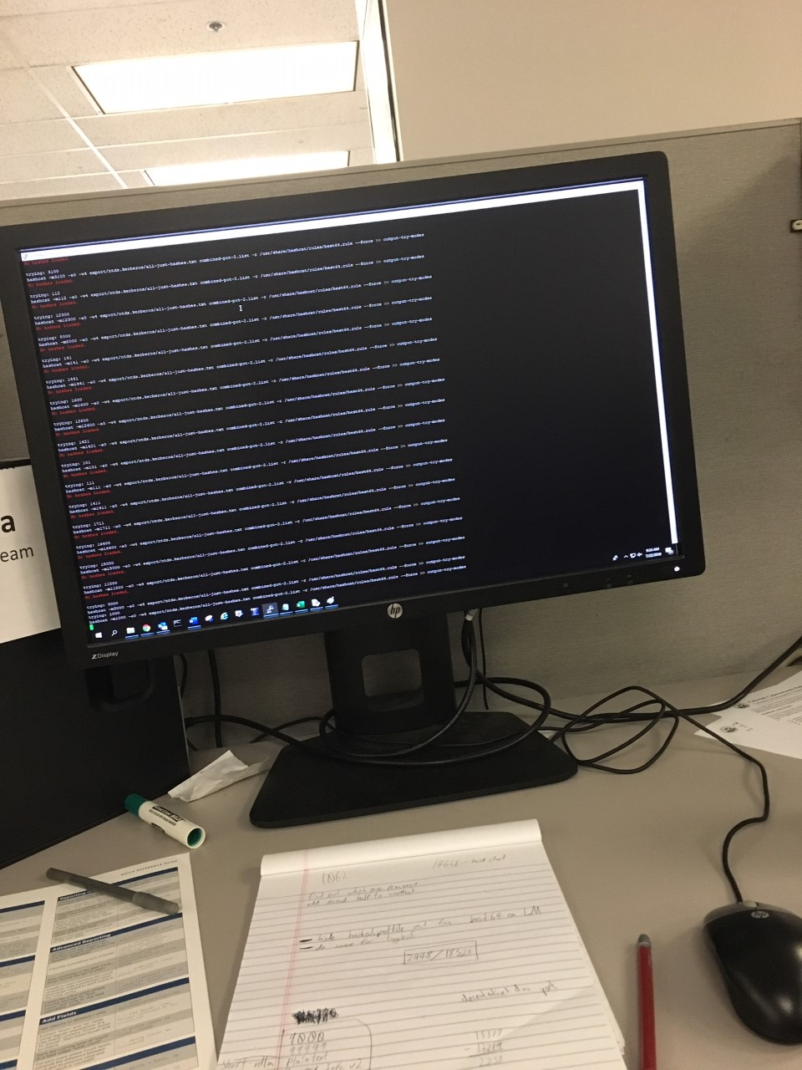
Cracking with AWS
Successful → $ support
GPUs are terrifying
Research + fun presentation

Slide 14
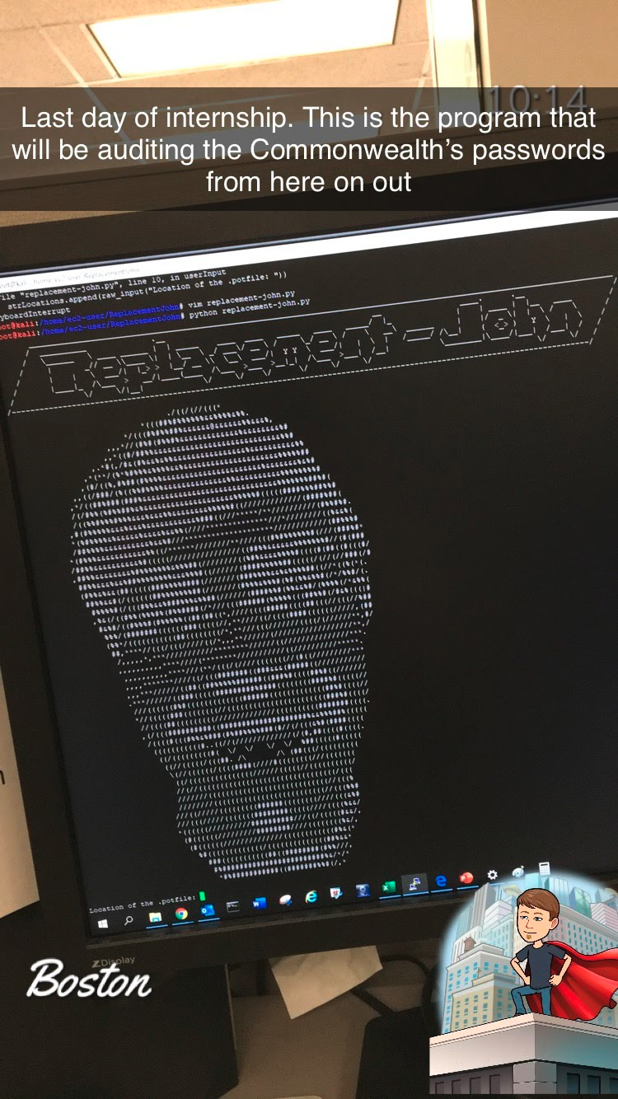
I just had to share this...

Slide 15
Conclusion:
Internships are a GREAT way to learn
  Work hard
  Figure it out
Questions?

Slide 16

Conclusion:
Internships are a GREAT way to learn
  Work hard
  Figure it out
Questions?

Slide 17
Further reading/videos
https://blog.codinghorror.com/password-rules-are-bullshit/
https://www.xkcd.com/936/
https://www.grc.com/haystack.htm
https://youtu.be/7U-RbOKanYs
https://wiki.securityweekly.com/SDL_Episode16

