Slide 1
Writeup for WPICTF 2019 coffeegate by zst123 (Manzel Seet)
coffeegate
200
Hardware
Danny the intern spilled coffee on my circuit! Can you help me recover my work?
Flag is in the format flag{...}. Submit it in the format WPI{...}.
made by John Faria
2:128

Slide 2
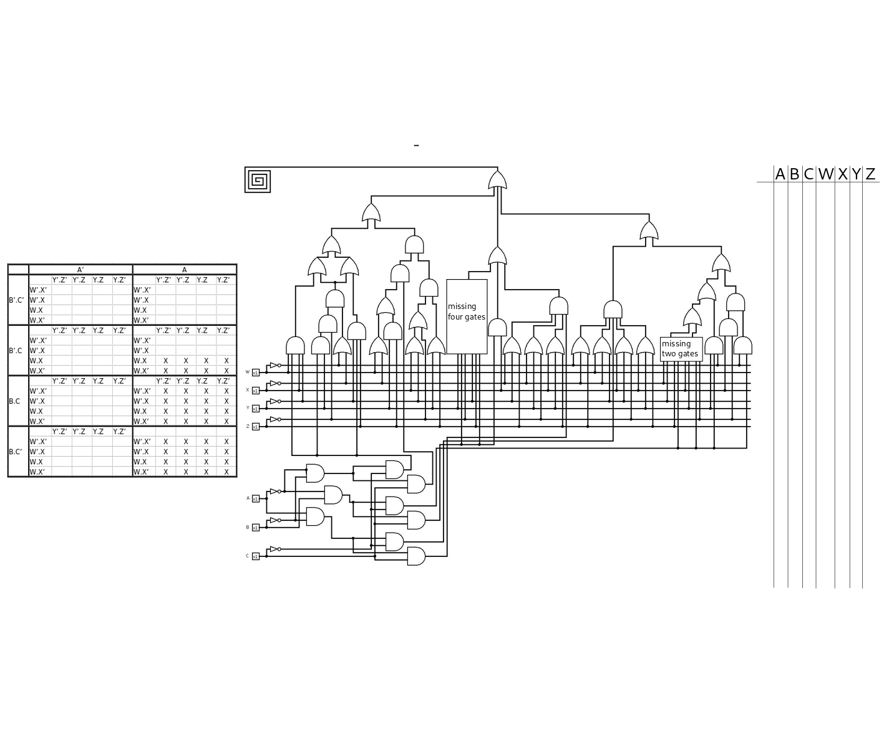

Slide 3
A’*B’
A’*B’*C’
A’*B
A’*B’*C
A’*B*C’
A*B’
A’*B*C
A*B’*C’
A*B’*C
We see the circuit is split up into ABC and WXYZ.
Let’s get the Boolean algebra of the ABC part first

Slide 4
P0
P0
P0
P1
P3
P3
P3
P5
P4
P2
P2
P2
P2
P0 = A’*B’*C’= 000
P1 = A’*B’*C = 001
P2 = A’*B*C’ = 010
P3 = A’*B*C = 011
P4 = A*B’*C’ = 100
P5 = A*B’*C = 101
Clean up the circuit.
I’ll be calling ABC as P# from now on

Slide 5
P0
P0
P0
P1
P3
P3
P3
P5
P4
P2
P2
P2
P2
I assume the circuit outputs bits of the flag.
Notice from the K-map that P5*W, P6, P7 are not used.
This leaves us with 88 bits or 11 chars of the flag.
Don’t cares
P6 = A*B*C’ = 110
P7 = A*B*C = 111
P5*W = W*A*B*C’ = W*110
P0 = A’*B’*C’= 000
P1 = A’*B’*C = 001
P2 = A’*B*C’ = 010
P3 = A’*B*C = 011
P4 = A*B’*C’ = 100
P5 = A*B’*C = 101

Slide 6
P1(W+X’+YZ) (X+Y’+Z’)(Y+Z)
P1(W+X’+YZ)
P4(W’+X’+Z)(W+X’+Y’) (X+Y’+Z’)(X+Y+Z)
P0*W’YZ’+ P0*X’YZ’
(X+Y’+Z’)(Y+Z)
P5(X’+Y’+Z)(X’+Y+Z’)(X+Y+Z)
(W+X’+YZ)
P2*W’XZ’
P0*YZ’
P0*Y’Z
X+Y’+Z’
P3, Y, Z’
XZ’
YZ
P3*X
X’+Y’+Z
X’+Y+Z’
X+Y
+Z
W’+X’+Z
W+ X’+Y’
X+Y’+Z’
X+Y+Z
P0*WXY’
(W’+X’)
(W+X’)
Y+Z
P3, Y’, Z
X’, Y’
Z, P2
X, Y
Z’, P2
P2*W’Y
P2*W’
P0
P0
P0
P1
P3
P3
P3
P5
P4
P2
P2
P2
P2
Don’t cares
P6 = A*B*C’ = 110
P7 = A*B*C = 111
P5*W = W*A*B*C’ = W*110
P0 = A’*B’*C’= 000
P1 = A’*B’*C = 001
P2 = A’*B*C’ = 010
P3 = A’*B*C = 011
P4 = A*B’*C’ = 100
P5 = A*B’*C = 101
Reverse the rest of the circuit.
The boxes in blue all feed into cascaded OR-gates.
Hence the final equation is the blue-equation OR-ed together.
Notes:
<number>

Slide 7
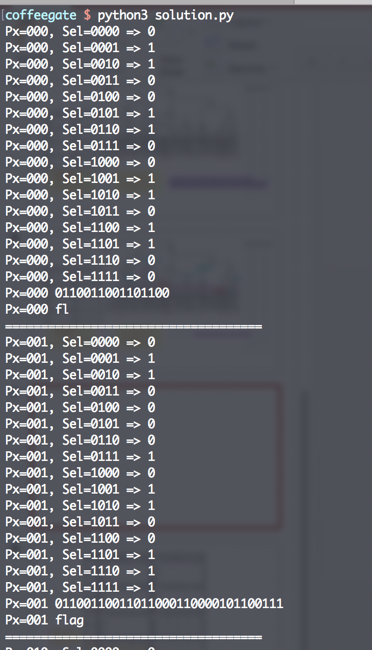
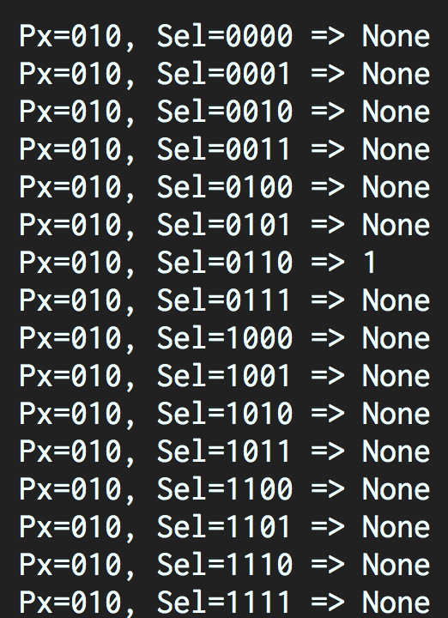
In a Python script, I printed out the truth tables based on the equations I had.
P0 and P1 corresponds to the flag format: flag{
But for P2, the circuit is incomplete.
We know the flag format flag{, hence we can deduce some bits
{ in binary is 01111011
Notes:
<number>

Slide 8
We know the flag format flag{, hence we can deduce some bits
Deduce the following:
Px=010, Sel=0000 => None # 0
Px=010, Sel=0001 => None # 1
Px=010, Sel=0010 => 1 # 1
Px=010, Sel=0011 => 1 # 1
Px=010, Sel=0100 => 1 # 1
Px=010, Sel=0101 => None # 0
Px=010, Sel=0110 => 1 # 1
Px=010, Sel=0111 => 1 # 1
As such,
We can fill in the bits 0111_1011
ABC = 010
W’Y
Given these
P2*W’XZ’
P2*W’Y
0
1
1
1
1
0
1
1
W’XZ’
From the flag format, we extracted 1 extra bit = W’X’Y’Z
Notes:
<number>

Slide 9
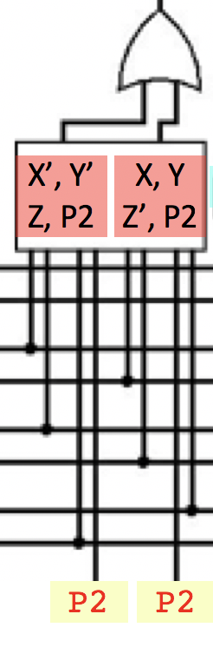
From context of the redacted circuit, I chose the 2nd option.
Left gate corresponds directly to one AND gate: X’Y’Z
Next, I assume right gate is also similar...
AND gate: XYZ’
0
1
1
1
1
0
1
1
From the flag format, we extracted 1 extra bit = W’X’Y’Z
From this extra bit, it can’t possibly be a single bit alone.
I assume 2 possible circles (dotted):
X’Z
X’Y’Z (I chose this)
Final result for P2
Before = (Wb * X * Zb) + (Wb * Y)
After = (Wb * X * Zb) + (Wb * Y) + (Xb*Yb*Z) + (X*Y*Zb)
Notes:
<number>

Slide 10
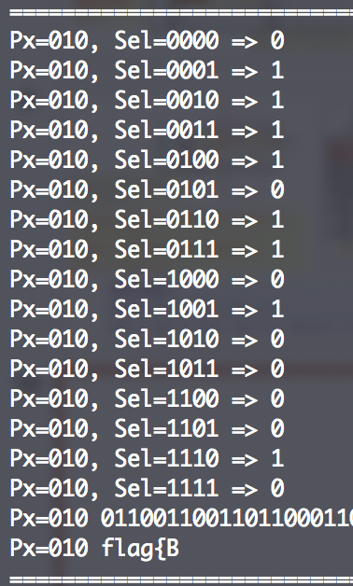
Updated my Python script, it gave the flag so far as flag{B
Final result for P2
Before = (Wb * X * Zb) + (Wb * Y)
After = (Wb * X * Zb) + (Wb * Y) + (Xb*Yb*Z) + (X*Y*Zb)

Slide 11
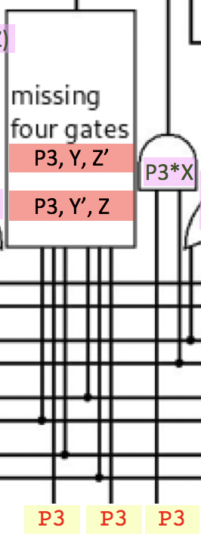
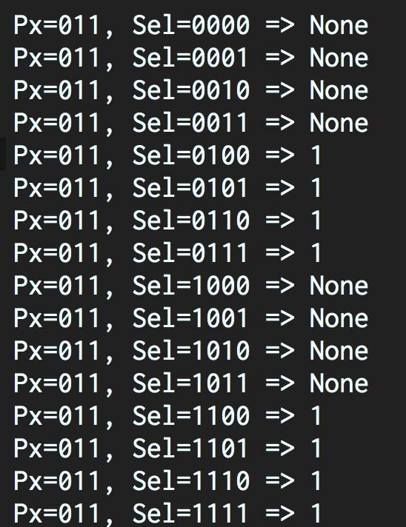
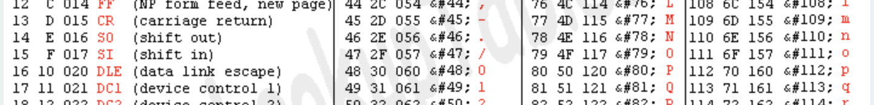
We know P3*X is given. This is the output from the script.
From the ASCII table, the possible values are /, O, o.
The actual type of gates can be varied, but I tried and using XORs seem to produce ‘o’.
Final result for P3
out = X or ((Y*Zb) ^ (Yb*Z))

Slide 12
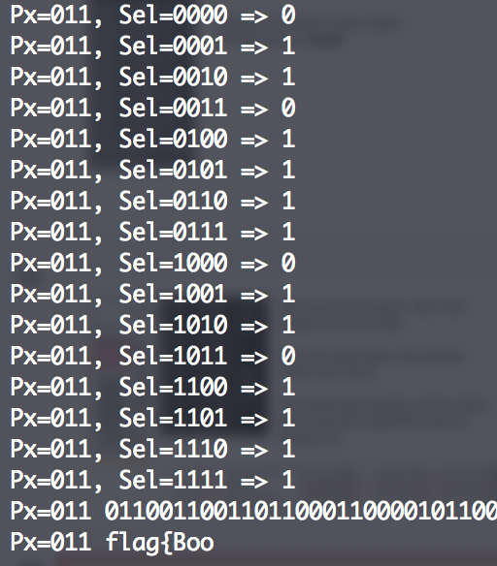
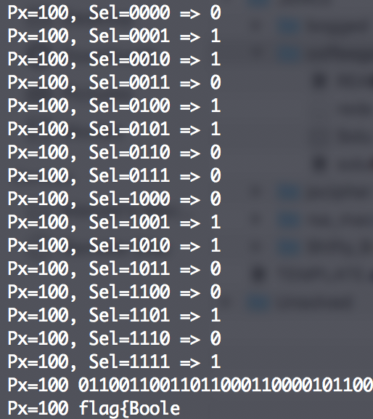
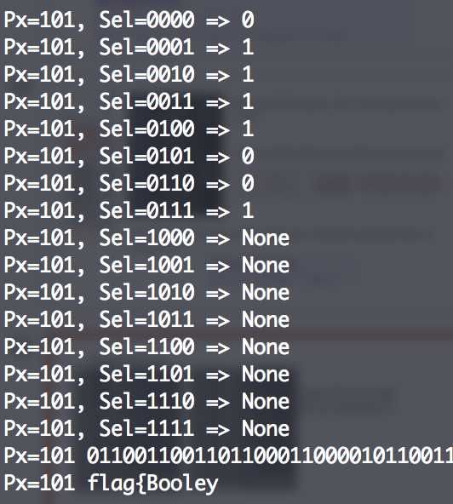
Output from P3
Output from P4
Output from P5
Note:
The final char seems to be a ‘y’ instead of ‘}’, it seems like it is a mistake of 1 bit in the circuit.
But this mistake doesn’t affect our flag.
The final part is simply fill in the code for P4 and P5 which are fully given in the circuit.
Flag is WPI{Boole}
Notes:
<number>

