Slide 1
An Opensource Modeling and Simulation Toolchain in R
It’s not the only one, just the one I use… This is an evolving process.
Copy of slides: osmdd.ubiquity.tools
Repository with examples: osmdd
Repository with examples: zip file

Slide 2















Reproducible Shiny interface to PMx Tools
Development and deployment of ODE models
Nonlinear mixed-effects modeling and simulation
ruminate.ubiquity.tools
r.ubiquity.tools, nlmixr2.github.io/rxode2
nlmixr2.org
onbrand.ubiquity.tools
Templated reporting in Word and PowerPoint

Slide 3
ruminate: Data Exploration and Analysis
Set of Shiny modules to allow users with limited experience use R
Data wrangling: Transform your data (tidyr and dplyr)
Figure generation: Plot your data (ggplot2)
NCA: Run noncompartmental analysis (PKNCA)
Model building: Construct ode-based models (rxode, in dev)
Trial simulation: Adaptive trial simulator (rxode2, in dev)
Each module element will generate the code to reproduce the element (see in real time the relationship between code and output)
Reporting: PowerPoint, Word and Excel
Save your analysis:
Generate a script to reproduce what was done in the app
Return and load the analysis later
Generate workflows to apply an analysis to new datasets

Slide 4
Coming up
Data management module: Support for multiple files
Merging in data wrangling module: Combine data views with files and previously defined data views
Manual point selection in NCA
Censoring, exclusion from half-life calculation, specifying half-life calculation points
Points flagged in observation tables
Flagging summarized in a specified table

Slide 5
Getting ruminate: CRAN and GitHub
Install with dependencies=TRUE
ruminate.ubiquity.tools | Package site with documentation
runruminate.ubiquity.tools | Public deployed instance for testing
useruminate.ubiquity.tools | Video tutorial showing a typical workflow

Slide 6
ODE Modeling
Working in a heterogenous computational environment

Slide 7
ODE-Based Model Development with ubiquity
Focus on interoperability and flexibility
Define your system in a simple text-based interface
Generate inputs for multiple languages: R, MATLAB, Adapt, Berkely-Madonna, mrgsolve, rxode2, NONMEM* and Monolix*
Full workflows for naïve-pooled estimation and simulation
R and MATLAB
Create templates for analysis
In R workflow
Automated reporting in Word and PowerPoint via onbrand
Template for customizable Shiny interface
*In R-workflow via babelmixr2 package

Slide 8
Installing ubiquity
R
MATLAB
Windows: Rtools
Mac: Xcode and Xquartz
Linux: Just Linux though some packages will require certain libraries to be installed
Doc: r.ubiquity.tools
Install off of CRAN or GitHub
Toolboxes: Statistics and Machine Learning, Simulink (to use the compiled C version of the model), Optimization
Compilers and mex configured
Doc*: presentation.ubiquity.tools
Template (zip file): template.ubiquity.tools
*Use r.ubiquity.tools for language reference

Slide 9
System Files
# name value lower upper units editable grouping
# bound bound
<P> CL 0.0129 eps inf L/hr yes System
<P> Q 0.79 eps inf L/hr yes System
<P> Vt 2.8 eps inf L yes System
<P> Vp 3.1 eps inf L yes System
<P> thalf_hr 0.5 eps inf hr yes Target
<P> Tp_IC 1.0 eps inf nM yes Target
<P> Tp_MW 30 eps inf KDA yes Drug
<P> kon 0.1 eps inf 1/nM-hr yes Drug
<P> KD 0.1 eps inf nM yes Drug
<P> D_MW 150 eps inf KDA yes Drug
<PSET:default> TMDD: Membrane bound target
<As> ktp = Q/Vt
<As> kpt = Q/Vp
<As> kel = CL/Vp
<As> koff = kon*KD
<As> kint = SIMINT_LOGN[2.0]/thalf_hr
<As> ksyn = Tp_IC*kint*Vp
# Bolus Events
# times/events state values scale units
<B:times>; [ 0 ]; 24*7 ; weeks
<B:events>; Cp ; [ 30 ]; 467/Vp; mpk
# Initial conditions
# define the non-zero initial conditions
<I> Tp = Tp_IC
<ODE:Ct> Cp*kpt*Vp/Vt - Ct*ktp
<ODE:Cp> -Cp*kpt + Ct*ktp*Vt/Vp - kel*Cp + koff*CpTp - kon*Cp*Tp
<ODE:Tp> + ksyn/Vp - kint*Tp + koff*CpTp - kon*Cp*Tp
<ODE:CpTp> - kint*CpTp - koff*CpTp + kon*Cp*Tp
<O> Cp_Total = Cp + CpTp
<O> Coverage = 1- Tp/Tp_IC
# free drug in ng/ml
<O> Cp_free_ng_ml = Cp*D_MW
An overview
The system file is like the portion of the NONMEM control stream that allows you to define different aspects of your system:
System parameters
Different parameterizations
Dosing: scaling and default dosing
ODES
Model outputs
Timescales, IIV, covariates, etc
Online documentation

Slide 10
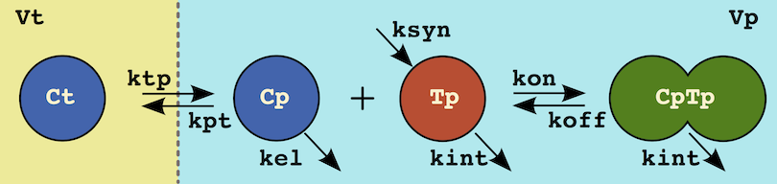
ODES and/or Processes
Describing your model
Differential Equations
<ODE:Ct> Cp*kpt*Vp/Vt - Ct*ktp
<ODE:Cp> -Cp*kpt + Ct*ktp*Vt/Vp - kel*Cp + koff*CpTp - kon*Cp*Tp
<ODE:Tp> + ksyn/Vp - kint*Tp + koff*CpTp - kon*Cp*Tp
<ODE:CpTp> - kint*CpTp - koff*CpTp + kon*Cp*Tp
Processes
# tissue distribution
Ct; Vt; ktp <C> Cp; Vp; kpt
# equilibrium
Cp + Tp <=kon:koff=> CpTp
# Turnover
ksyn/Vp <S:Tp> kint*Tp
<S:Cp> kel*Cp
<S:CpTp> kint*CpTp
Process descriptors can be used with ODEs
Trust but verify: You can view generated
system_new(system_file="tmdd")

Slide 11
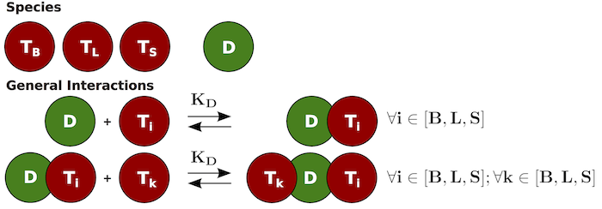
Mathematical Sets
Reduce tedium, minimize mistakes, and more easily find bugs
Consider the following:
Say you different targets competing for your drug.
You have a PBPK model where each organ is structurally the same.
Product and summation notation
Multiple sets
Every permutation is enumerated
You can align or pair sets
<SET:TSi> TL; TB; TS
<SET:TSk> TL; TB; TS
D + {TSi} <=kon:koff=> D_{TSi}
D_{TSi} + {TSk} <=kon:koff=> {TSk}_D_{TSi}
PBPK Template
Mouse PBPK [Shah and Betts 2012]
system_new(system_file="pbpk_template")
system_new(system_file="pbpk")

Slide 12
R Workflow
Templates to get you started
Create a system file or use an existing one:
Build the system
Start with a template
system_new(system_file="mab_pk")
cfg = build_system("system.txt")
system_fetch_template(cfg, template="Simulation")

Slide 13
R vs MATLAB
A simulation workflow
R
MATLAB
rm(list=ls())
library(ubiquity)
cfg = build_system(system_file="system.txt")
cfg = system_select_set(cfg, "default")
parameters = system_fetch_parameters(cfg)
cfg=system_set_option(cfg,
group = "simulation",
option = "output_times",
seq(0,100,1))
cfg = system_zero_inputs(cfg)
cfg = system_set_bolus(cfg, state ="At",
times = c(0),
values = c(400))
som = run_simulation_ubiquity(parameters, cfg)
clear; close all;
build_system
provision_workspace;
cfg = auto_fetch_system_information();
cfg = system_select_set(cfg, 'default');
parameters = system_fetch_parameters(cfg);
cfg = system_set_option(cfg, ...
'simulation’, ...
'output_times', ...
linspace(0, 10, (10-0)/.1)');
cfg=system_zero_inputs(cfg);
cfg=system_set_bolus(cfg, 'At’, ...
[ 0], ...
[400]);
som = run_simulation_ubiquity(parameters, cfg);

Slide 14
Getting Started
Workshops, tutorials and documentation
Workshops embedded in package
Simulation* – individual and population simulations
Estimation * – Naïve-pooled parameter estimation
Titration – Rule-based simulations
In Vitro – Analysis of static and invitro systems
Reporting – Automated reporting of outputs
Deployment * – Deploy your model as a Shiny App
workshop_fetch("Simulaton")
*Screencast available

Slide 15
Nonlinear Mixed-Effects Modeling with ODEs
More working in a heterogenous computational environment

Slide 16
Nonlinear Mixed-Effects Modeling with ODEs
Working in a heterogenous computational environment
Create the following:
Simple NLME parameter estimation → add covariate effects through model piping → report output to powerpoint or word
Take NONMEM → open in nlmixr2 → simulate new subjects
Create system in nlmixr2→ estimate in NONMEM → plot output and create

Slide 17
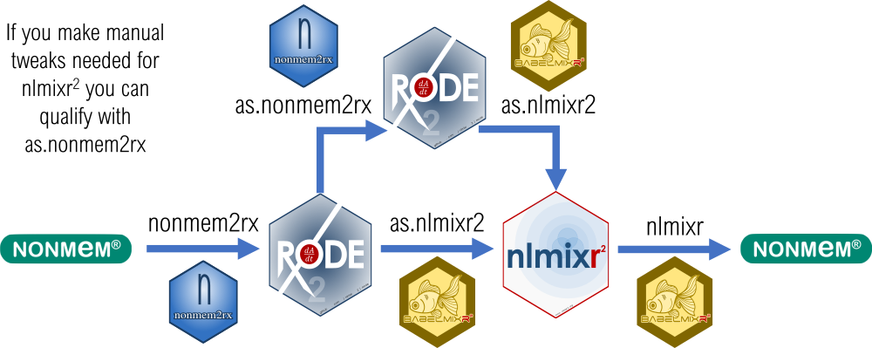
Interoperability Between nlmixr2 and NONMEM
nonmem2rx & babelmixr2

Slide 18
Simulating from NONMEM Results
nonmem2rx
Scenario: You have results from an analysis in NONMEM and you want to run simulations based on those results.
Examples:
sim_nonmem.R: Read in a NONMEM output then simulate the typical value and population predictions from IIV
sim_nonmem_manual.R: Read in a NONMEM output and then simulate using sampling from post hoc estimates using dosing based on individual body weights

Slide 19
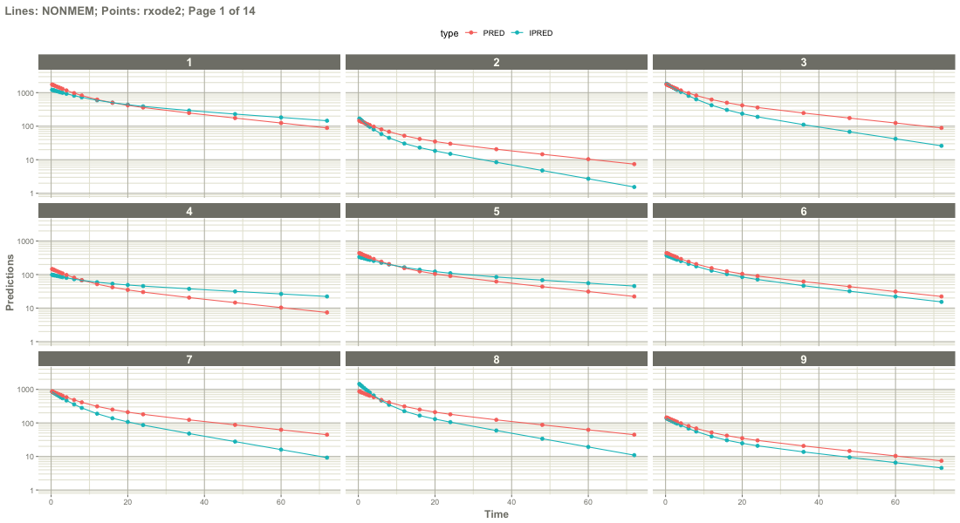
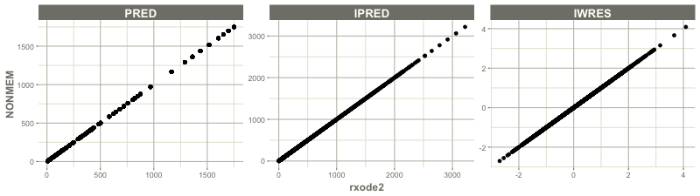
Reading in NONMEM Results
sim_nonmem.R
You need the following:
NONMEM output (lst or xml)
Analysis data set
Post hoc parameters (patab)
PRED, IPRED, RES, etc (sdtab)
Using nonmem2rx you can read in the NONMEM results
Validation is built in (use plot)
resFileName <- system.file("mods/cpt/runODE032.res", package="nonmem2rx")
mod <- nonmem2rx(resFileName, validate = TRUE, save=FALSE)
xmlFileName <- system.file("mods/cpt/runODE032.xml", package="nonmem2rx")
# Show the rxode2 model
rxode_mod_str = paste0(deparse(as.function(mod)), collapse="\n")
cat(rxode_mod_str)
# Validation
plot(mod)
plot(mod, page=1, log="y")

Slide 20
NONMEM-Specific Aspects of mod
sim_nonmem.R
When NONMEM output is read in an rxode2 model is created (called mod here). This contains data specific to the NONMEM analysis these are some of the fields that you may find useful:
mod$nonmemData: original NONMEM dataset
mod$ipredCompare: Data frame with ipred values
mod$predCompare: Data frame with pred values
mod$etaData: Subject level IIV values
More information on rxode2/nlmixr2 model objects here.

Slide 21
Creating Events and Simulating
sim_nonmem.R
Simulating only typical values: Specify only events
Simulating from IIV: Specify events and also the number of subjects (nSub)
# Flat dosing simulation event table
ev <- et(amt = 120000, time=0, # 10 doses
addl = 9, ii=12) |> # first +9 addl every 12 hours
et(amt = 120000, time=120, # Followed by 6 doses
addl = 5, ii=24) |> # Every 24 hours
add.sampling(seq(0,200,1))
ev
# Individual simulation using the typical values (do not specify nSub)
# https://nlmixr2.github.io/rxode2/articles/rxode2-single-subject.html
sim_ind <- rxSolve(mod, ev)
plot(sim_ind, ipred)
# Accessing the dataframe of the simulation
sim_ind_res <- as.data.frame(sim)
# Population simulation from iiv (specify nSub)
# https://nlmixr2.github.io/rxode2/articles/rxode2-sim-var.html
nsub = 100
sim_pop <- rxSolve(mod, ev, nSub=nsub)
confint(sim_pop, "ipred", level=0.95) |>
plot()
# Accessing the dataframe of the simulations
sim_pop_res <- as.data.frame(sim_pop)

Slide 22
Notes on Event Tables and rxode2
rxode2::rxSolve(mod, events, params, iCov)
Like NONMEM: The events table can have dosing events, subject level parameters, and covariates (time-varying and non-time-varying)
Using rxode2 you have some flexibility in how this is specified:
Same dose sampling from IIV: events table with only dosing events and no id column, nSub > 1
Same dose using user-specified parameters: events table with only dosing events and params table with a row for each subject and an id column
User specific dosing: events table with dosing for each subject with an id column
Covariates that are non-time-varying: These can be specified in either then params table or the iCov table

Slide 23
Templated Reporting
Outputting your work into Word and PowerPoint

Slide 24
Word and PowerPoint Reporting
If you want absolute control use the officer package
Provides detailed methods to create and modify both Word and PowerPoint files
Images from files (png, svg, etc), ggplot objects, Office charts (mschart)
Tables can be office formatted tables or you have have more granular control through flextable
Text can utilize styles or you can control the format more explicitly
Equations: the equatags (relatively new)
Downsides:
High level of control means → complexity
Changes to the code base have broken things for me
Placeholders in documents are used and can difficult to deal with when templates change

Slide 25
Templated Reporting with onbrand
Generating Word and PowerPoint reports
Sits on top of the officer package
Allows you to switch easily between organizational templates
Functionality to help you
Format text with Markdown
Span large tables across multiple pages
Automates the reporting part of workflows
Dumping figures and tables directly into PowerPoint
Creating Word reports that can be used as appendices
You can pull out the officer object, modify it, and put it back
The end of a validatable workflow:

Slide 26

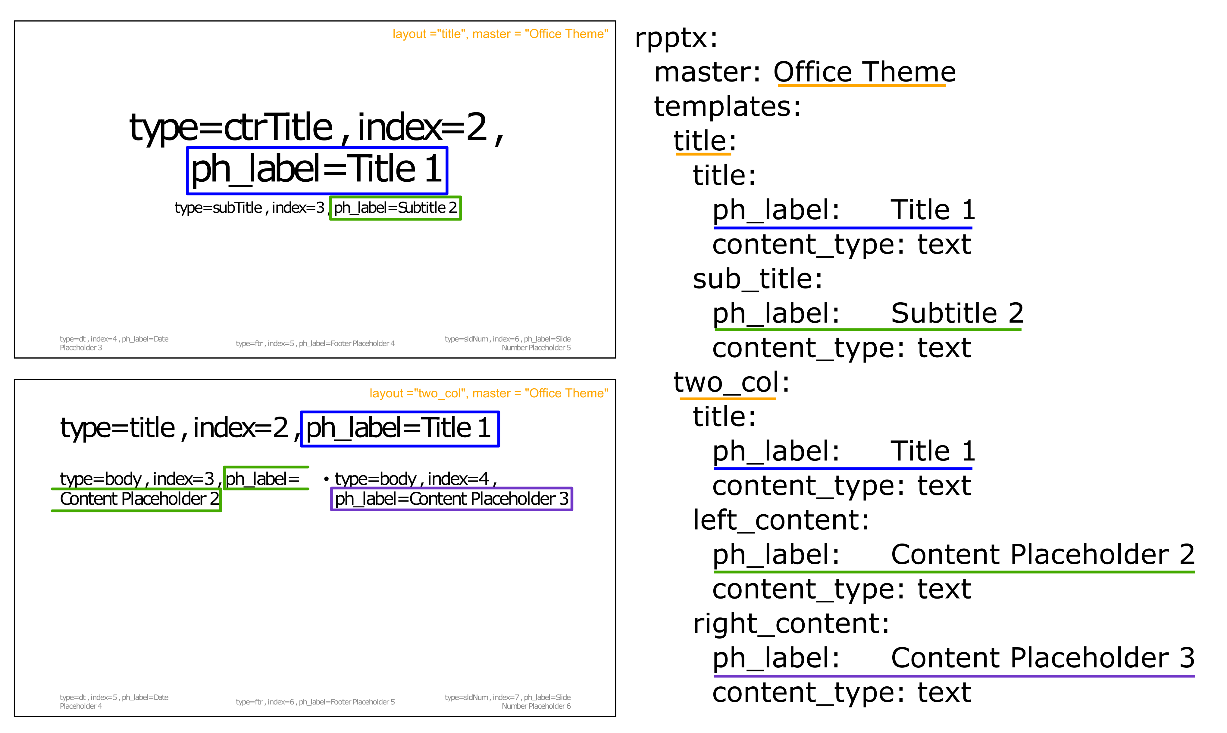
Getting Started
Tutorials
Word and PowerPoint workflows
Creating user defined templates
The mapping details between document templates and scripts are stored in user-defined yaml files

Slide 27
A Word Example
obnd = read_template(
template = file.path(system.file(package="onbrand"), "templates", "report.docx"),
mapping = file.path(system.file(package="onbrand"), "templates", "report.yaml"))
obnd = report_add_doc_content(obnd,
type = "text",
content = list(text = "Unformatted text",
style = "Heading_2"))
content =
paste0(rep("The quick brown fox jumps over the lazy dog.", 10), collapse=" ")
obnd = report_add_doc_content(obnd,
type = "text",
content = list(text = content,
style = ”Normal"))
save_report(obnd, "my_report.docx")
Full example: onbrand/mk_docx.R

Slide 28
A PowerPoint Example
obnd = read_template(
template = file.path(system.file(package="onbrand"), "templates", "report.pptx"),
mapping = file.path(system.file(package="onbrand"), "templates", "report.yaml"))
p = ggplot() + annotate("text", x=0, y=0, label = "picture example")
obnd = report_add_slide(obnd,
template = "content_text",
elements = list(
title = list( content = "Figures",
type = "text"),
sub_title = list( content = "Inserting a ggplot",
type = "text"),
content_body = list( content = p,
type = "ggplot")))
save_report(obnd, "my_report.pptx")
Full example: onbrand/mk_pptx.R

Slide 29
Reporting nlmixr2rpt Results
Templated reporting of nlmixr2 results
Reads in a yaml template with reporting details: figures, tables, etc
Can have placeholders and default values, can overwrite when called
Appends report for nlmixr2fit to onbrand object
The fit object is the result of nlmixr2
obnd_docx = read_template(
template = system.file(package="nlmixr2rpt", "templates","nlmixr_obnd_template.docx"),
mapping = system.file(package="nlmixr2rpt", "templates","nlmixr_obnd_template.yaml"))
obnd_docx = report_fit(
fit = fit,
obnd = obnd_docx)
save_report(obnd_docx, "report.docx")
Full example: nlmixr2rpt/pk_example.R

Slide 30
nlmixr2rpt
Templated reporting of nlmixr2 results
Reads in a yaml template with reporting details: figures, tables, etc
Appends report for nlmixr2fit to onbrand object
fit <- nlmixr2(one.compartment, theo_sd, est="saem", saemControl(print=0))
obnd_docx = read_template(
template = system.file(package="nlmixr2rpt", "templates","nlmixr_obnd_template.docx"),
mapping = system.file(package="nlmixr2rpt", "templates","nlmixr_obnd_template.yaml"))
obnd_docx = report_fit(
fit = fit,
obnd = obnd_docx)
save_report(obnd_docx, "report.docx")
Full example: nlmixr2rpt/pk_example.R

Slide 31
nlmixr2rpt Template
Create templates for different types of analysis: PK, TGI, ER, etc.
Standard formatting and naming of parameters.
Figure and table code can be written to execute conditionally (report type, based on dataset contents, etc).
Placeholders: Write your figure/table code with placeholders that will be populated when the report is generated.
file.copy(system.file(package="nlmixr2rpt", "templates", "report_fit.yaml"),"my_report.yaml")

Slide 32
nlmixr2rpt Template
High-level yaml components
figures:
dv_vs_pred:
orientation: "portrait"
caption: "dv_vs_pred caption"
caption_format: "text"
title: "dv_vs_pred title"
cmd: |-
p_res <- dv_vs_pred(xpdb, caption=NULL, title=NULL) +
xlab("Observed ===CMPD=== Concentrations (===CUNITS===)") +
ylab("Population Predicted ===CMPD=== Concentrations (===CUNITS===)")
tables:
pest_table:
orientation: "portrait"
caption: "Parameter Estimates"
caption_format: "text"
title: "Parameter Estimates"
cmd: |- t_res <- gen_pest_table(
fit = fit,
obnd = obnd,
rptdetails = rptdetails)
docx:
content:
- text:
text: "Figures"
style: Heading_1
- figure: dv_vs_pred
- text:
text: "Tables"
style: Heading_1
- table: pest_table

