Slide 1

Introduction to Bayesian Machine Learning
Dr John Hawkins
Lead Data Scientist @ DataRobot
@john_c_hawkins

Slide 2
Overview
Bayesian?
The ML Problem
Steps to Bayesian ML
Maximum Likelihood
Maximum a-posteriori
Estimating the posterior
Markov Chain Monte Carlo
Variations / Extensions
Practical Observations

Slide 3
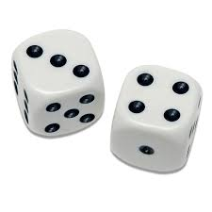
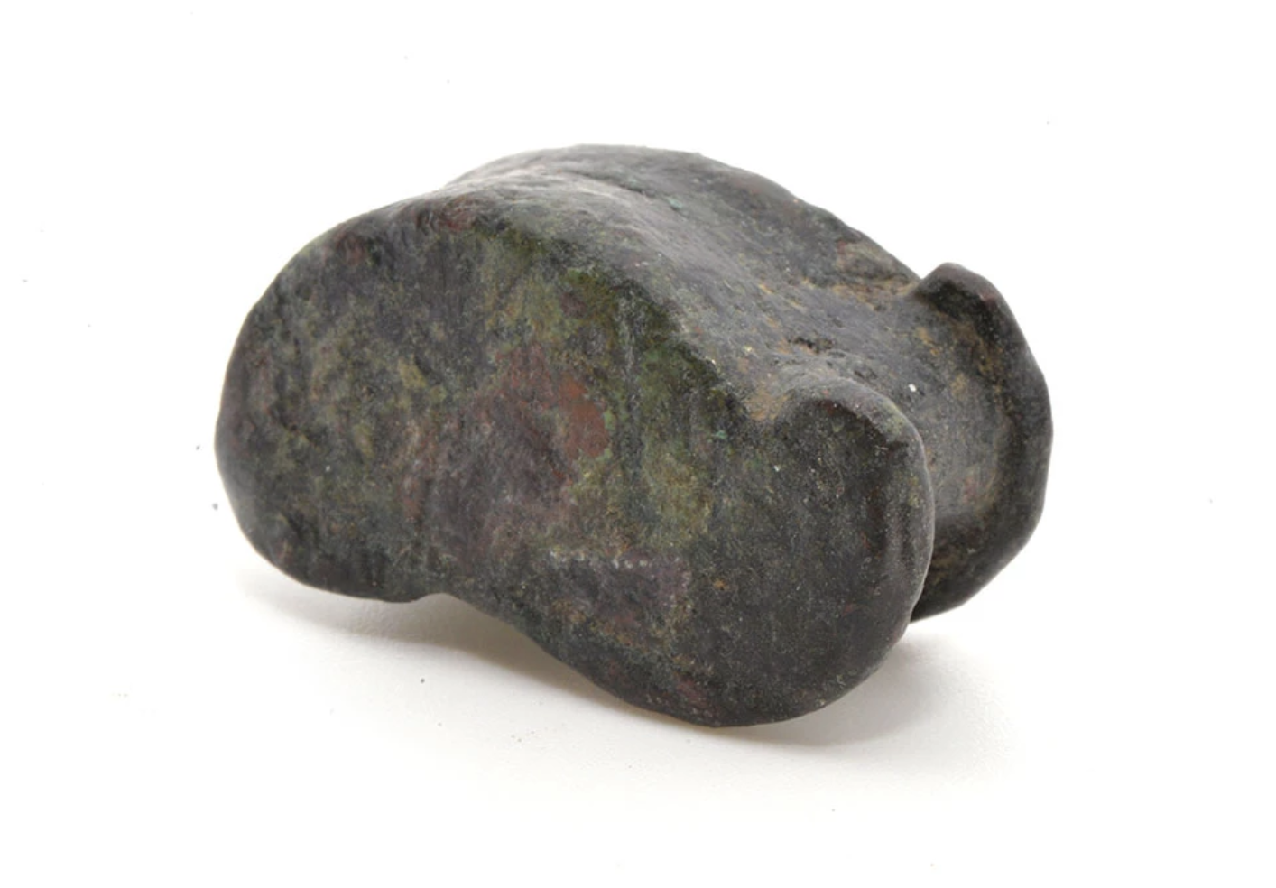
Brief History of Bayes Formula

Slide 4

Bayesian Formula for ?
$$p(A|B)=\frac{p\left(B | A\right) p(A)}{p(B)}$$
Definition of joint probability
p(A,B) = p(A|B) p(B)
p(A,B) = p(B|A) p(A)

Slide 5

Bayesian Formula for inferring probabilities
$$p(θ|𝒟)=\frac{p\left(𝒟 | θ\right) p(θ)}{p(𝒟)}$$

Slide 6

Bayesian Formula for inferring parameters
$$p(θ|𝒟)=\frac{p\left(𝒟 | θ\right) p(θ)}{p(𝒟)}$$

Slide 7
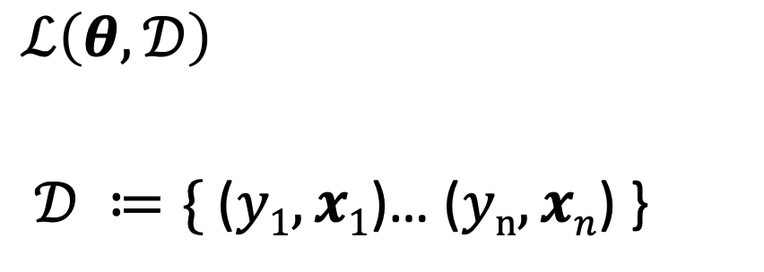

Enter the ML Problem
$$y=f\left(x\right)+ ε$$
$$\hat{y}=F\left(x|θ\right)$$
$$ℒ\left(θ,𝒟\right)$$
$𝒟 ≔\{$($y1,x1$)… ($yn,xn$) }

Slide 8
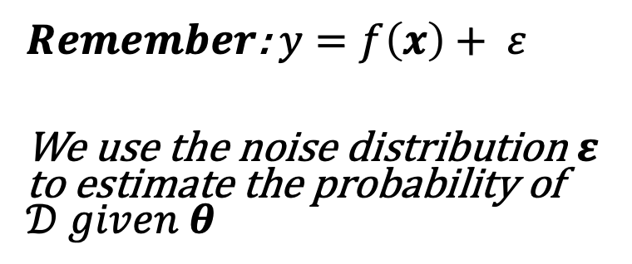
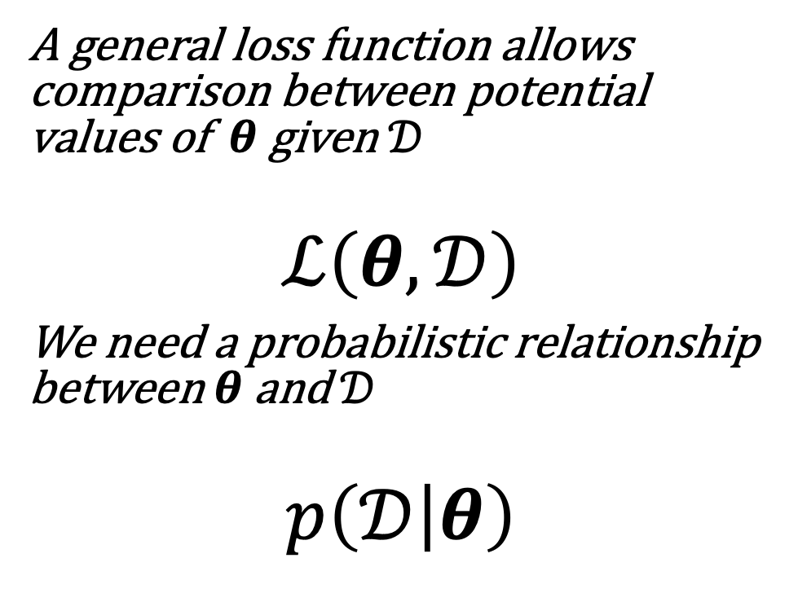
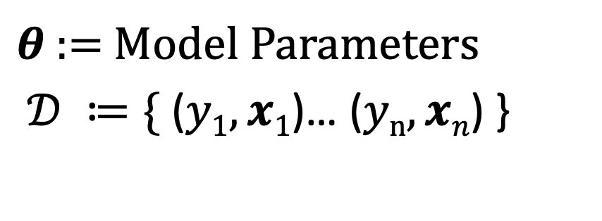
Probabilistic ML
A general loss function allows comparison between potential values of $θ$ given $𝒟$
$$ℒ\left(θ,𝒟\right)$$
We need a probabilistic relationship between $θ$ and $𝒟$
$$p\left(𝒟 | θ\right)$$
$θ$ := Model Parameters
$𝒟 ≔\{$($y1,x1$)… ($yn,xn$) }
$Remember$: $y=f\left(x\right)+ ε$
We use the noise distribution $ε$ to estimate the probability of $𝒟 given θ$

Slide 9
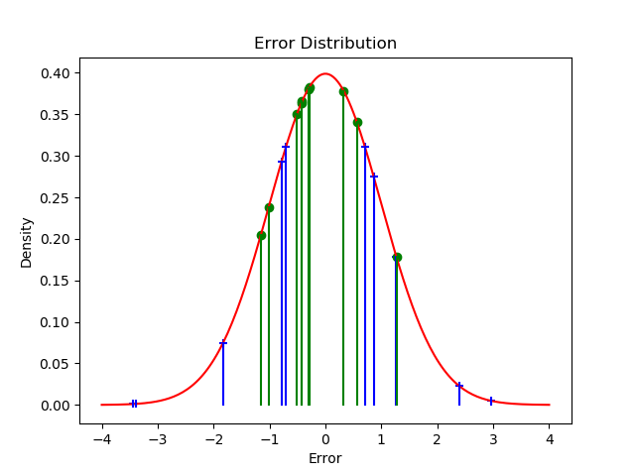

$$p\left(𝒟 | θ\right)$$

Slide 10

Maximum Likelihood
$$p(θ|𝒟)=\frac{p\left(𝒟 | θ\right) p(θ)}{p(𝒟)}$$

Slide 11

Maximum a posteriori
$$p(θ|𝒟)=\frac{p\left(𝒟 | θ\right) p(θ)}{p(𝒟)}$$

Slide 12

Bayesian: Estimate the posterior distribution
$$p(θ|𝒟)=\frac{p\left(𝒟 | θ\right) p(θ)}{p(𝒟)}$$
$$This is usually intractable$$

Slide 13

Markov Chain Monte Carlo

Slide 14
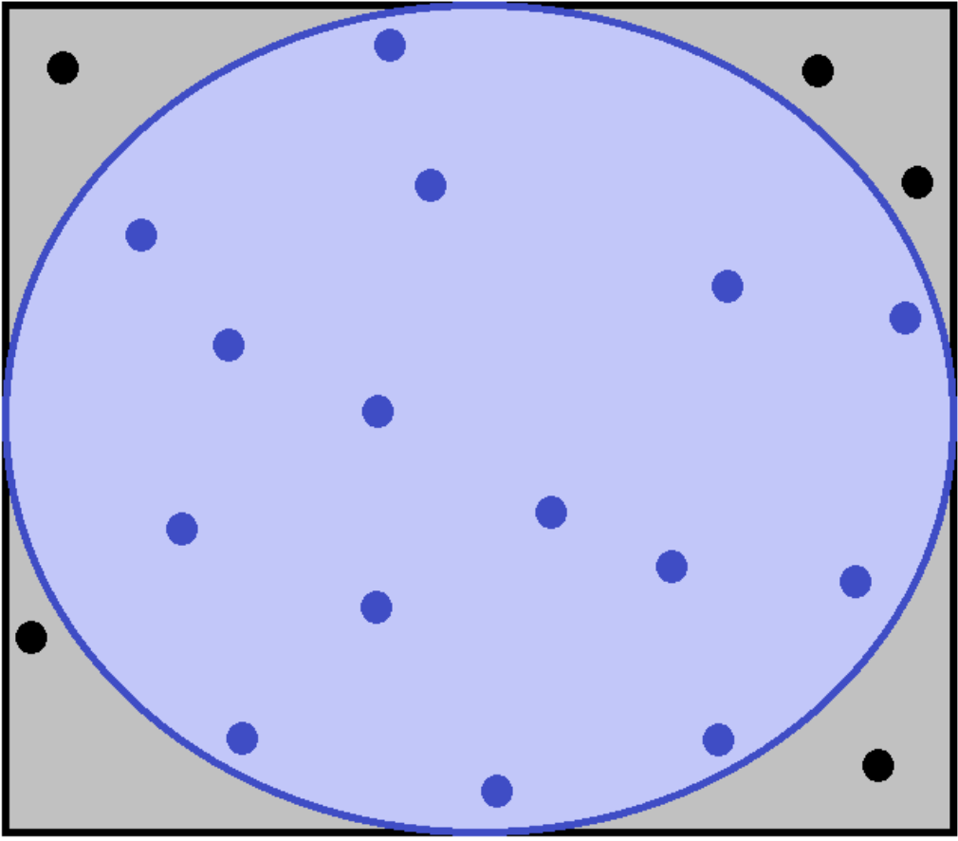
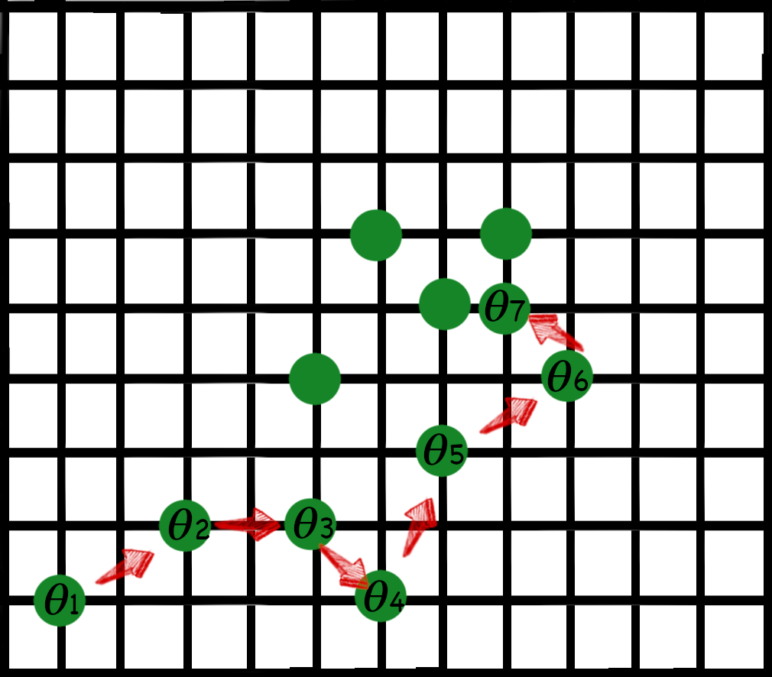
Markov Chain Monte Carlo

Slide 15
How do we sample from the posterior?
$$p(θ|𝒟)=\frac{p\left(𝒟 | θ\right) p(θ)}{p(𝒟)}$$

Slide 16
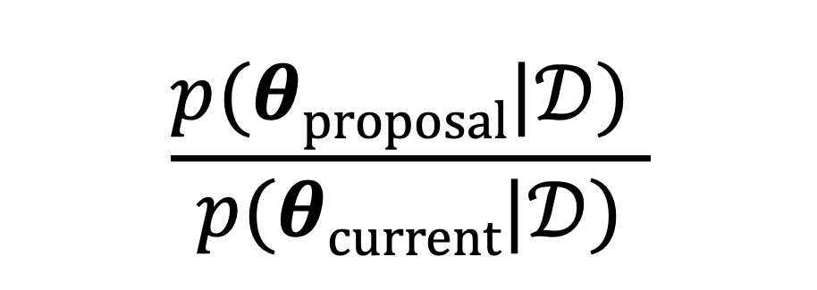
Metropolis-Hastings
Accept or reject steps in the Markov process by calculating an acceptance probability.
The acceptance probability is the ratio of the posterior probability evaluated at the two points:
$$\frac{p(θproposal|𝒟) }{p(θcurrent|𝒟)}$$

Slide 17

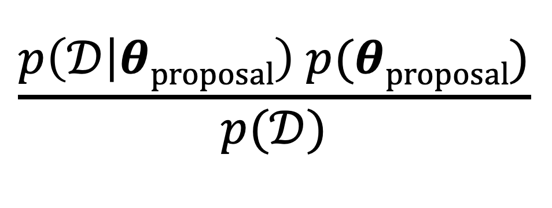
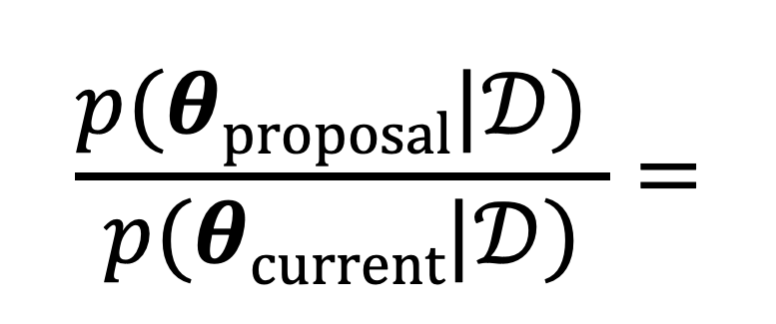
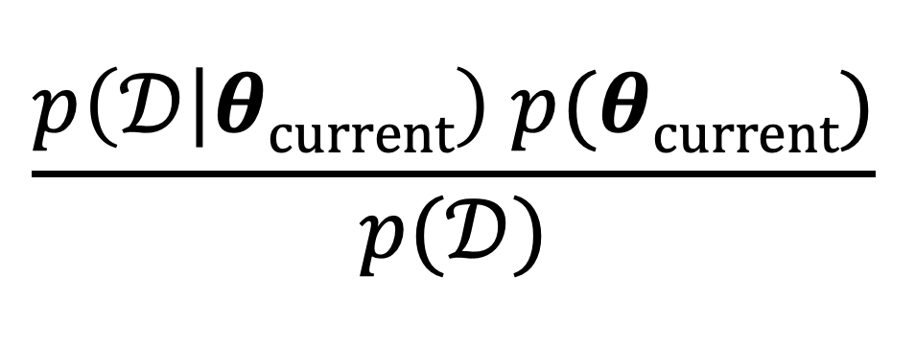
Wait, What?
$$\frac{p\left(𝒟 | θproposal\right) p(θproposal)}{p(𝒟)}$$
$$\frac{p(θproposal|𝒟) }{p(θcurrent|𝒟)}=$$
$$\frac{p\left(𝒟 | θcurrent\right) p(θcurrent)}{p(𝒟)}$$

Slide 18
Accept / Reject Samples to Estimate the Posterior
$$p(θ|𝒟)=\frac{p\left(𝒟 | θ\right) p(θ)}{p(𝒟)}$$

Slide 19
Extensions / Research Areas
Gradient / Langevin MCMC
Hamiltonian Monte Carlo
Variational Approximations

Slide 20
Why do this?
You will get a strong sense of how certain your model is about its predictions:
You can generate confidence intervals directly from the model
Without having to artificially construct those bounds
You can explicitly code in your assumptions about the model, the data and the problem and see them reflected in the results

Slide 21
Some Observations/Warnings
Taking samples from the posterior over parameters and generating confidence intervals is not guaranteed to be calibrated (in the frequentist sense)
Remember this is a probability distribution over parameters and reflects the model’s uncertainty in the parameters given the assumptions you gave it.
Some people expound the ensemble advantage of a Bayesian model: You are generating a prediction from an ensemble of Neural Networks.
This is not generally as good as an ensemble of very different models

Slide 22
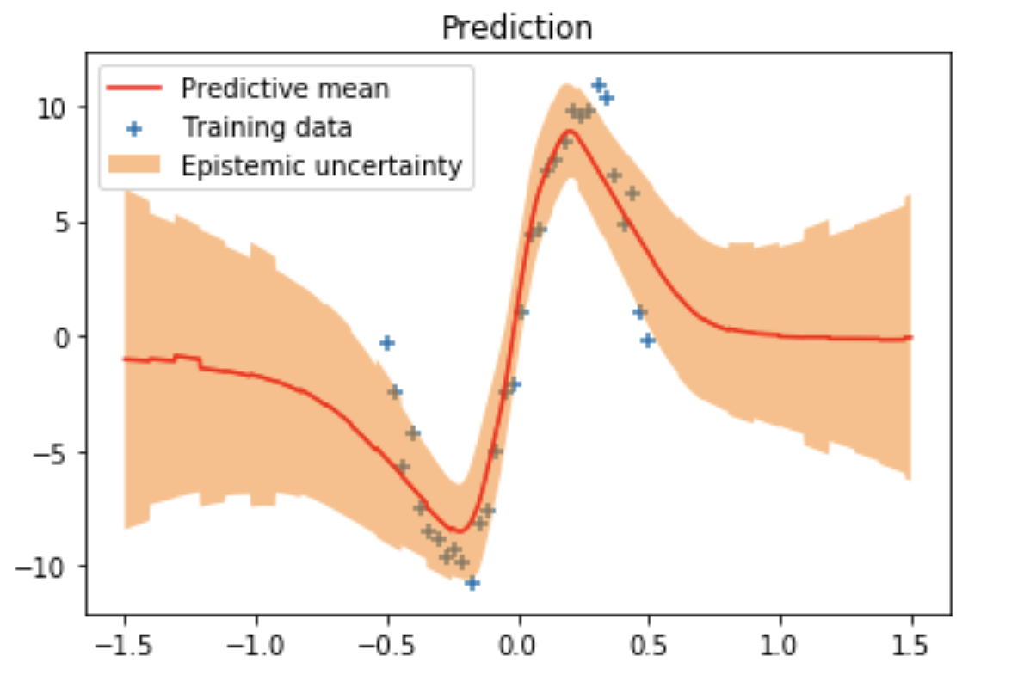
Be Wary
Many code examples on toy problems cheat by using the exact noise distribution for the likelihood.

Slide 23


Other Reading / Materials
@john_c_hawkins
github.com/john-hawkins

