Slide 1
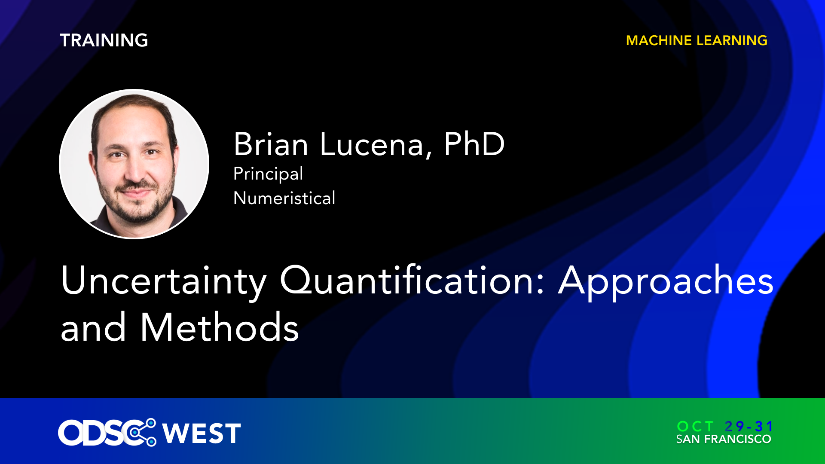

Slide 2
UNCertainty Quanitification: Approaches and Methods
Brian Lucena, Ph.D.

Slide 3
getting started
Go to www.github.com/numeristical/resources
Navigate to “ODSC_West_2024/W24_Prob_Regression”
Option 1: Google colab: colab.google.com then open the url from Github (recommended)
Option 2: Clone the repo and use your own environment

Slide 4

About me: PAID WORK
Brian Lucena, Ph.D.
Taught at UC Berkeley, University of San Francisco, American University in Cairo
New Position! Principal Data Scientist at Swish Analytics
Swish is hiring! http://grnh.se/a24ee0a85us

Slide 5
About me : FUN work
Open Source Development / Research
Have Developed 3 Python Packages
ML-insights : Model Interpretation / Calibration
Structureboost : Advanced Gradient Boosting
SplineCalib : Prob Calibration (inside ML-insights)
YouTube channel: numeristical
Academic Papers: arxiv, AISTATS

Slide 6
About me : FUN work
More recently: Baseball Prediction!
15 video series on YouTube
From Data Wrangling and Scraping to advanced Gradient Boosting
Put model into production for 2024 season – documented the journey.

Slide 7
Overview: What is uncertainty quantification?
How confident is my model about a particular prediction?
Can try to generalize from test set performance
That only tells you how good the model is “on average”
Some predictions should be more confident than others: a model may be 99% accurate for one prediction and only 65% on another.
We want our models to “know what they don’t know”
That is what is meant by “Uncertainty Quantification”
Overall theme: Predict probability distributions, not particular values

Slide 8
REGRESSION problems
Classical view is to make a point prediction.
Measure performance by judging how “far” you are from the true answer
Alternate view: output a probability density as your prediction
Measure performance by “likelihood-based” approaches (e.g. log-loss)
This is called “Probabilistic Regression” or “Conditional Density Estimation”
Another view: specify a “coverage”, then output an interval (or region)
e.g. 90% prediction interval
Conformal Prediction: framework for making these kinds of predictions
Theoretical guarantees (that must be carefully understood)

Slide 9
Classification problems
Hard predictions => Guess the category
Probabilistic predictions => Give a probability distribution across the possible labels
Can we trust those probabilities?
In the long run, does 85% really mean (roughly) 85 out of 100?
Often, models output probabilities that are “poorly calibrated”
“Probability Calibration” refers to post-hoc methods to correct this.

Slide 10
To the Notebook!
Let’s dive into some examples!

Slide 11

Types of predictions
“Hard” Prediction:
Predict the exact value of y given x.
“Ranking” Prediction: (binary classification)
Provide a score for x, where higher score
means it is more likely that y is True
“Probabilistic” Prediction:
Predict the probabilities on y given x.

Slide 12
Types of predictions
“Hard” Prediction
“Ranking” Prediction
“Probabilistic” Prediction
Choose Threshold
Direct

Slide 13
Types of predictions
“Hard” Prediction
“Ranking” Prediction
“Probabilistic” Prediction
Not generally possible
Calibration!

Slide 14

What is Calibration?
Calibration:
Adjusting the predictions of a model so that they are probabilistically meaningful
Probabilistically meaningful:
When predicting probability .3, in the long run, 30% of those events occur.

Slide 15
Why Calibrate?
Action depends on a precise probability.
Assessing Model Quality
Assessing Model Impact (Simulation)
Implications for fairness, bias, etc.
Recalibrating for model drift (or use on a different population)

Slide 16
How to do Calibration?
Fit a function that maps the uncalibrated score to the “true” probability.
Use a data set of pairs (score, outcome) to fit this function.
Methods vary in what kinds of functions they fit, and how they fit them.
Different ways to get the data set on which to fit the calibration.
Multiclass – more complicated.

Slide 17
Help Me out!
Rate this talk on the Conference App
Subscribe to my YouTube channel
Give stars to my Github repos

