Slide 1
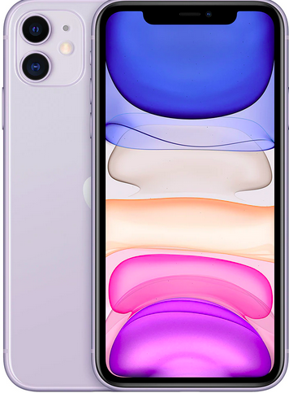



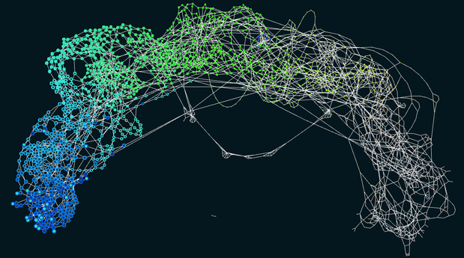
I.T. [Centralised in Cloud]
BACKEND :: BLOCKCHAINS + DATABASE
SCHEMATA + OPERATIONAL AUTOMATION
I.T. [Distributed]
GUIs (dApps)
+ BLOCKCHAINS (DLT)
I.T. [Centralised in Cloud]
MACHINE LEARNING: BUILD, TRAIN, TEST, DEPLOY – MODELS
Data Science
Canonical/LXD/Juju Kubernetes, incorporating
Elastos SmartWeb
Elastos ‘Carrier’
Database webserver
BlockChains servers
Ethereum Smart Contracts
Etcd In-Memory key:value Store-Cluster
PostgreSQL/PostGIS
IOTA Client – zero-fees Trust
Node-Red-Industrial
Elastos ‘Carrier’
Node.js Functions IOTA
Networking Tangle
Sequencing
Parsing
Storage
PLCs
ctrl-X Movement Automation
OPCUA
Ionic/Cordova/Angular
/html/css +
Typescript compiles to:
JavaScript
Elastos Runtime with
Blockchains & ‘Carrier’
Ethereum Smart Contracts
Canonical KubeFlow, incorporating
Microk8s Cloud
Juju Controller/ k8s Model
Python
Jupyter Notebooks
Dashboard
Pipelines
GPU support
Build
Train
Test
Deploy
O.T. [Distributed]
Operational Technology
Incl Industry 4.0
Industrial PI
(Edge computers)
Elastos ‘Carrier
Node-Red-Industrial
IOTA Client – IoT Trust
PLCs
ctrl-X (Bosch/Rexroth)
OPCUA
Motors, actuators, sensors
Hydraulics/Pneumatics
I.o.T. Admin [Distributed]
GUIs (dApps)
+ BLOCKCHAINS (DLT)
+ Node-Red-Industrial
+ Elastos Carrier
+ IOTA Client – zero-fees Trust

