Slide 1
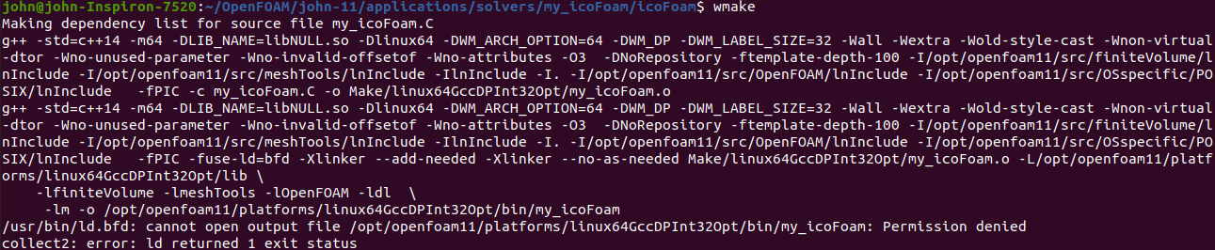
https://openfoamwiki.net/index.php/How_to_add_temperature_to_icoFoam
When using the following, I’m unable to output permission denied.
my_icoFoam.C
EXE = $(FOAM_APPBIN)/my_icoFoam

Slide 2
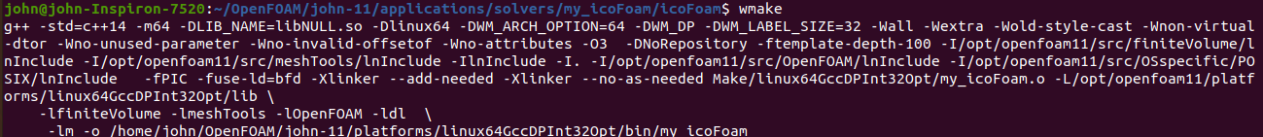
https://openfoamwiki.net/index.php/How_to_add_temperature_to_icoFoam
After changing to the following, I’m able to output.
my_icoFoam.C
EXE = $(FOAM_USER_APPBIN)/my_icoFoam

Slide 3
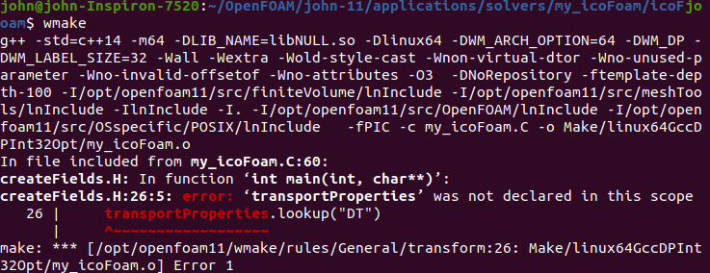
https://openfoamwiki.net/index.php/How_to_add_temperature_to_icoFoam - adding temperature fields
Previous version of OF
OF v11 – this results in error
Info<< "Reading transportProperties\n" << endl;
IOdictionary transportProperties
(
IOobject
(
"transportProperties",
runTime.constant(),
mesh,
IOobject::MUST_READ,
IOobject::NO_WRITE
)
);
dimensionedScalar nu
(
transportProperties.lookup("nu")
);
//Add here...
dimensionedScalar DT
(
transportProperties.lookup("DT")
);
Info<< "Reading physicalProperties\n" << endl;
IOdictionary physicalProperties
(
IOobject
(
"physicalProperties",
runTime.constant(),
mesh,
IOobject::MUST_READ_IF_MODIFIED,
IOobject::NO_WRITE
)
);
dimensionedScalar nu
(
"nu",
dimViscosity,
physicalProperties.lookup("nu")
);
dimensionedScalar DT
(
transportProperties.lookup("DT")
);

Slide 4
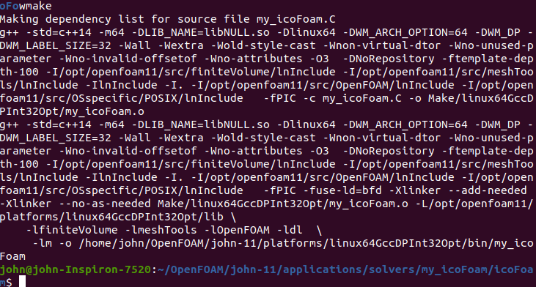
https://openfoamwiki.net/index.php/How_to_add_temperature_to_icoFoam - adding temperature fields
Previous version of OF
OF v11 – amending code seems to compile
Info<< "Reading transportProperties\n" << endl;
IOdictionary transportProperties
(
IOobject
(
"transportProperties",
runTime.constant(),
mesh,
IOobject::MUST_READ,
IOobject::NO_WRITE
)
);
dimensionedScalar nu
(
transportProperties.lookup("nu")
);
//Add here...
dimensionedScalar DT
(
transportProperties.lookup("DT")
);
Info<< "Reading physicalProperties\n" << endl;
IOdictionary physicalProperties
(
IOobject
(
"physicalProperties",
runTime.constant(),
mesh,
IOobject::MUST_READ_IF_MODIFIED,
IOobject::NO_WRITE
)
);
dimensionedScalar nu
(
"nu",
dimViscosity,
physicalProperties.lookup("nu")
);
dimensionedScalar DT
(
physicalProperties.lookup("DT")
);

