Slide 1
Unreal Engine Physics-based Game John McCoubrie

Slide 2
Problem Statement
Traditional cooperative multiplayer games often fail to offer a highly interactive and physics-based environment that forces true collaboration between players. In “Buddies in a Ball” the core challenges lies in designing a system that synchronizes physics-based interactions for multiple players while maintaining a fun, responsive, and collaborative gameplay experience in a peer-to-peer (P2P) network. This includes addressing the technical challenges of multiplayer synchronization, implementing responsive controls for multiple users in a shared physics-based system, and creating an engaging experience that scales to different skill levels.

Slide 3
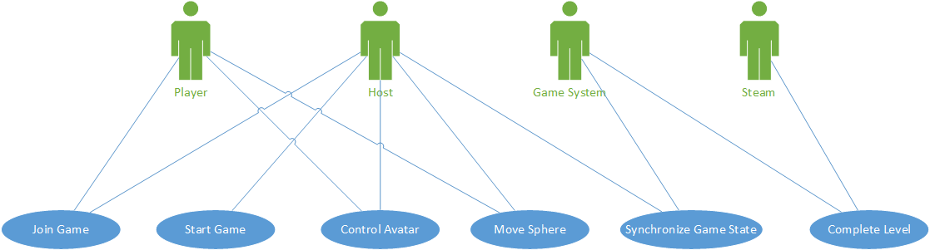
UML Use Case Diagram

Slide 4
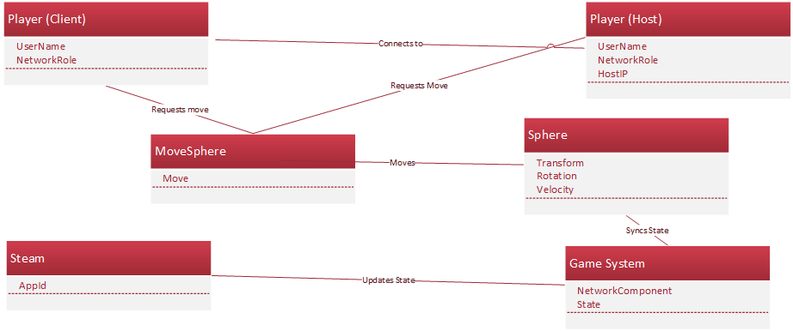
UML Domain Model

Slide 5
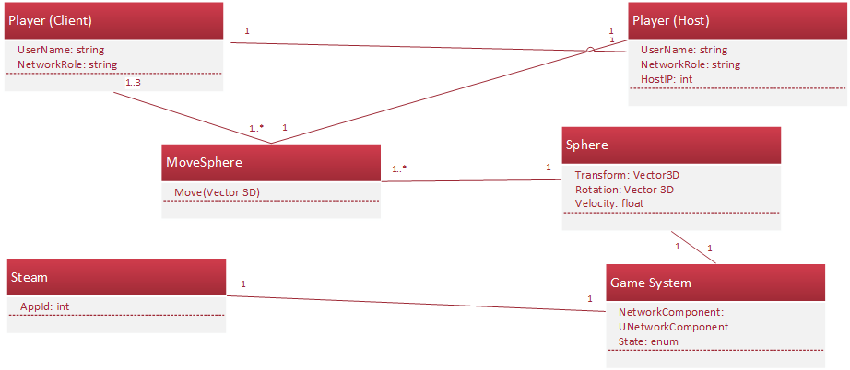
UML Class Diagram

Slide 6
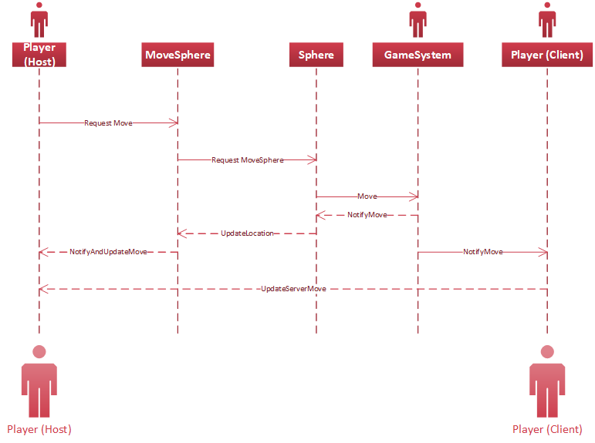
UML Sequence Diagram

Slide 7
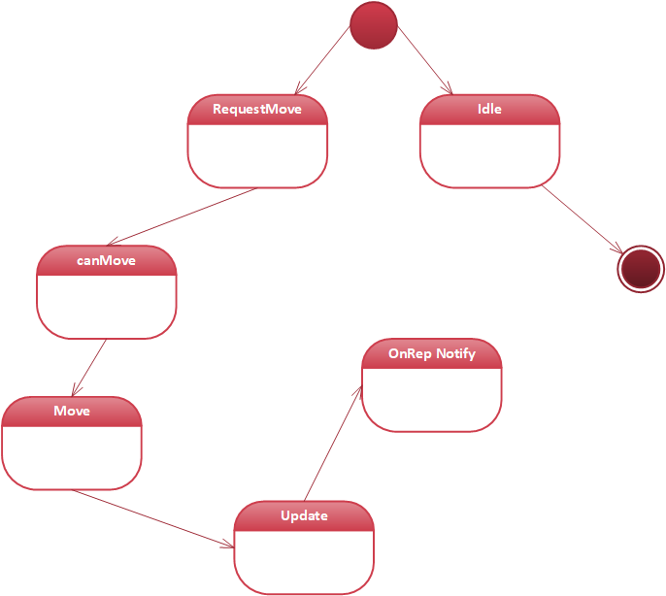
UML State Diagram

Slide 8
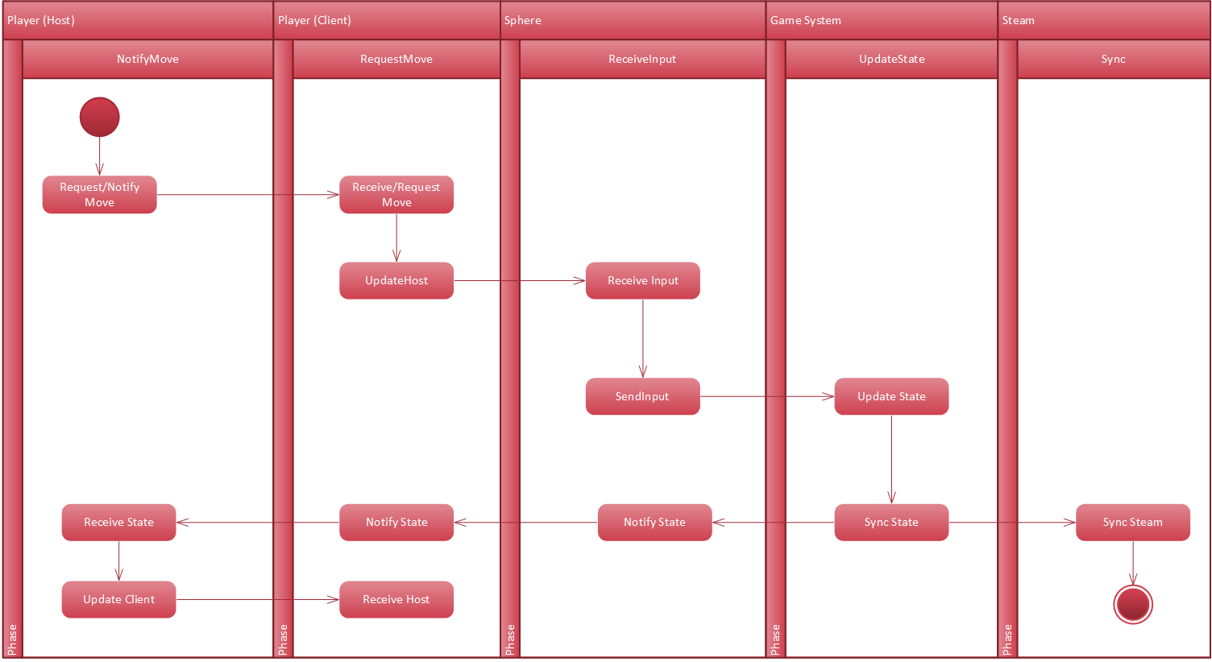
UML Activity Diagram

Slide 9
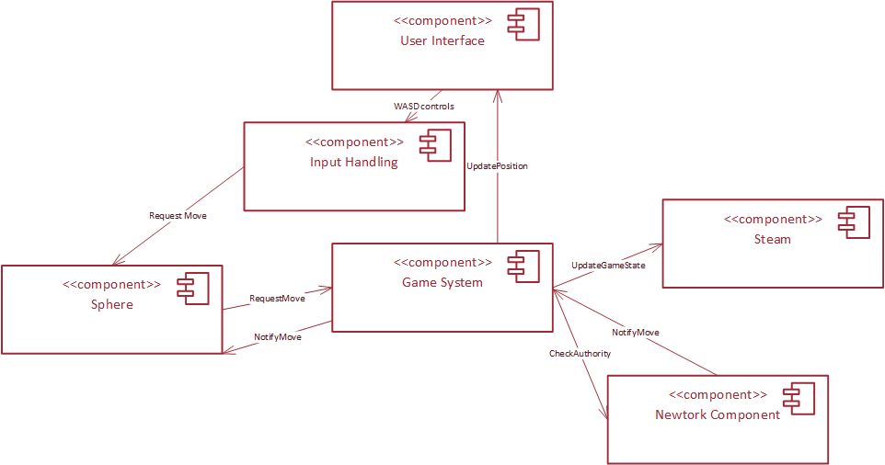
UML Component Diagram

Slide 10
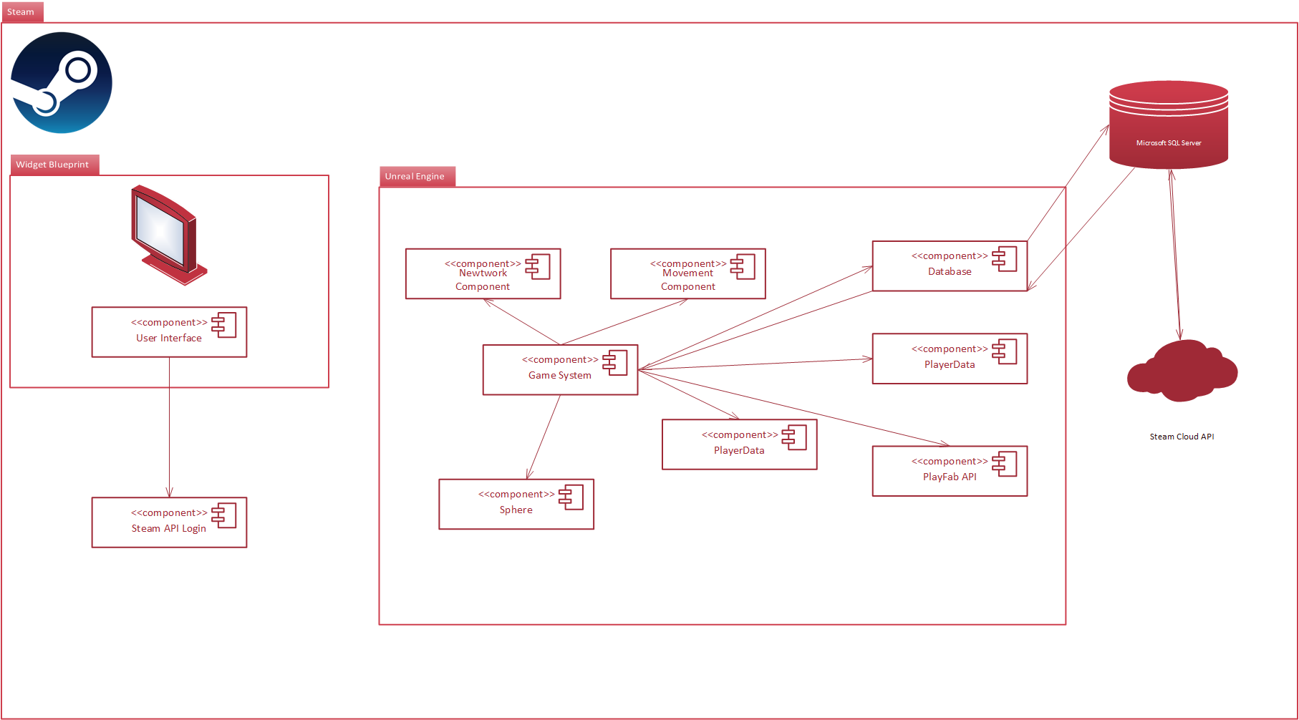
UML Deployment Diagram

Slide 11
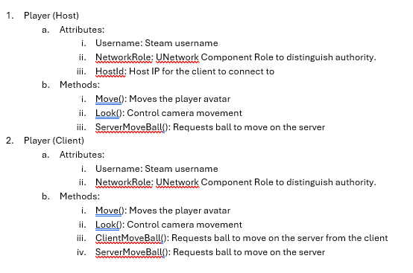
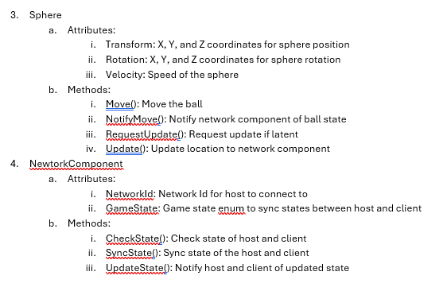
Skeleton Classes

Slide 12
Design Patterns
GRASP Patterns
SOLID Principles
GOF (Gang of Four) Patterns
Microservices and Best Practices

Slide 13
Scalability/Speed
Peer-to-peer (P2P) Architecture
Steam
LOD, Network Optimization Tools
Custom Blender Assets

Slide 14
Cost Optimization
Budget
Steam
Asset store (free assets)
Blender-made assets

Slide 15
Thank you
John McCoubrie

