Slide 1
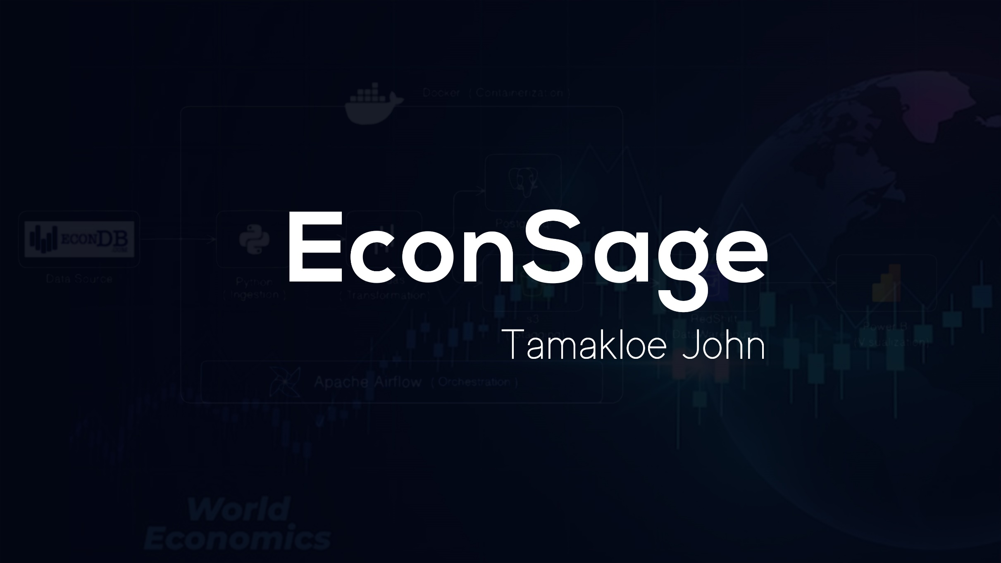
EconSage
By Tamakloe John
01

Slide 2
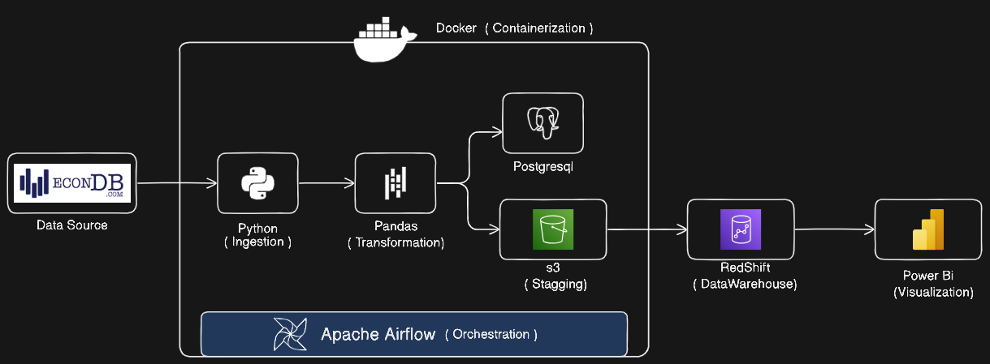
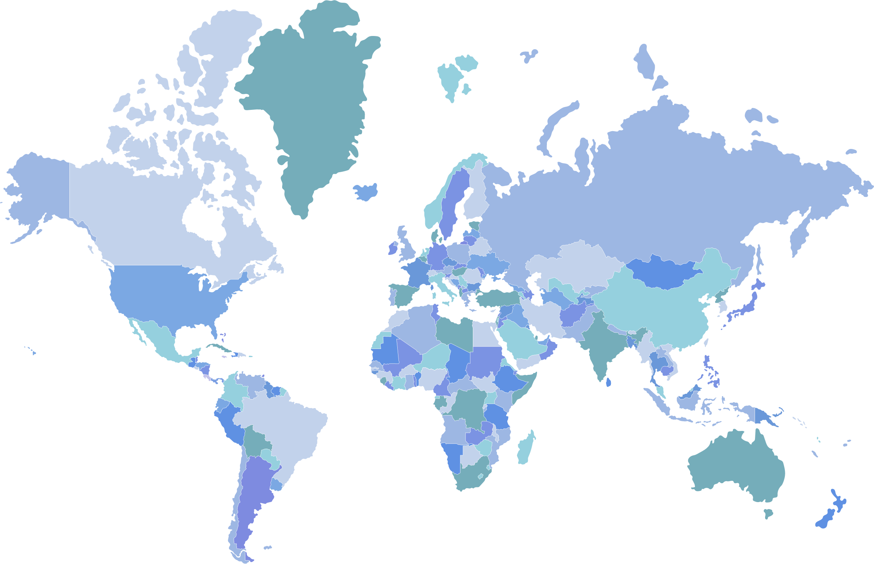

Project Overview
The aims is to create a resilient and fault-proof data pipeline for obtaining economic data from EconDB.com and making it available for creating dashboards.
02

Slide 3
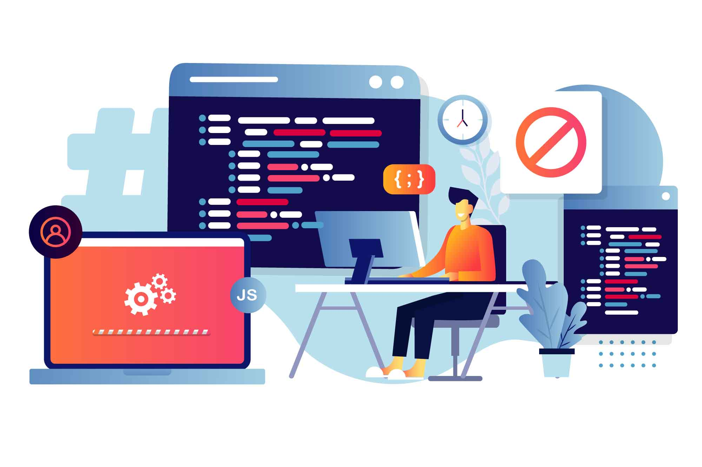
My Role
Develop and test Python scripts for data ingestion.
Implement data transformation logic using Pandas.
Set up PostgreSQL and S3 for data storage.
Configure Redshift for data warehousing.
Design Power BI dashboards.
Configure Airflow for workflow orchestration.
Containerize the pipeline with Docker.
03

Slide 4

Technical Challenges
Budget limitations for subscriptions and tools.
API call limitations from EconDB.com.
Fault tolerance
Data Transformation
Date | CNY | USD | … | ZAR
2014-01-01 | 18509.82 | 13653.70 | … | 226.24
2014-02-01 | 18426.40
… | …
2024-02-01 | 41673.45
2024-03-01 | 42207.80
Date | Code | GMS
2014-01-01 | CNY | 18509.82
2014-02-01 | CNY | 18426.40
… | … | …
2024-02-01 | ZAR | 265.72
2024-03-01 | ZAR | 275.59
04

Slide 5

Solution Approach
Used series of API tokens
Exceptions Handling
Melting table (pd.melt)
Unpivoting
05

Slide 6
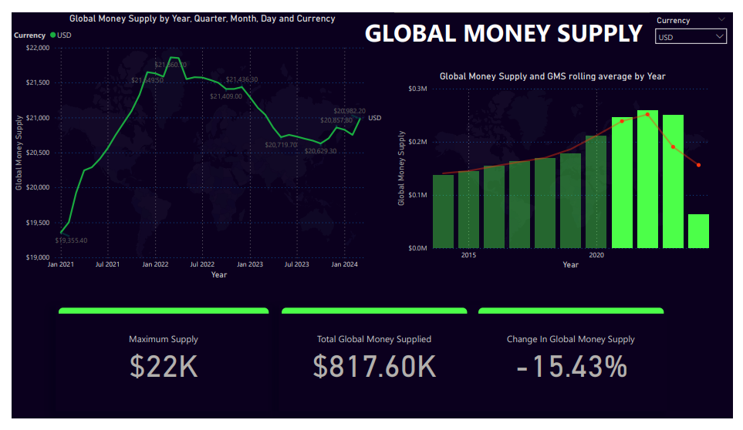
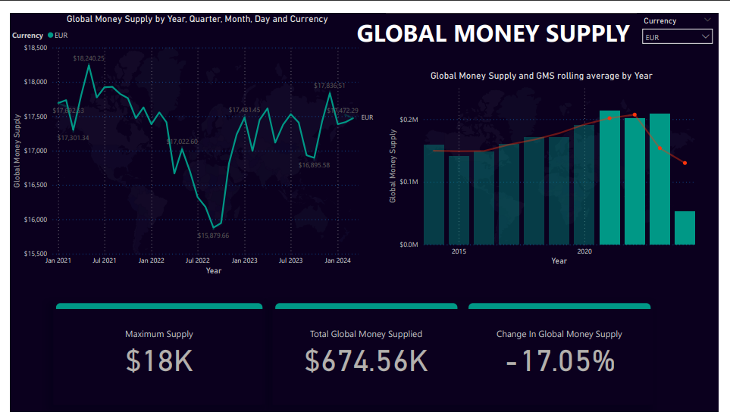
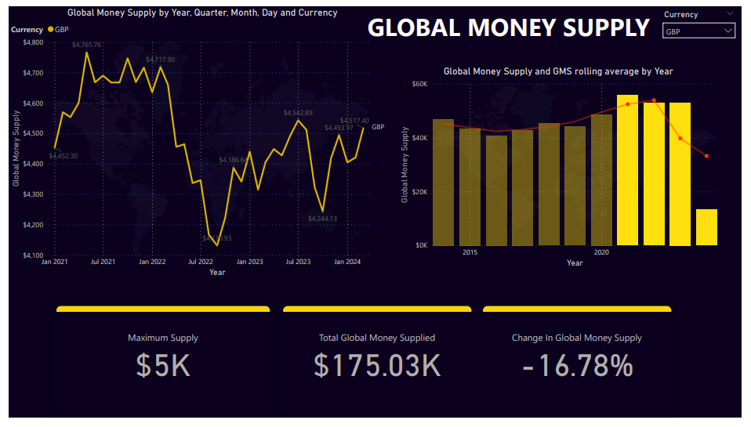

Results and Impact
Automated data pipeline runs without errors.
Data is accurately transformed
Dashboards display correct and up-to-date data.
Workflow orchestration is functioning as expected.
Consistent performance
06

Slide 7

Lessons Learned
Scalability
Fault Tolerance
Optimization
Data Transformation
Debugging
07

Slide 8

Adaptability
The project is designed to be highly adaptable, ensuring it can meet changing requirements, integrate new data sources, and accommodate evolving technological advancements
08

Slide 9







Technical Tools
Ingestion
Visualization
Containerization
Warehousing
Staging
Orchestration
09

Slide 10
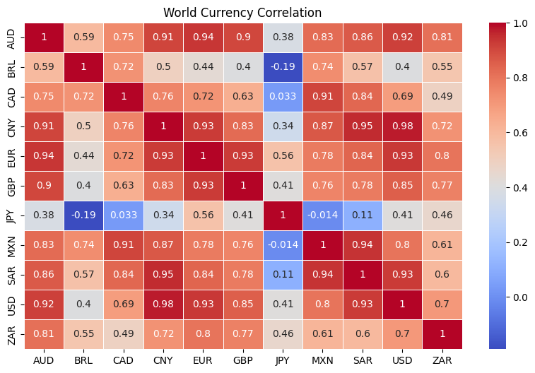

Closing Statement
EconSage Project is designed with adaptability at its core, ensuring it can meet current needs while being flexible enough to accommodate future changes. This adaptability makes the project a robust solution for economic data management, capable of evolving with technological advancements and shifting user requirements.
10

Slide 11


Thank you
Econdb_Project
https://github.com/john-ml-dev/econdb_project
tjohn@treastleacademyghana.org

