Slide 1
Master Node :
Resource Manager (one of )
YARN
Mesos
Kubernetes
Scheduler
Responsibilities:
Allocates Resources (Task Nodes or Data Nodes) for Job execution
Node Monitoring and Health Management
Creating AppMaster for each job submitted
Data Node
Or
Task Node
Data Node
Or
Task Node
Master
Node
Task Node - Responsibilities
Performs Computation or Run Mapper or Reducer functions
Data Node - Responsibilities
Holds Data for Jobs copied from underlying storage like S3, RedShift
Note
Task Node and Data Nodes can reside on same Slave Node
They can scale independently
Data Node
Or
Task Node

Slide 2
ToolSets
Data Compression
Data Transfer (S3 to HDFS)

Slide 3
Integration Patterns
Resource Manager
YARN (Default)
Mesos
Kubernetes
Cluster Lifetime
Persistent
Transient
Notebook
Attach Existing Cluster
Create Cluster at time of creation of Notebook

Slide 4

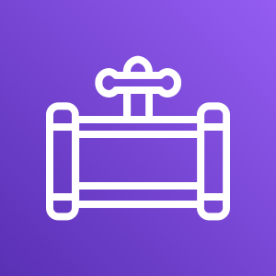


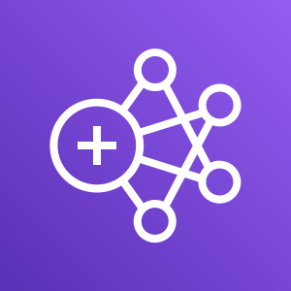

AWS Cloud
AWS Data Pipeline
On-Prem
Raw CSV, JSON Files
Amazon EMR ETL Cluster
Transformed Parquet Files

Slide 5




Directory 1
Amazon EMR
Notebook
Crawler
Data Catalog
Directory 2
Crawler
Notebook
Parquet Files
Amazon EMR
Crawler
Amazon EMR
Notebook
Directory 3
AWS Glue ETL to Parquet Files

