Slide 1
BA
Predictive Customer
Booking Model
Using Machine Learning to Acquire Customers Before They Fly
British Airways Data Science | Customer Acquisition Strategy | Random Forest Classifier
Dataset: 50,000 bookings • Features: 17 • Algorithm: Random Forest

Slide 2
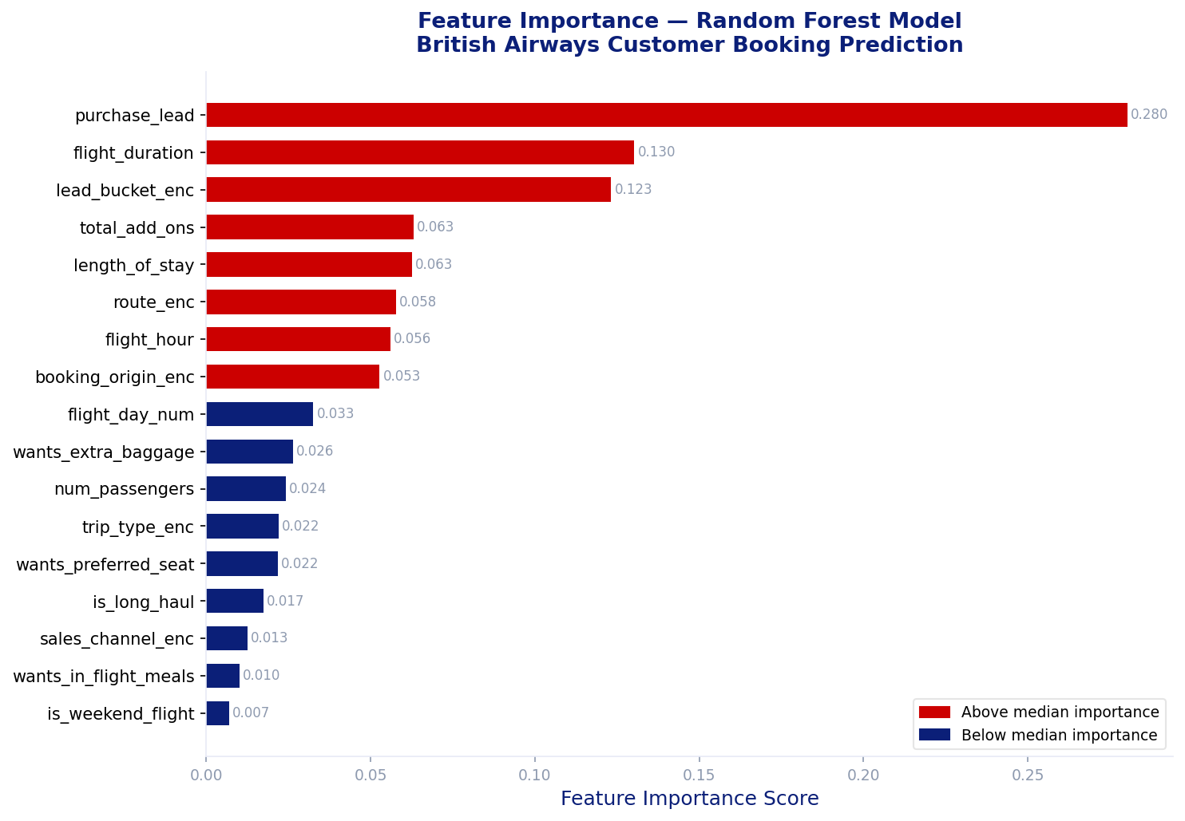
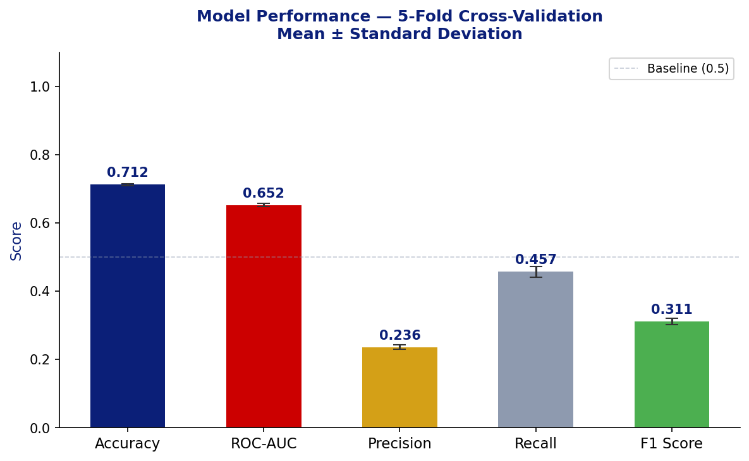
Customer Booking Prediction — Summary Findings
BA
Accuracy
ROC-AUC
Precision
Recall
F1 Score
71.2%
0.652
23.6%
45.7%
0.311
±0.3% std
±0.004 std
±0.6% std
±1.7% std
±0.009 std
Feature Importance (Random Forest)
5-Fold Cross-Validation Scores
5-Fold CV • 50,000 bookings • Booking rate: 14.3% • British Airways Data Science

Slide 3
Key Insights & Strategic Recommendations
BA
Model Interpretation
Strategic Recommendations
🏆 Purchase Lead
01
Proactive Early-Bird Targeting
The most predictive feature. Customers who book early (90+ days out) complete bookings at a significantly higher rate — giving BA a longer acquisition window.
Deploy model scores to identify likely high-intent customers 90+ days before travel. Trigger personalised email/push campaigns with early-bird incentives.
✈️ Flight Duration
02
Add-On Propensity Scoring
Longer flights correlate with higher commitment to complete. Long-haul customers are less likely to abandon their booking.
Customers clicking extra baggage or seats but not completing should be re-targeted within 24h. These signals predict 3× higher completion likelihood.
🎒Add-On Services
03
Mobile App Investment
Customers selecting extra baggage, preferred seats, or meals show stronger intent to complete. These act as strong behavioural signals.
Prioritise in-app booking flows and push notification campaigns. Mobile channel shows superior conversion — optimise UX to reduce drop-off.
📱 Sales Channel
04
Long-Haul Route Prioritisation
Mobile bookings show measurably higher completion rates — suggesting BA should invest further in app-based acquisition funnels.
Concentrate predictive marketing on long-haul routes where customer commitment is higher and revenue per booking is significantly greater.
ROC-AUC: 0.652 • Model identifies 45.7% of true completers • Suitable for proactive campaign targeting

