Slide 1
Salesforce DevOps, for everyone
CLAUDE PLUGIN · BITBUCKET · SALESFORCE
Promote changes and keep a clean version history — no senior developer required.

Slide 2
Why DevOps has been a weak spot
1
2
3
Change sets
The CI/CD push
Admins locked out
Slow, manual, and they overwrite silently — the top way admins break production.
Salesforce wants everyone on VCS + CI/CD, but the tooling needs a senior developer.
Non-developers can't promote cleanly, so good DevOps never reaches the team.

Slide 3
A Claude plugin that does the heavy lifting
The consultant speaks in plain environment terms — “promote from Dev to Stage.” Claude translates that into the right git and Salesforce CLI steps, under OpFocus guardrails.
Everyone can promote
Clean Bitbucket VCS
Admins and devs alike — the judgment is Claude's job.
Every change captured to git with real history.
Review with diffs
Shared audit trail
See exactly what changed — summary plus the line diff.
Every promote recorded in Salesforce.

Slide 4
How it fits together
Consultant
admin or developer
Claude plugin
promote & deploy logic
Salesforce CLI
Bitbucket Cloud
OpFocus Prod Org
retrieve / deploy to the client orgs
per-client repos — code & history
audit DB + secret broker
Claude orchestrates the CLI, Bitbucket, and the prod-org database — nothing new to install.

Slide 5
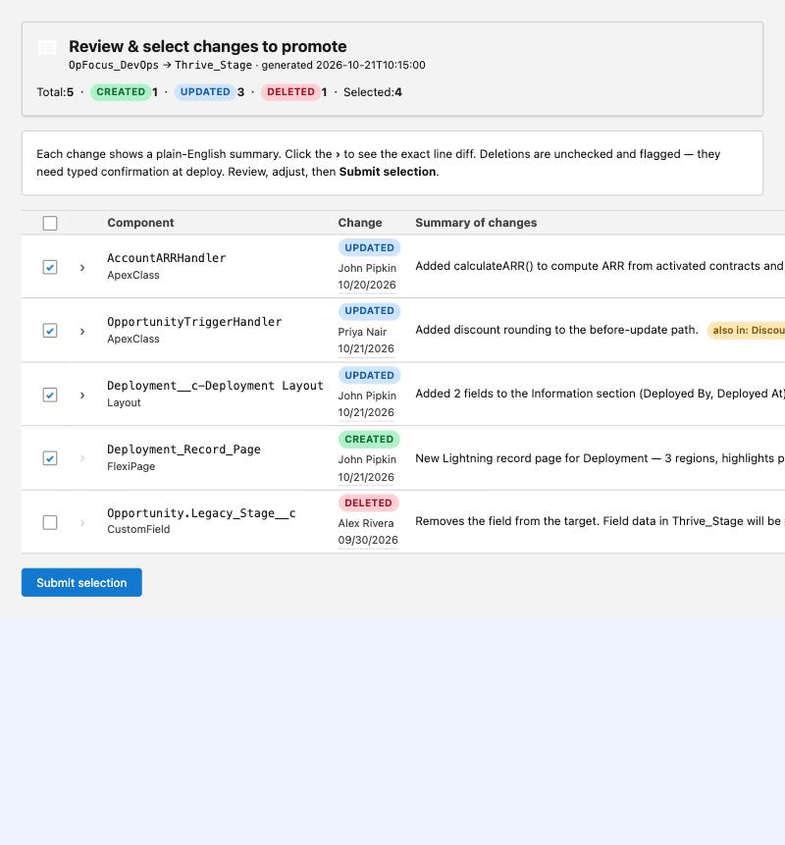
The daily flow: capture → review → promote
1
Capture
Source tracking detects exactly what changed in the org.
2
Review
Every change with a plain-English summary and the line diff.
3
Select
The consultant picks what to promote — nothing added behind their back.
4
Promote
Validate, deploy, commit to the branch, record it.
The review screen — every change, nothing hidden

Slide 6
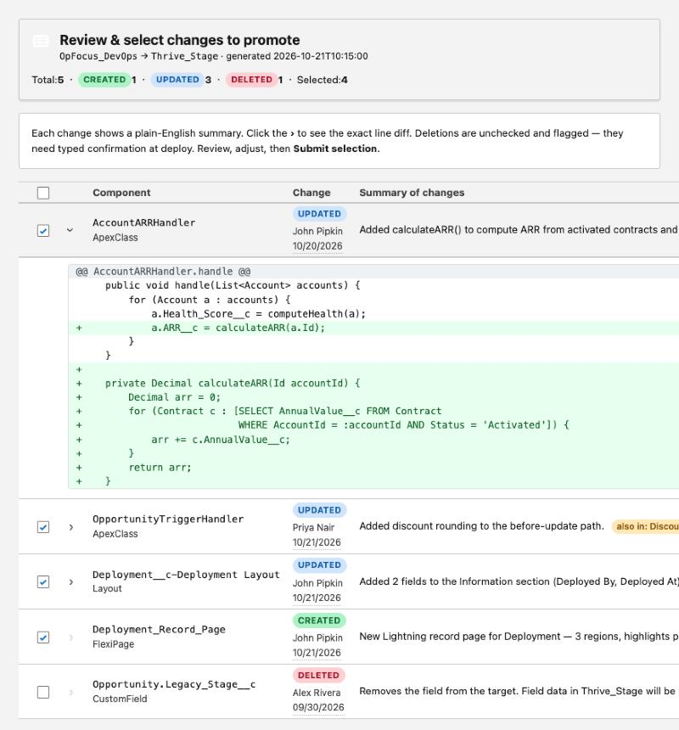
Review every change — with the real diff
Plain-English summary
Every row, always visible.
Diff on demand
A chevron reveals the exact red/green line diff.
Who & when
Last modified by and date, from the org.
Flags that matter
Shared-initiative and destructive deletes stand out.
Live change-selector — Apex diff expanded

Slide 7
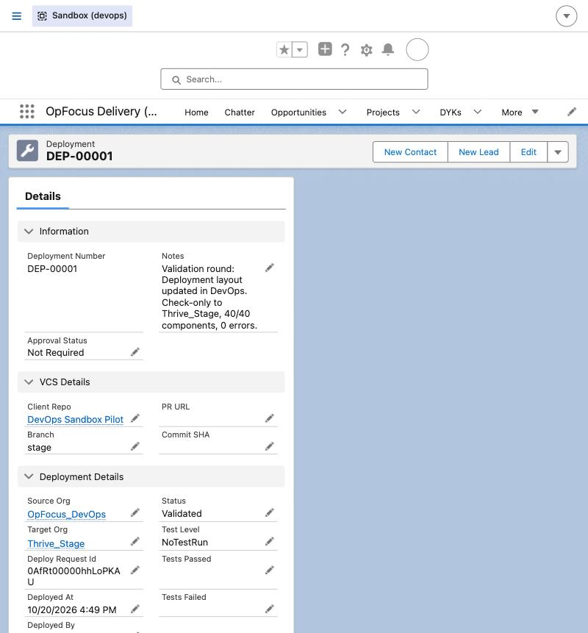
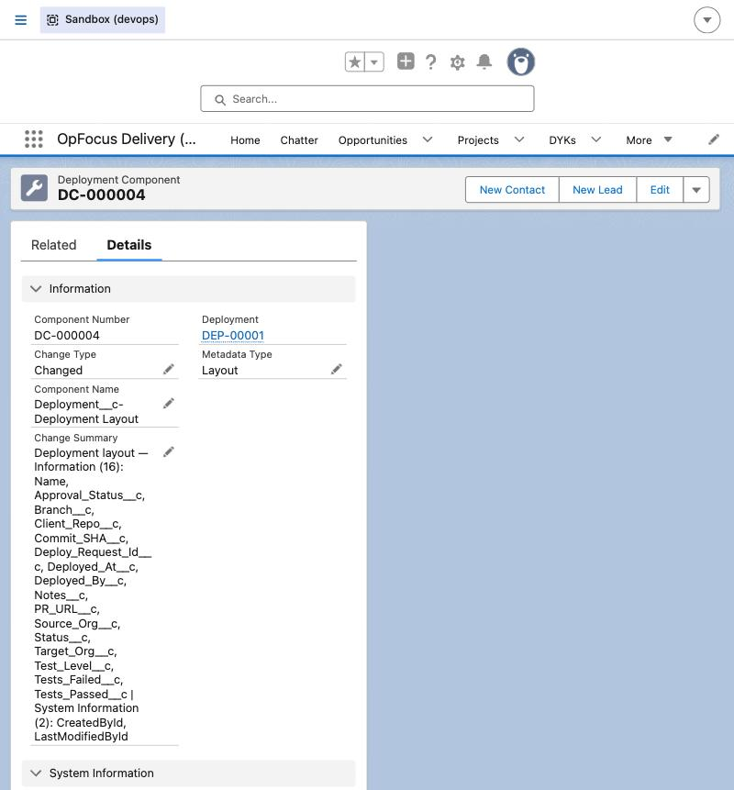
Every promote is recorded in Salesforce
The OpFocus production org is the shared database. Each promote writes a Deployment and a child record per component, each with a plain-English change summary.
Who, what, where
Source/target org, branch, commit, who ran it.
Validated → Deployed
Status lifecycle; tests captured.
Per-component detail
Change type + a summary of what changed.
Deployment record
Component + change summary

Slide 8
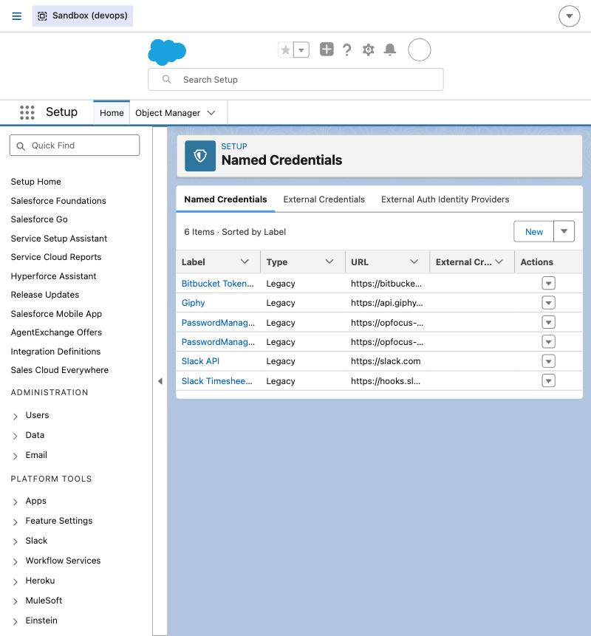
Secrets never touch a laptop
The Bitbucket OAuth secret lives only in a Named Credential in the prod org — encrypted and non-retrievable. An Apex endpoint hands out short-lived tokens. No secret file on any machine.
✓
No secret on laptops
Only disposable 2-hour tokens are vended.
✓
One-step offboarding
Deactivate the user — token access ends.
✓
Rotate in one place
Swap the secret once; everyone keeps working.
The token-broker Named Credential in Setup

Slide 9
Guardrails built in
Validate first, always
Overwrite protection
✓
✓
Check-only before any write — no surprise failures.
Warned if the target changed under you.
Deletes need typed confirmation
Profiles excluded
✓
✓
Destructive changes are off by default.
Use permission sets instead — better practice.
Never another team's work
Default-namespace only
✓
✓
A missing component is flagged, never auto-added.
Managed packages & static resources stay out.

Slide 10
Where it stands today
Working end to end
Next
✓
Plugin packaged & installable from Bitbucket
1
Roll the backend + broker to OpFocus Prod
✓
Backend data model live in the sandbox
2
Onboard a pilot client repo (CRL)
✓
Source-tracking capture + the review UI
3
Install for a first group of consultants
✓
Validated dev → stage promote (46 components, 0 errors)
4
A real dev → stage deploy, then widen rollout
✓
Token broker proven — no secret on the laptop

Slide 11
Let’s promote something
READY WHEN YOU ARE
Install it from Bitbucket, point it at a sandbox, and run a real capture-and-promote.

Slide 12


