Slide 1
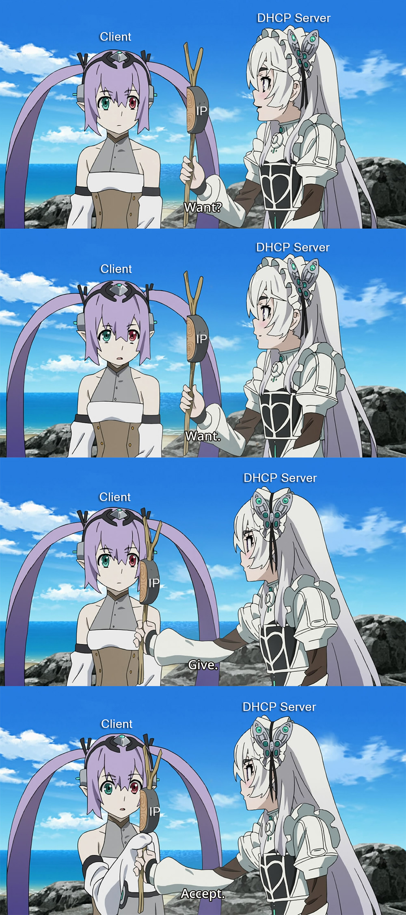
Discover
I need an address
Is there a DHCP server?
Offer
I’m here. Here’s an address
Request
Cool, I’ll take it
Acknowledge
You got it!

