Slide 1
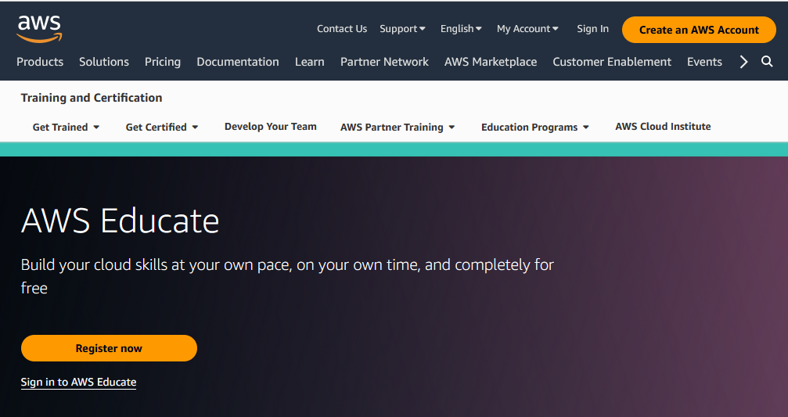
Use later to access AWS services
Create your account
Log in to your account

