Slide 1
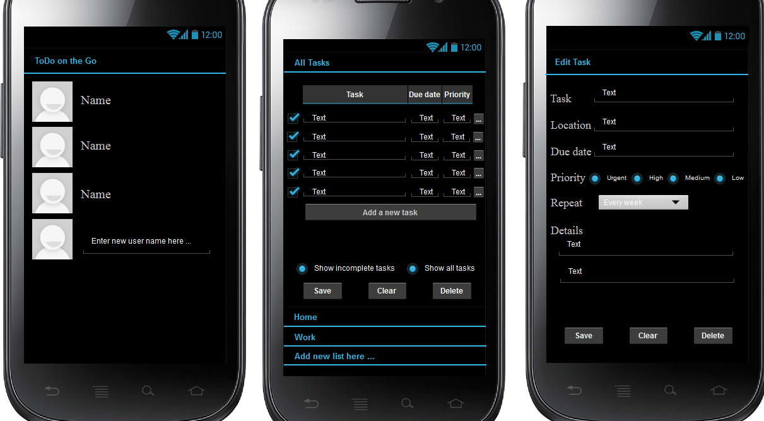
Sort by “Task”, “Due Date”, or “Priority”
Click user icon to view lists
Click “Add a new task” or “…” button to edit task
Some default settings: 1, Show incomplete tasks; 2, Due date: one day after entering date 3, Repeat: Never.

