Slide 1
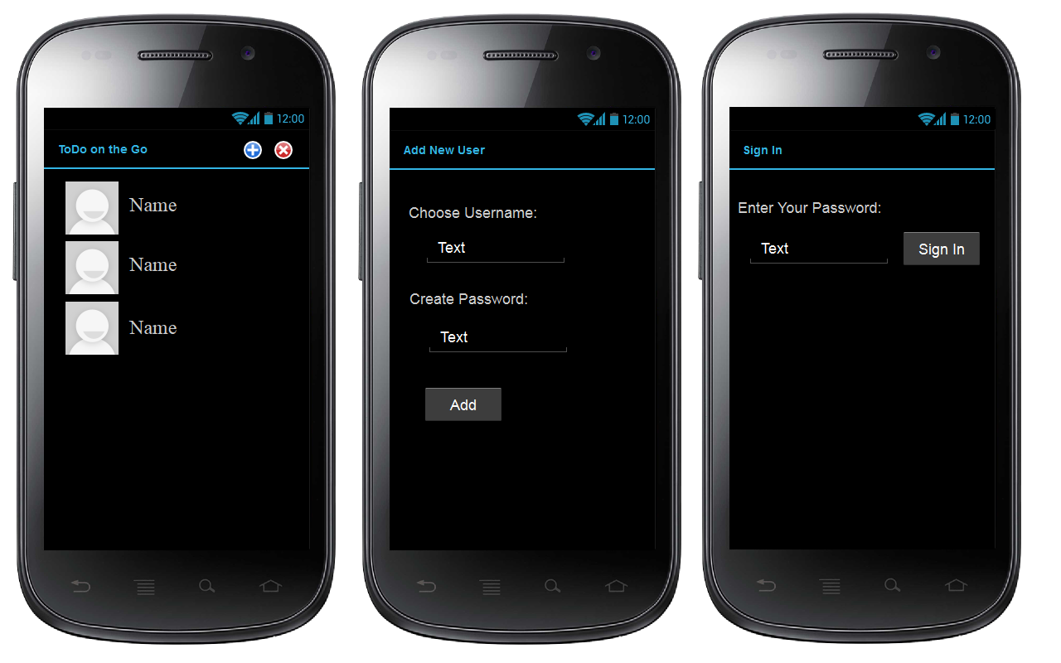
Main Screen
Add new user
Sign in

Slide 2
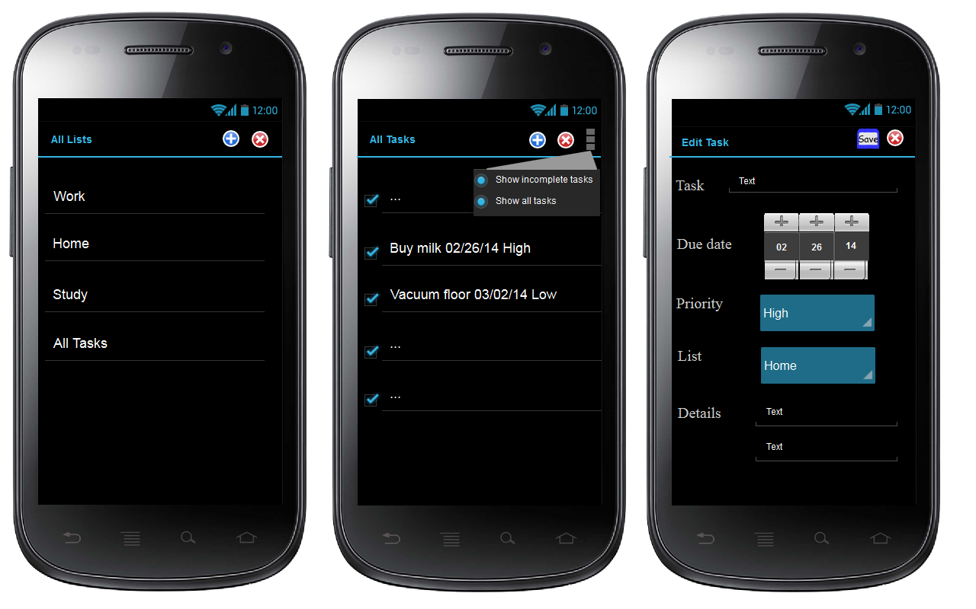
View all lists
View all tasks
Edit task
(default: Show incomplete tasks)
(default priority: High)

