Slide 1

Python Ireland
Meetups Monthly, Pizza and Python:
https://www.meetup.com/pythonireland/
https://www.meetup.com/PyLadiesDublin/
Annual Events:
PyCon.ie
PyCon Dublin Autumn 2020
PyCon Limerick, 29 February Strand Hotel
PyCon Cork , Spring 2020
EuroPyCon: 20-26 July 2020

Slide 2
today
Background stuff.. that you need to know
Resources you need to get started
Free lessons and where to find them
Demo of hand writing recognition

Slide 3
For now....
Consider :
Machine Learning (ML)
Artificial Intelligence (AI)
Image Classification and Object detection
Are all closely related....
….. with overlap into Data Science..
...and Python is used extensively

Slide 4
Back in the 90's
Computers could read typed characters
eg printed words on paper
OCR with scanners
But handwriting a major challenge
Problem: How do we get a computer to recognise handwriting with all its variations
Solution: CNN's => basis for AI/AL

Slide 5
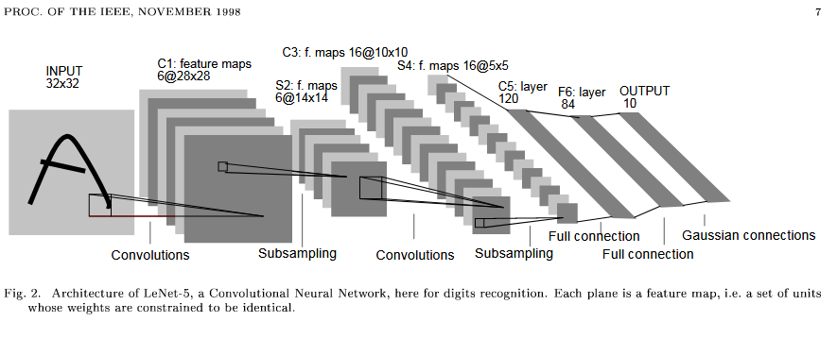
Yann LeCun and Lenet
Source http://yann.lecun.com/exdb/publis/pdf/lecun-98.pdf
DataSet : MNIST
Problem: How to read handwritten digits automatically
Solution: CNN's ==> universal tool for machine learning

Slide 6
Image-Net
http://www.image-net.org/
Challenge competition 2011 to 2016
16 million images 20 thousand categories
Error before 2011- 30% by 2016 - 5%
Famous Entries become industry start-points
AlexNet, GoogLenet, VGG, ResNet
Pretrained now available
NEW! Google Dataset search
https://datasetsearch.research.google.com/

Slide 7
Remember this one thing....
“The difference between Artificial Intelligence and Artificial Stupidity is good data !”....John Reilly

Slide 8
Keras
Since 2015, Python Deep Learning Library
Lets you design CNN's at high level
Uses Theano, CNTK (MS), Tensorflow (Google)
Now integrated with Tensoflow 2.0
Keras on top of Tensorflow for fast development
Tensorflow for detailed work
https://keras.io/

Slide 9
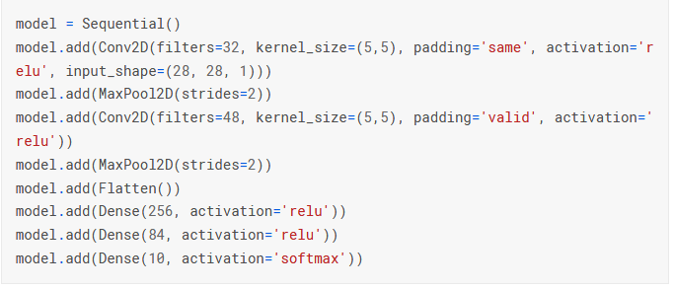
Keras Example, LeNet
https://www.kaggle.com/curiousprogrammer/lenet-5-cnn-with-keras-99-48

Slide 10
Tensorflow
Google release Tensorflow 2015
Very detailed control possible
Most popular and universal in use
2.0 out Autumn 2019 beware old code snippets
Now standard with Keras
https://www.tensorflow.org/
https://github.com/tensorflow/models/tree/master/official
Tensorlite new!

Slide 11
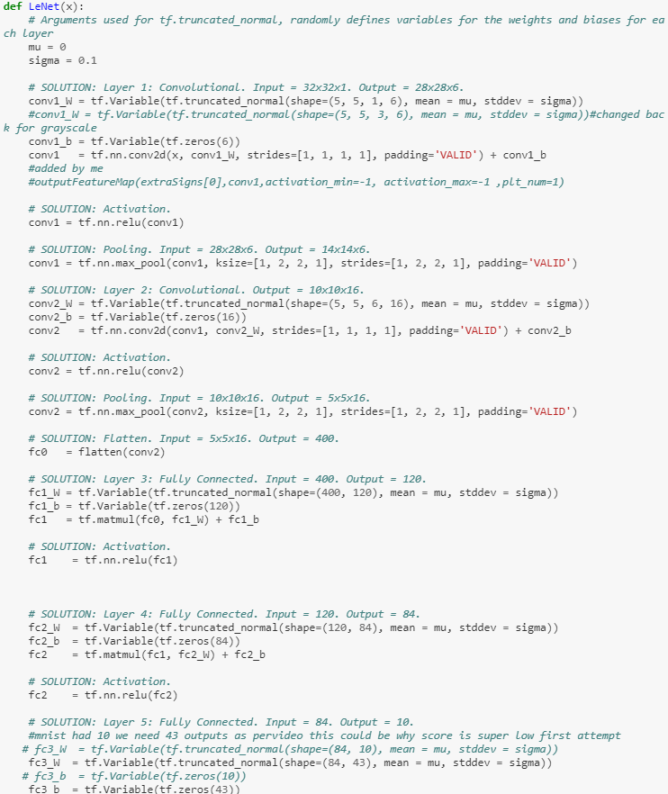
Tensorflow ,LeNet https://github.com/john-reilly/Self_Driving_Car_Nano_Degree_Project_2_Traffic_Sign_Classifier/blob/master/Traffic_Sign_Classifier_John_Reilly_85%25_Validation_Score.ipynb

Slide 12
Pytorch , Facebook
Released 2016 , FAIR
Generally easier to use than Tensorflow
more like Keras than TF
Known for ease of use and “built in” models and datasets

Slide 13
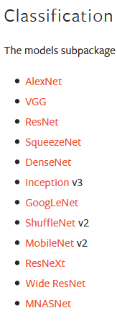
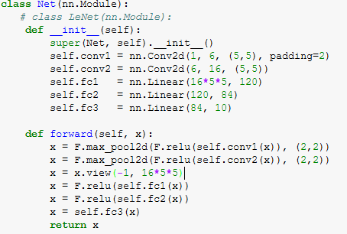
Pytorch https://pytorch.org/docs/stable/torchvision/models.html

Slide 14
API's , just add Data!
Face, Image, Voice, translation etc...
Google :
https://cloud.google.com/ai-platform/
Microsoft :
https://azure.microsoft.com/en-us/services/cognitive-services/
https://docs.microsoft.com/en-us/azure/machine-learning/
Amazon:
https://aws.amazon.com/machine-learning/

Slide 15
Summary, So far
We can make AI models like LeNet to “learn”
Make with Keras, Tensorflow, Pytorch
“standard” Datasets (Image-Net) and Models (AlexNet) ready for use
API's from Cloud Providers
Next what you need to start

Slide 16
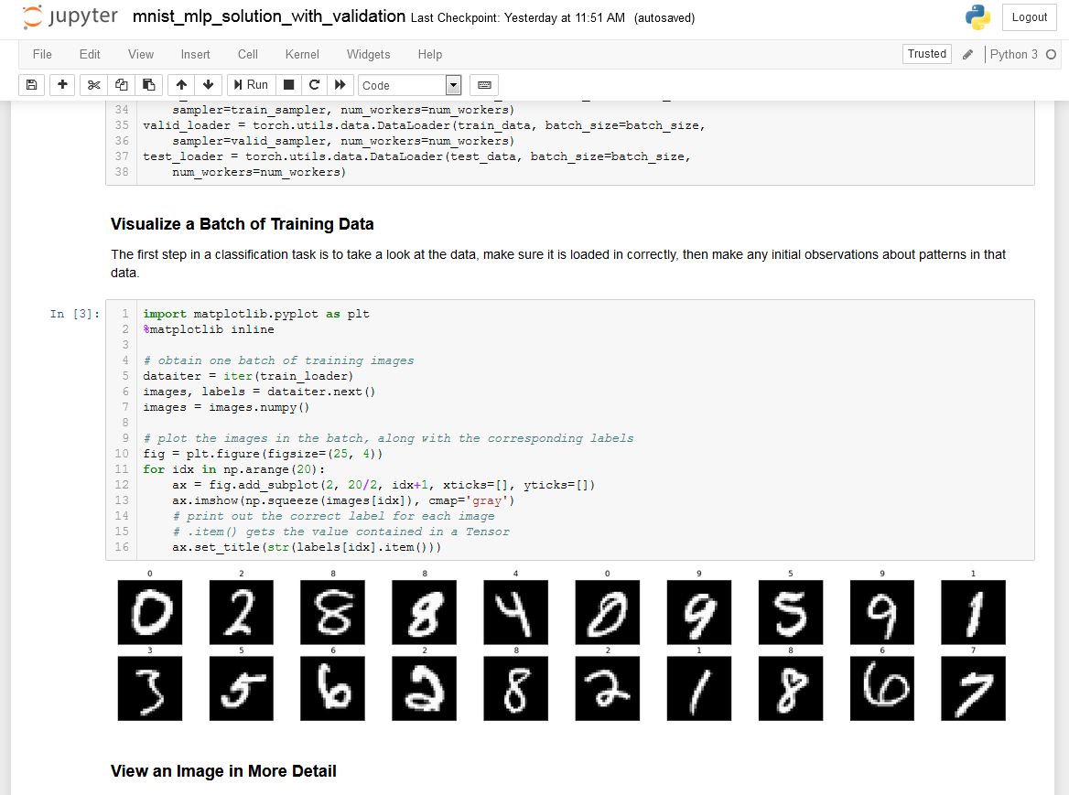
Notebooks https://jupyter.org/

Slide 17
Google Colab
Ready to go in the Google Drive
Python installed AND GPU available!
Clone a Github Repo and go
Also but no GPU for free
MS Azure notebook:
https://notebooks.azure.com/
Binder:
https://mybinder.org/

Slide 18
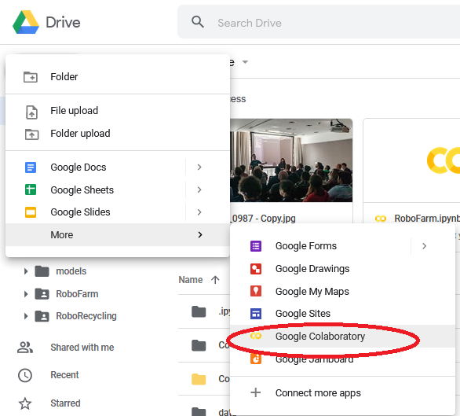
A bit hidden.....

Slide 19
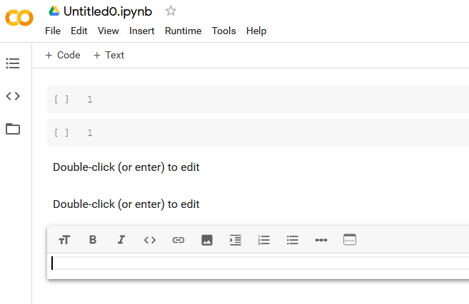
A new Colab notebook

Slide 20
Beyond notebooks
Sublime free and open source
https://www.sublimetext.com/
Visual Studio Code, open source, many languages, lots of plug-ins, notebooks can now be integrated
https://code.visualstudio.com/
Link to video of VS studio with notebooks integrated....new feature
https://www.youtube.com/watch?v=FSdIoJdSnig

Slide 21
Learning Resources
Tensorflow:
https://www.tensorflow.org/tutorials
https://www.tensorflow.org/resources/learn-ml
(includes books)
Google seedbank:
https://research.google.com/seedbank/
Keras:
https://keras.io/
PyTorch:
https://pytorch.org/tutorials/

Slide 22
3rd party Learning Resources
Udacity, my favourite
PyTorch:
https://www.udacity.com/course/deep-learning-pytorch--ud188
Tensorflow:
https://www.udacity.com/course/intro-to-tensorflow-for-deep-learning--ud187
Kaggle, very popular, known for competitions
https://www.kaggle.com/
Fast.ai , also very popular and well known
https://docs.fast.ai/tutorials.htmL
Udemy , many cheap courses
https://www.udemy.com/courses/search/?q=pytorch&src=sac&kw=pytorch

Slide 23
A plan....
Start with Google Colab
Do Udacity Deep Learning with Pytorch Free Course
Follow up with more examples Kaggle and Fast.ai
Python 3 and Jupyter Notebook locally
Evolving towards Visual Studio Code locally to run bigger projects
Invest in NVIDIA card …...
why NVIDIA????..... there is a reason.......

Slide 24
DEMO

Slide 25
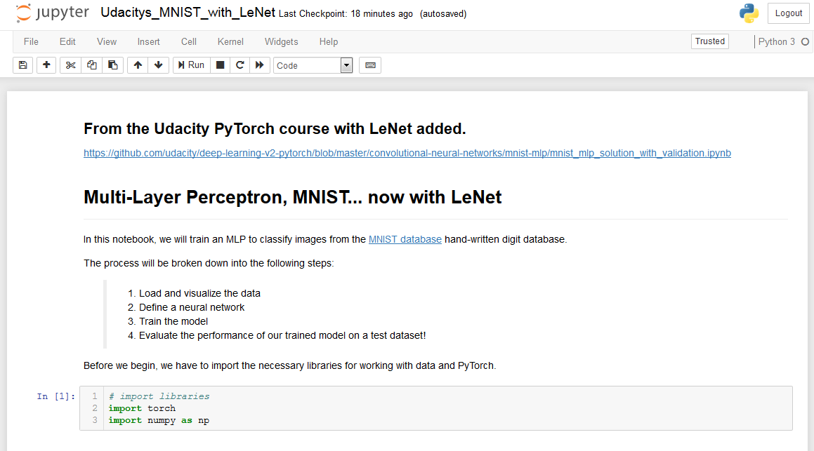

Slide 26
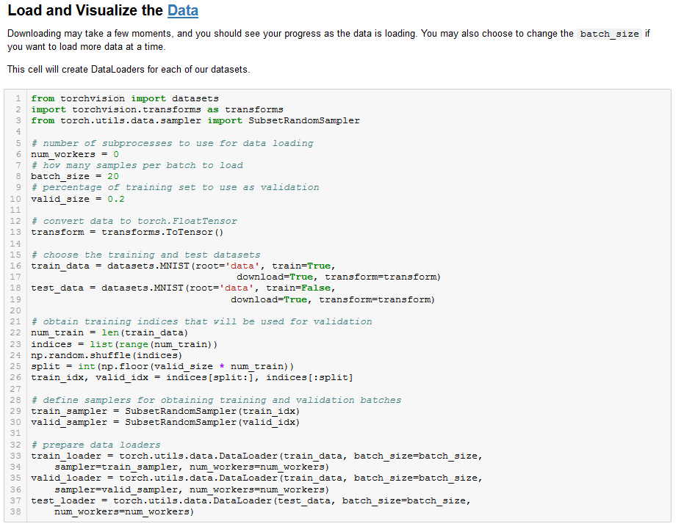

Slide 27
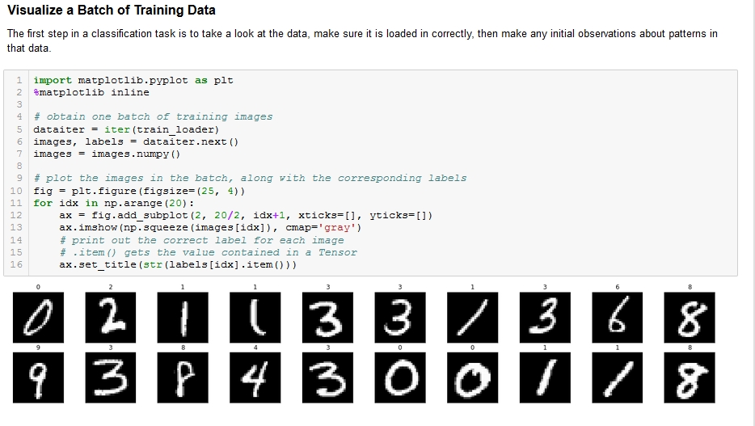

Slide 28
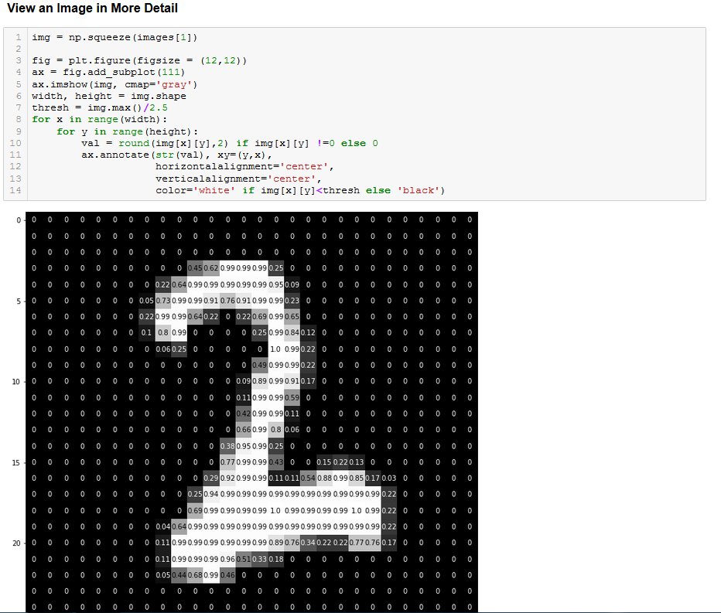

Slide 29
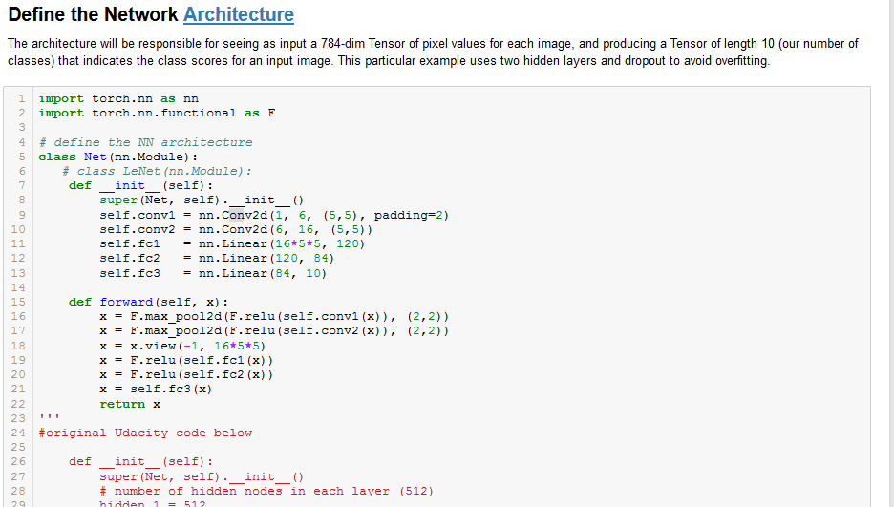

Slide 30
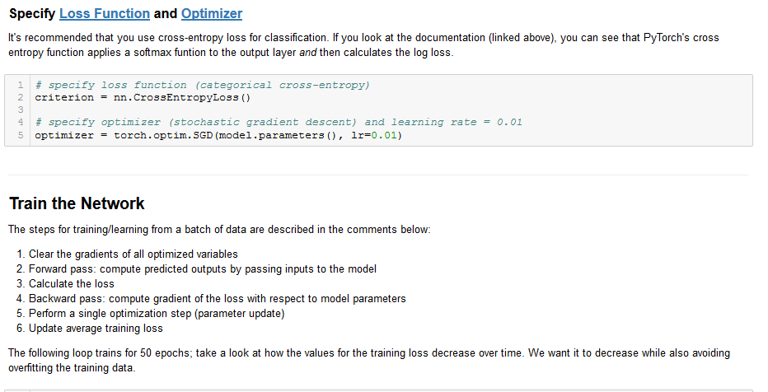

Slide 31
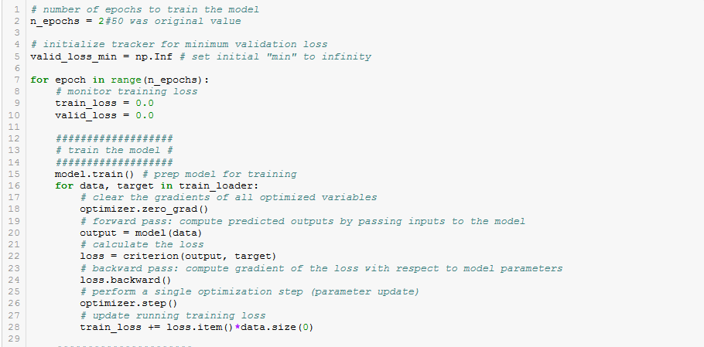

Slide 32
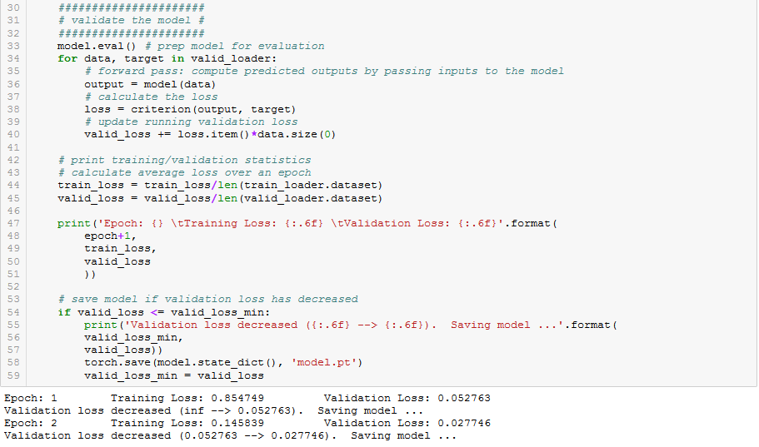

Slide 33
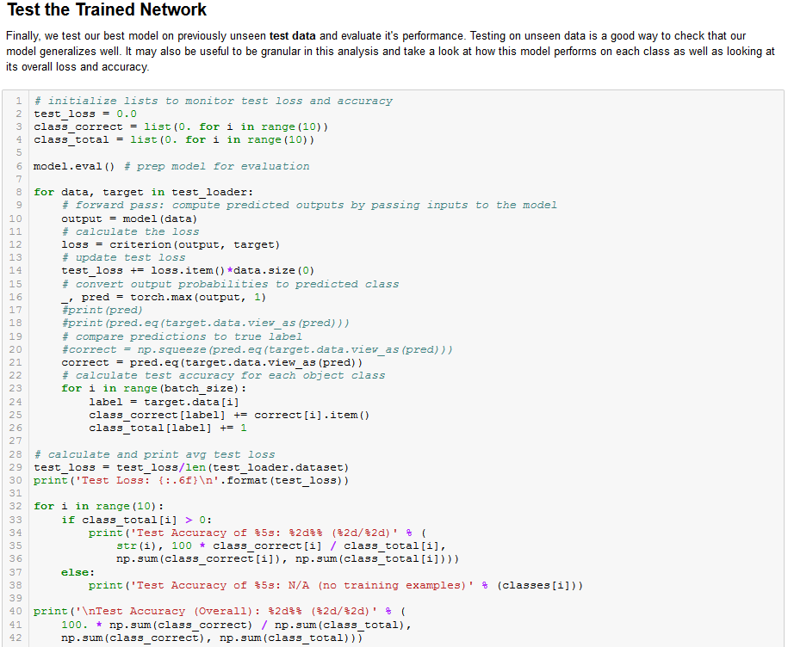

Slide 34
