Slide 1
project one
by j.rice

Slide 2
presentation agenda
07 conclusions
q1 – article with the most traffic on oct 20th
q6 – comparison of mobile vs. desktop views on articles
07
q1
q6
q2 – article with the largest % of internal link visits
q2
q5 – average vandalized article visits before reversal
q5
q3
q3 – series of Hotel California articles with the highest % internal link visits
q4
q4 – articles more popular in US, UK & Australia

Slide 3
what article on Oct 20th got the most traffic?

Slide 4
q1
PROCESS
Loaded hourly page views files (.gz, no extract)
Ran a MapReduce in Hive, selected on “en” and “en.m” results
Limited the query and sorted by total views
grouped by article and domain code to show specifics (desktop or mobile)

Slide 5
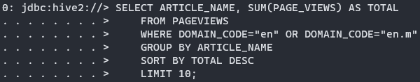
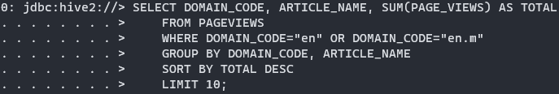
q1
QUERIES

Slide 6
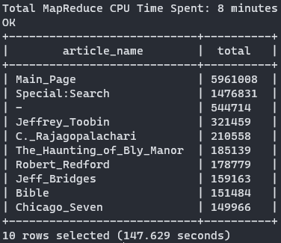
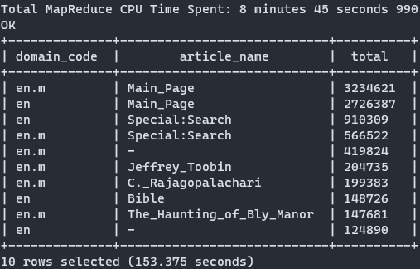
q1
RESULTS

Slide 7
what article has the largest % of internal link visits?

Slide 8
q2
PROCESS
Ran MapReduce on clickstream data in Hadoop to only internal referrers
Sent results of Hadoop’s clickstream MapReduce to Hive
Ran a MapReduce in Hive on Pageview data (because of previous queries)
Used Hive to join both clickstream and pageview data
Ran a query to divide internal clicks by the total page views to get a percentage of use

Slide 9
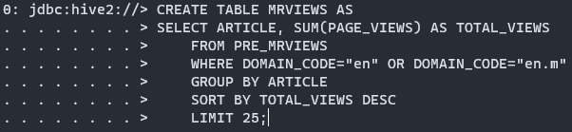

q2
QUERIES

Slide 10
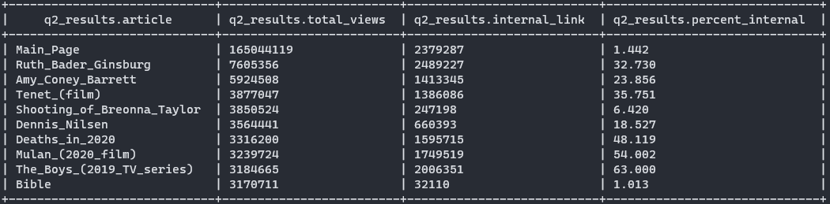
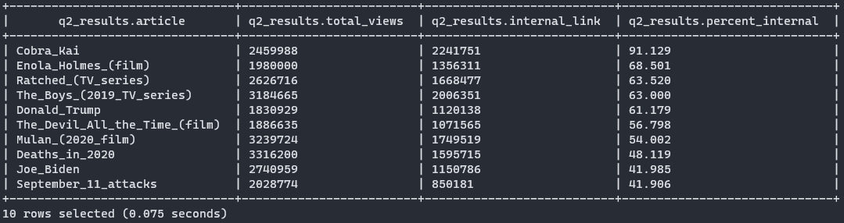
q2

Slide 11
what series of Hotel California-related articles have the largest amount of internal link visits?

Slide 12
q3
PROCESS
Used the click stream data from q2
Queried to select internal links from where the referrer was an article, while the requested title was set to Hotel California
Queried to select internal links from where the referrer was Hotel California, while the requested title was set to any article title

Slide 13
q3
PROCESS
After running both variations, querying the click stream when the referrer was set to Hotel California gave me the most promising results.
From there, I replaced the where statement portion where “referrer like” “article” was replaced with the next highest article in respect to internal links.

Slide 14
q3
QUERIES

Slide 15
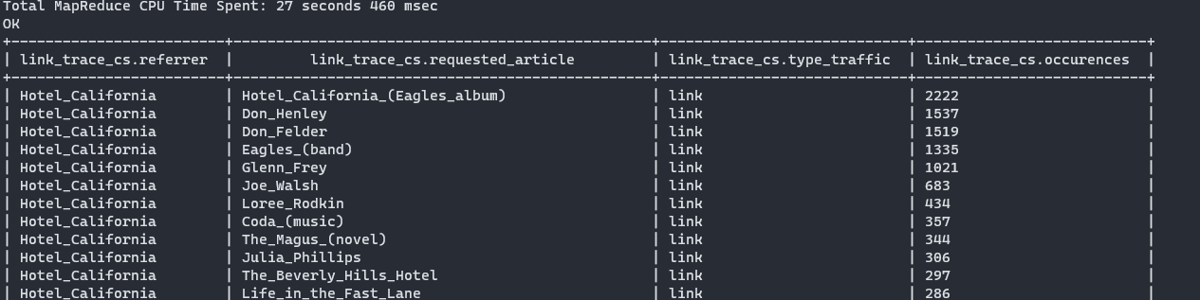
q3
RESULTS

Slide 16
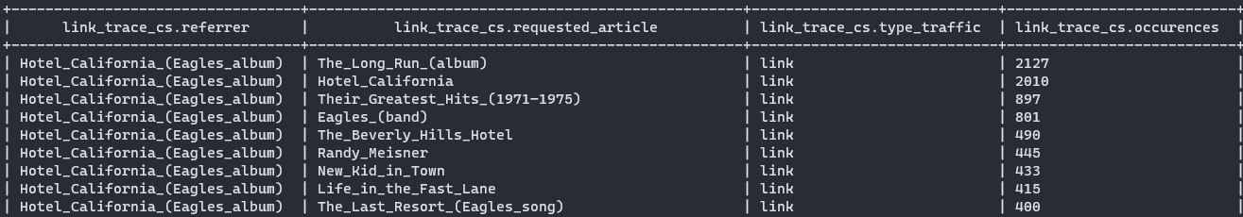
q3
RESULTS

Slide 17
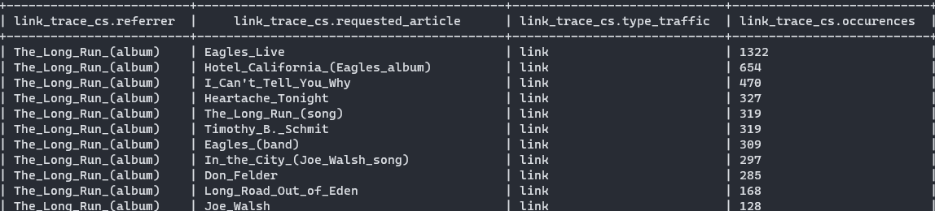
q3
RESULTS

Slide 18

q3
RESULTS

Slide 19
what articles are relatively more popular in US, UK & Australia?

Slide 20
q4
PROCESS
Sampled pageview data from Sept 1st 2020
Used a time zone converter to get US, UK and Australian city times respectively
To get the most consistent data, I took a 5-hour UTC period that remained the same for each chosen city for each country.

Slide 21
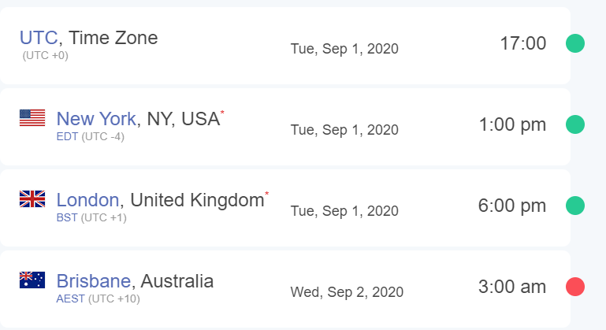
q4
PROCESS

Slide 22
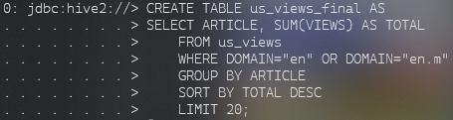
q4
PROCESS
For 5-hour blocks for each country, I placed them in to hive tables.

Slide 23
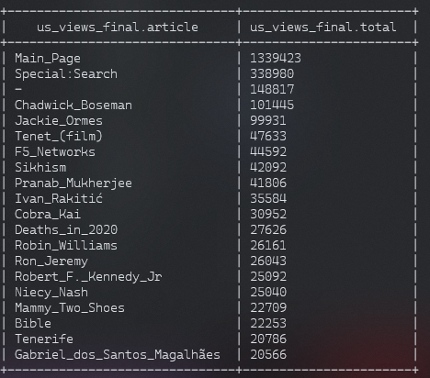
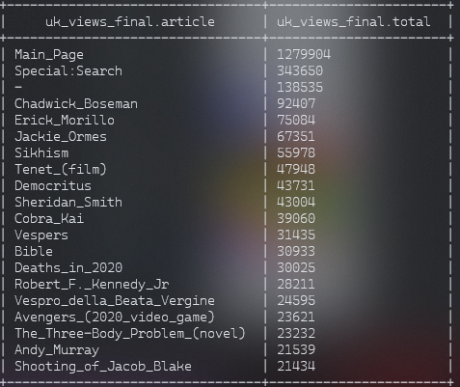
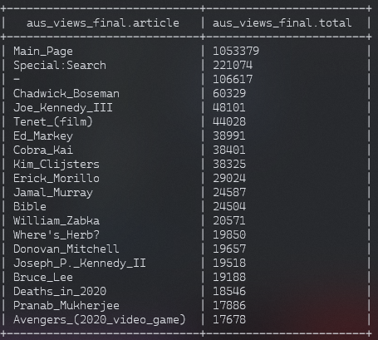
q4
RESULTS

Slide 24
what’s the average visits a vandalized article receives before reversed?

Slide 25
q5
PROCESS
For Q5, I made some simplifications due to the denormalized state of the dataset
For Q5, I found the worst-case scenario of vandalism to an article and took a sample of pageviews to represent the worst-case amount of views a page could receive

Slide 26
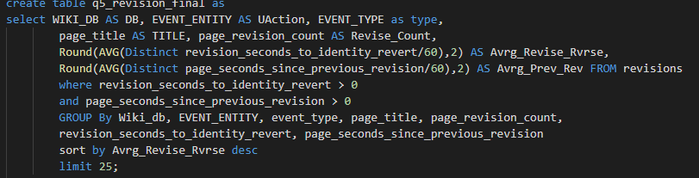
q5
QUERIES

Slide 27
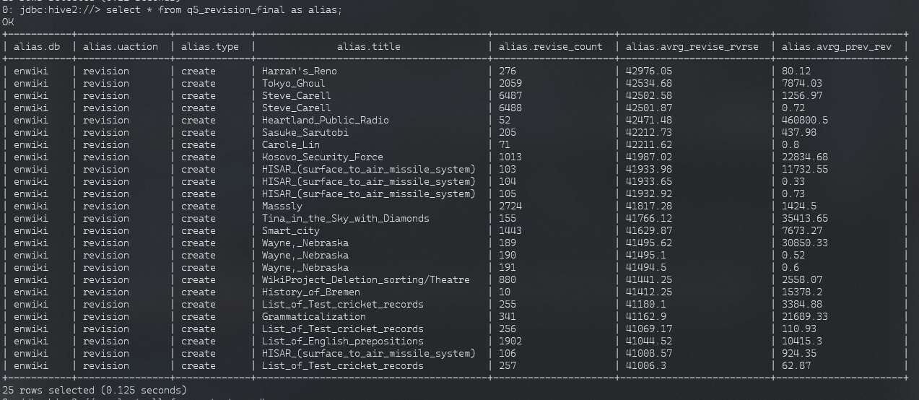
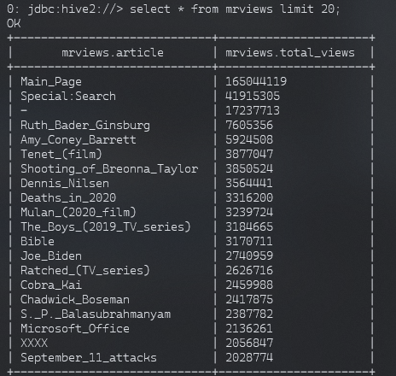
q5
RESULTS

Slide 28
what does the mobile vs. desktop pageviews show us? possible explanations?

Slide 29
q6
PROCESS
For Q6, I decided to compare the mobile and desktop pageviews
Typically, in a company this can be important to understand the type of devices their visitors use and can help them better display information

