Slide 1

The Maths of Predators and Preys Don’t get Eaten by the Wolf
Dr John Butler TU Dublin (Lecturer in Mathematics and Statistics)

Slide 2
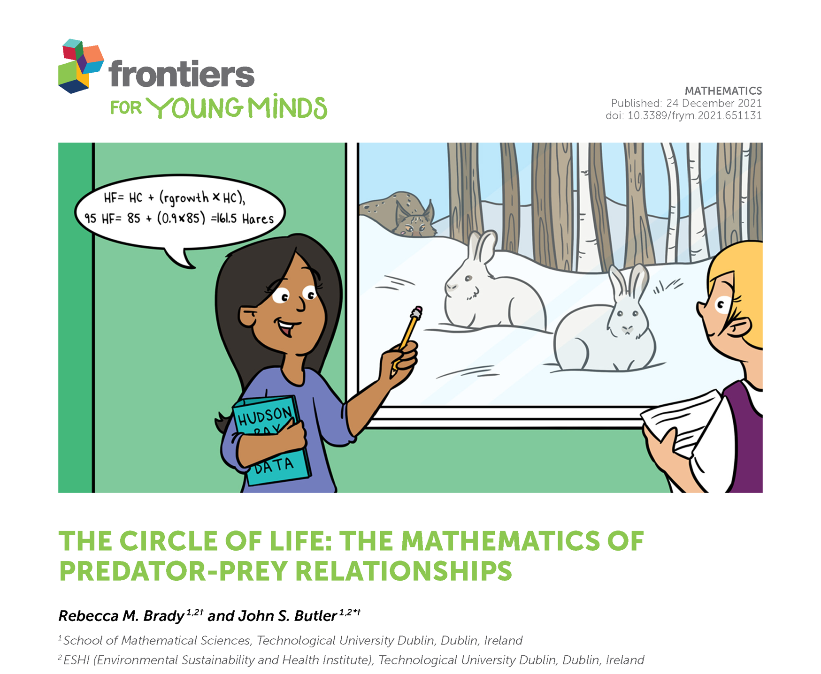

Slide 3
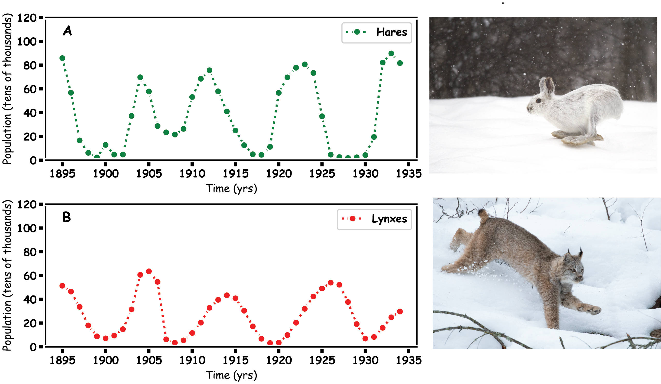
Predator Prey
Hares and Lynx

Slide 4
Prey Hares

Slide 5
Predator

Slide 6
Predator and Prey

Slide 7
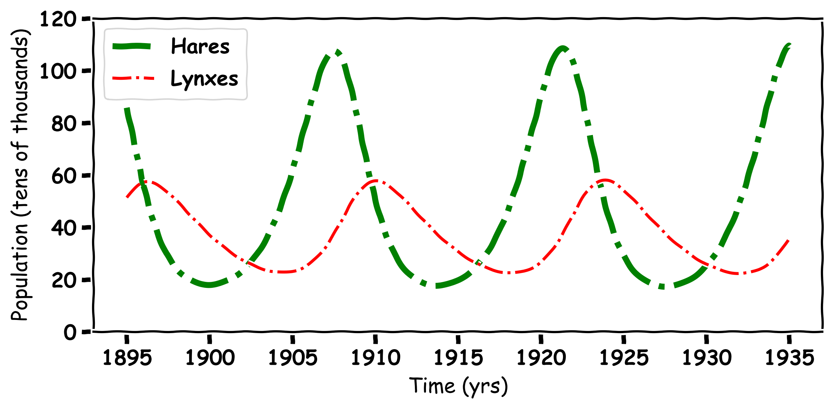
Predator and Prey

Slide 8
Mathematics

Slide 9
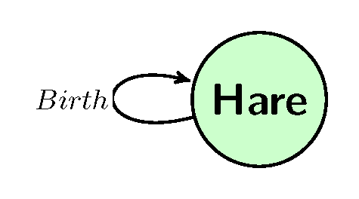

Hares
How to we make a model for a Hare population

Slide 10
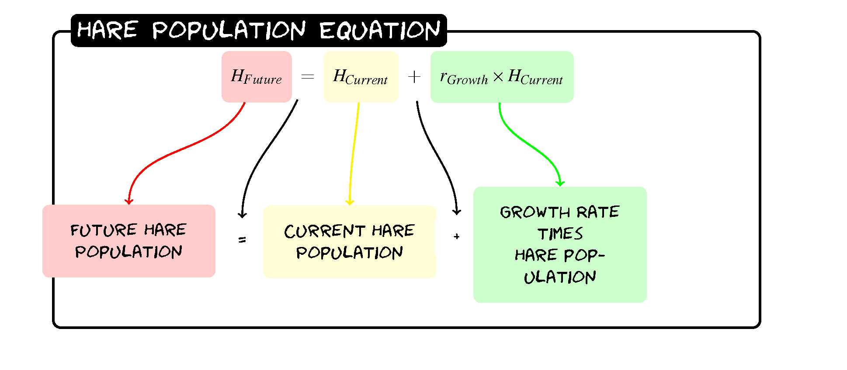
Hares
H_{Future}=H+0.2(H)

Slide 11
Hares
H_{Future}=H+0.2(H)
Year | Hare Population
0 | 60
1
2
3

Slide 12
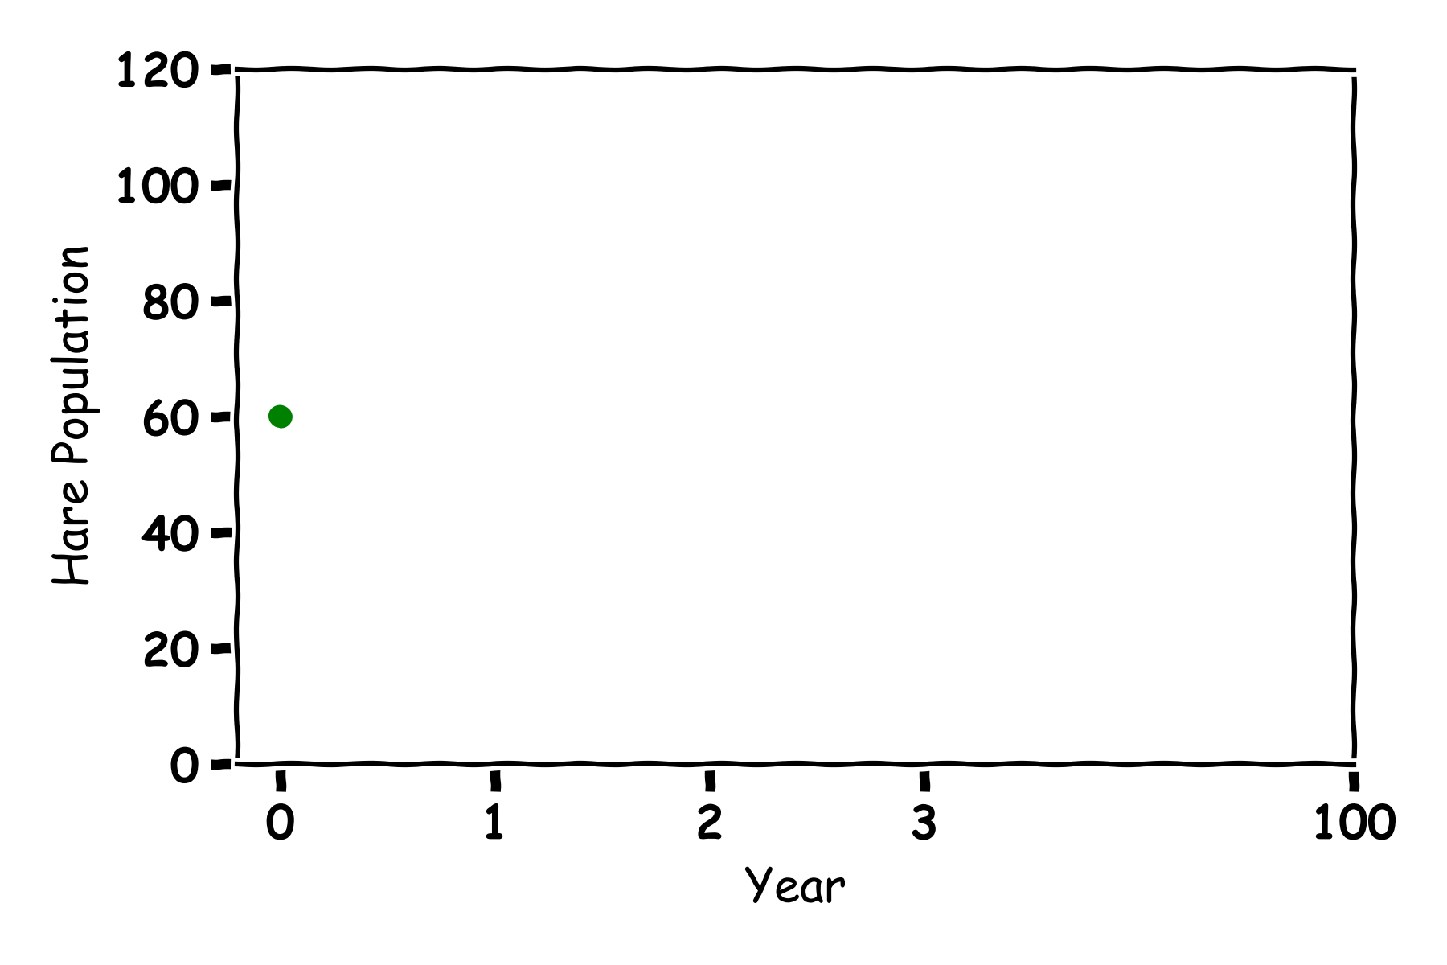
Hares
H_{Future}=H+0.2(H)
Year | Hare Population
0 | 60
1 | 60+0.2(60)=72
2
3

Slide 13
Hares
H_{Future}=H+0.2(H)
Year | Hare Population
0 | 60
1 | 60+0.2(60)=72
2 | 72+0.2(72)=86
3

Slide 14
Hares
H_{Future}=H+0.2(H)
Year | Hare Population
0 | 60
1 | 60+0.2(60)=72
2 | 72+0.2(72)=86
3 | 86+0.2(86)=103

Slide 15
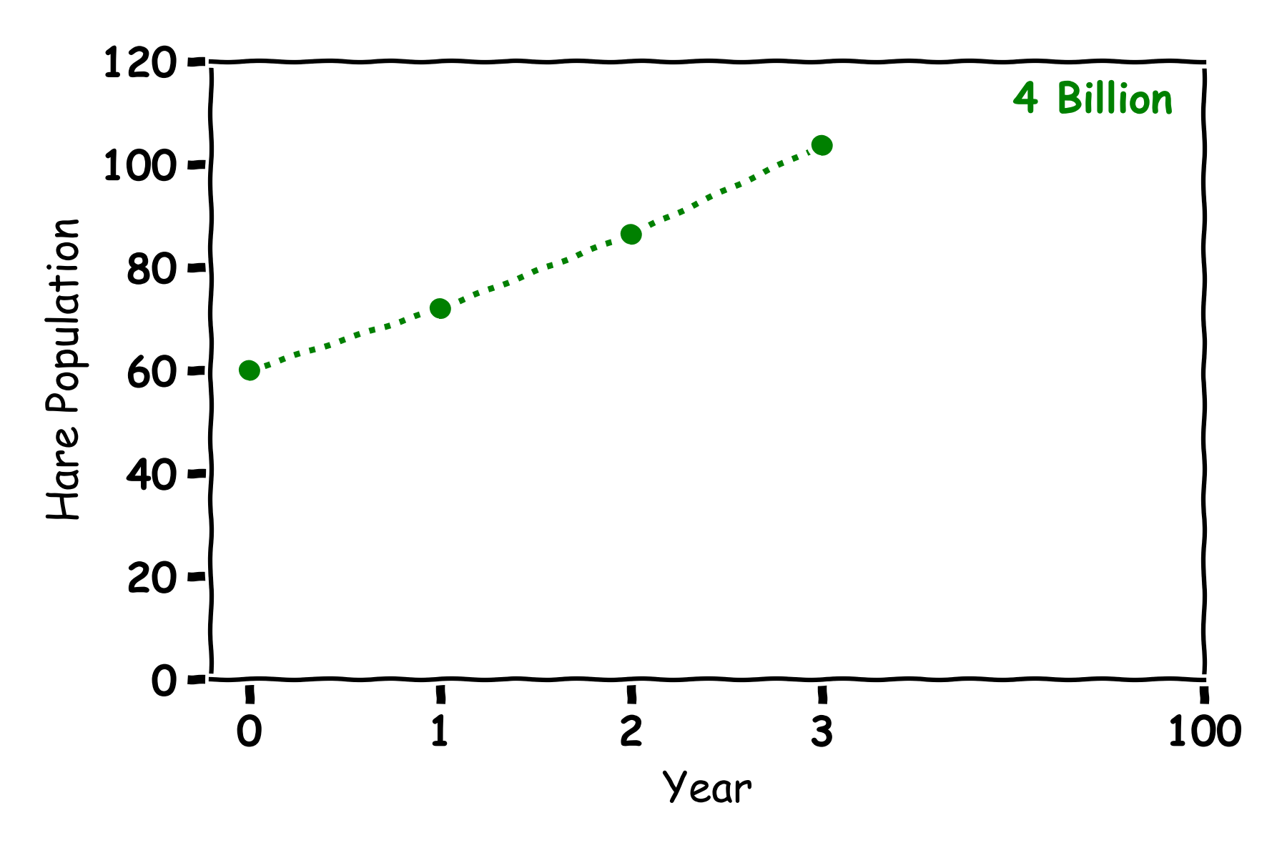
Hares
Year | Hare Population
0 | 60
1 | 72
2 | 86
3 | 103

Slide 16
Hares
Year | Hare Population
0 | 60
1 | 72
2 | 86
3 | 103

Slide 17
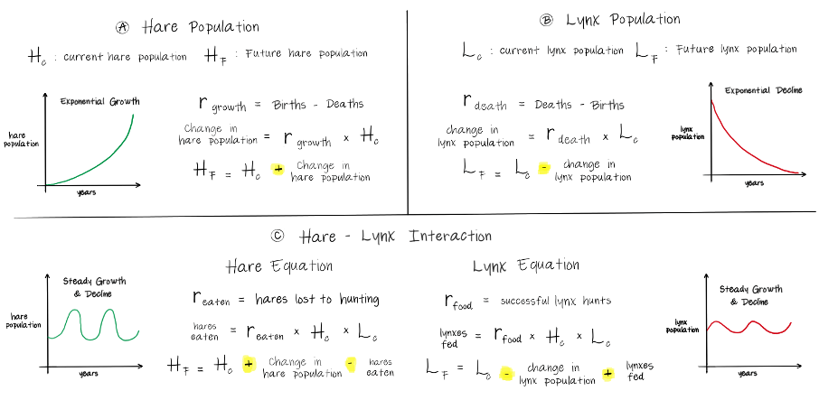
Hare Population

Slide 18
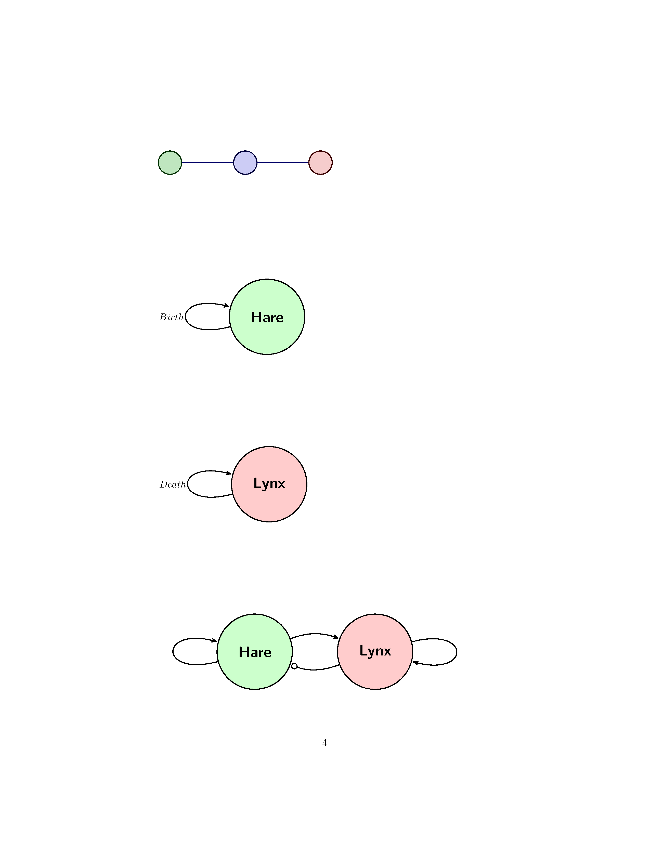
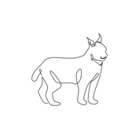
Lynx
How to we make a model for a Lynx population

Slide 19

Lynx
L_{Future}= L-0.1(L)

Slide 20
Lynx
Year | Lynx Population
0 | 30
1
2
3

Slide 21
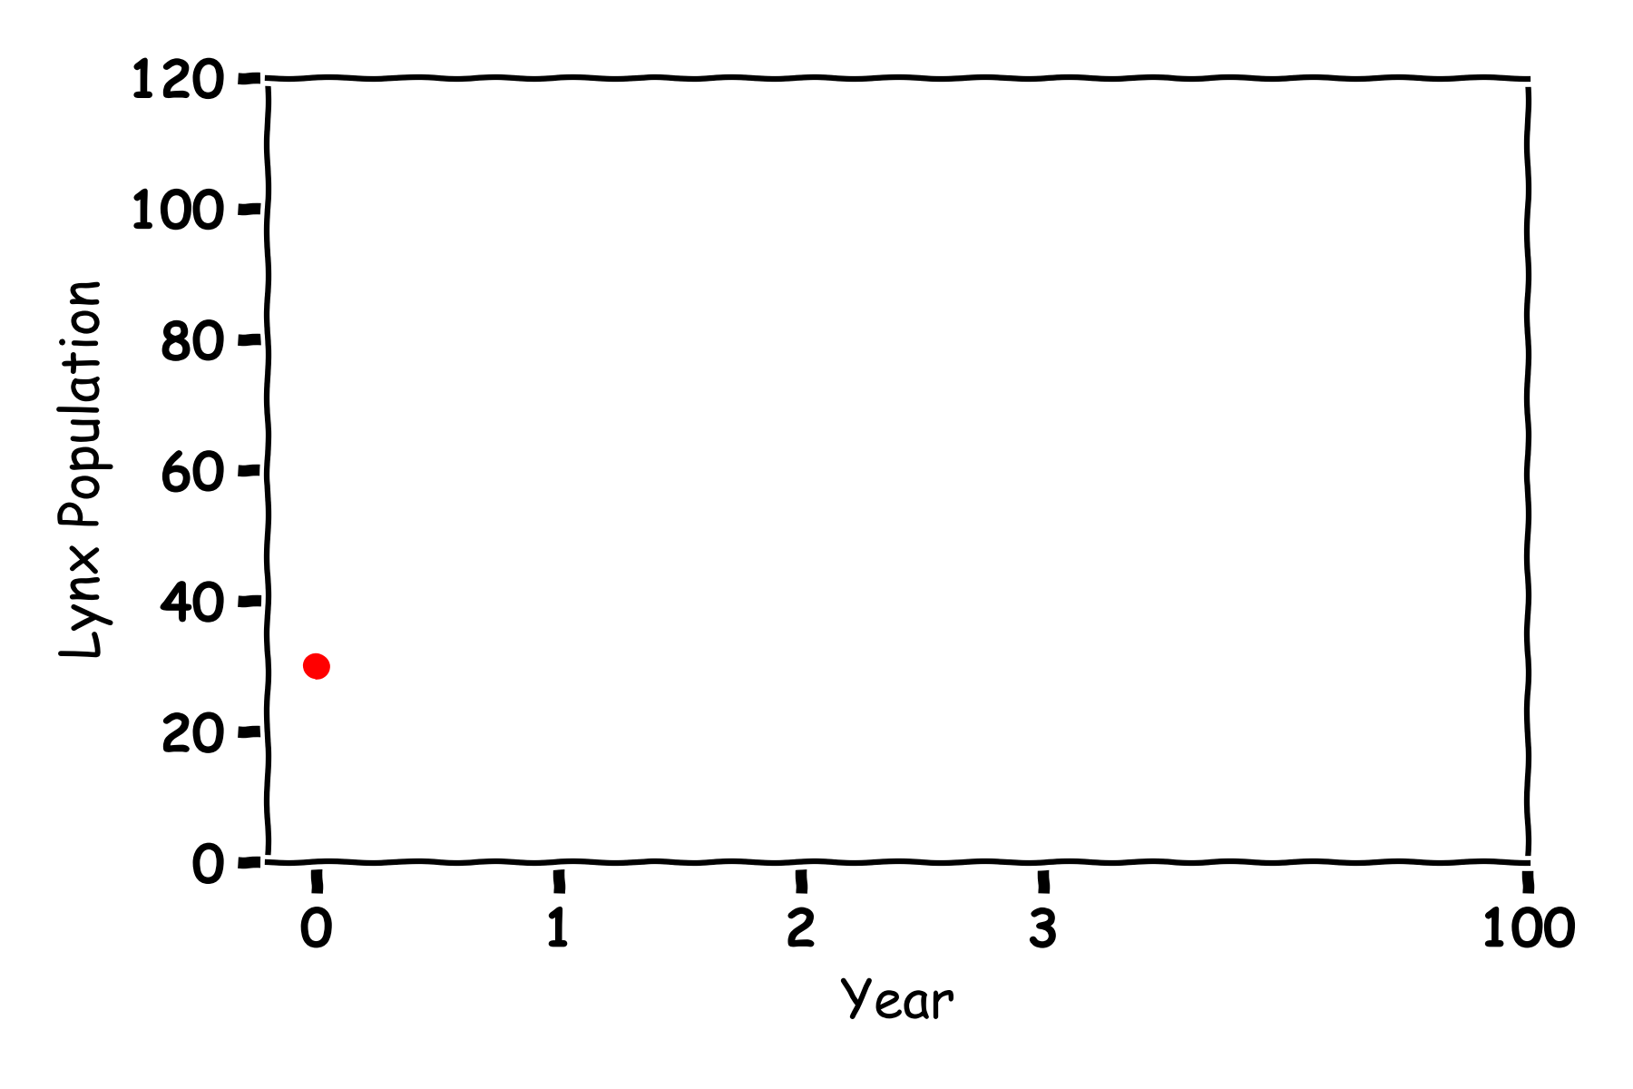
Lynx
L_{Future}= L-0.1(L)
Year | Lynx Population
0 | 30
1
2
3

Slide 22
Lynx
L_{Future}= L-0.1(L)
Year | Lynx Population
0 | 30
1 | 30-0.1(30)=27
2
3

Slide 23
Lynx
L_{Future}= L-0.1(L)
Year | Lynx Population
0 | 30
1 | 30-0.1(30)=27
2 | 27-0.1(27)=24
3

Slide 24
Lynx
L_{Future}= L-0.1(L)
Year | Lynx Population
0 | 30
1 | 30-0.1(30)=27
2 | 27-0.1(27)=24
3 | 24-0.1(24)=22

Slide 25
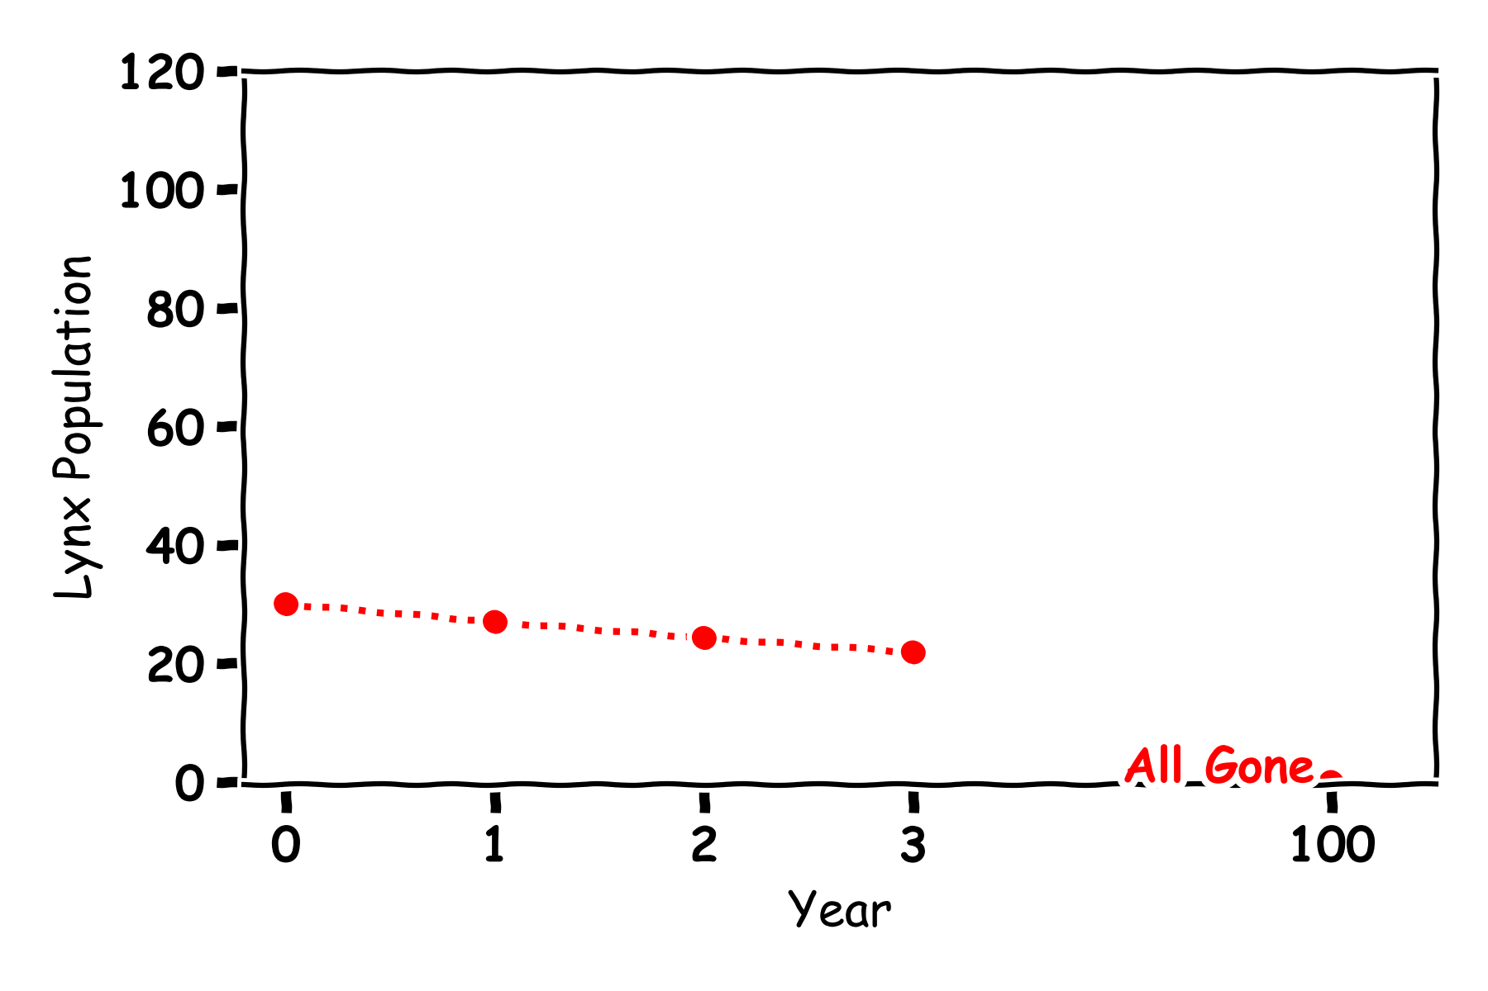
Lynx
Year | Lynx Population
0 | 30
1 | 27
2 | 24
3 | 22

Slide 26
Lynx
Year | Lynx Population
0 | 30
1 | 27
2 | 24
3 | 22

Slide 27
Lynx

Slide 28
Predator and Prey

Slide 29
Predator and Prey

Slide 30
Predator and Prey
Food Rate
Birth rate
Death rate
Eat Rate

Slide 31
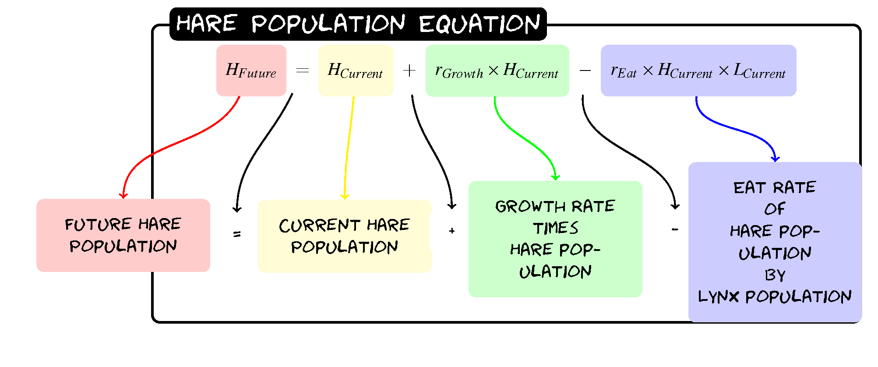
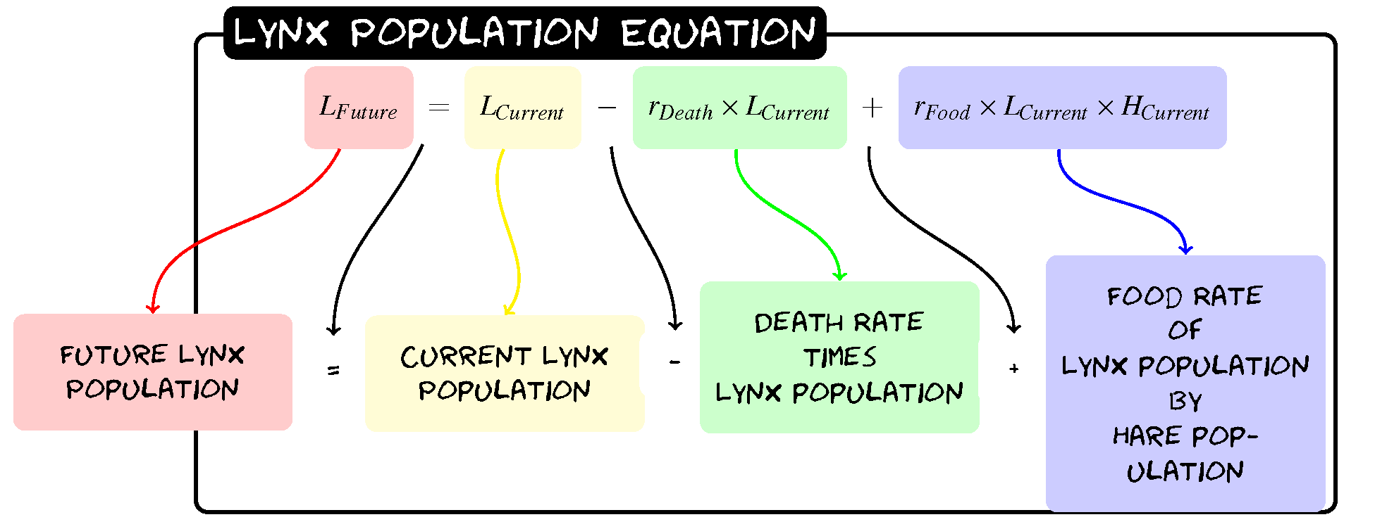
Predator and Prey

Slide 32
Predator and Prey
H_{Future}=H+0.2(H)-0.005(H)(L)
L_{Future}= L-0.1(L)+0.002(L)(H)

Slide 33
Predator and Prey
H_{Future}=H+0.2(H)-0.005(H)(L)
L_{Future}= L-0.1(L)+0.002(L)(H)
Year | Hare Population | Lynx Population
0 | 60 | 30
1
2
3

Slide 34
Predator and Prey
H_{Future}=H+0.2(H)-0.005(H)(L)
L_{Future}= L-0.1(L)+0.002(L)(H)
Year | Hare Population | Lynx Population
0 | 60 | 30
1 | 60+0.2(60)-0.005(60)(30)=63 | 30-0.1(30)+0.002(30)(60)=30.6
2
3

Slide 35
Predator and Prey
H_{Future}=H+0.2(H)-0.005(H)(L)
L_{Future}= L-0.1(L)+0.002(L)(H)
Year | Hare Population | Lynx Population
0 | 60 | 30
1 | 60+0.2(60)-0.005(60)(30)=63 | 30-0.1(30)+0.002(30)(60)=30.6
2 | 63+0.2(63)-0.005(63)(30.6)=65.9 | 30.6-0.1(30.6)+0.002(30.6)(63)=31.3
3

Slide 36
Predator and Prey
H_{Future}=H+0.2(H)-0.005(H)(L)
L_{Future}= L-0.1(L)+0.002(L)(H)
Year | Hare Population | Lynx Population
0 | 60 | 30
1 | 60+0.2(60)-0.005(60)(30)=63 | 30-0.1(30)+0.002(30)(60)=30.6
2 | 63+0.2(63)-0.005(63)(30.6)=65.9 | 30.6-0.1(30.6)+0.002(30.6)(63)=31.3
3 | 65.9+0.2(65.9)-0.005(65.9)(31.3)=68.8 | 31.3-0.1(31.3)+0.002(31.3)(65.9)=32.4

Slide 37
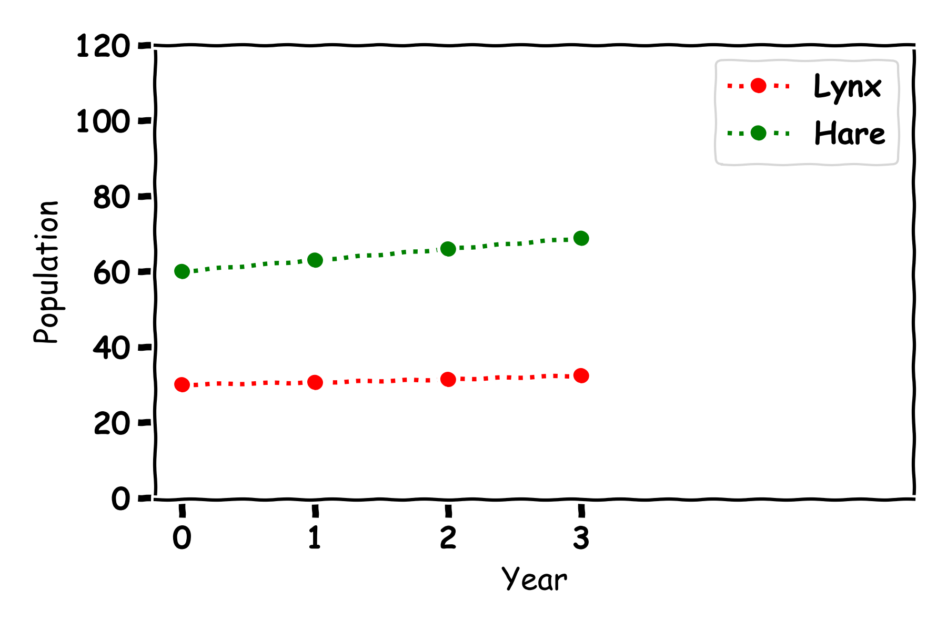
Predator and Prey
Year | Hare Population | Lynx Population
0 | 60 | 30
1 | 63 | 30.6
2 | 65.9 | 31.3
3 | 68.8 | 32.4

Slide 38
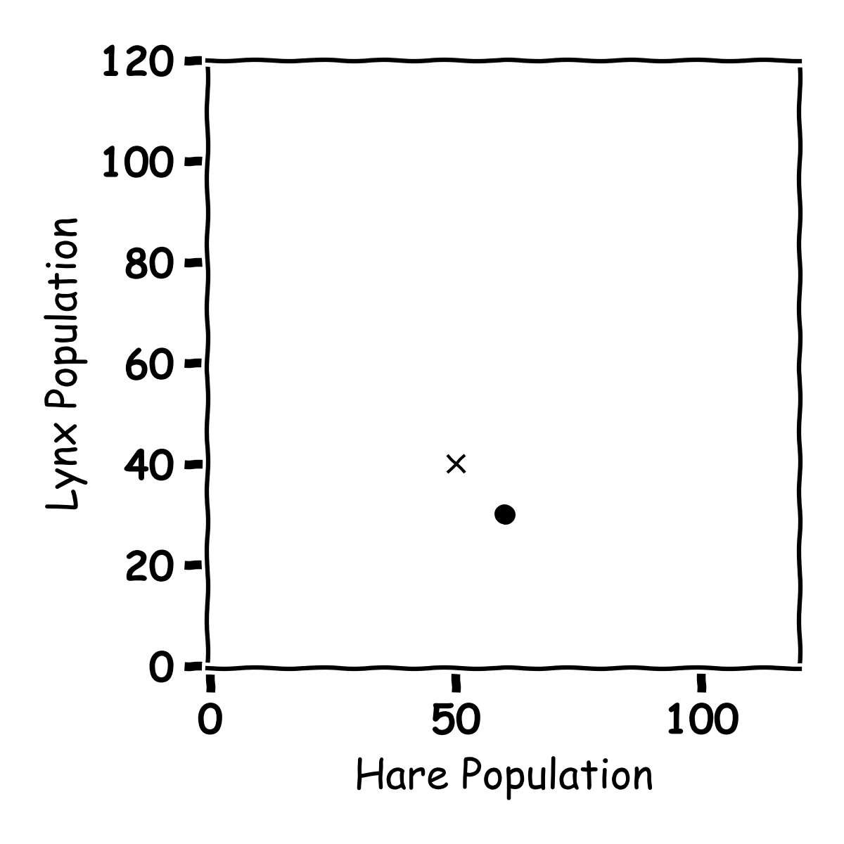
Predator and Prey
Year | Hare Population | Lynx Population
0 | 60 | 30
1
2
3

Slide 39
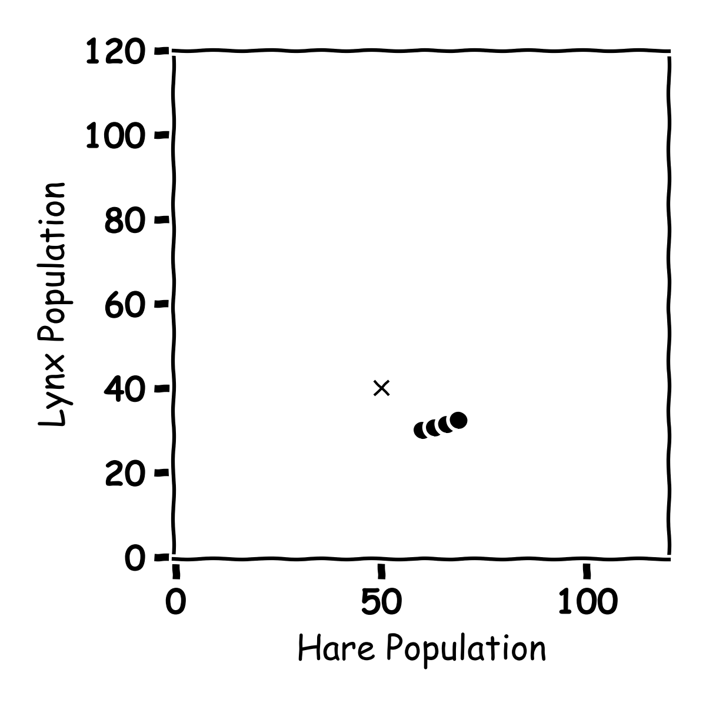
Predator and Prey
Year | Hare Population | Lynx Population
0 | 60 | 30
1 | 63 | 30.6
2 | 65.9 | 31.3
3 | 68.8 | 32.4

Slide 40
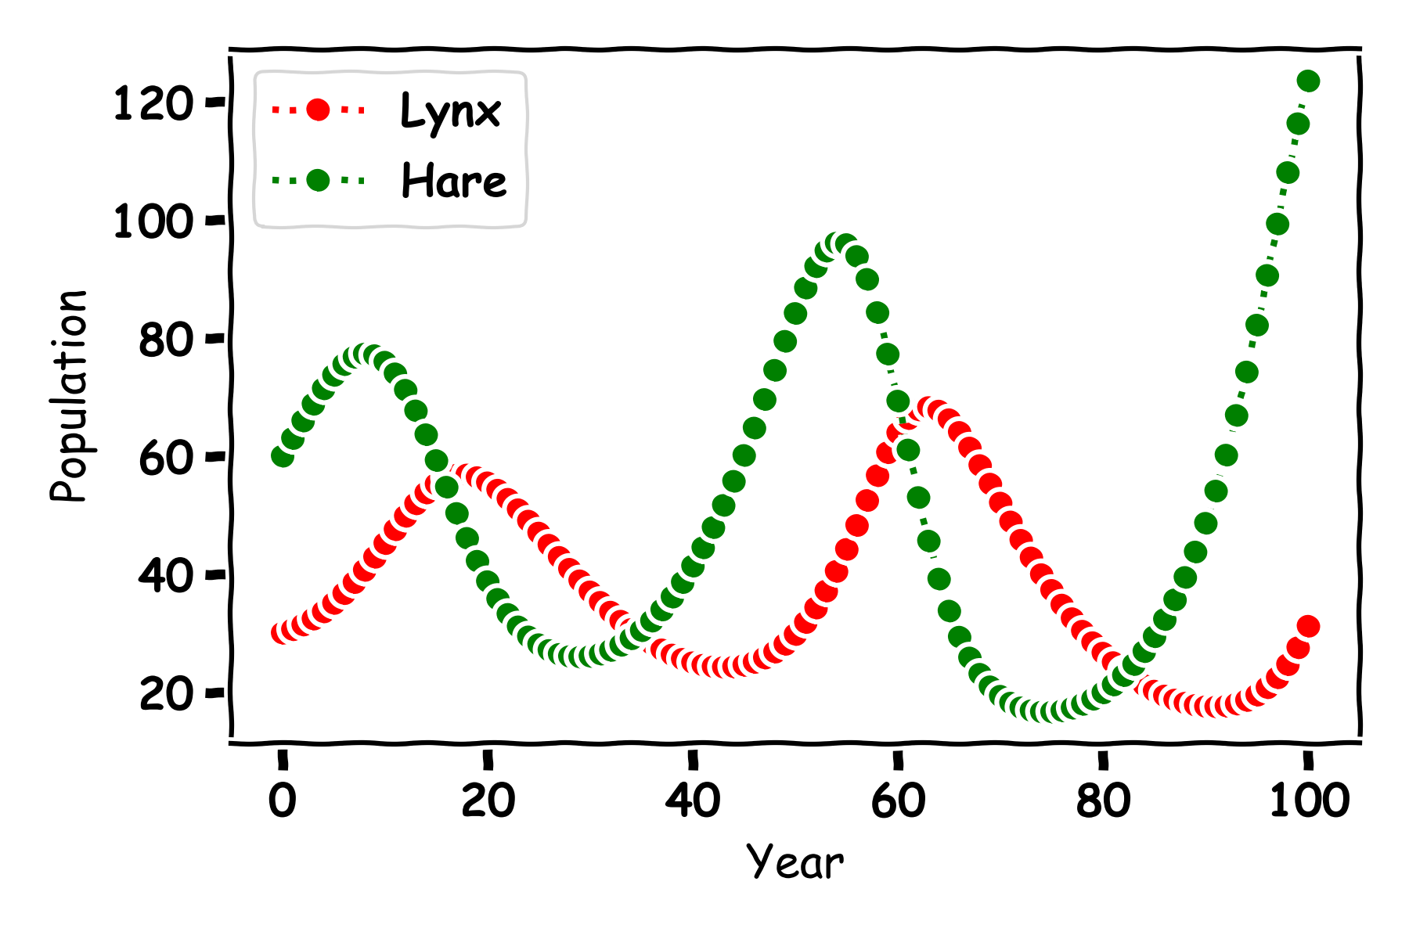
Predator and Prey

Slide 41
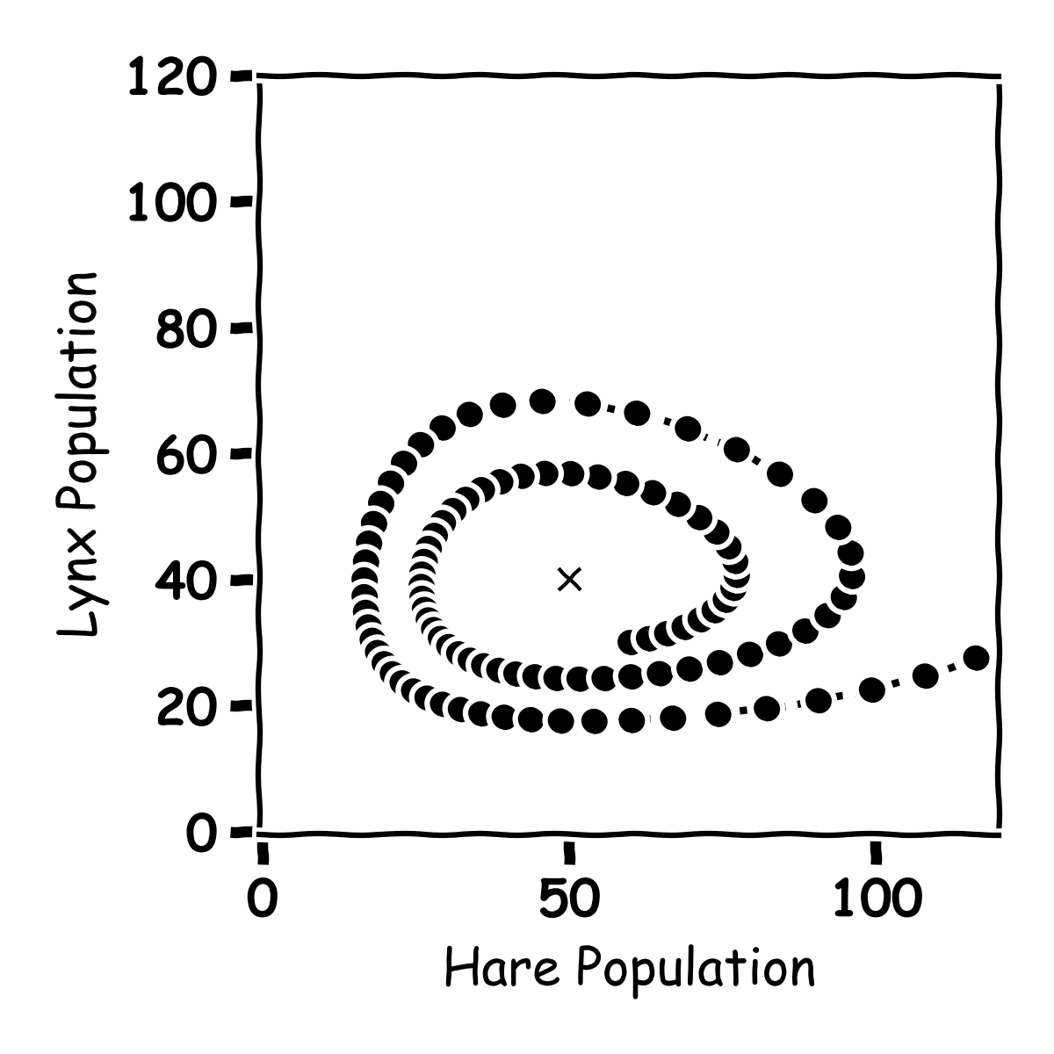
Predator and Prey

Slide 42
Predator and Prey

Slide 43
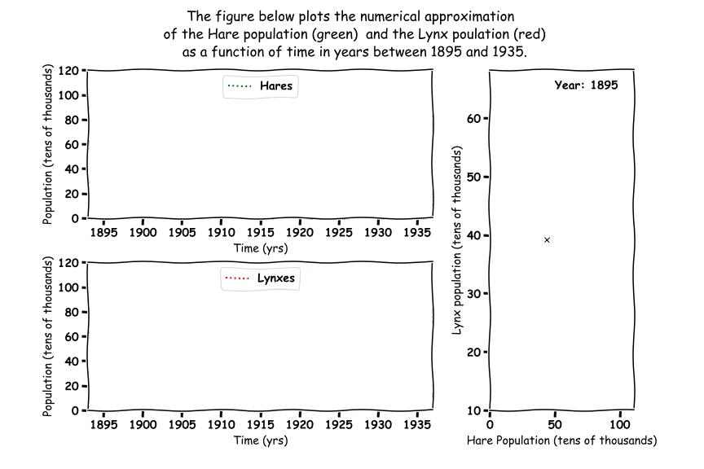
Predator and Prey

Slide 44
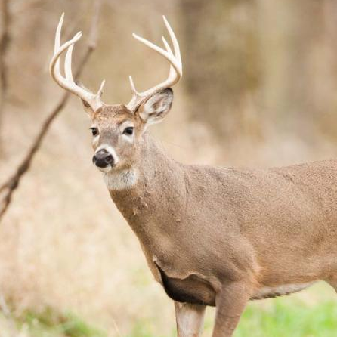
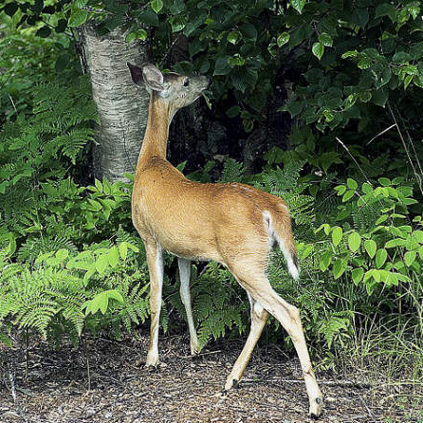
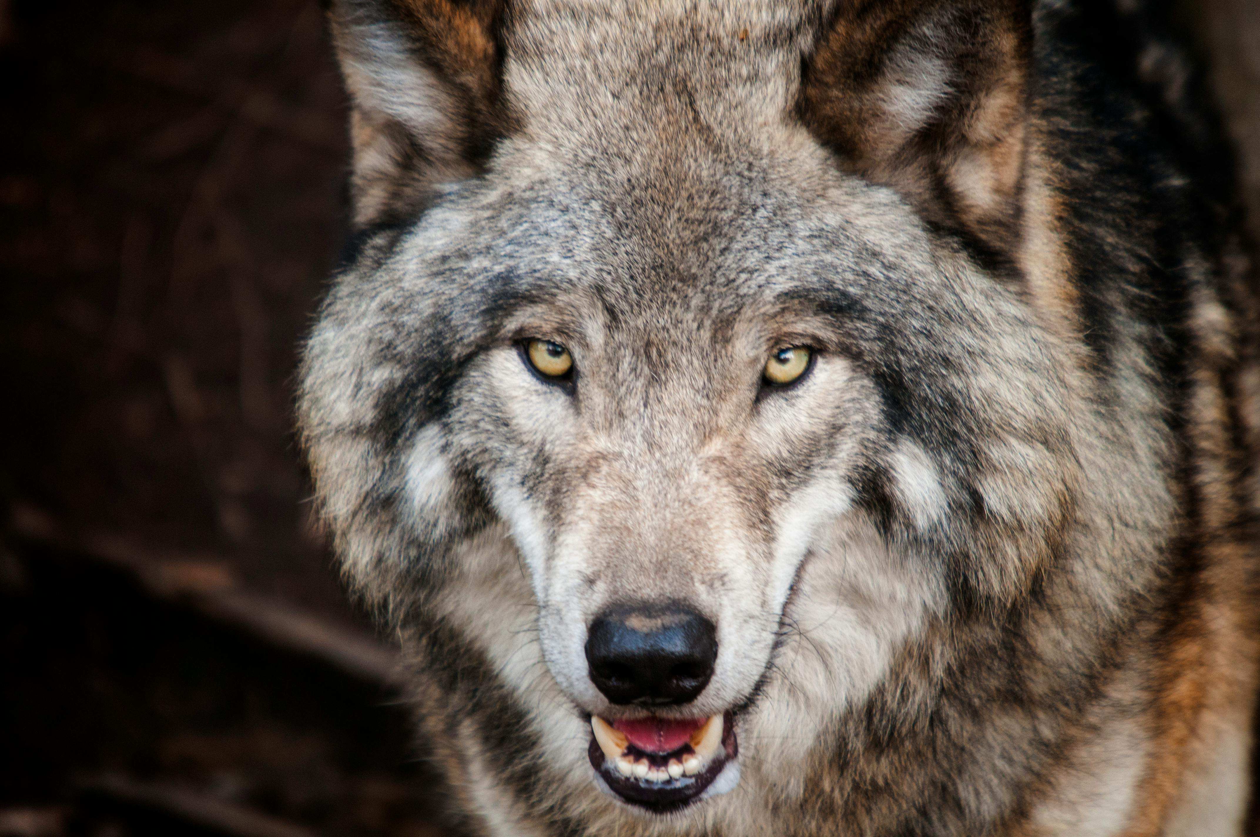
Predator Prey
Deer, Plants and Wolves

Slide 45
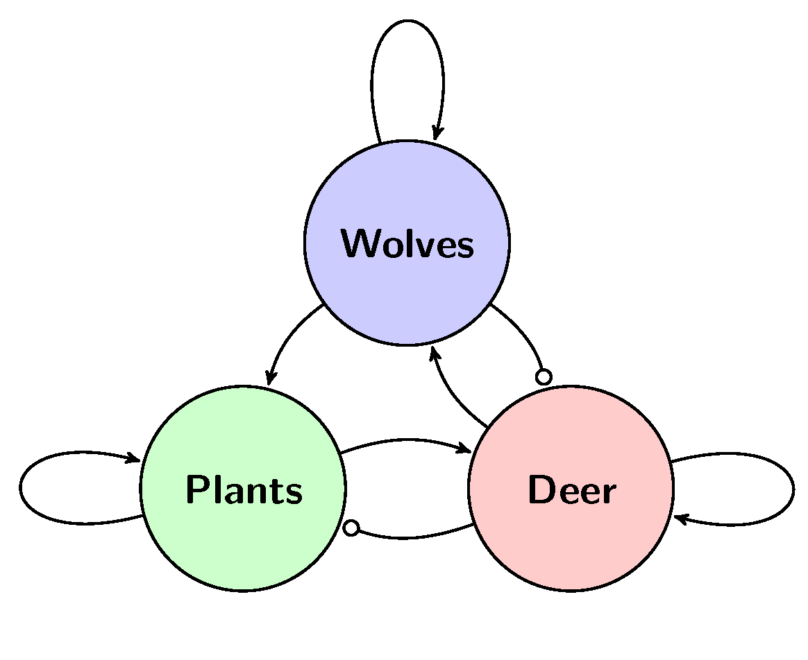
Three Animals

Slide 46
Three Animals
Death rate Wolves
Wolves eat Deer
Wolves project plants
Food for wolves
Food for deer
More Deer Born
More Plants Grow
Deer eat plants

Slide 47
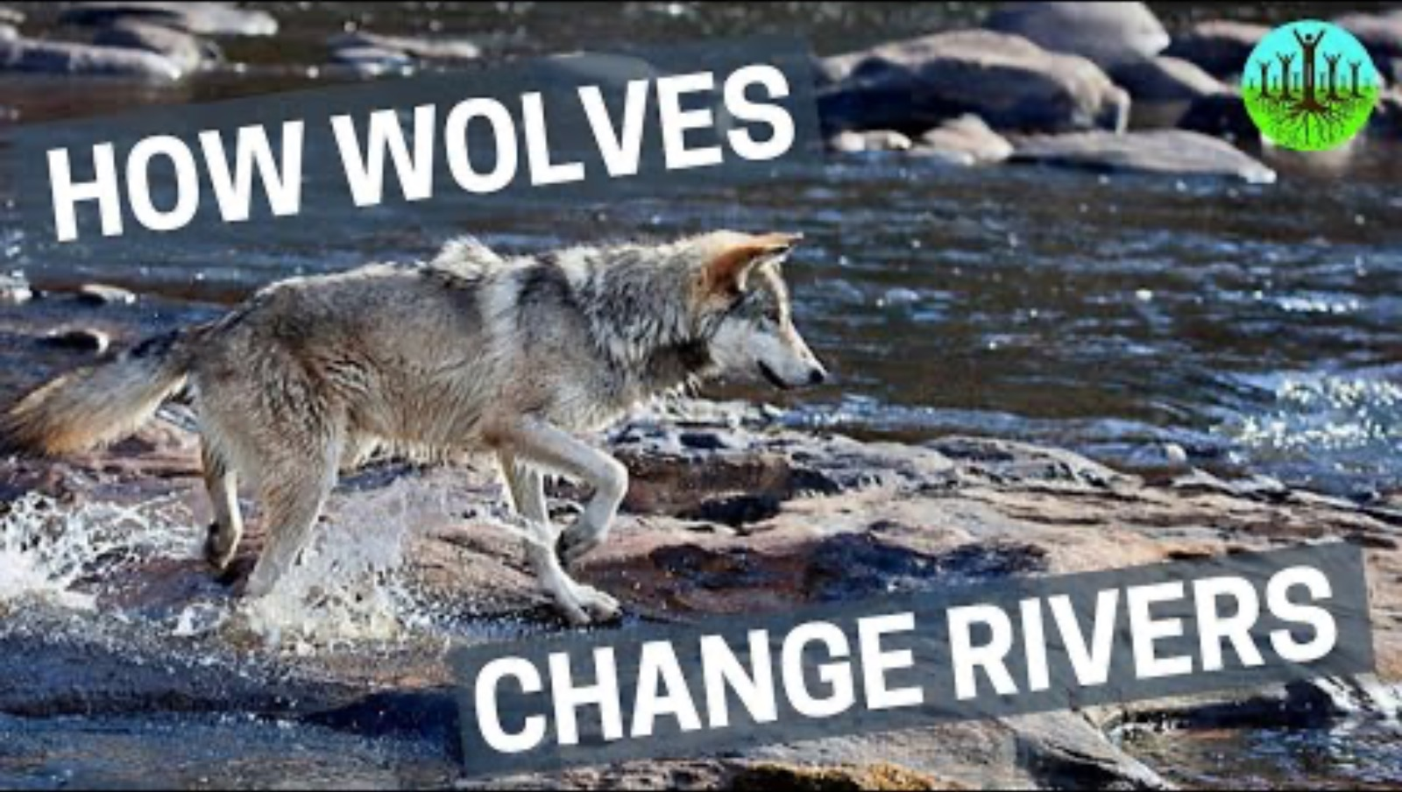
Three Animals

Slide 48
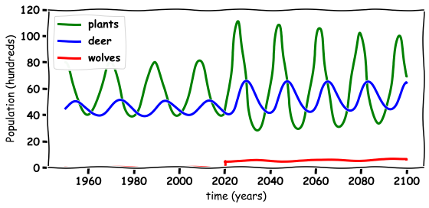
Three Animals

Slide 49
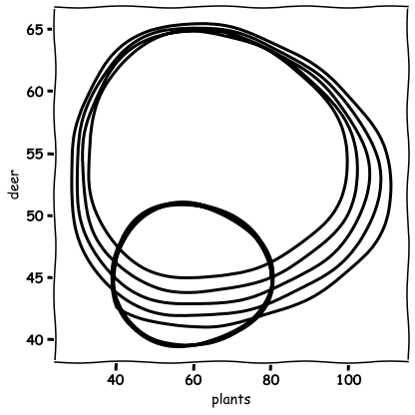
Three Animals

Slide 50

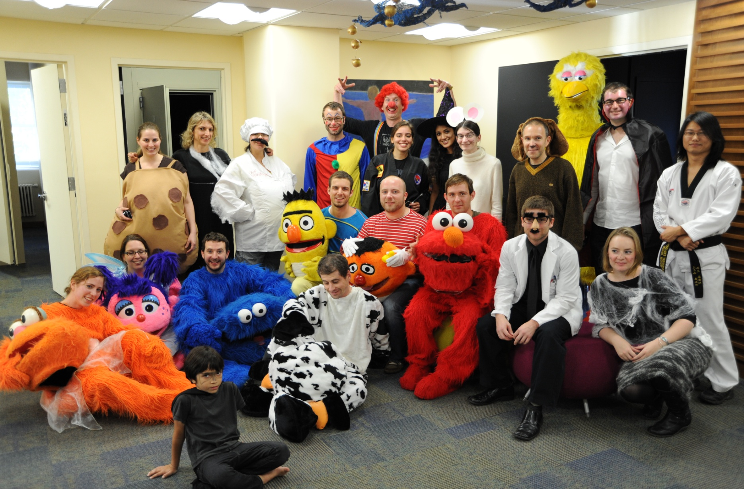
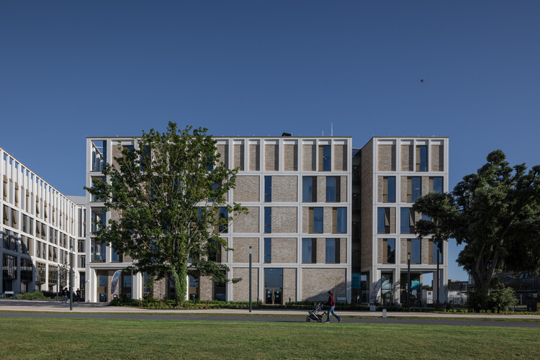
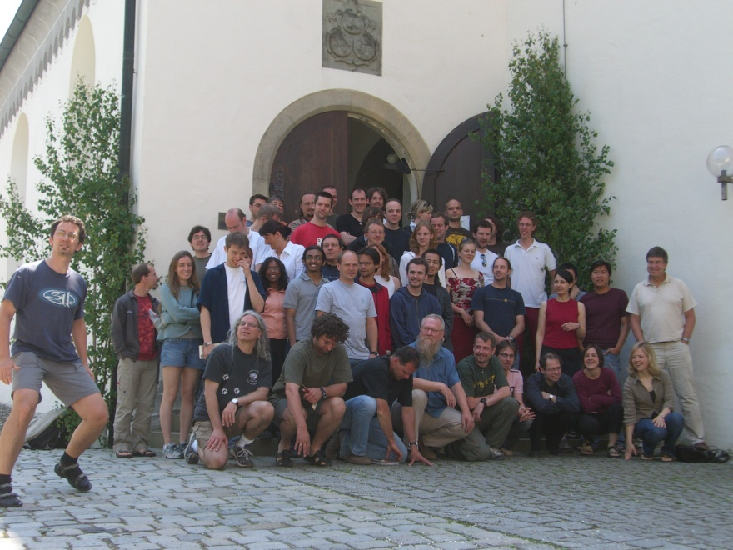
Thank you for Listening
TCD
Albert Einstein College of Medicine
TU Dublin
Max Planck Institute Germany

