Slide 1

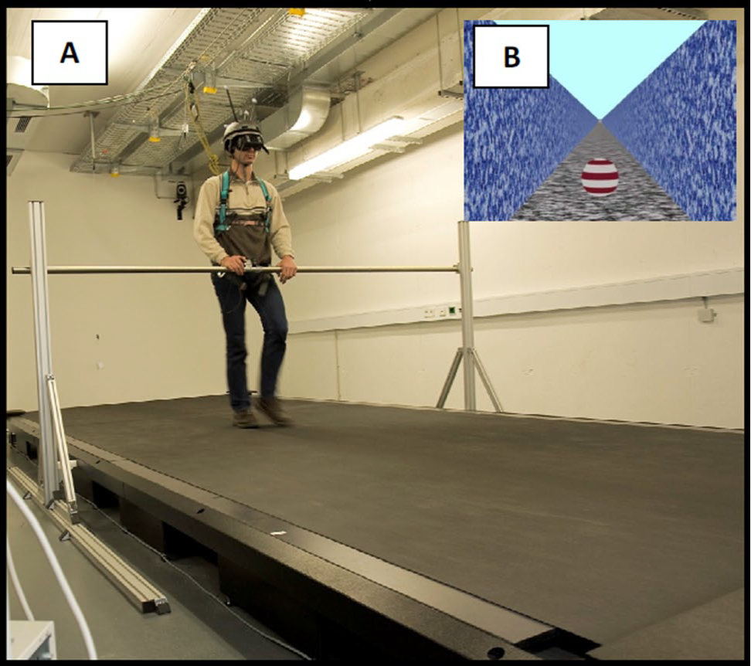
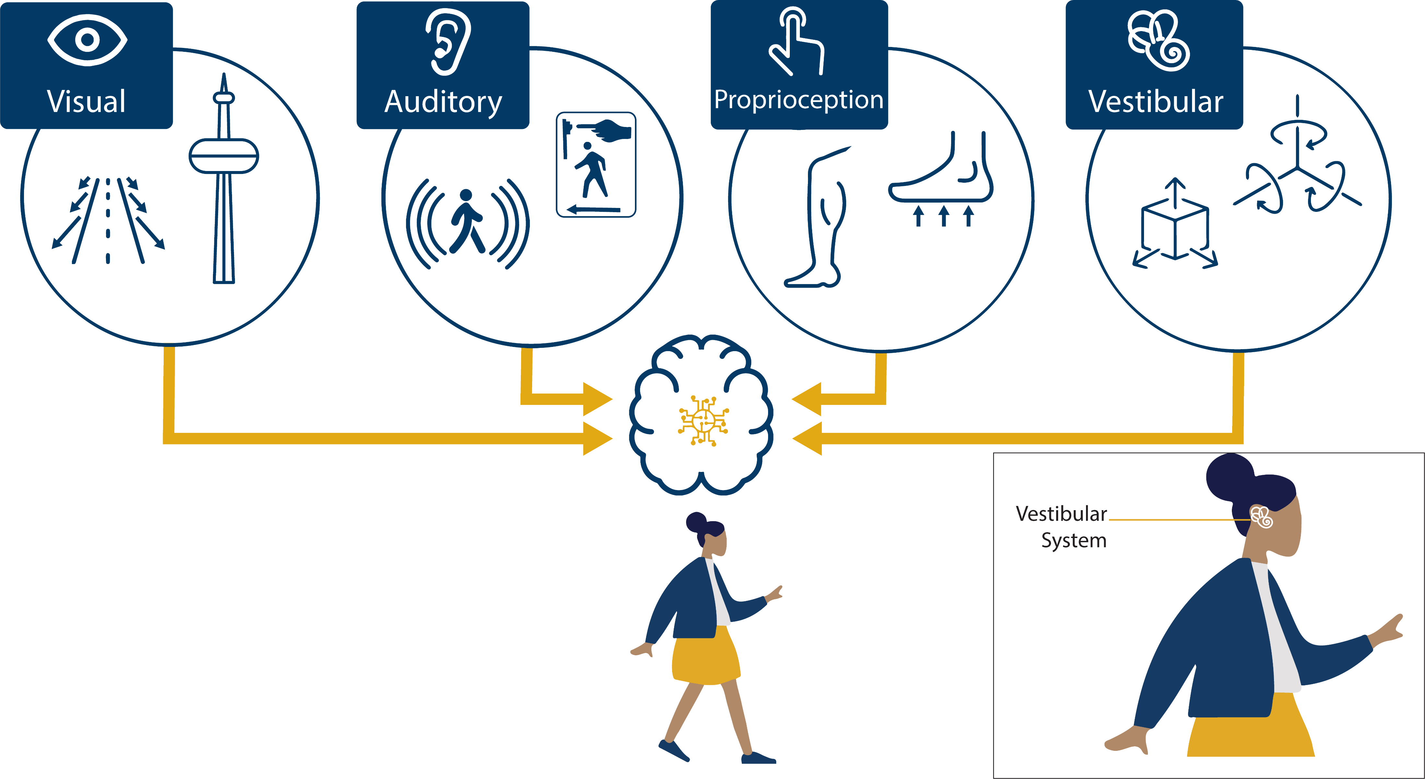
The Maths and Neuroscience of Walking: Walking is Not as Easy You Think
Dr John Butler TU Dublin (Mathematics and Statistics)
Trinity (Neuroscience)

Slide 2
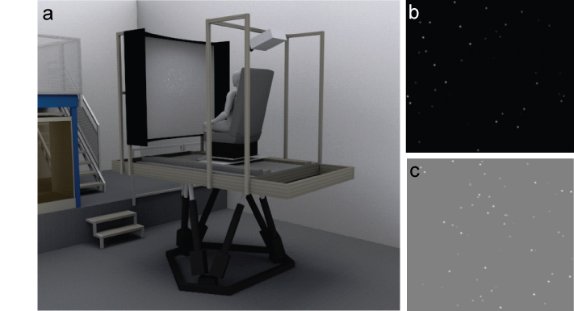
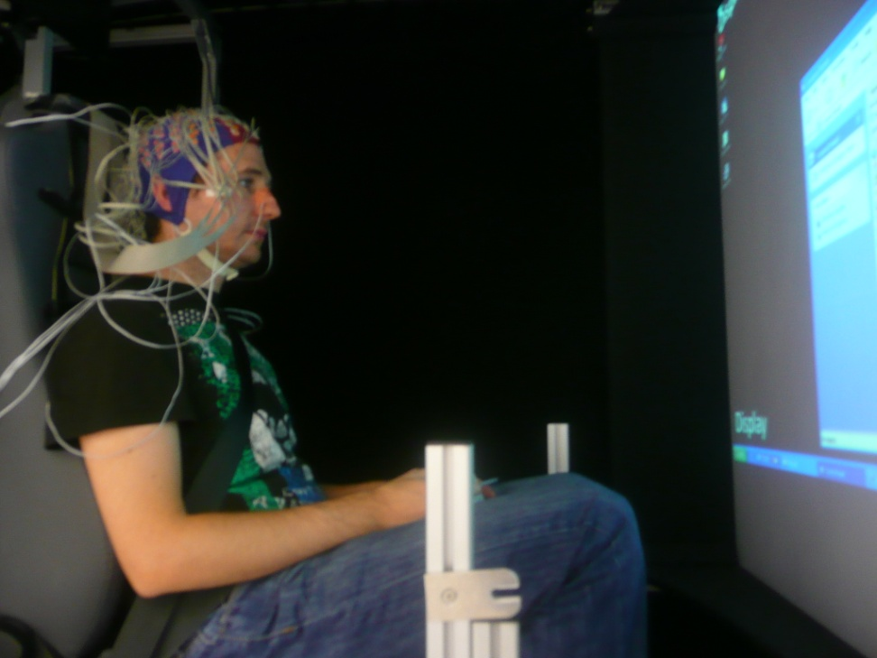

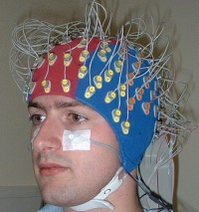
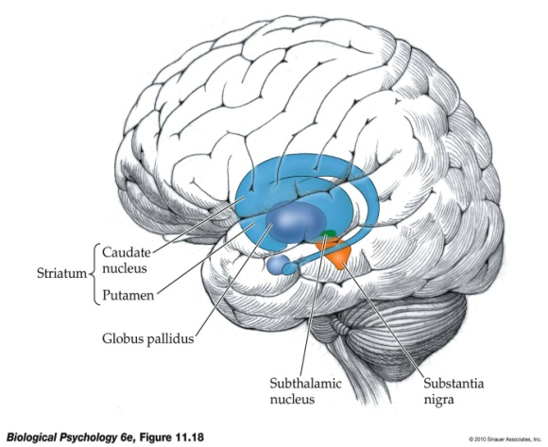

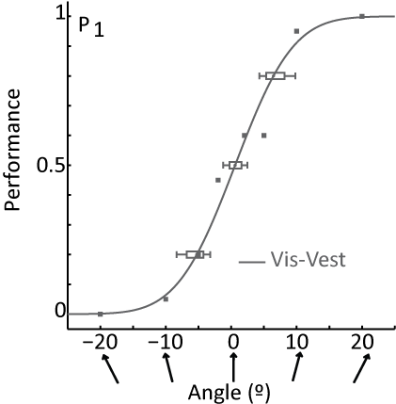
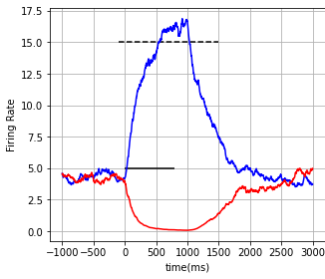
Who Do I Work With
Self-Motion
Computer Science
Neuroscience
Physics
Mathematics
Psychology
Electrical Engineering
Medicine

Slide 3
What do I Research

Slide 4
The Senses
The Big Five
1. Visual
2. Auditory
3. Olfactory (smell) System
4. Gustatory (taste) System
5. Tactile System
A Couple More
6. Vestibular
7. Proprioception
Notes:
Future work sensory processing
Nervous system guide interaction, guide behaviour
Falls

Slide 5
Vision
Light/Dark Detection
Movement Detection
Form and Shape Recognition
Visual Acuity
Face Recognition
Contrast Sensitivity
Colour Sensitivity
…
Taste
Taste Detection
Sweet
Salty
Sour
Bitter
Spicy
Umami …
Auditory
Frequency (Pitch) Detection
Loudness Detection
Sound Localization
Temporal Processing
Echo Perception (Echolocation)
Speech Perception ….
Smell
Odor Detection
Odor Identification
Odor Localization
Odor Intensity
Odor Memory ….
Notes:
Future work sensory processing
Nervous system guide interaction, guide behaviour
Falls

Slide 6
Tactile
Touch Sensation
Temperature Sensation
Pain Sensation
Vibration Sensation
Tactile Discrimination
Texture and Fine Touch Perception
…
Proprioception
Muscle Tension Detection
Sense of Movement
Joint Receptors
Motor Learning
Reflex Modulation
Muscle Length and Stretch Detection …
Vestibular
Gravity Perception
Angular Motion Detection
Linear Motion Detection
Balance and Postural Control
Vestibulo-Spinal Reflex
Head position ….
Notes:
Future work sensory processing
Nervous system guide interaction, guide behaviour
Falls

Slide 7
“FEELING” OURSELVES MOVE: A TEAM EFFORT BY OUR SENSES
Campos, Pandi, Butler

Slide 8




Who I Did This Work With on This Research
Prof. Heinrich Bülthoff Germany
Prof. Jennifer Campos Canada
Maryam Pandi Toronto
Dr Stuart Smith Australia

Slide 9
Self-Motion
What is self-motion?
Walking
Running
Driving
Cycling
…
Why study walking?
Development
Aging
Falls
Parkinson’s Disease
…
Notes:
Future work sensory processing
Nervous system guide interaction, guide behaviour
Falls

Slide 10
Sensory Information for Walking
Body Cues

Slide 11
Questions for You
What is the most important sense for walking?
Possible Answers:
We use vision much more than body cues
We use body cues much more than vision
We use body cues as much as vision

Slide 12
Answer for You
What is the most important sense for walking?
Answers:
We use vision much more than body cues
We use body cues much more than vision
We use body cues as much as vision

Slide 13
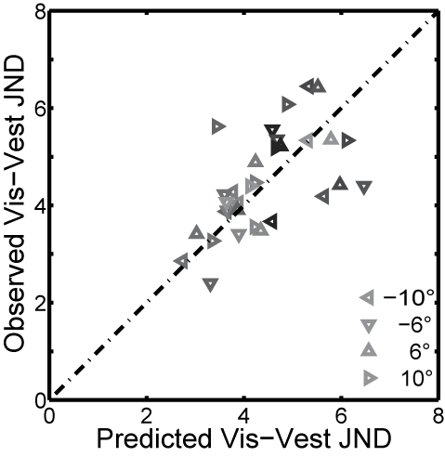
How to Study Walking
Isolate each sensory cue
Blindfold to remove vision
Push in a wheel-chair to reduce some body cues
Use Virtual Reality
Make a model to predict how they should work together
Winner takes all, the “best” sensory system is used, and the others ignored
Some combination of the two to reduce error (Maximum Likelihood)

Slide 14
Walking

Slide 15
Let’s do a bit of memory before we walk
Name the Objects

Slide 16



Name the Objects

Slide 17
Name the Objects

Slide 18
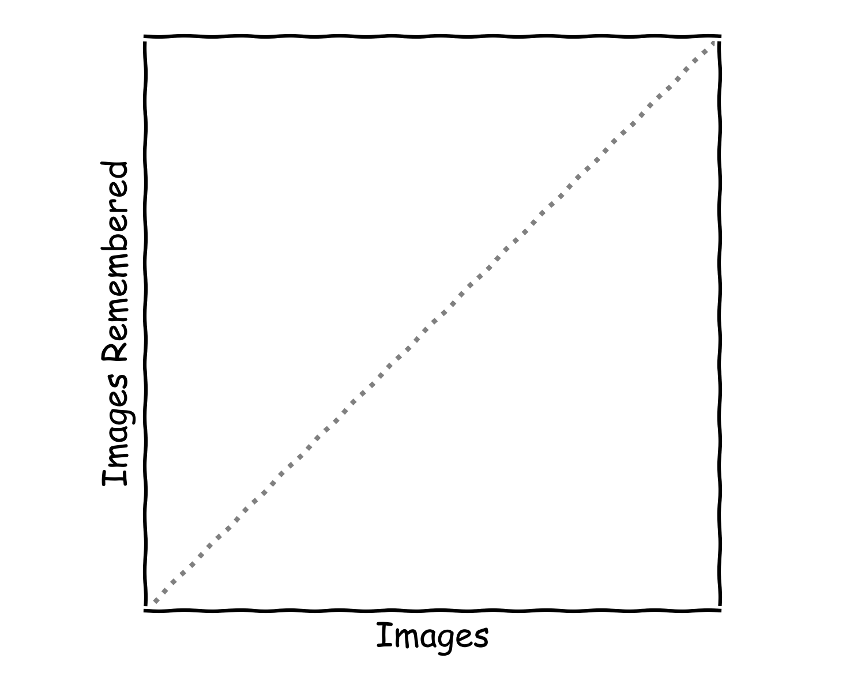
Memory Graph

Slide 19






Name the Objects

Slide 20
Name the Objects

Slide 21





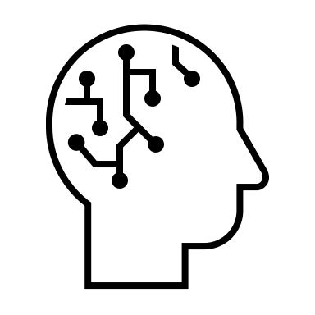







Slide 23
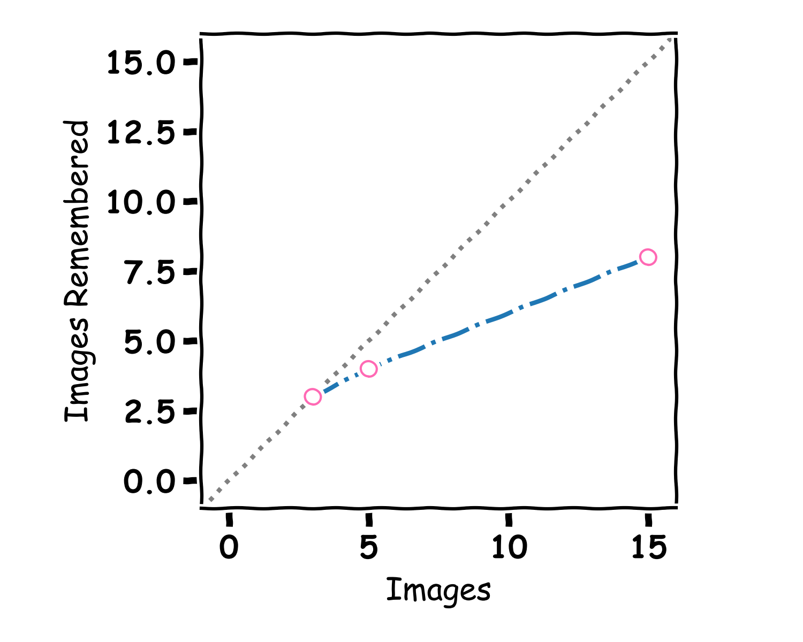
Memory Graph

Slide 24
A bit of Walking

Slide 25
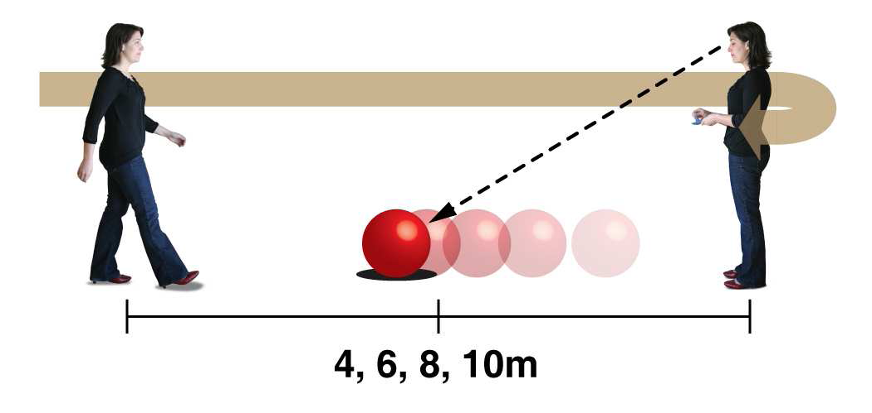
Multisensory integration in the estimation of walked distances
Conditions
Visual Alone
Body Cues
Combined
4 distances (4, 6, 8 10m)

Slide 26
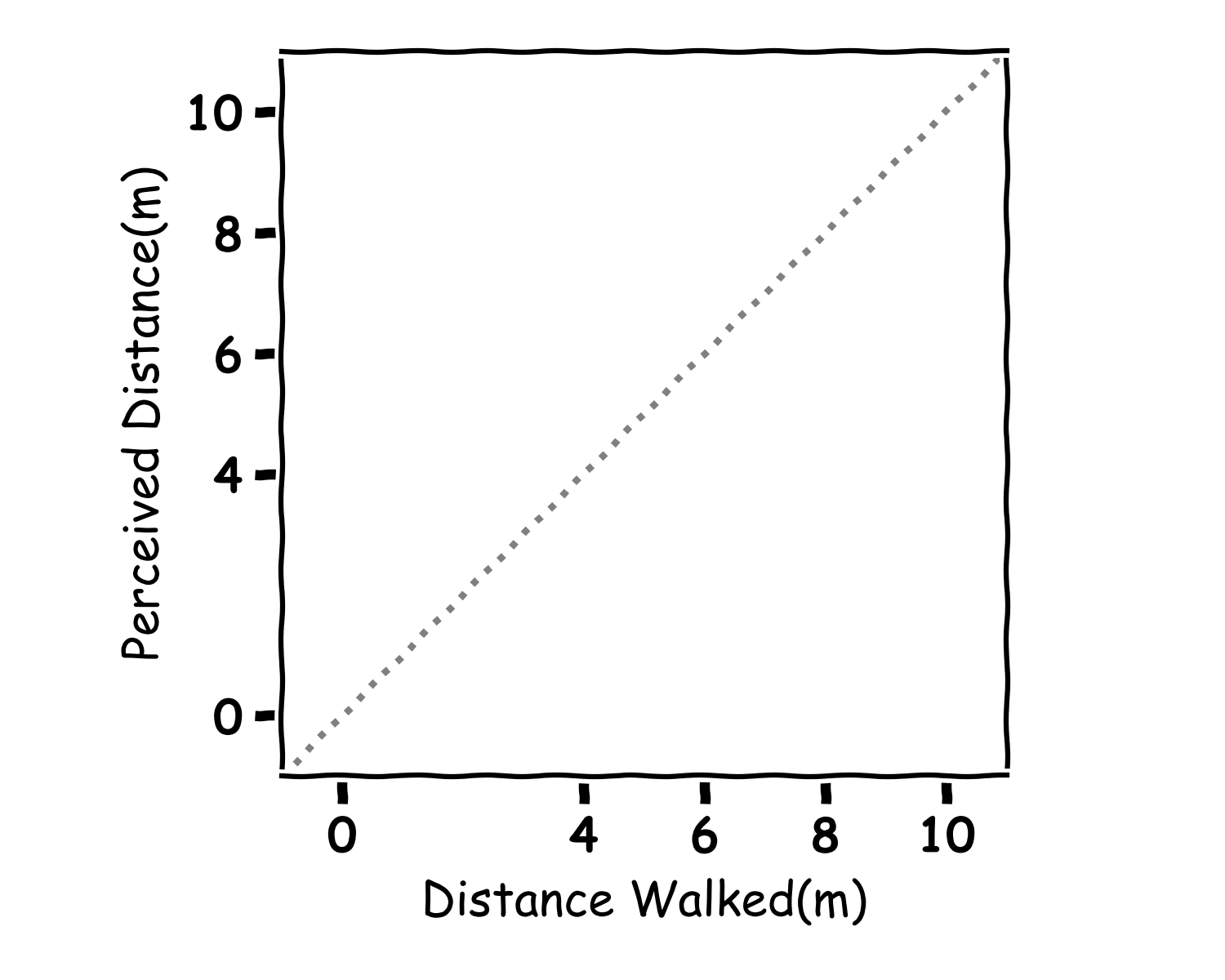
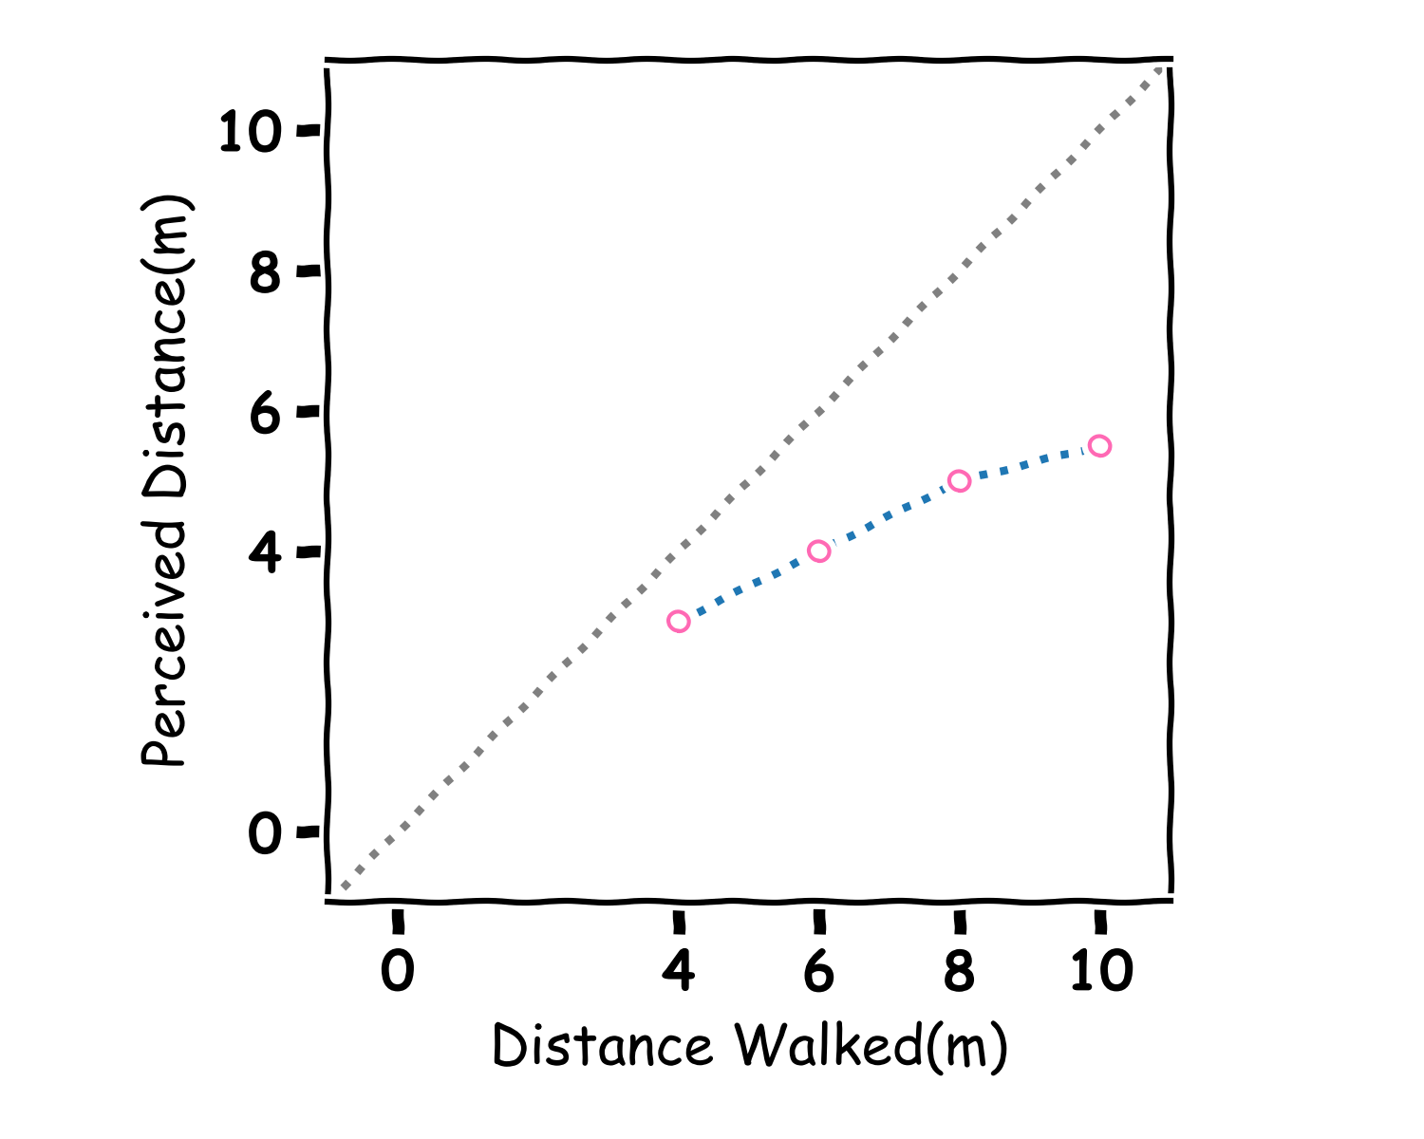
Walking Graph

Slide 27
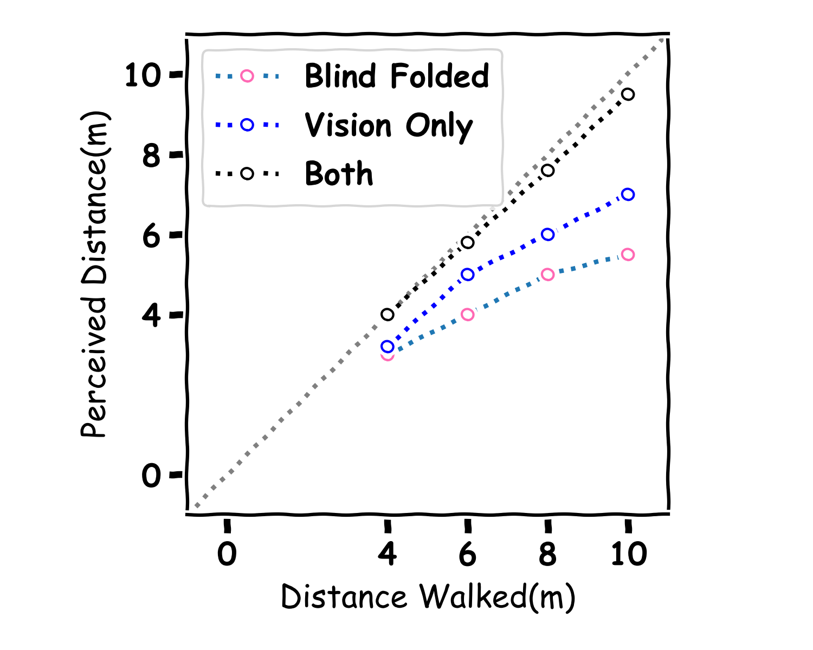
Walking Graph

Slide 28
Heading

Slide 29
Virtual reality setup and stimuli
2D
3D

Slide 30
Visual-Vestibular Integration for Heading
Notes:
Concept of combination

Slide 31
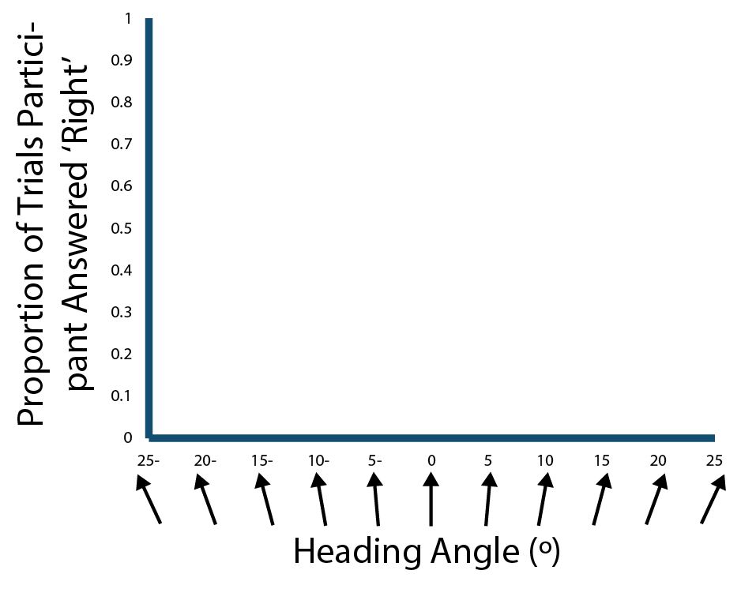

Slide 32
The Experiment

Slide 33
The Experiment

Slide 34
The Experiment

Slide 35
The Experiment

Slide 36
The Experiment

Slide 37
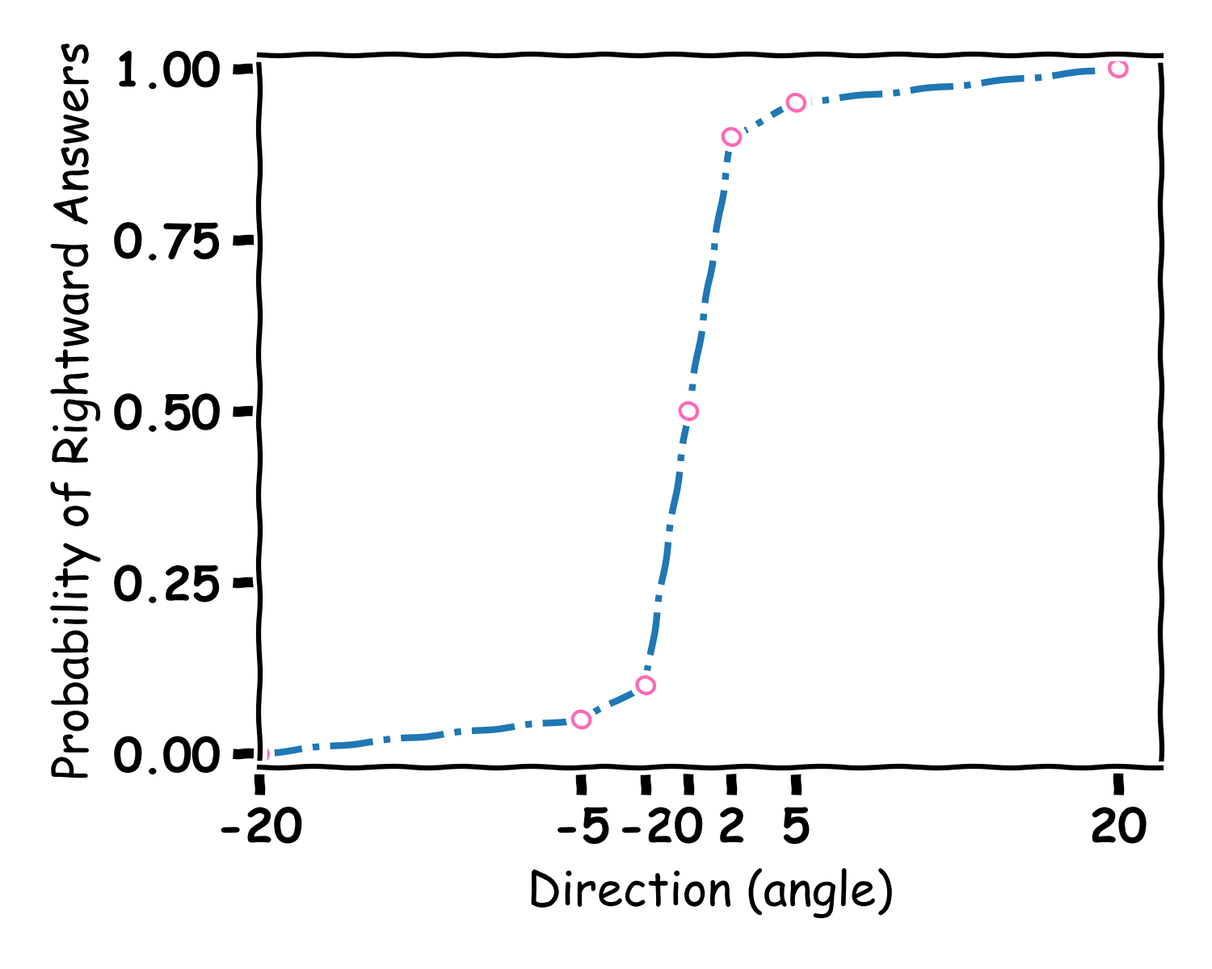
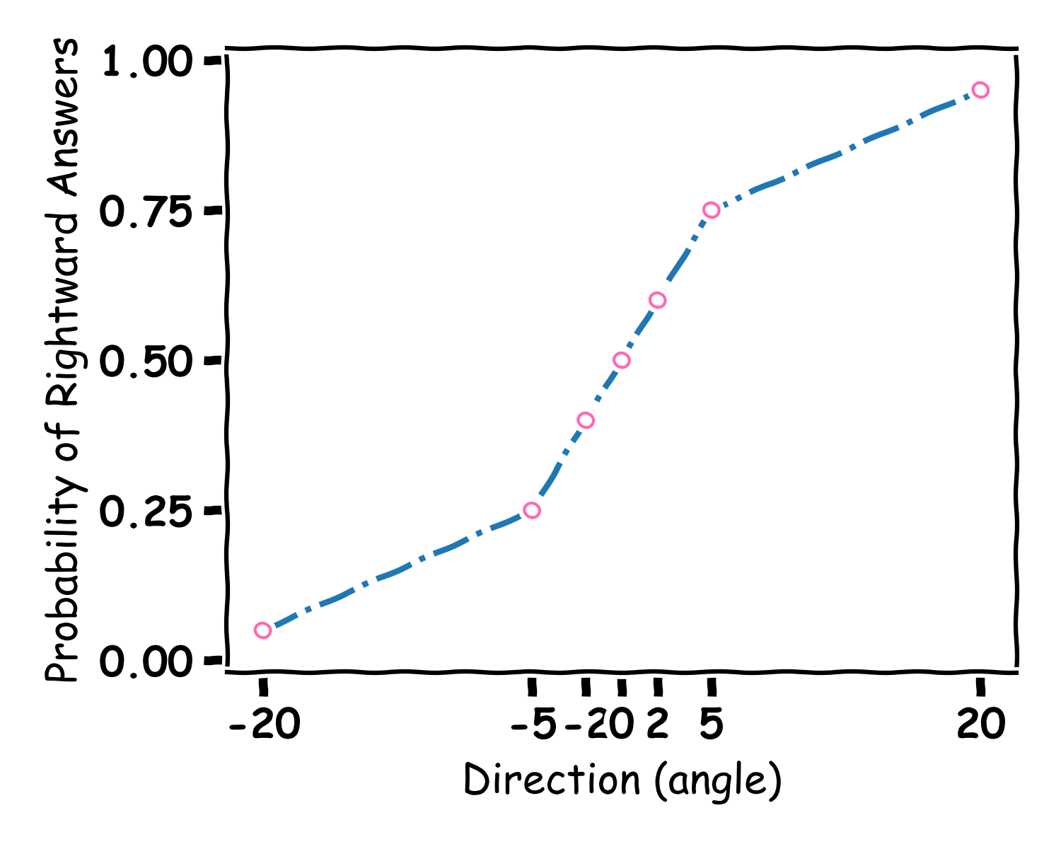
Reliability

Slide 38
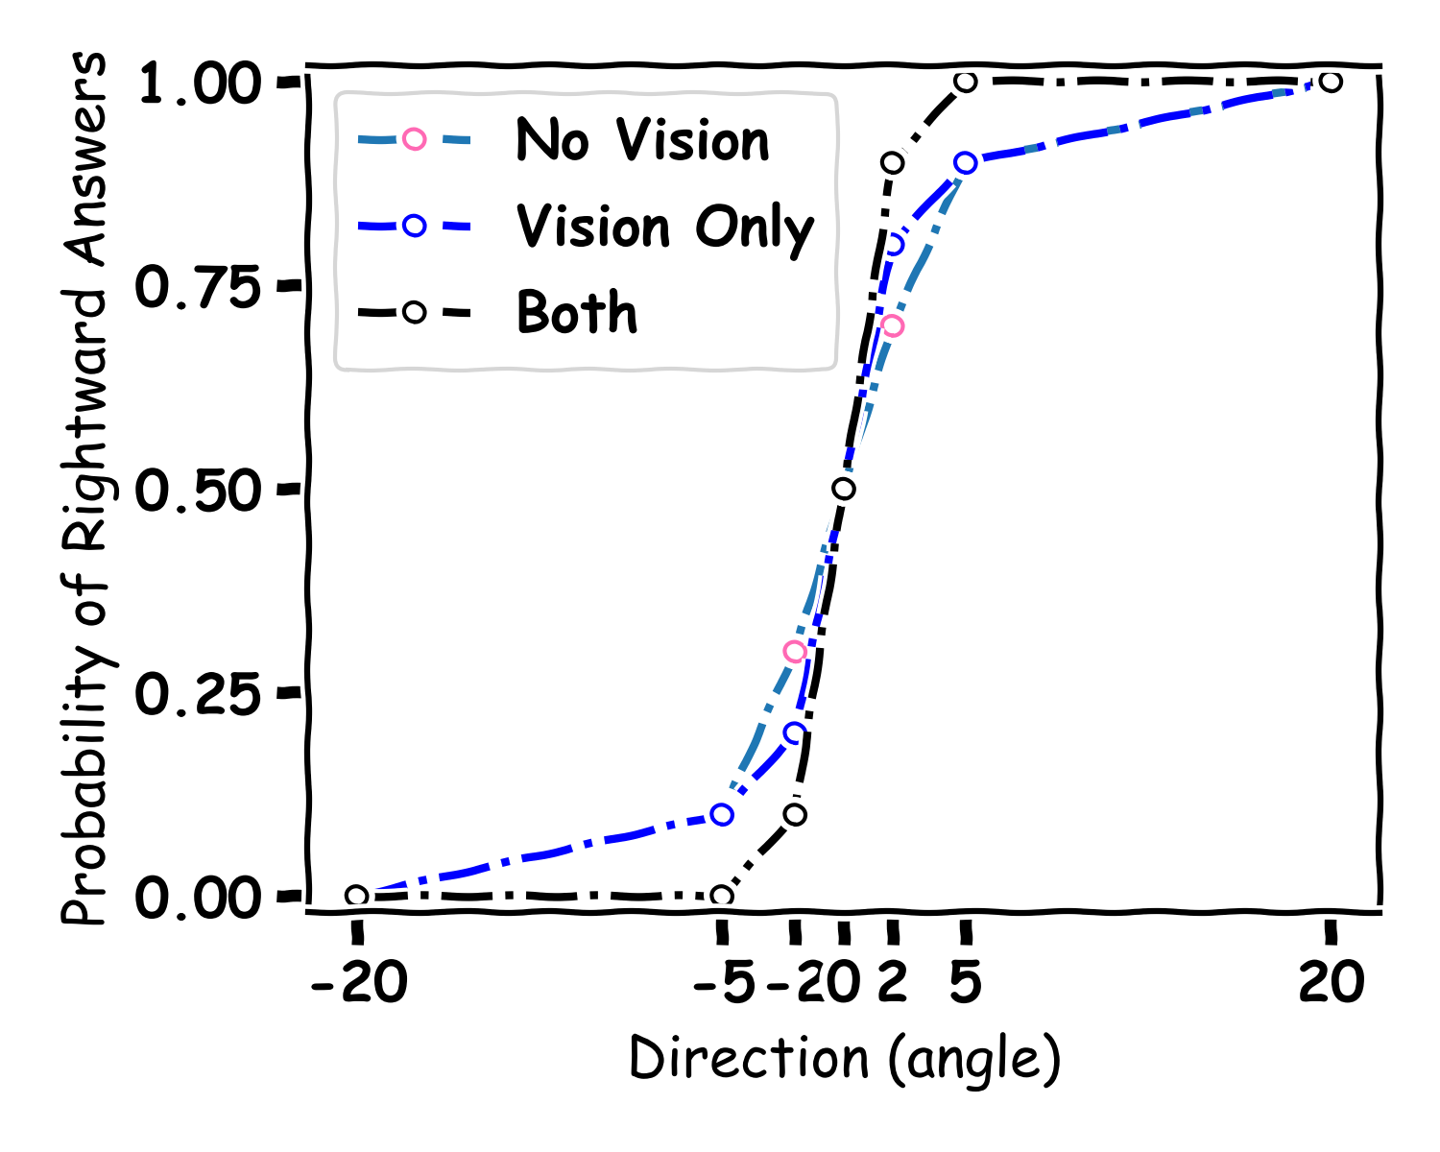
Multisensory

Slide 39
Visual-Vestibular Integration for Heading (conflict)
Δ
Notes:
Concept of combination
Colour arrow
By introducing a conflict we can see if there is a breakdown of the combination of sense
We can calculate the weights given to each cue

Slide 40
The logic of conflicts
Equally weighted
Vestibular weighted more
Vision weighted more

Slide 41
The Experiment

Slide 42
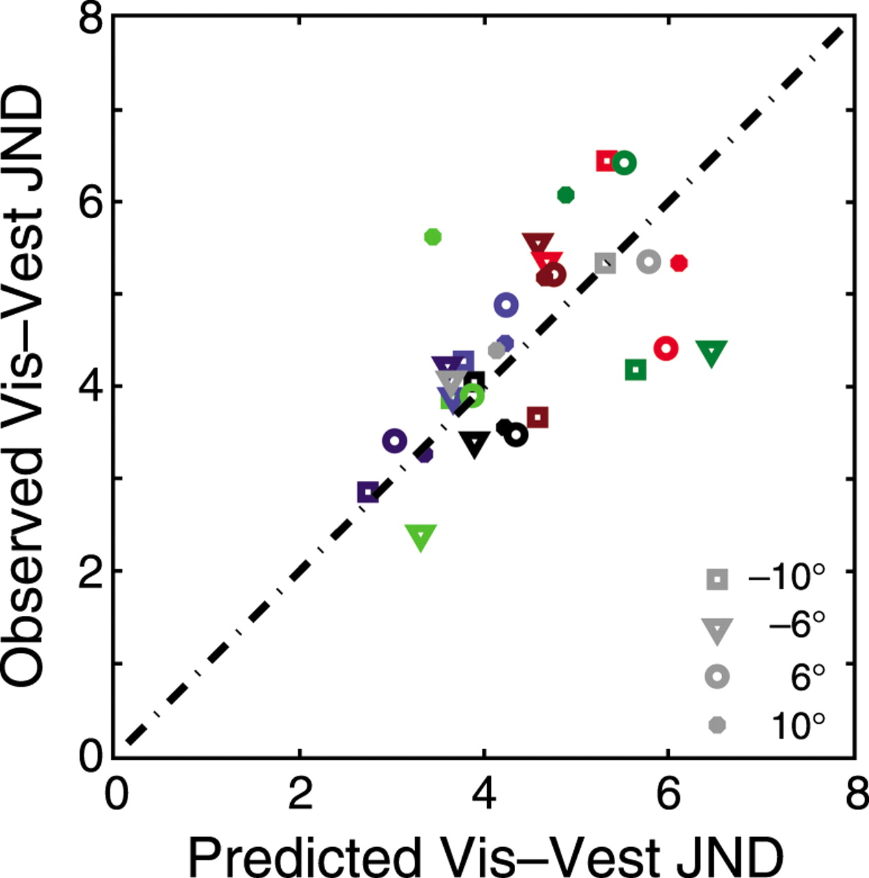
Maths can make a Prediction

Slide 43


Ongoing Research Questions
Is self-motion the same for kids and adults?
Is self-motion the same for adults and older people?
How does the brain change different signals into one unified signal?
Where in the brain is self-motion processed?
Is self-motion the same as other processes?
How can this work benefit people with movement disorders?

Slide 44
Selected Publications
Fearon, C., Butler, J. S., Waechter, S. M., Killane, I., Kelly, S. P., Reilly, R. B., & Lynch, T. (2021). Neurophysiological correlates of dual tasking in people with Parkinson’s disease and freezing of gait. Experimental Brain Research, 239(1), 175-187.
Campos J, Pandi M and Butler JS (2020) “Feeling” Ourselves Move: A Team Effort by Our Senses. Front. Young Minds. 8:9. doi: 10.3389/frym.2020.00009
B. Malcolm, J. J. Foxe, J. S. Butler, S. Molholom, P. De Sanctis, (2018) “Long-term test-retest reliability of event-related potential (ERP) recordings during treadmill walking using the mobile brain/body imaging (MoBI) approach” Journal of Neurophysiology 120 (5), 2246-2259
R Ramkhalawansingh, J. S. Butler, J. L. Campos, (2018) “Multisensory Self-motion Perception in Younger and Older Adults” Psychology and aging 33 (5), 798
B. Malcolm, J. J. Foxe, J. S. Butler, P. De Sanctis, (2015) “The aging brain shows less flexible reallocation of processing during dual-task walking: A Mobile Brain-Body Imaging (MOBI) Study” Neuroimage
J. L. Campos, J. S. Butler, H. H. Bülthoff, (2014) “Visual, and proprioceptive cue-weighting in travelled distance perception.” Experimental Brain Research
De Sanctis, P., Butler, J. S., Malcolm, B. R., & Foxe, J. J. (2014). Recalibration of inhibitory control systems during walking-related dual-task interference: a mobile brain-body imaging (MOBI) study. Neuroimage, 94, 55-64.
H. Nolan, J. S. Butler*, R. Whelan, J. J. Foxe, H. H. Bülthoff, R B. Reilly, (2012) “Detecting Changes in Self-motion Heading: A High Density Electrophysiological Measure of Vestibular Processing.” Experimental Brain Research, 219(1):1-11
Campos, J. L., Butler, J. S., & Bülthoff, H. H. (2012). Multisensory integration in the estimation of walked distances. Experimental brain research, 218(4), 551-565.
Butler, J. S., Smith, S. T., Campos, J. L., & Bülthoff, H. H. (2010). Bayesian integration of visual and vestibular signals for heading. Journal of vision, 10(11), 23-23.

Slide 45
Selected Publications
Brady R., Butler, J.S., (2022) “The Circle of Life: The Mathematics of Predator-Prey Dynamics” Frontiers for Young Minds doi: 10.3389/frym.2021.651131
McCrann, S., Loughman, J., Butler, J.S., Paudel, N. and Flitcroft, D.I. (2021), Do smartphones hurt our eyes by causing shortsightedness? Frontiers for Young Minds https://doi: 10.3389/frym.2021.56985
Campos J, Pandi M and Butler JS (2020) “Feeling Ourselves Move: A Team Effort by Our Senses.” Front. Young Minds. 8:9. doi: 10.3389/frym.2020.00009

Slide 46
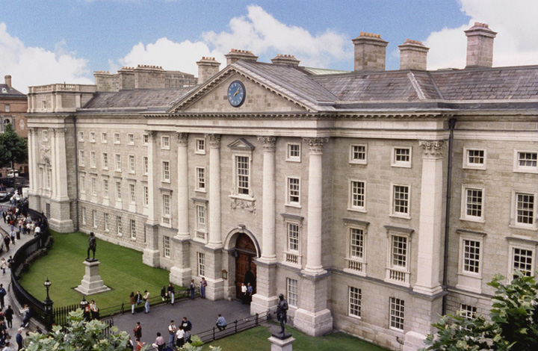
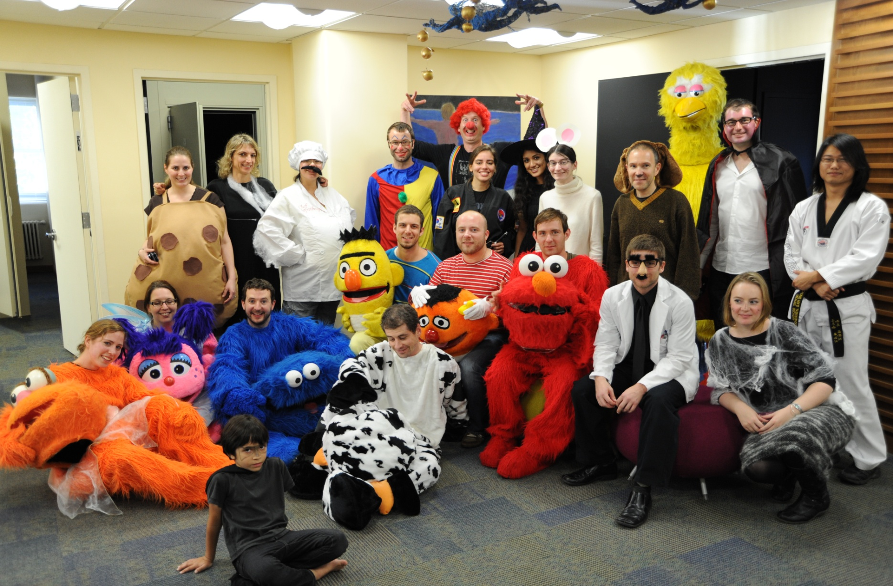
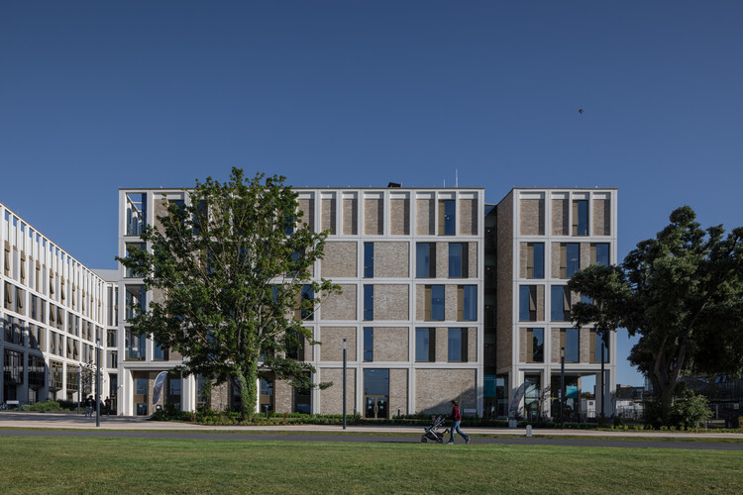
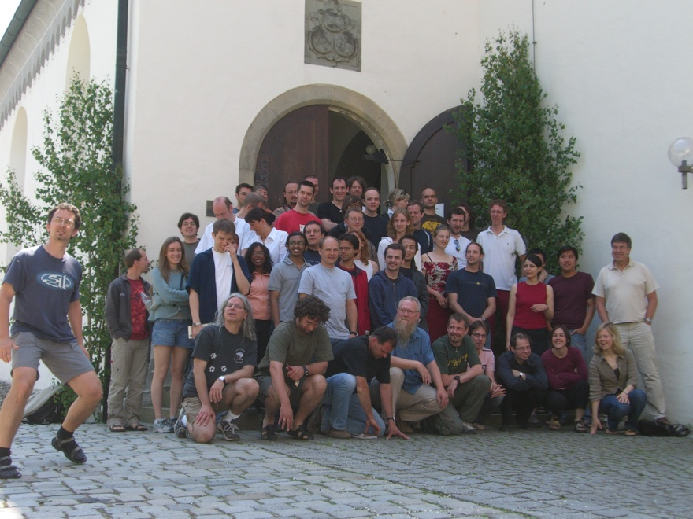
Thank you for Listening
TCD
Albert Einstein College of Medicine
TU Dublin
Max Planck Institute Germany

Slide 47
Question Time

Slide 48
Question 1
What is the brain not made of?
L. Neurons
R. Muscles

Slide 49
Question 2
How many neurons are there in a Human Brian
L. 1,000,000
R. 100,000,000,000

Slide 50
Question 3
What is a neuron in an artificial Neural Network called
L. Node
R. Neutron

