Slide 1
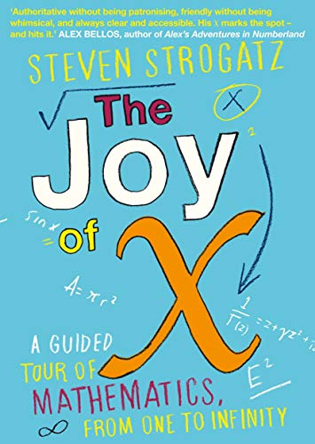
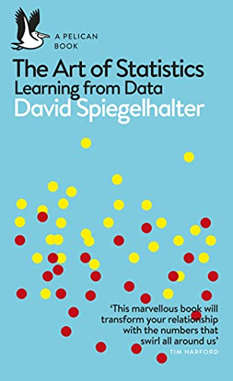
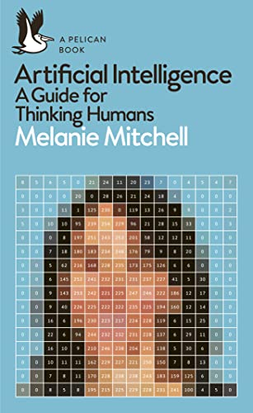
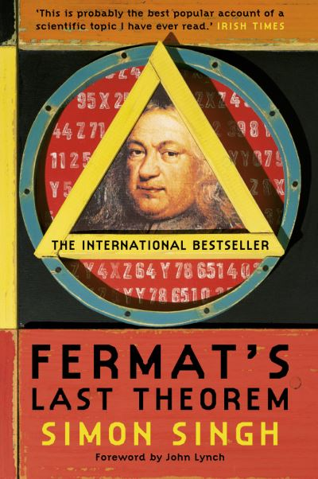
Books for Maths Week 2022

Slide 2
Artificial Intelligence: A Guide for Thinking Humans by Melanie Mitchell
The Art of Statistics: Learning from Data by David Spiegelhalter
The Joy of X: A Guided Tour of Mathematics, from One to Infinity by Steven Strogatz
Fermat’s Last Theorem by Simon Singh

Slide 3
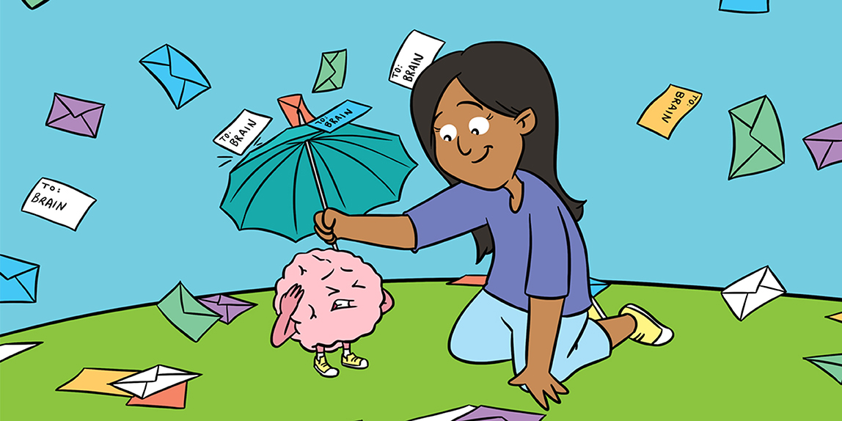
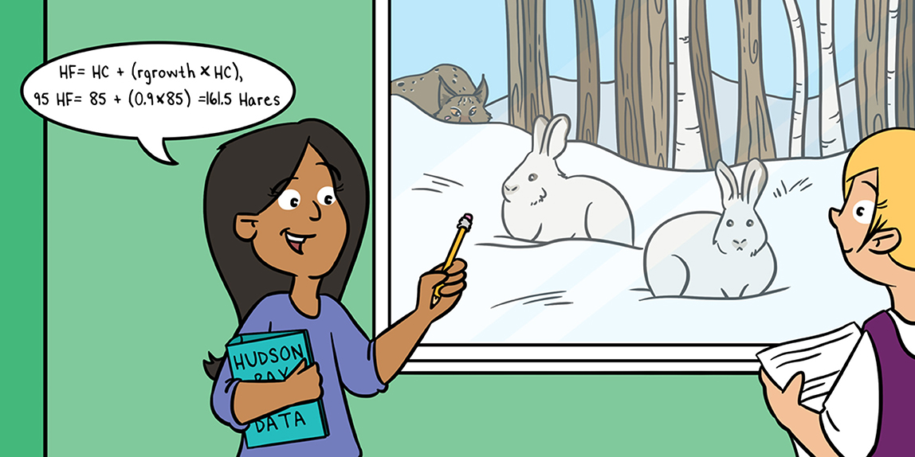
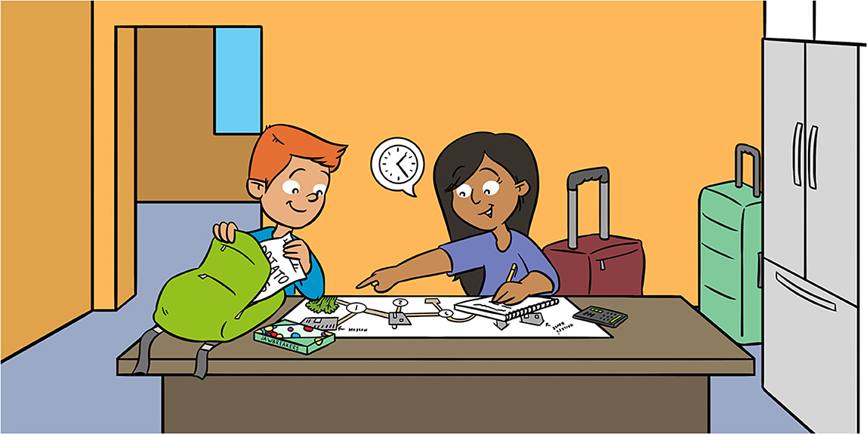
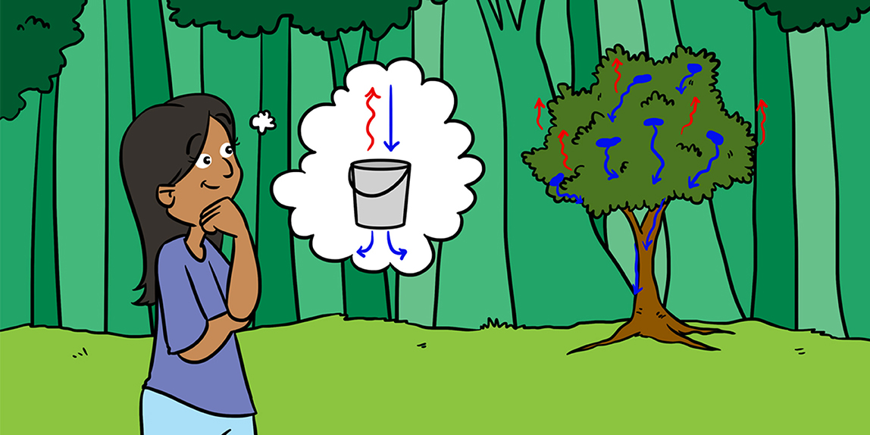
Using Mathematics to Become in Sync With the Brain
The Circle of Life: The Mathematics of Predator-Prey Relationships
Maths Papers for Kids Maths Week 2022
Finding Your Way: Shortest Paths on Networks
How Math Helps us Predict Water Flows in Forests

Slide 4
Using Mathematics to Become in Sync With the Brain
The Circle of Life: The Mathematics of Predator-Prey Relationships
Maths Papers for Kids Maths Week 2022
Finding Your Way: Shortest Paths on Networks
How Math Helps us Predict Water Flows in Forests

Slide 5
The Circle of Life: The Mathematics of Predator-Prey Relationships
Rebecca Brady and John Butler
https://kids.frontiersin.org/articles/10.3389/frym.2021.651131
Using Mathematics to Become in Sync With the Brain
Micah Swartz and Leonid L. Rubchinsky
https://kids.frontiersin.org/articles/10.3389/frym.2022.741510
Finding Your Way: Shortest Paths on Networks
Teresa Rexin 1 and Mason A. Porter 1,2*
https://kids.frontiersin.org/articles/10.3389/frym.2021.631045
How Math Helps us Predict Water Flows in Forests
Katarina Zabret 1,2*, Mojca Šraj 1 and John T. Van Stan II 3
https://kids.frontiersin.org/articles/10.3389/frym.2022.762009

Slide 6
The Circle of Life: The Mathematics of Predator-Prey Relationships
The first paper The Circle of Life: The Mathematics of Predator-Prey Relationships
by Rebecca Brady and John Butler
shows how maths can be used to model nature.
https://kids.frontiersin.org/articles/10.3389/frym.2021.651131

Slide 7
Using Mathematics to Become in Sync With the Brain
Using Mathematics to Become in Sync With the Brain
Micah Swartz and Leonid L. Rubchinsky
https://kids.frontiersin.org/articles/10.3389/frym.2022.741510

Slide 8
The Circle of Life: The Mathematics of Predator-Prey Relationships
Rebecca Brady and John Butler
https://kids.frontiersin.org/articles/10.3389/frym.2021.651131
Using Mathematics to Become in Sync With the Brain
Micah Swartz and Leonid L. Rubchinsky
https://kids.frontiersin.org/articles/10.3389/frym.2022.741510
Finding Your Way: Shortest Paths on Networks
Teresa Rexin 1 and Mason A. Porter 1,2*
https://kids.frontiersin.org/articles/10.3389/frym.2021.631045
How Math Helps us Predict Water Flows in Forests
Katarina Zabret 1,2*, Mojca Šraj 1 and John T. Van Stan II 3
https://kids.frontiersin.org/articles/10.3389/frym.2022.762009

Slide 9
The Circle of Life: The Mathematics of Predator-Prey Relationships
Rebecca Brady and John Butler
https://kids.frontiersin.org/articles/10.3389/frym.2021.651131
Using Mathematics to Become in Sync With the Brain
Micah Swartz and Leonid L. Rubchinsky
https://kids.frontiersin.org/articles/10.3389/frym.2022.741510
Finding Your Way: Shortest Paths on Networks
Teresa Rexin 1 and Mason A. Porter 1,2*
https://kids.frontiersin.org/articles/10.3389/frym.2021.631045
How Math Helps us Predict Water Flows in Forests
Katarina Zabret 1,2*, Mojca Šraj 1 and John T. Van Stan II 3
https://kids.frontiersin.org/articles/10.3389/frym.2022.762009

Slide 10
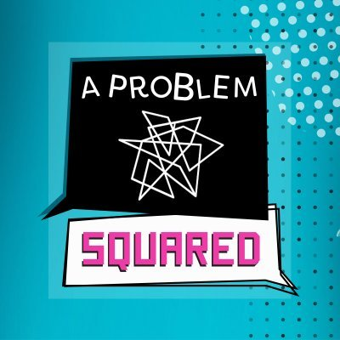
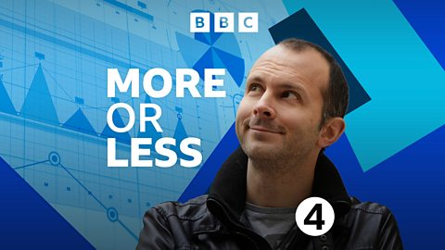

Maths Week 2022
Podcast Recommendations

