Slide 1
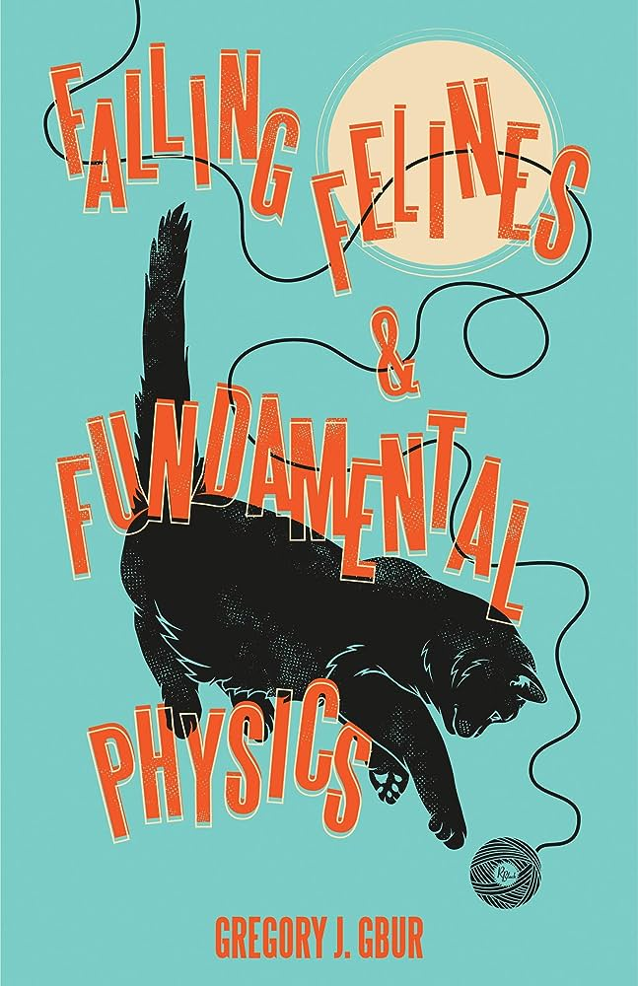
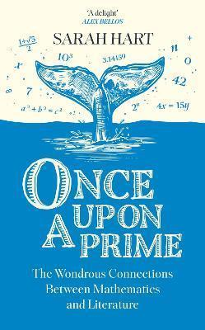
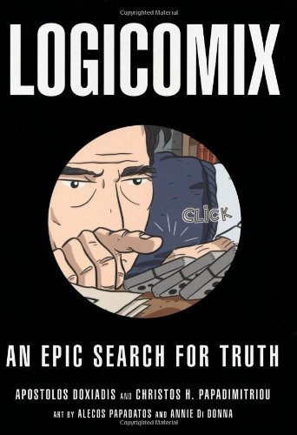
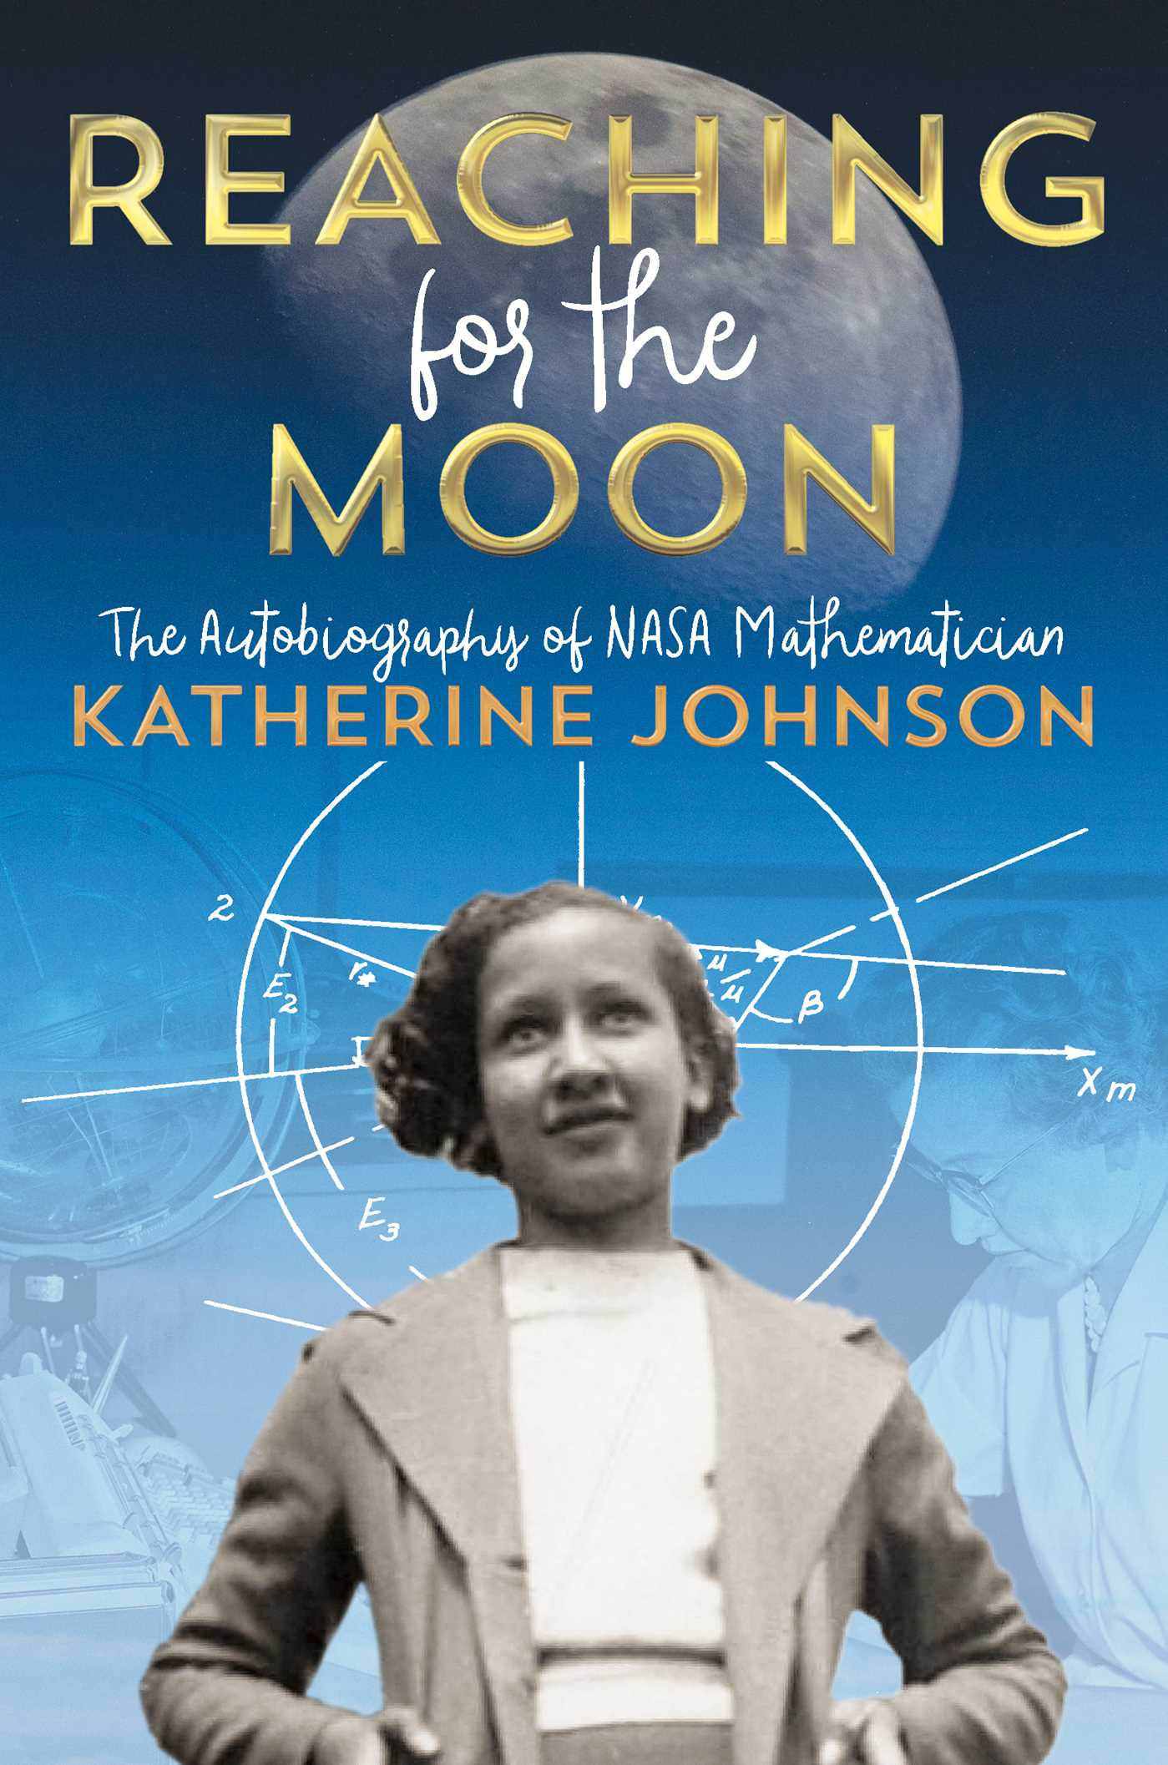
Books for Maths Week 2023

Slide 2
Falling Felines and Fundamental Physics by Gregory J. Gbur
Once Upon a Prime by Sarah Hart
Logicomix: An Epic Search for Truth by Apostolos and Christos H. Papadimitirou
Reaching for the Moon: The Autobiography of NASA Mathematician Katherine Johnson by Katherine Johnson

Slide 3
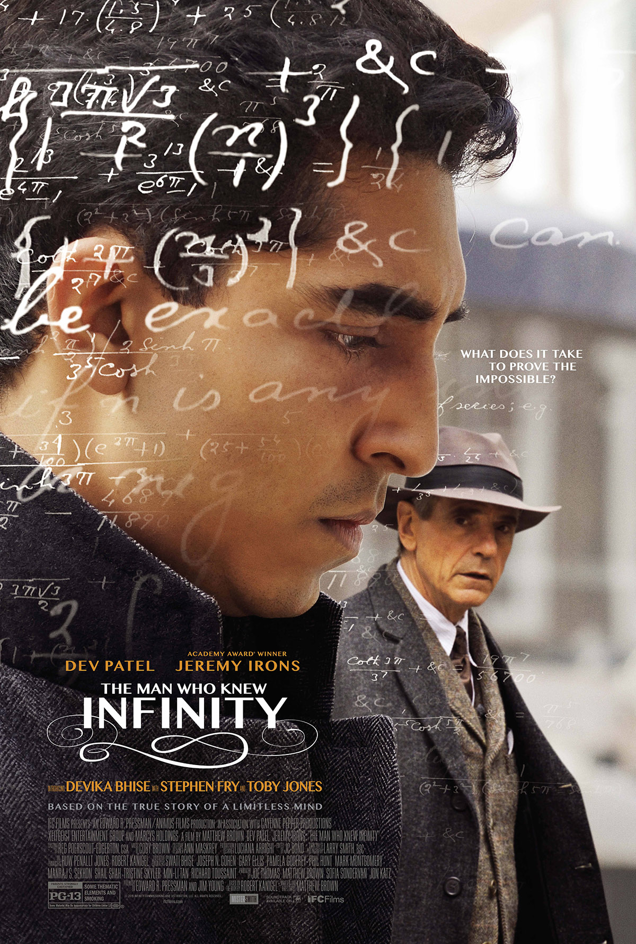
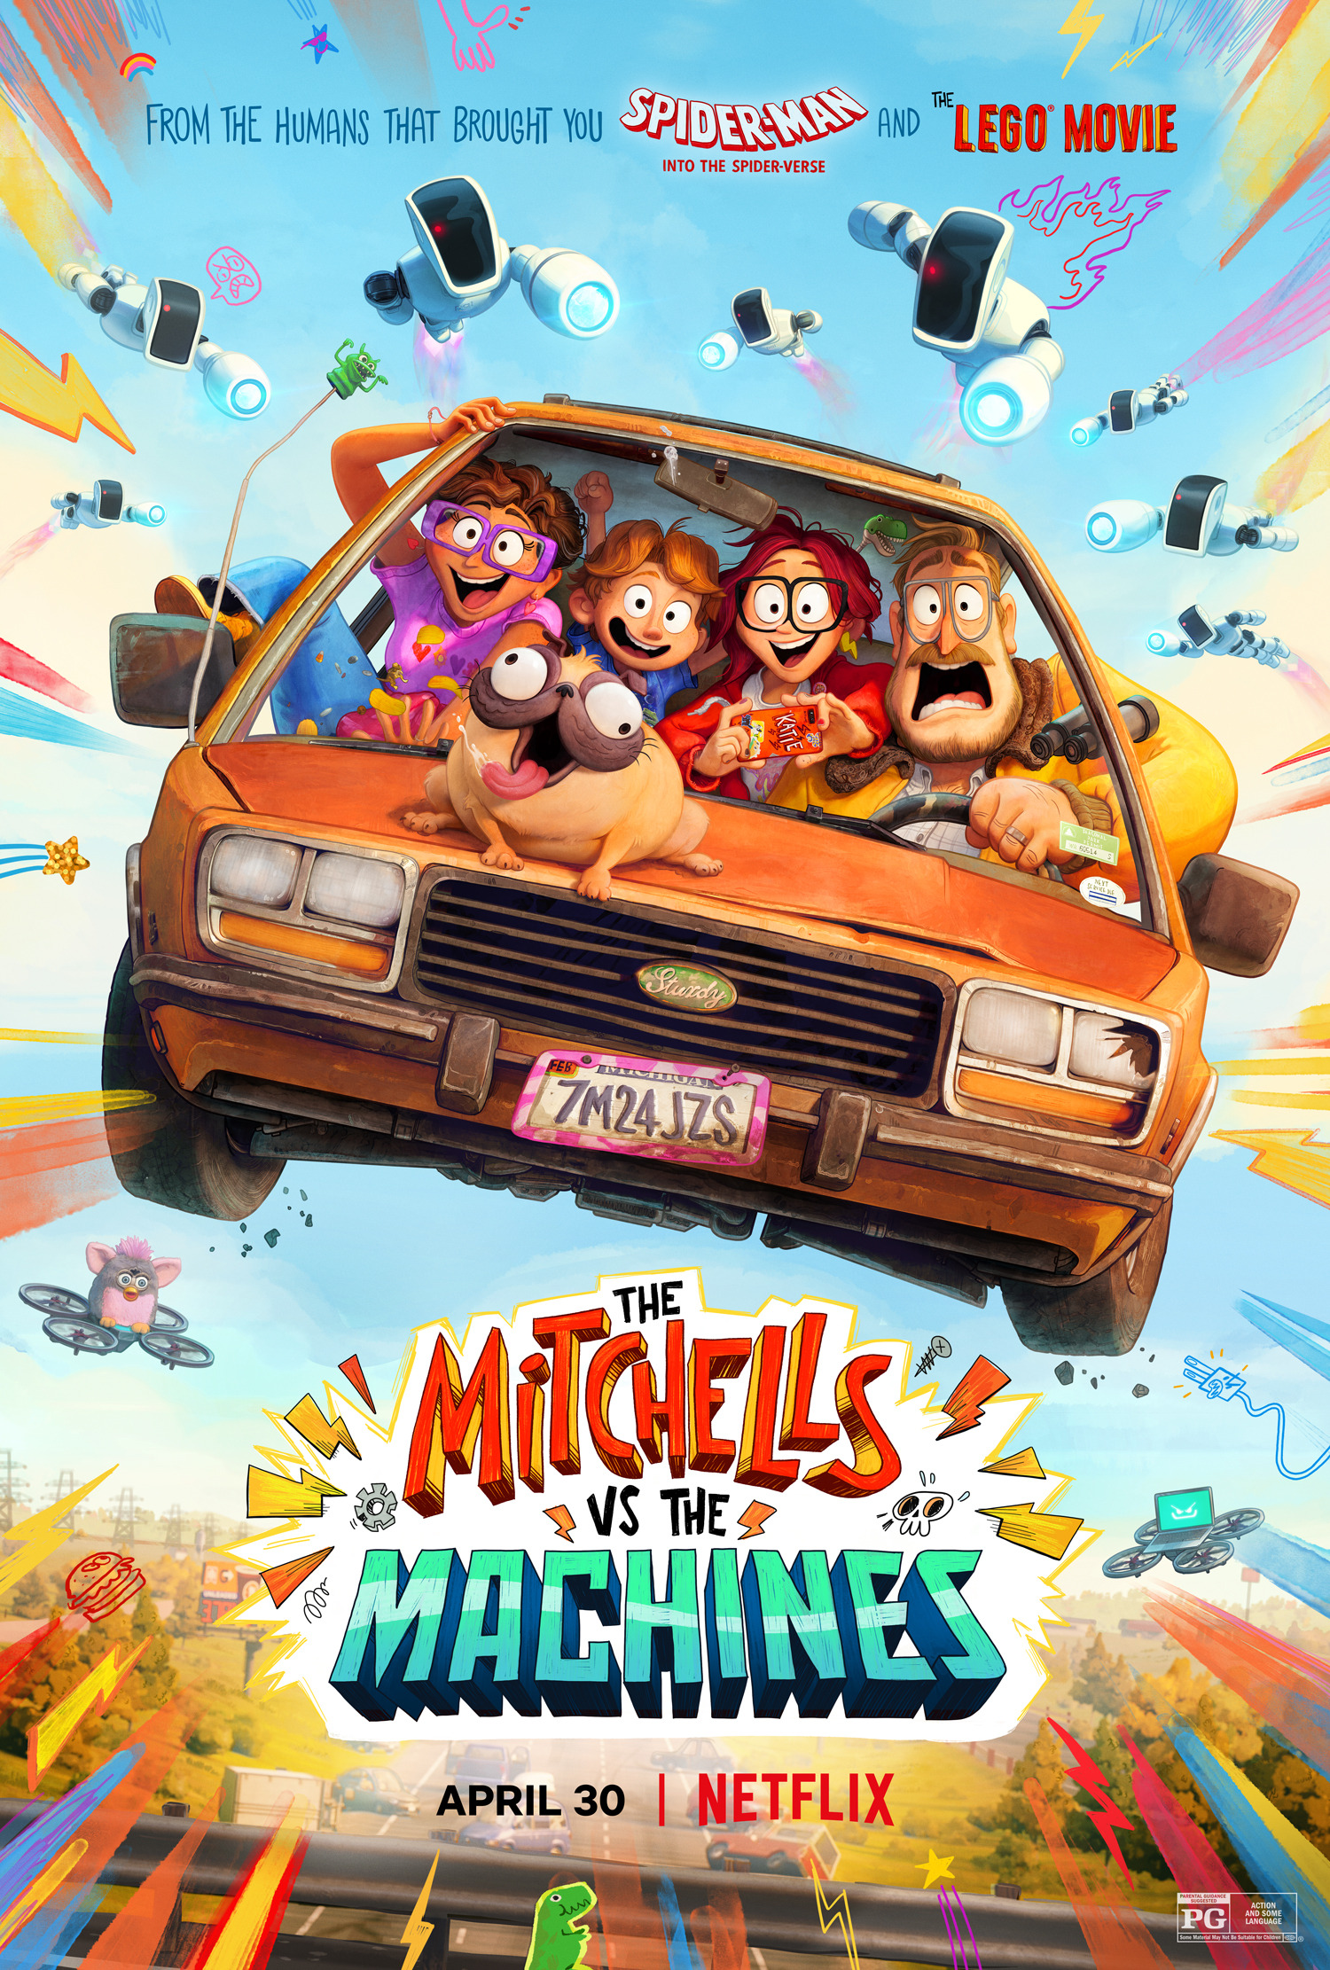
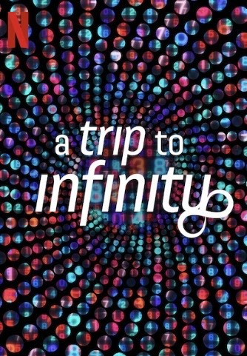


Films for Maths Week 2023

Slide 4
The Man Who Knew Infinity
Mitchell’s vs the Machines
A Trip to Infinity
Barbie and Oppenheimer

Slide 5
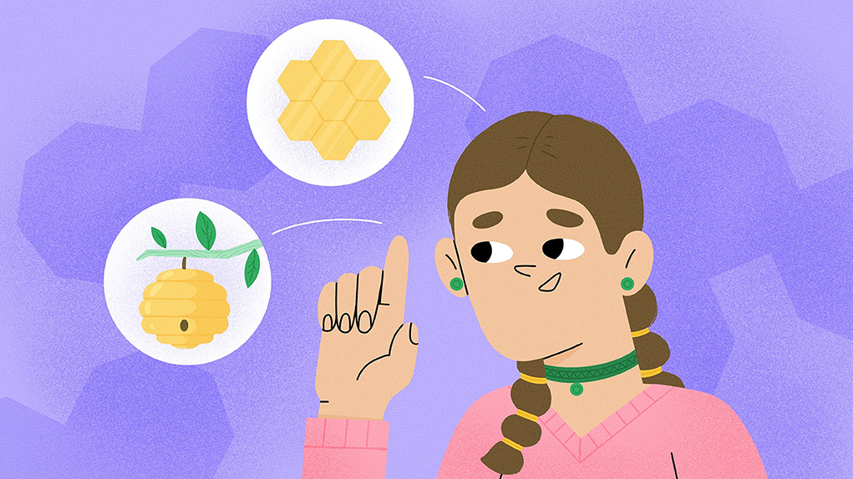

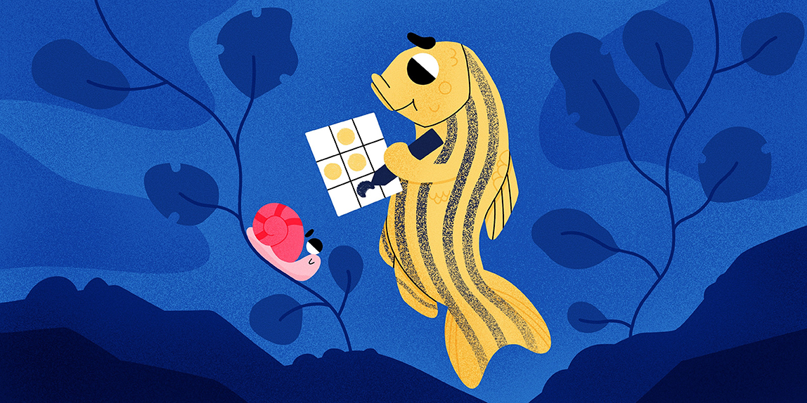

Puzzling Pentagons—How Many Ways Can We Cover a Flat Surface?
Predict Who Your Friends Are?
Maths Papers for Kids Maths Week 2023
What Does Math Have to Do With Patterns in Fish?
Understanding The Odds: Statistics in Public Health

Slide 6
Mann C and McLoud-Mann J (2023) Puzzling Pentagons—How Many Ways Can We Cover a Flat Surface? Front. Young Minds. 11:953114. doi: 10.3389/frym.2023.953114
https://kids.frontiersin.org/articles/10.3389/frym.2023.953114
Black A and West G (2023) Predict Who Your Friends Are?. Front. Young Minds. 11:820289. doi: 10.3389/frym.2022.820289
https://kids.frontiersin.org/articles/10.3389/frym.2022.820289
Goodwin G and Ryu S (2023) Understanding The Odds: Statistics in Public Health. Front. Young Minds. 11:926624. doi: 10.3389/frym.2022.926624
https://kids.frontiersin.org/articles/10.3389/frym.2022.926624
Shirman B and Volkening A (2022) What Does Math Have to Do With Patterns in Fish?. Front. Young Minds. 10:834049. doi: 10.3389/frym.2022.834049
https://kids.frontiersin.org/articles/10.3389/frym.2022.834049

Slide 7



Maths Week 2023
Podcast Recommendations

Slide 8
Not so Standard Deviations with Roger Peng and Hilary Parker
The Function Room, Colm O’Regan chats about maths
Future proof with Jonathan McCrea

