Slide 1
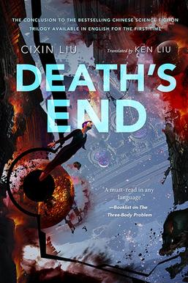
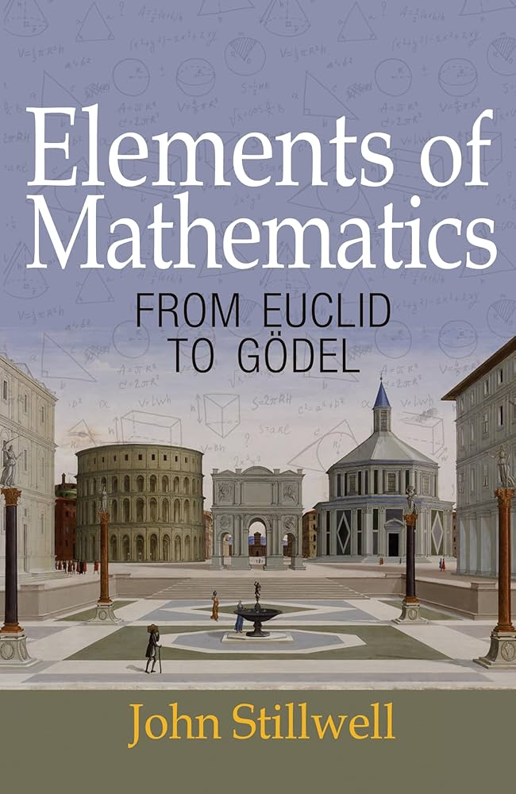
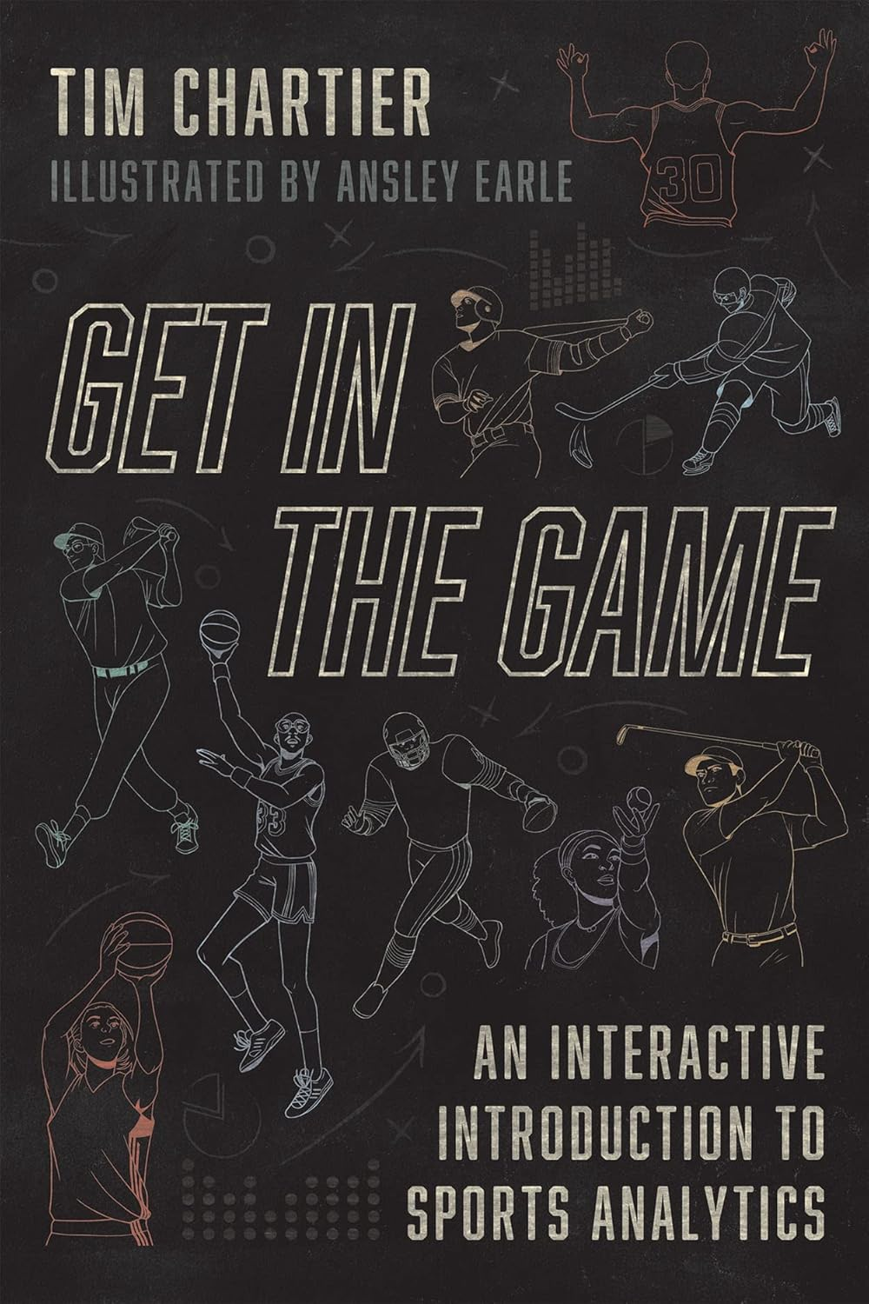
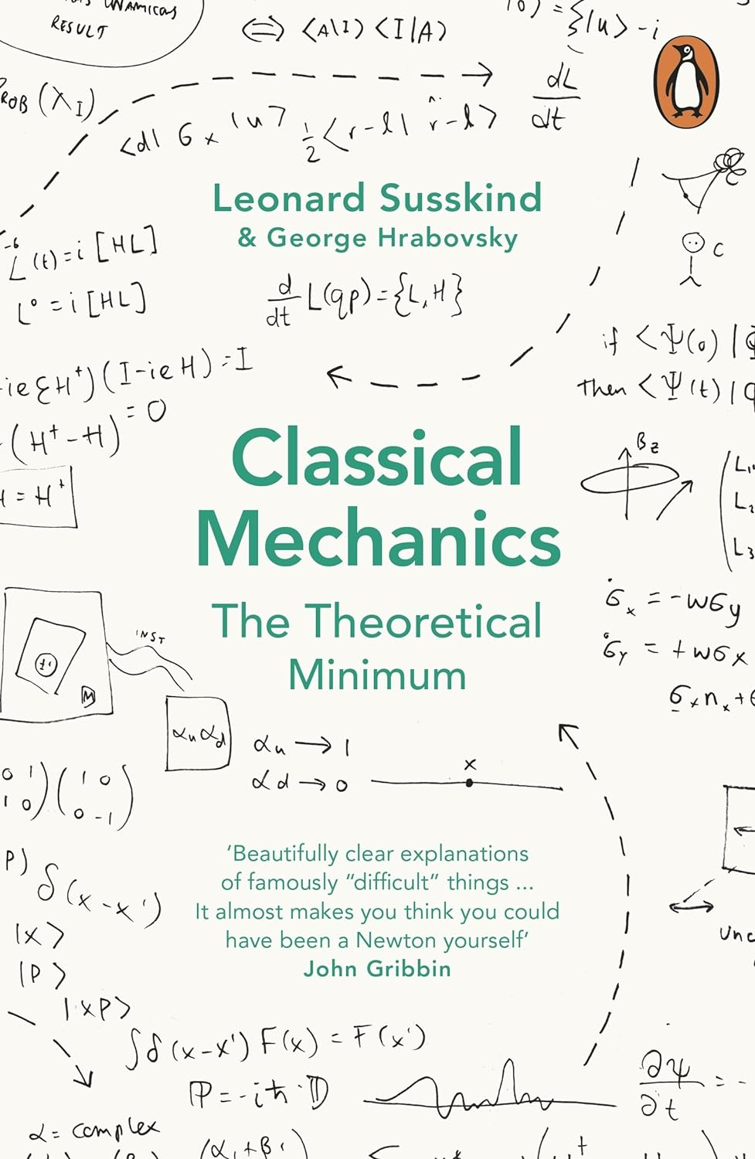
Books for Maths Week 2024

Slide 2
Elements of Mathematics: From Euclid to Godel: From Euclid to Gödel by John Stillwell
Classical Mechanics: The Theoretical Minimum Paperback
by George Hrabovsky (Author), Leonard Susskind (Author)
Get in the Game: An Interactive Introduction to Sports Analytics Paperback – 7 Sept. 2022
by Tim Chartier (Author), Ansley Earle (Illustrator)
Deaths End by Cixin Liu

Slide 3

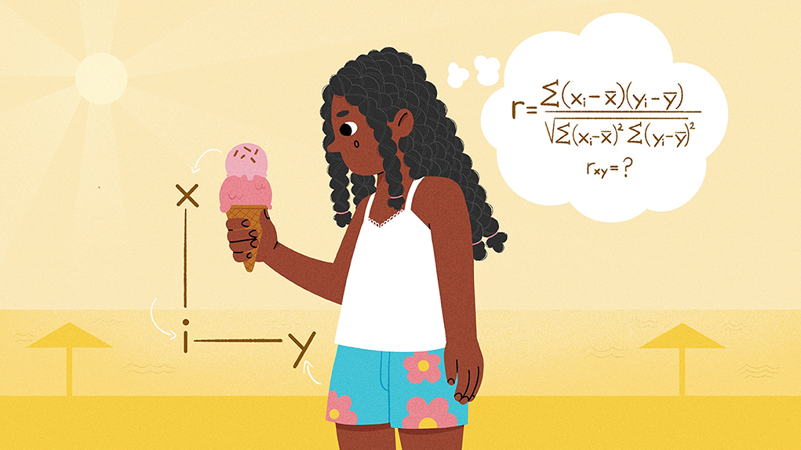
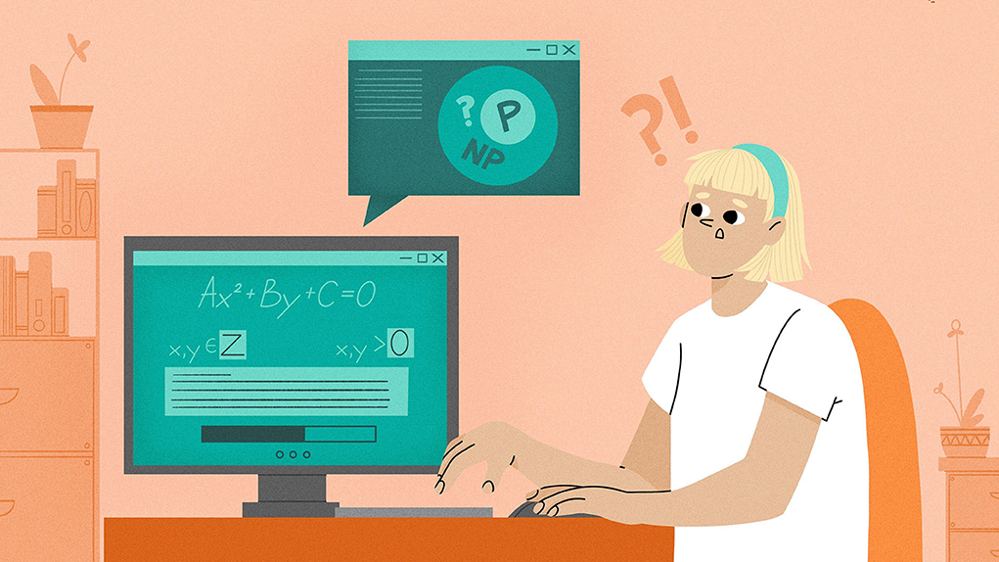
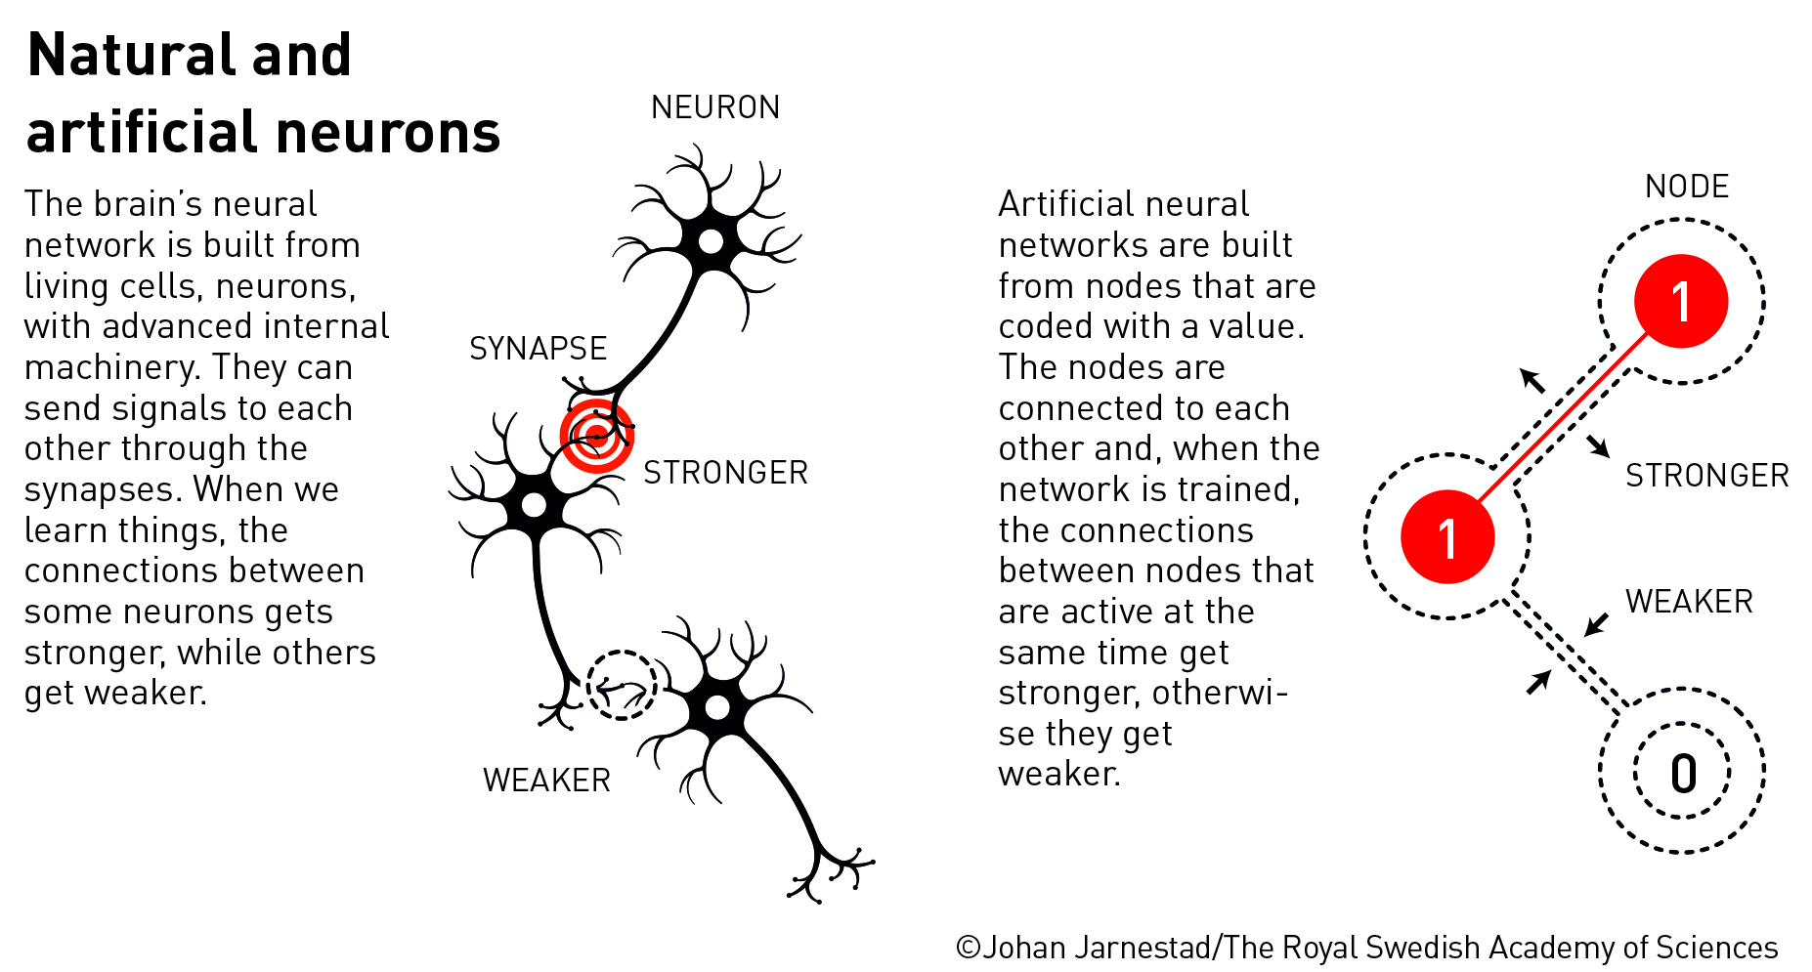
Maths Research for All Maths Week 2024

Slide 4
popular-physicsprize2024.pdf (nobelprize.org)
Emmert-Streib F and Dehmer M (2023) Causality: Using Math to Understand the Science of Cause and Effect. Front. Young Minds. 11:1155100. doi: 10.3389/frym.2023.1155100
Causality: Using Math to Understand the Science of Cause and Effect · Frontiers for Young Minds (frontiersin.org)
Segev N and Wigderson A (2024) Easy Or Hard? Basic Questions in Computational Complexity Theory. Front. Young Minds. 12:1284284. doi: 10.3389/frym.2023.1284284
Easy Or Hard? Basic Questions in Computational Complexity Theory · Frontiers for Young Minds (frontiersin.org)
The maths behind a perfect cup of coffee (rte.ie) By Kevin Moroney and Ken O’Connell, University of Limerick

Slide 5
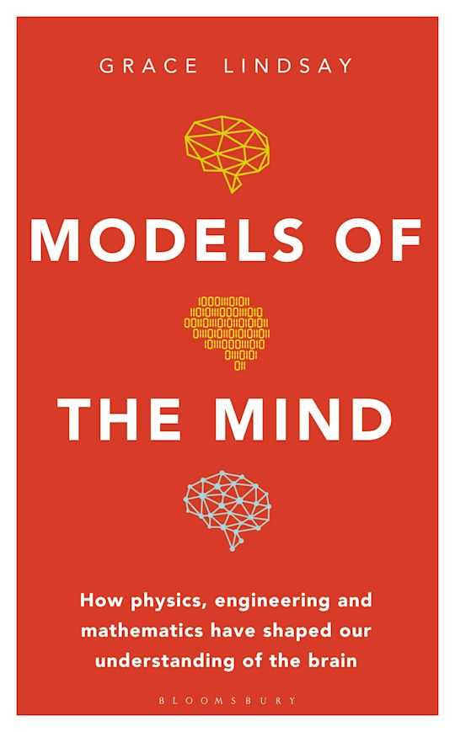
Books for Maths Week 2024

Slide 6
Maths Research for All Maths Week 2024
Noble Prize in Physics
Easy Or Hard? Basic Questions in Computational Complexity Theory
The maths behind a perfect cup of coffee
Causality: Using Math to Understand the Science of Cause and Effect

Slide 7




Podcast for Maths Week 2024

Slide 8
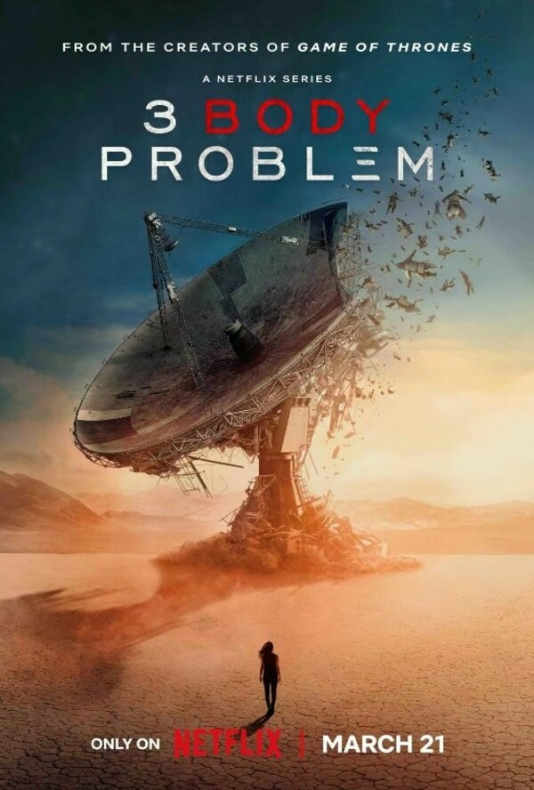
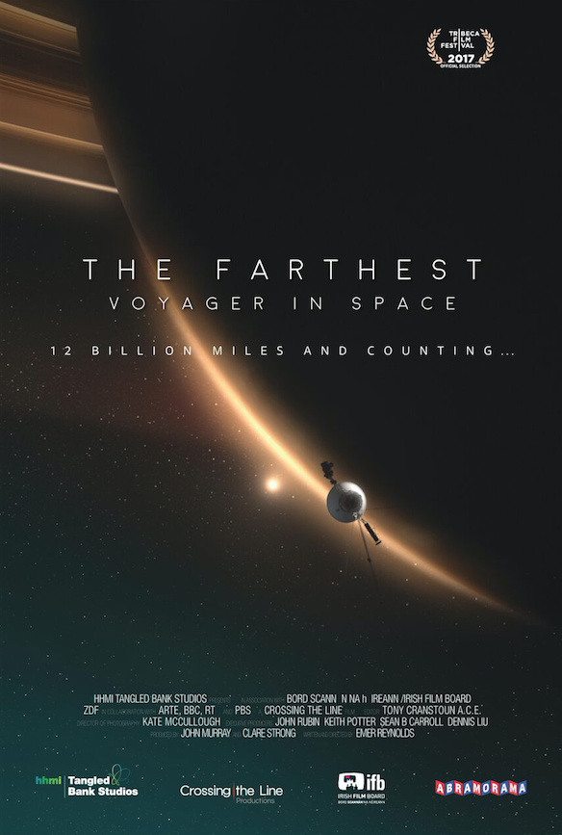

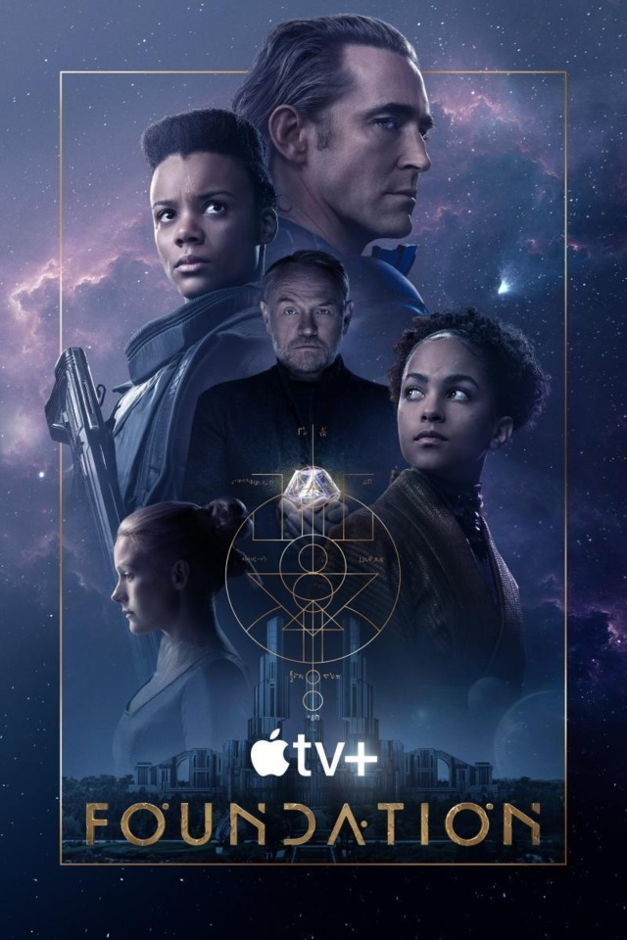
Films/Shows for Maths Week 2024

Slide 9
Maths Week 2024
Podcast Recommendations

Slide 10
The Function Room, Colm O’Regan chats about maths

Slide 11
Films/Shows for Maths Week 2024

Slide 12
The Man Who Knew Infinity
Mitchell’s vs the Machines
A Trip to Infinity
Barbie and Oppenheimer

