Slide 1
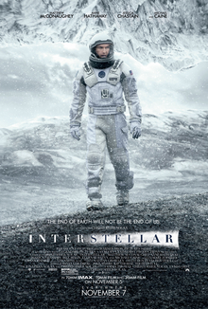

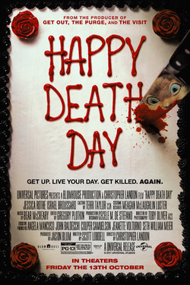
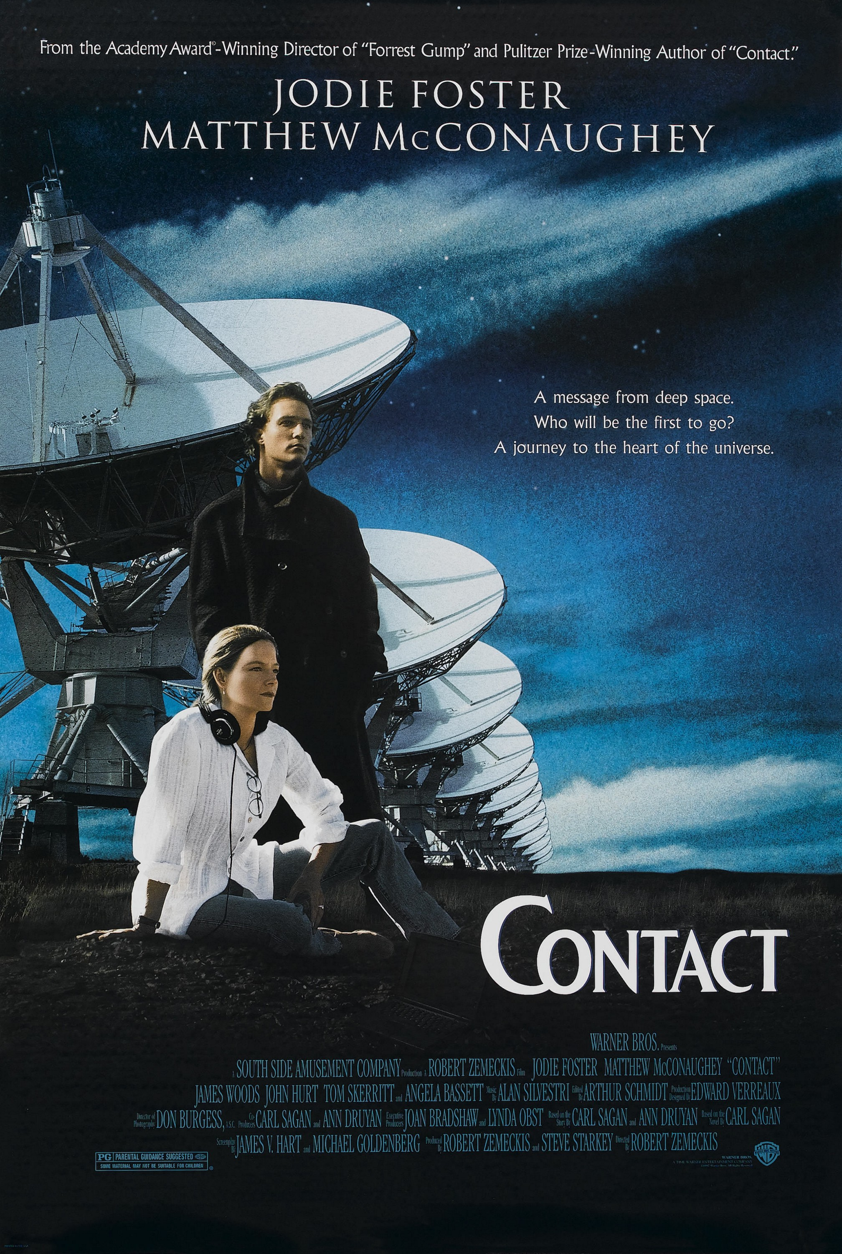

Films and TV for Maths Week 2025

Slide 2
Film Post
It’s hashtag#MathsWeek2025 🎉 — time for my annual posts on the different ways to enjoy maths! 🎬 Maths in TV & Film edition 👇 🚀 Interstellar The perfect film to start Maths Week. The real maths behind the wormholes and time dilation was developed by Nobel Laureate Kip Thorne, who’s giving this year’s Hamilton Lecture on Thursday! 🔗 https://lnkd.in/edpiq_tu 🎯 Prime Target (Apple TV+) A handsome maths PhD student researching prime numbers, the foundation of modern cryptography, becomes the target of secretive agencies trying to steal or weaponise his discovery. Possibly inspired by the true story of Phil Zimmermann, who created an encryption algorithm in 1991 and was investigated under US arms-control laws. 🎂 Happy Death Day A time-loop, a murder mystery, and a masterclass in algorithmic thinking: iteration, hypothesis testing, refining strategies, and problem-solving. A perfect mix of Halloween and mathematics! 🎃 👽 Contact Based on Carl Sagan’s novel, it explores prime numbers as the universal language and the maths of wormholes for interstellar travel. Which nicely bookends the recommendations as it stars Matthew McConaughey and the wormhole physics was done by Kip Thorne again! 💡 Check out my previous recommendations here 👉 https://lnkd.in/eVn378QF Which one will you watch first this Maths Week? 🎥🧮 hashtag#MathsWeek hashtag#MathsInMovies hashtag#ScienceMeetsCinema hashtag#STEM hashtag#MathsIsEverywhere

Slide 3
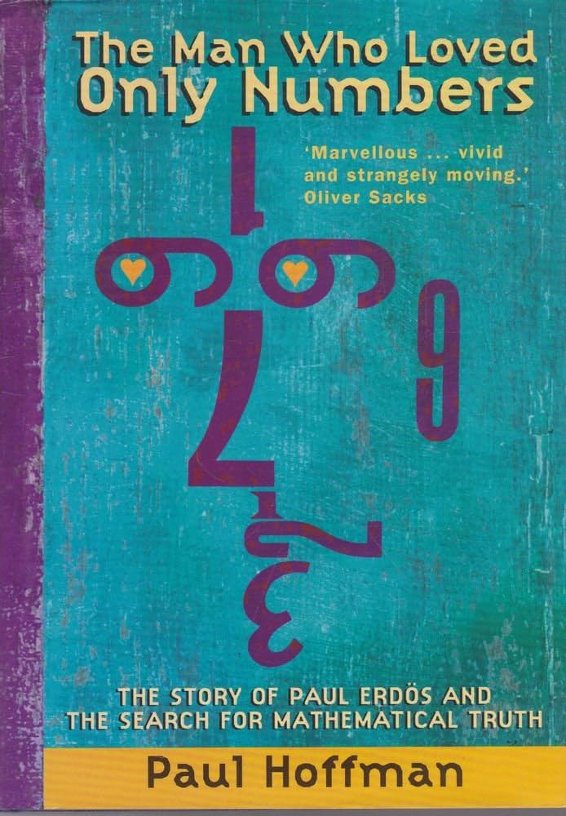

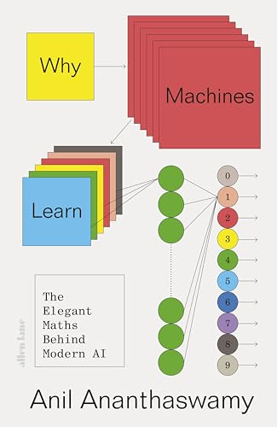

Books for Maths Week 2025

Slide 4
Books Post
It’s hashtag#MathsWeek2025 🎉 — time for my annual posts on the different ways to enjoy maths! 🎬 Maths in TV & Film edition 👇 🚀 Interstellar The perfect film to start Maths Week. The real maths behind the wormholes and time dilation was developed by Nobel Laureate Kip Thorne, who’s giving this year’s Hamilton Lecture on Thursday! 🔗 https://lnkd.in/edpiq_tu 🎯 Prime Target (Apple TV+) A handsome maths PhD student researching prime numbers, the foundation of modern cryptography, becomes the target of secretive agencies trying to steal or weaponise his discovery. Possibly inspired by the true story of Phil Zimmermann, who created an encryption algorithm in 1991 and was investigated under US arms-control laws. 🎂 Happy Death Day A time-loop, a murder mystery, and a masterclass in algorithmic thinking: iteration, hypothesis testing, refining strategies, and problem-solving. A perfect mix of Halloween and mathematics! 🎃 👽 Contact Based on Carl Sagan’s novel, it explores prime numbers as the universal language and the maths of wormholes for interstellar travel. Which nicely bookends the recommendations as it stars Matthew McConaughey and the wormhole physics was done by Kip Thorne again! 💡 Check out my previous recommendations here 👉 https://lnkd.in/eVn378QF Which one will you watch first this Maths Week? 🎥🧮 hashtag#MathsWeek hashtag#MathsInMovies hashtag#ScienceMeetsCinema hashtag#STEM hashtag#MathsIsEverywhere

Slide 5


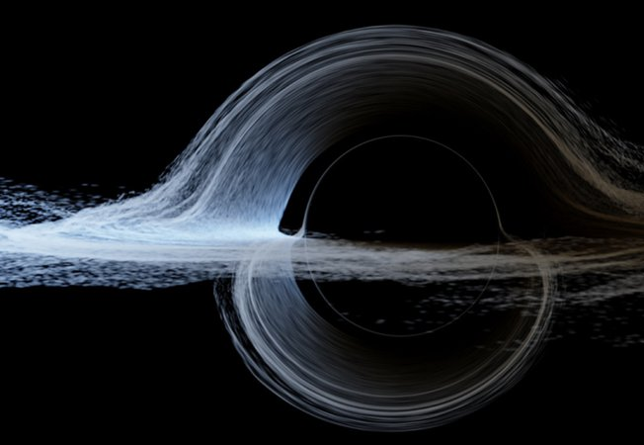
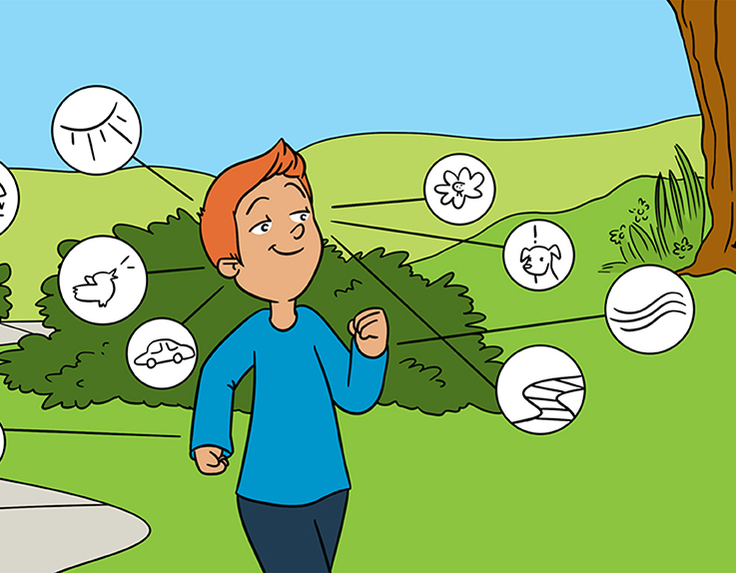
Maths Research for All Maths Week 2025
Will Learning Machines Take Over the World?
How Does Math Keep Secrets?
“Feeling” Ourselves Move: A Team Effort by Our Senses
Astrophysics in Interstellar

