Slide 1
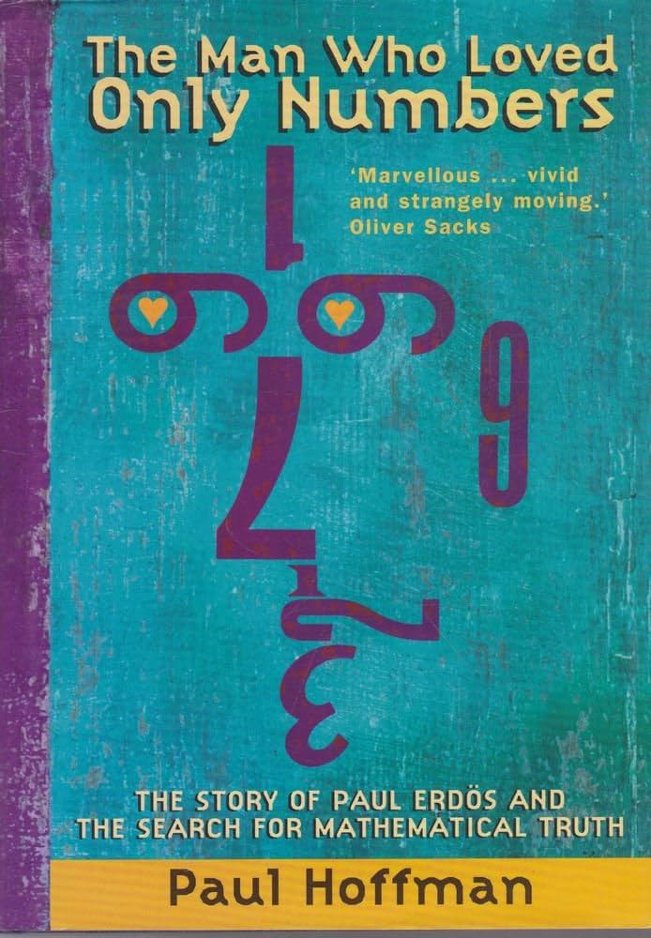

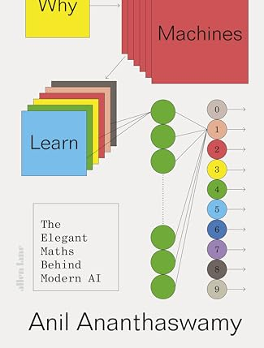
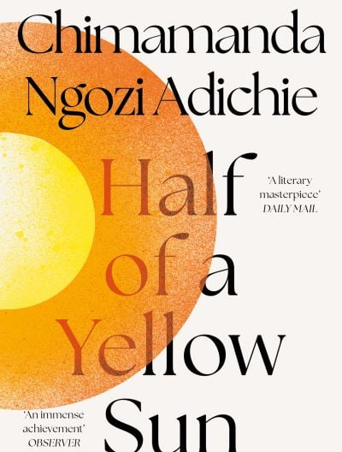
Books for Maths Week 2025

Slide 2
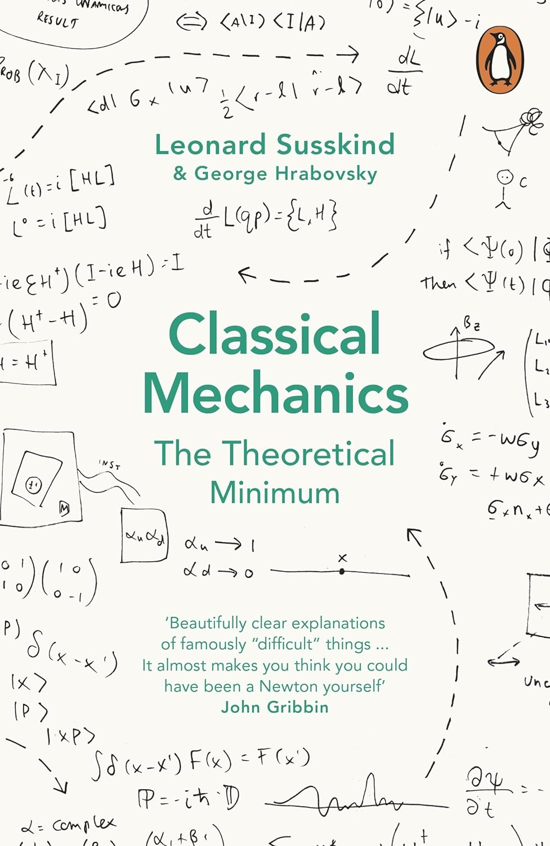
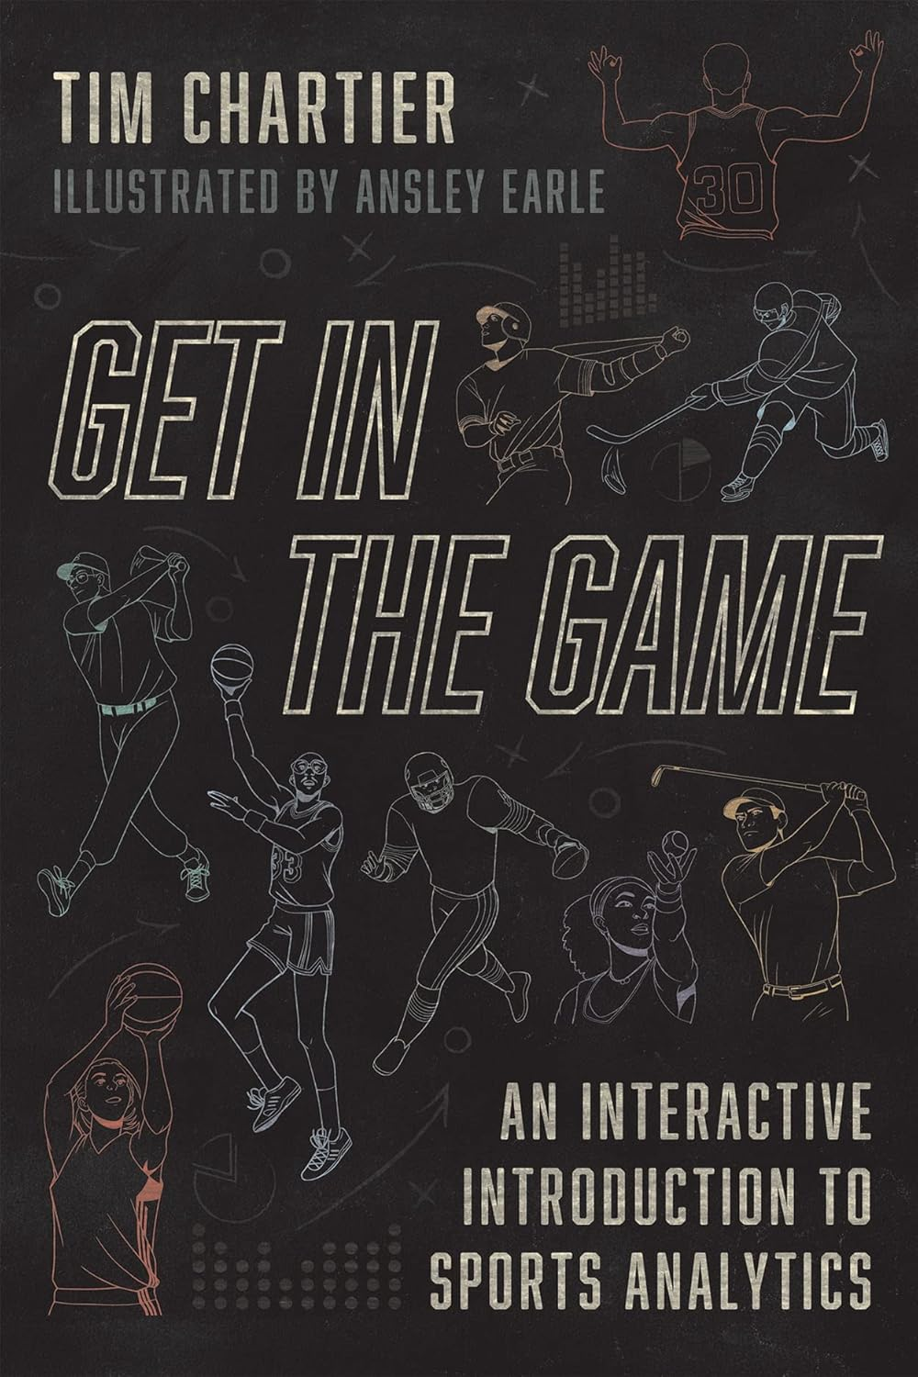
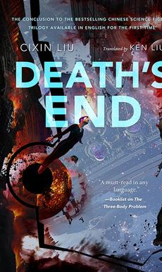
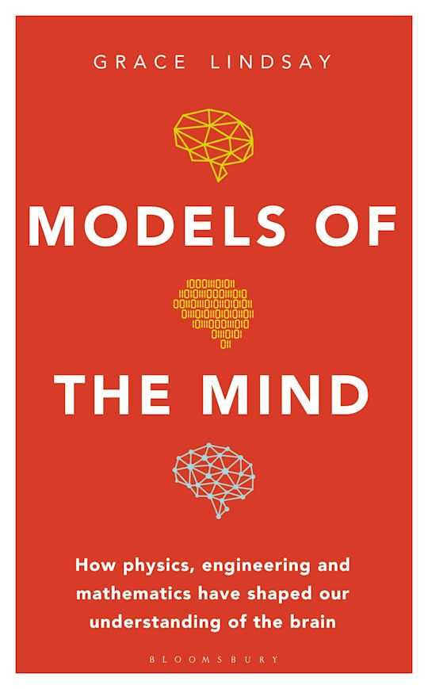
Books for Maths Week 2024

Slide 3
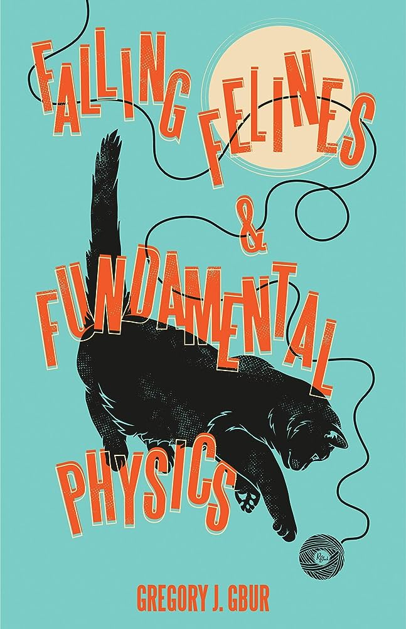
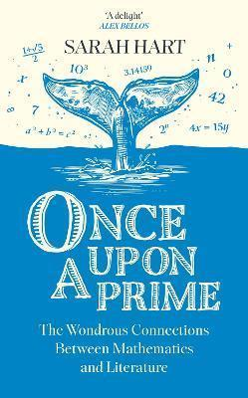
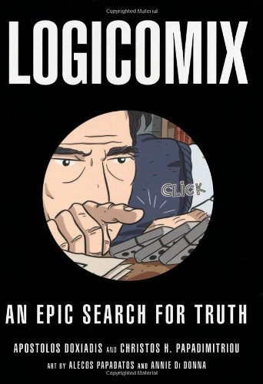
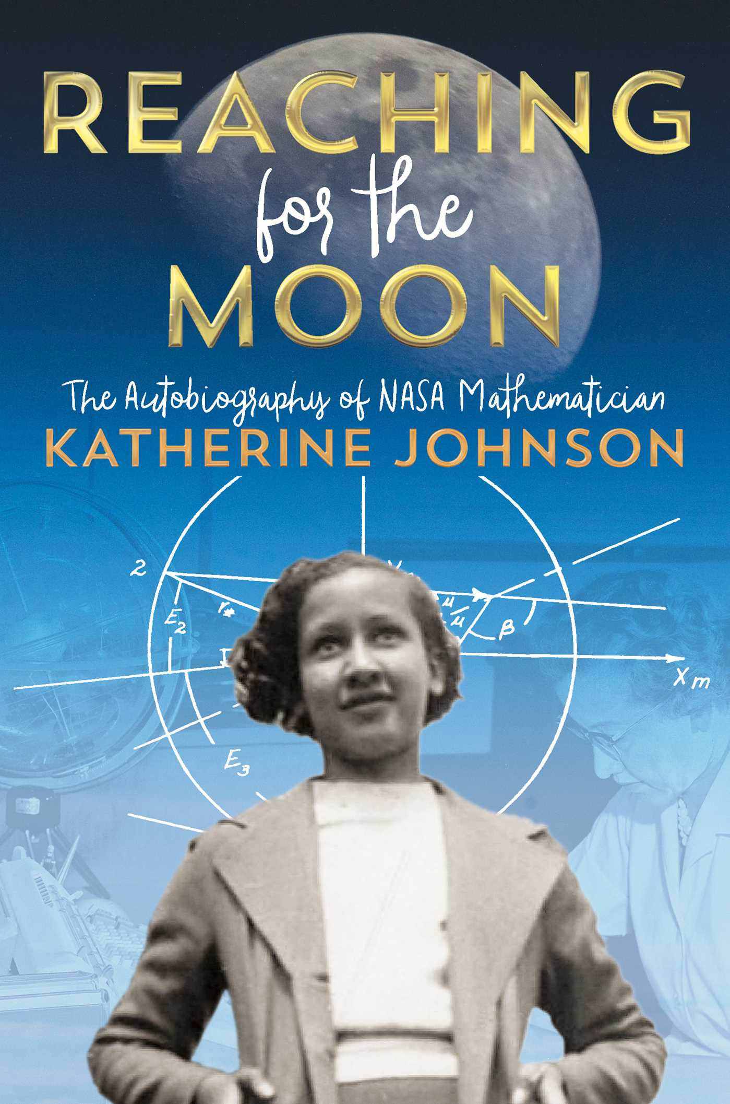
Books for Maths Week 2023

Slide 4
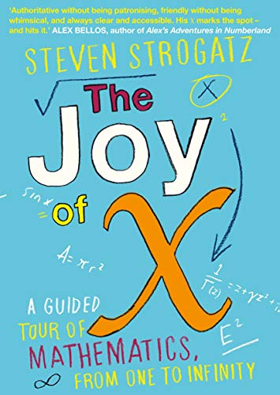
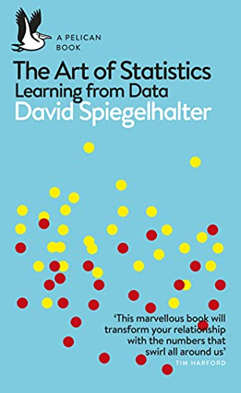
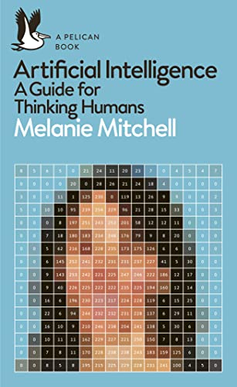
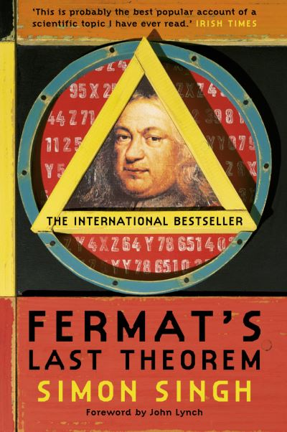
Books for Maths Week 2022

Slide 5
Elements of Mathematics: From Euclid to Godel: From Euclid to Gödel by John Stillwell
Classical Mechanics: The Theoretical Minimum Paperback
by George Hrabovsky (Author), Leonard Susskind (Author)
Get in the Game: An Interactive Introduction to Sports Analytics Paperback – 7 Sept. 2022
by Tim Chartier (Author), Ansley Earle (Illustrator)
Deaths End by Cixin Liu

Slide 6
Falling Felines and Fundamental Physics by Gregory J. Gbur
Once Upon a Prime by Sarah Hart
Logicomix: An Epic Search for Truth by Apostolos and Christos H. Papadimitirou
Reaching for the Moon: The Autobiography of NASA Mathematician Katherine Johnson by Katherine Johnson

Slide 7
Artificial Intelligence: A Guide for Thinking Humans by Melanie Mitchell
The Art of Statistics: Learning from Data by David Spiegelhalter
The Joy of X: A Guided Tour of Mathematics, from One to Infinity by Steven Strogatz
Fermat’s Last Theorem by Simon Singh

