Slide 1
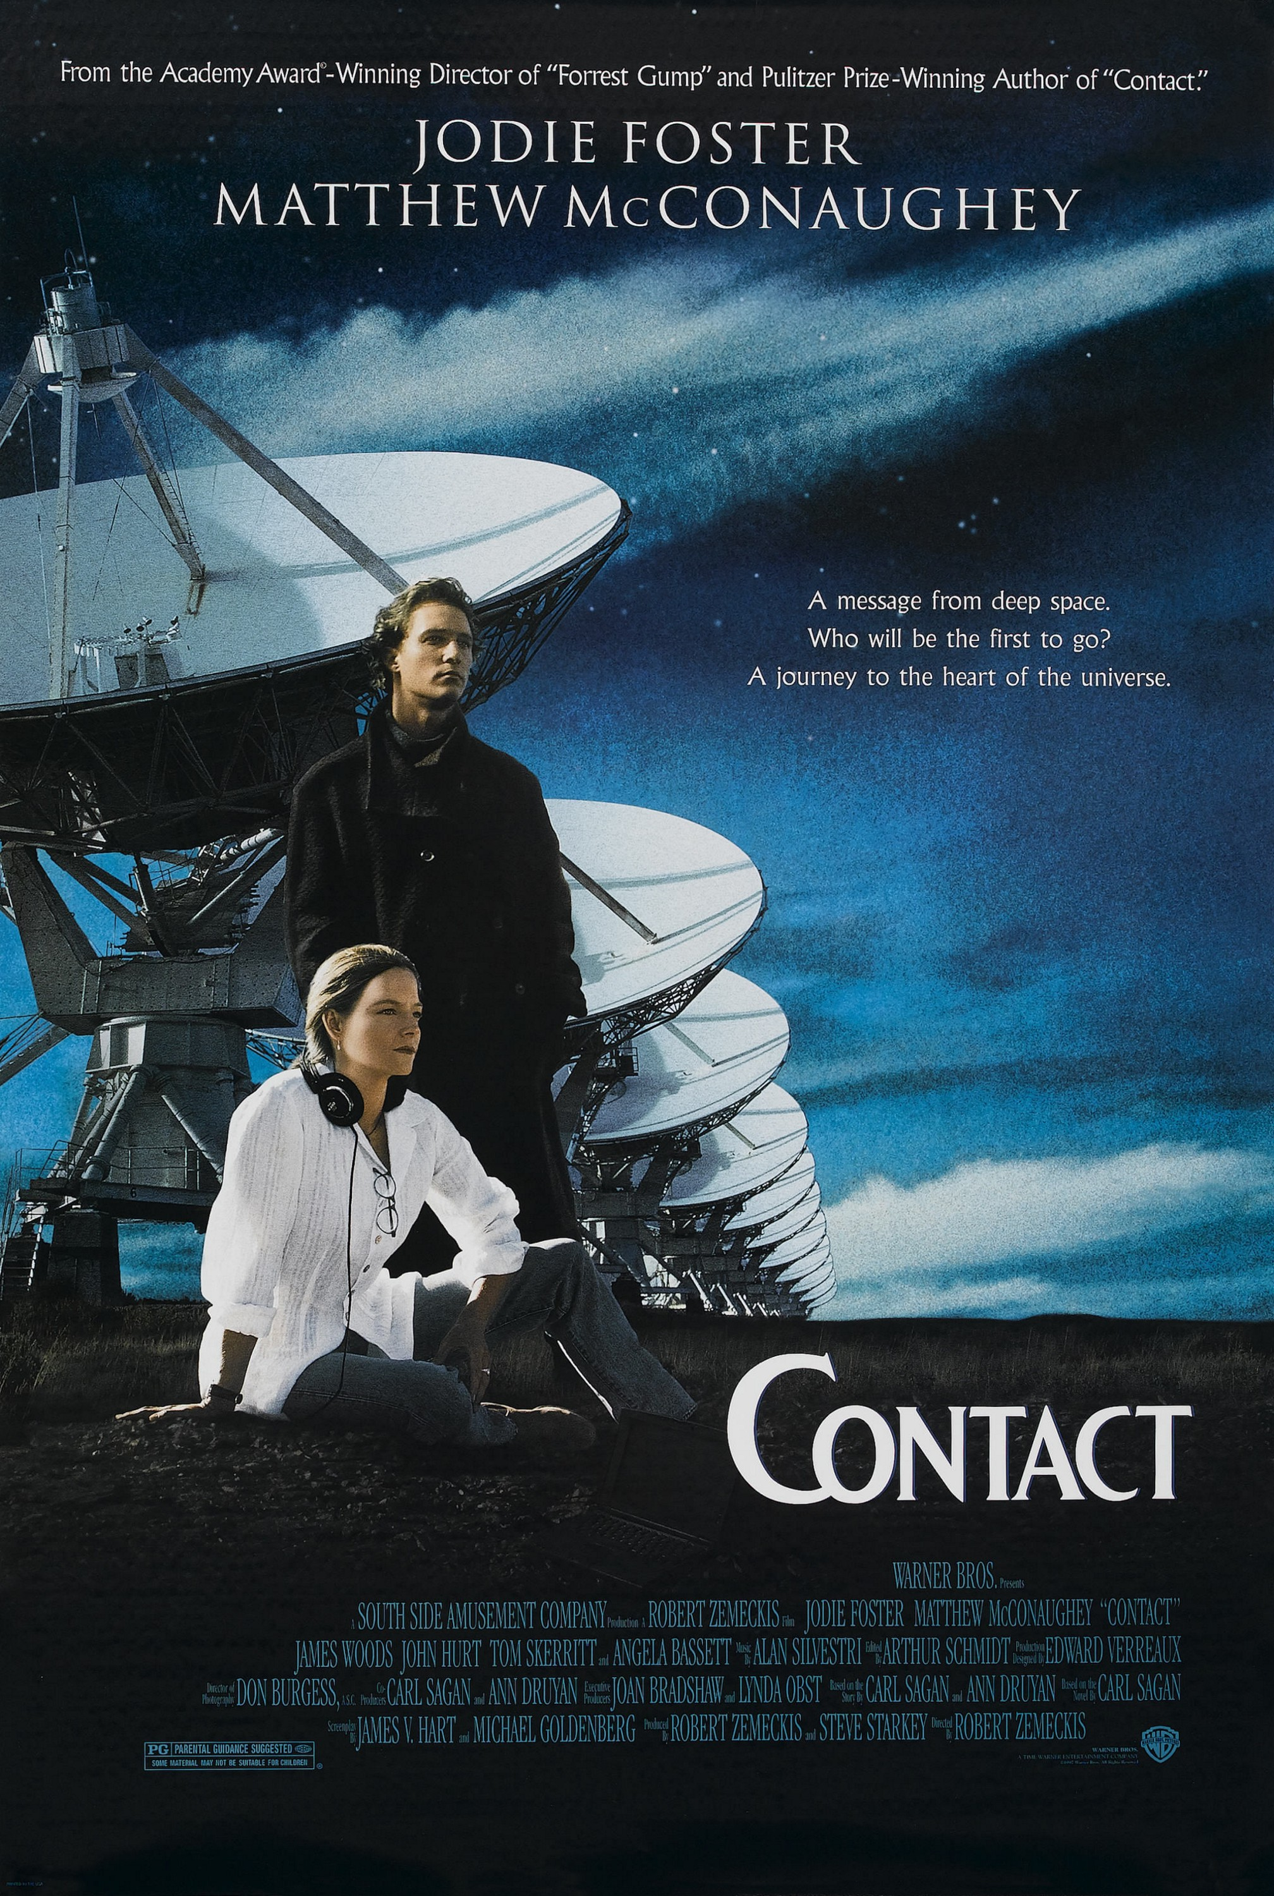



Films and TV for Maths Week 2025

Slide 2




Films/Shows for Maths Week 2024

Slide 3





Films for Maths Week 2023

Slide 4




Films and TV for Maths Week 2022

Slide 5
Prime Target
Contact
Interstellar
Contact

Slide 6
3 Body Problem
Taskmaster
The Farthest
Foundation

Slide 7
The Man Who Knew Infinity
Mitchell’s vs the Machines
A Trip to Infinity
Barbie and Oppenheimer

Slide 8
A Beautiful Mind
Good Will Hunting
The Simpsons
Arcadia

