Slide 1


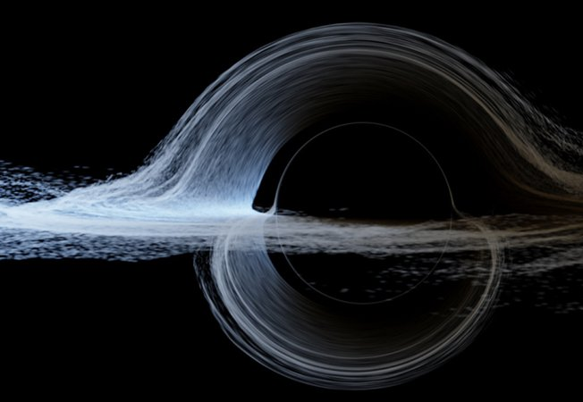
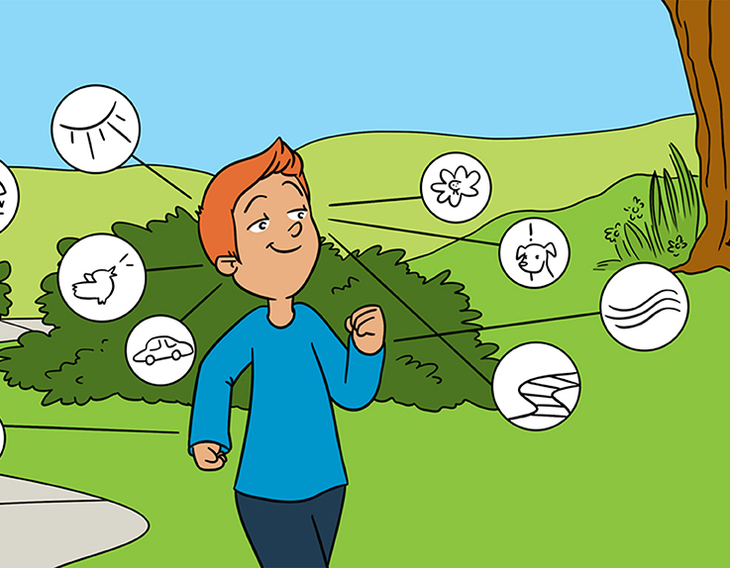
Maths Research for All Maths Week 2025
Will Learning Machines Take Over the World?
How Does Math Keep Secrets?
“Feeling” Ourselves Move: A Team Effort by Our Senses
Astrophysics in Interstellar

Slide 2
Campos JL, Pandi M and Butler JS (2020) “Feeling” Ourselves Move: A Team Effort by Our Senses. Front. Young Minds. 8:9. doi: 10.3389/frym.2020.00009
https://kids.frontiersin.org/articles/10.3389/frym.2020.00009
LeCun Y (2024) Will Learning Machines Take Over the World?. Front. Young Minds. 12:1164958. doi: 10.3389/frym.2024.1164958
https://kids.frontiersin.org/articles/10.3389/frym.2024.1164958
THE JOY OF WHY, How Does Math Keep Secrets? https://www.quantamagazine.org/how-does-math-keep-secrets-20240801/
James, O., von Tunzelmann, E., Franklin, P., & Thorne, K. S. (2015). Gravitational lensing by spinning black holes in astrophysics, and in the movie Interstellar. Classical and Quantum Gravity, 32(6), 065001.
https://doi.org/10.1088/0264-9381/32/6/065001

Slide 3

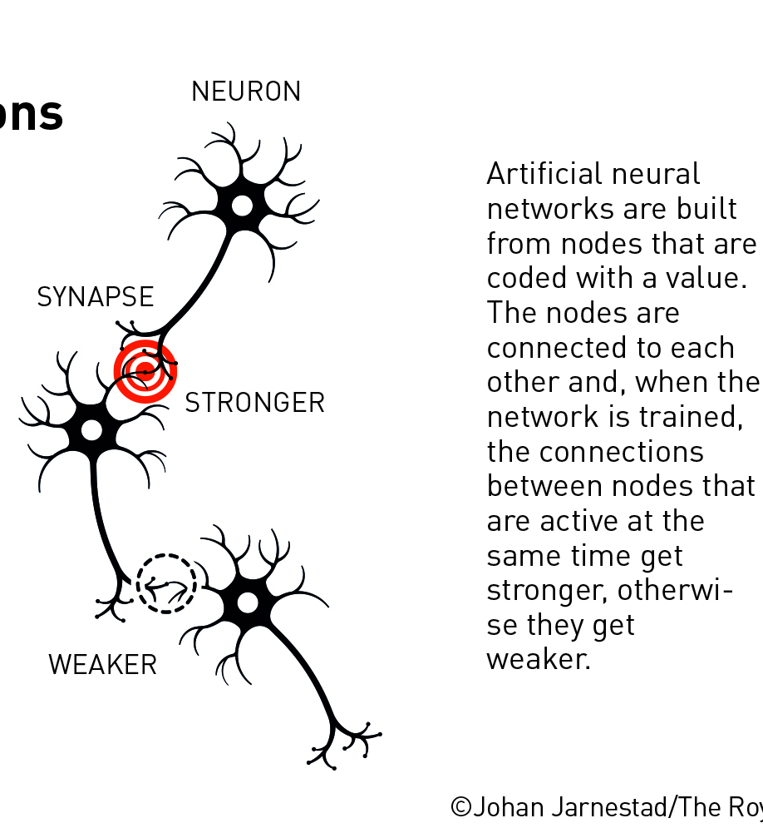

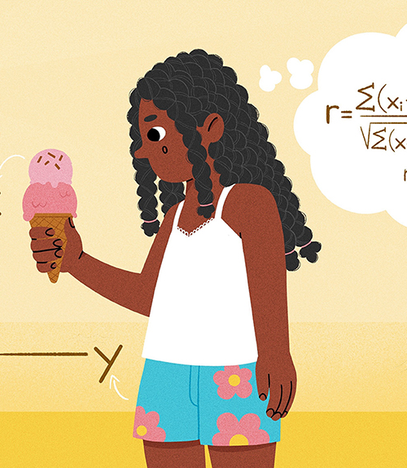
Maths Research for All Maths Week 2024
Noble Prize in Physics
Easy Or Hard? Basic Questions in Computational Complexity Theory
The maths behind a perfect cup of coffee
Causality: Using Math to Understand the Science of Cause and Effect

Slide 4
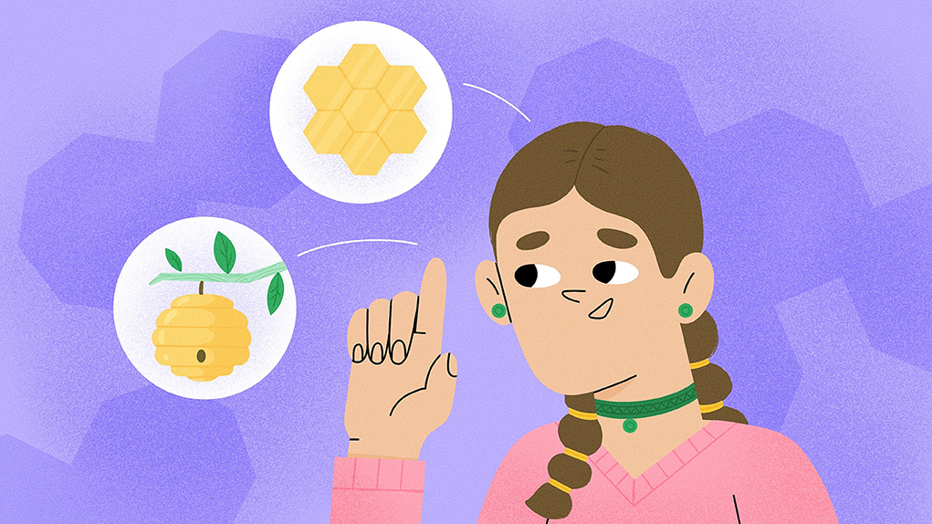

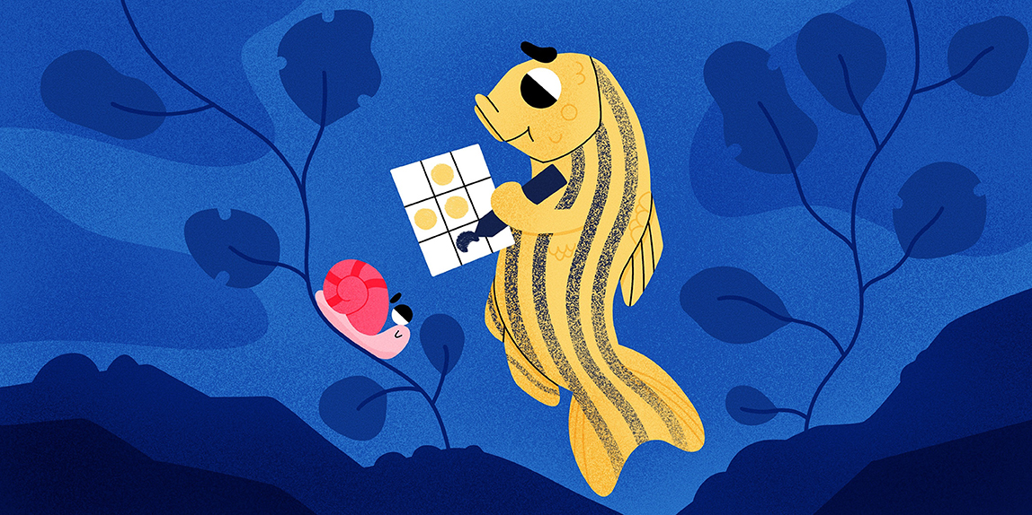

Puzzling Pentagons—How Many Ways Can We Cover a Flat Surface?
Predict Who Your Friends Are?
Maths Papers for Kids Maths Week 2023
What Does Math Have to Do With Patterns in Fish?
Understanding The Odds: Statistics in Public Health

Slide 5

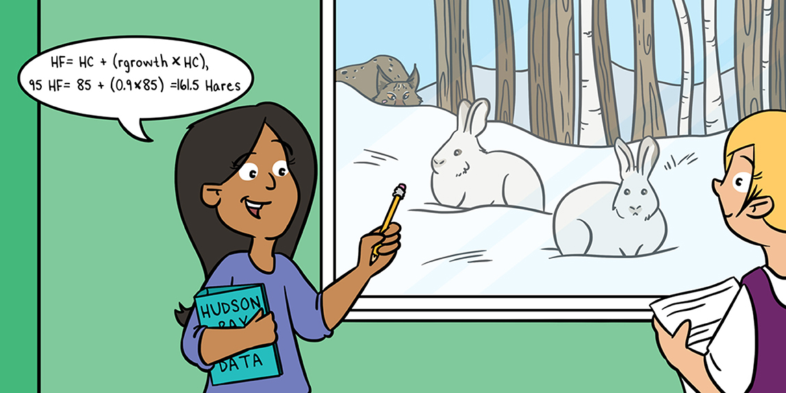
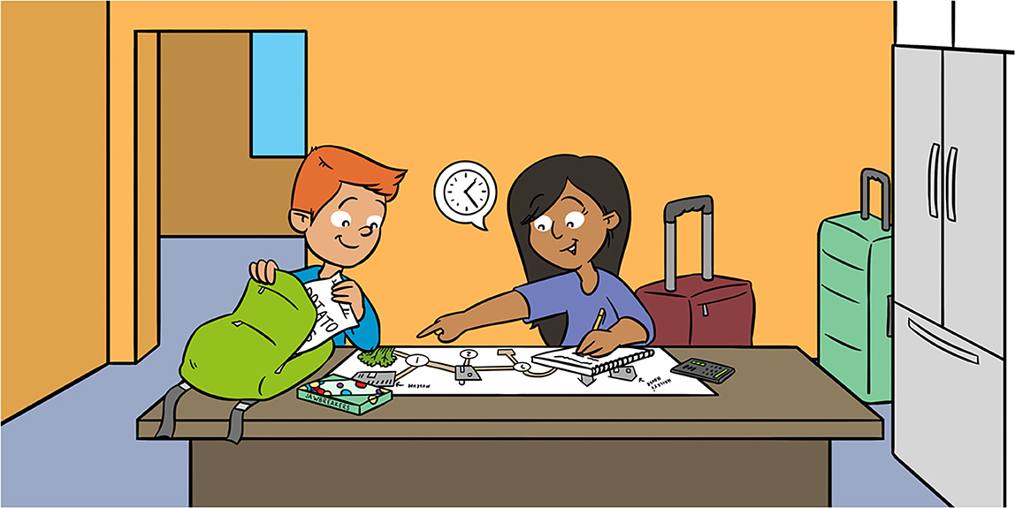
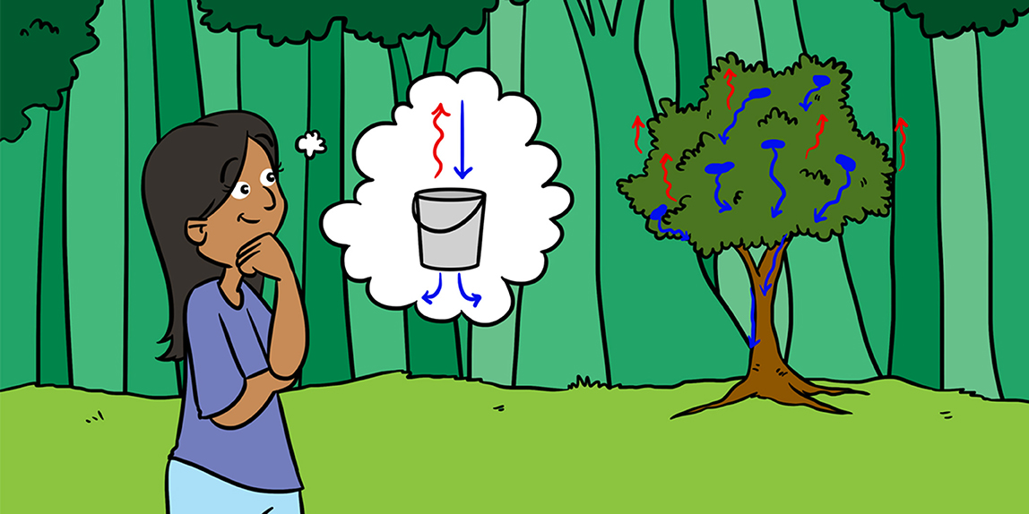
Using Mathematics to Become in Sync With the Brain
The Circle of Life: The Mathematics of Predator-Prey Relationships
Maths Papers for Kids Maths Week 2022
Finding Your Way: Shortest Paths on Networks
How Math Helps us Predict Water Flows in Forests

Slide 6
popular-physicsprize2024.pdf (nobelprize.org)
Emmert-Streib F and Dehmer M (2023) Causality: Using Math to Understand the Science of Cause and Effect. Front. Young Minds. 11:1155100. doi: 10.3389/frym.2023.1155100
Causality: Using Math to Understand the Science of Cause and Effect · Frontiers for Young Minds (frontiersin.org)
Segev N and Wigderson A (2024) Easy Or Hard? Basic Questions in Computational Complexity Theory. Front. Young Minds. 12:1284284. doi: 10.3389/frym.2023.1284284
Easy Or Hard? Basic Questions in Computational Complexity Theory · Frontiers for Young Minds (frontiersin.org)
The maths behind a perfect cup of coffee (rte.ie) By Kevin Moroney and Ken O’Connell, University of Limerick

Slide 7
Mann C and McLoud-Mann J (2023) Puzzling Pentagons—How Many Ways Can We Cover a Flat Surface? Front. Young Minds. 11:953114. doi: 10.3389/frym.2023.953114
https://kids.frontiersin.org/articles/10.3389/frym.2023.953114
Black A and West G (2023) Predict Who Your Friends Are?. Front. Young Minds. 11:820289. doi: 10.3389/frym.2022.820289
https://kids.frontiersin.org/articles/10.3389/frym.2022.820289
Goodwin G and Ryu S (2023) Understanding The Odds: Statistics in Public Health. Front. Young Minds. 11:926624. doi: 10.3389/frym.2022.926624
https://kids.frontiersin.org/articles/10.3389/frym.2022.926624
Shirman B and Volkening A (2022) What Does Math Have to Do With Patterns in Fish?. Front. Young Minds. 10:834049. doi: 10.3389/frym.2022.834049
https://kids.frontiersin.org/articles/10.3389/frym.2022.834049

Slide 8
The Circle of Life: The Mathematics of Predator-Prey Relationships
Rebecca Brady and John Butler
https://kids.frontiersin.org/articles/10.3389/frym.2021.651131
Using Mathematics to Become in Sync With the Brain
Micah Swartz and Leonid L. Rubchinsky
https://kids.frontiersin.org/articles/10.3389/frym.2022.741510
Finding Your Way: Shortest Paths on Networks
Teresa Rexin 1 and Mason A. Porter 1,2*
https://kids.frontiersin.org/articles/10.3389/frym.2021.631045
How Math Helps us Predict Water Flows in Forests
Katarina Zabret 1,2*, Mojca Šraj 1 and John T. Van Stan II 3
https://kids.frontiersin.org/articles/10.3389/frym.2022.762009

