Slide 1

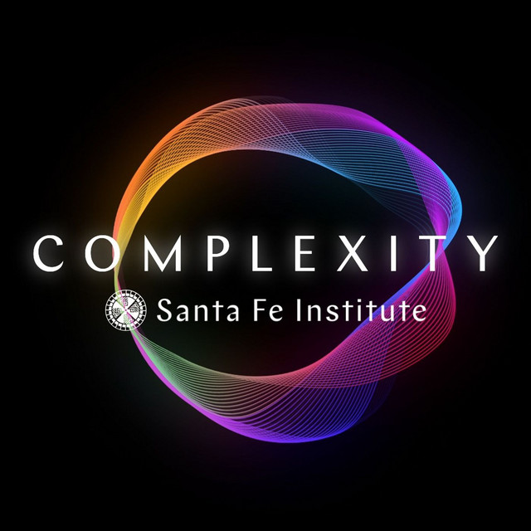
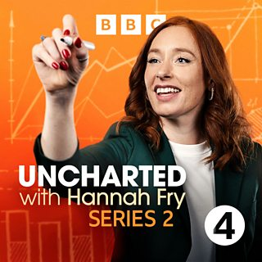
Podcast for Maths Week 2025

Slide 2
Uncharted with Hannah Fry
The Joy of Y
Complexity Santa Fe Institute

Slide 3
Podcast for Maths Week 2024

Slide 4
Uncharted with Hannah Fry
The Joy of Y
Complexity Santa Fe Institute

Slide 5
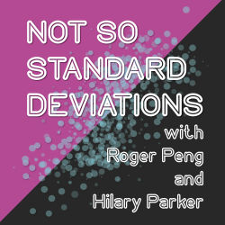
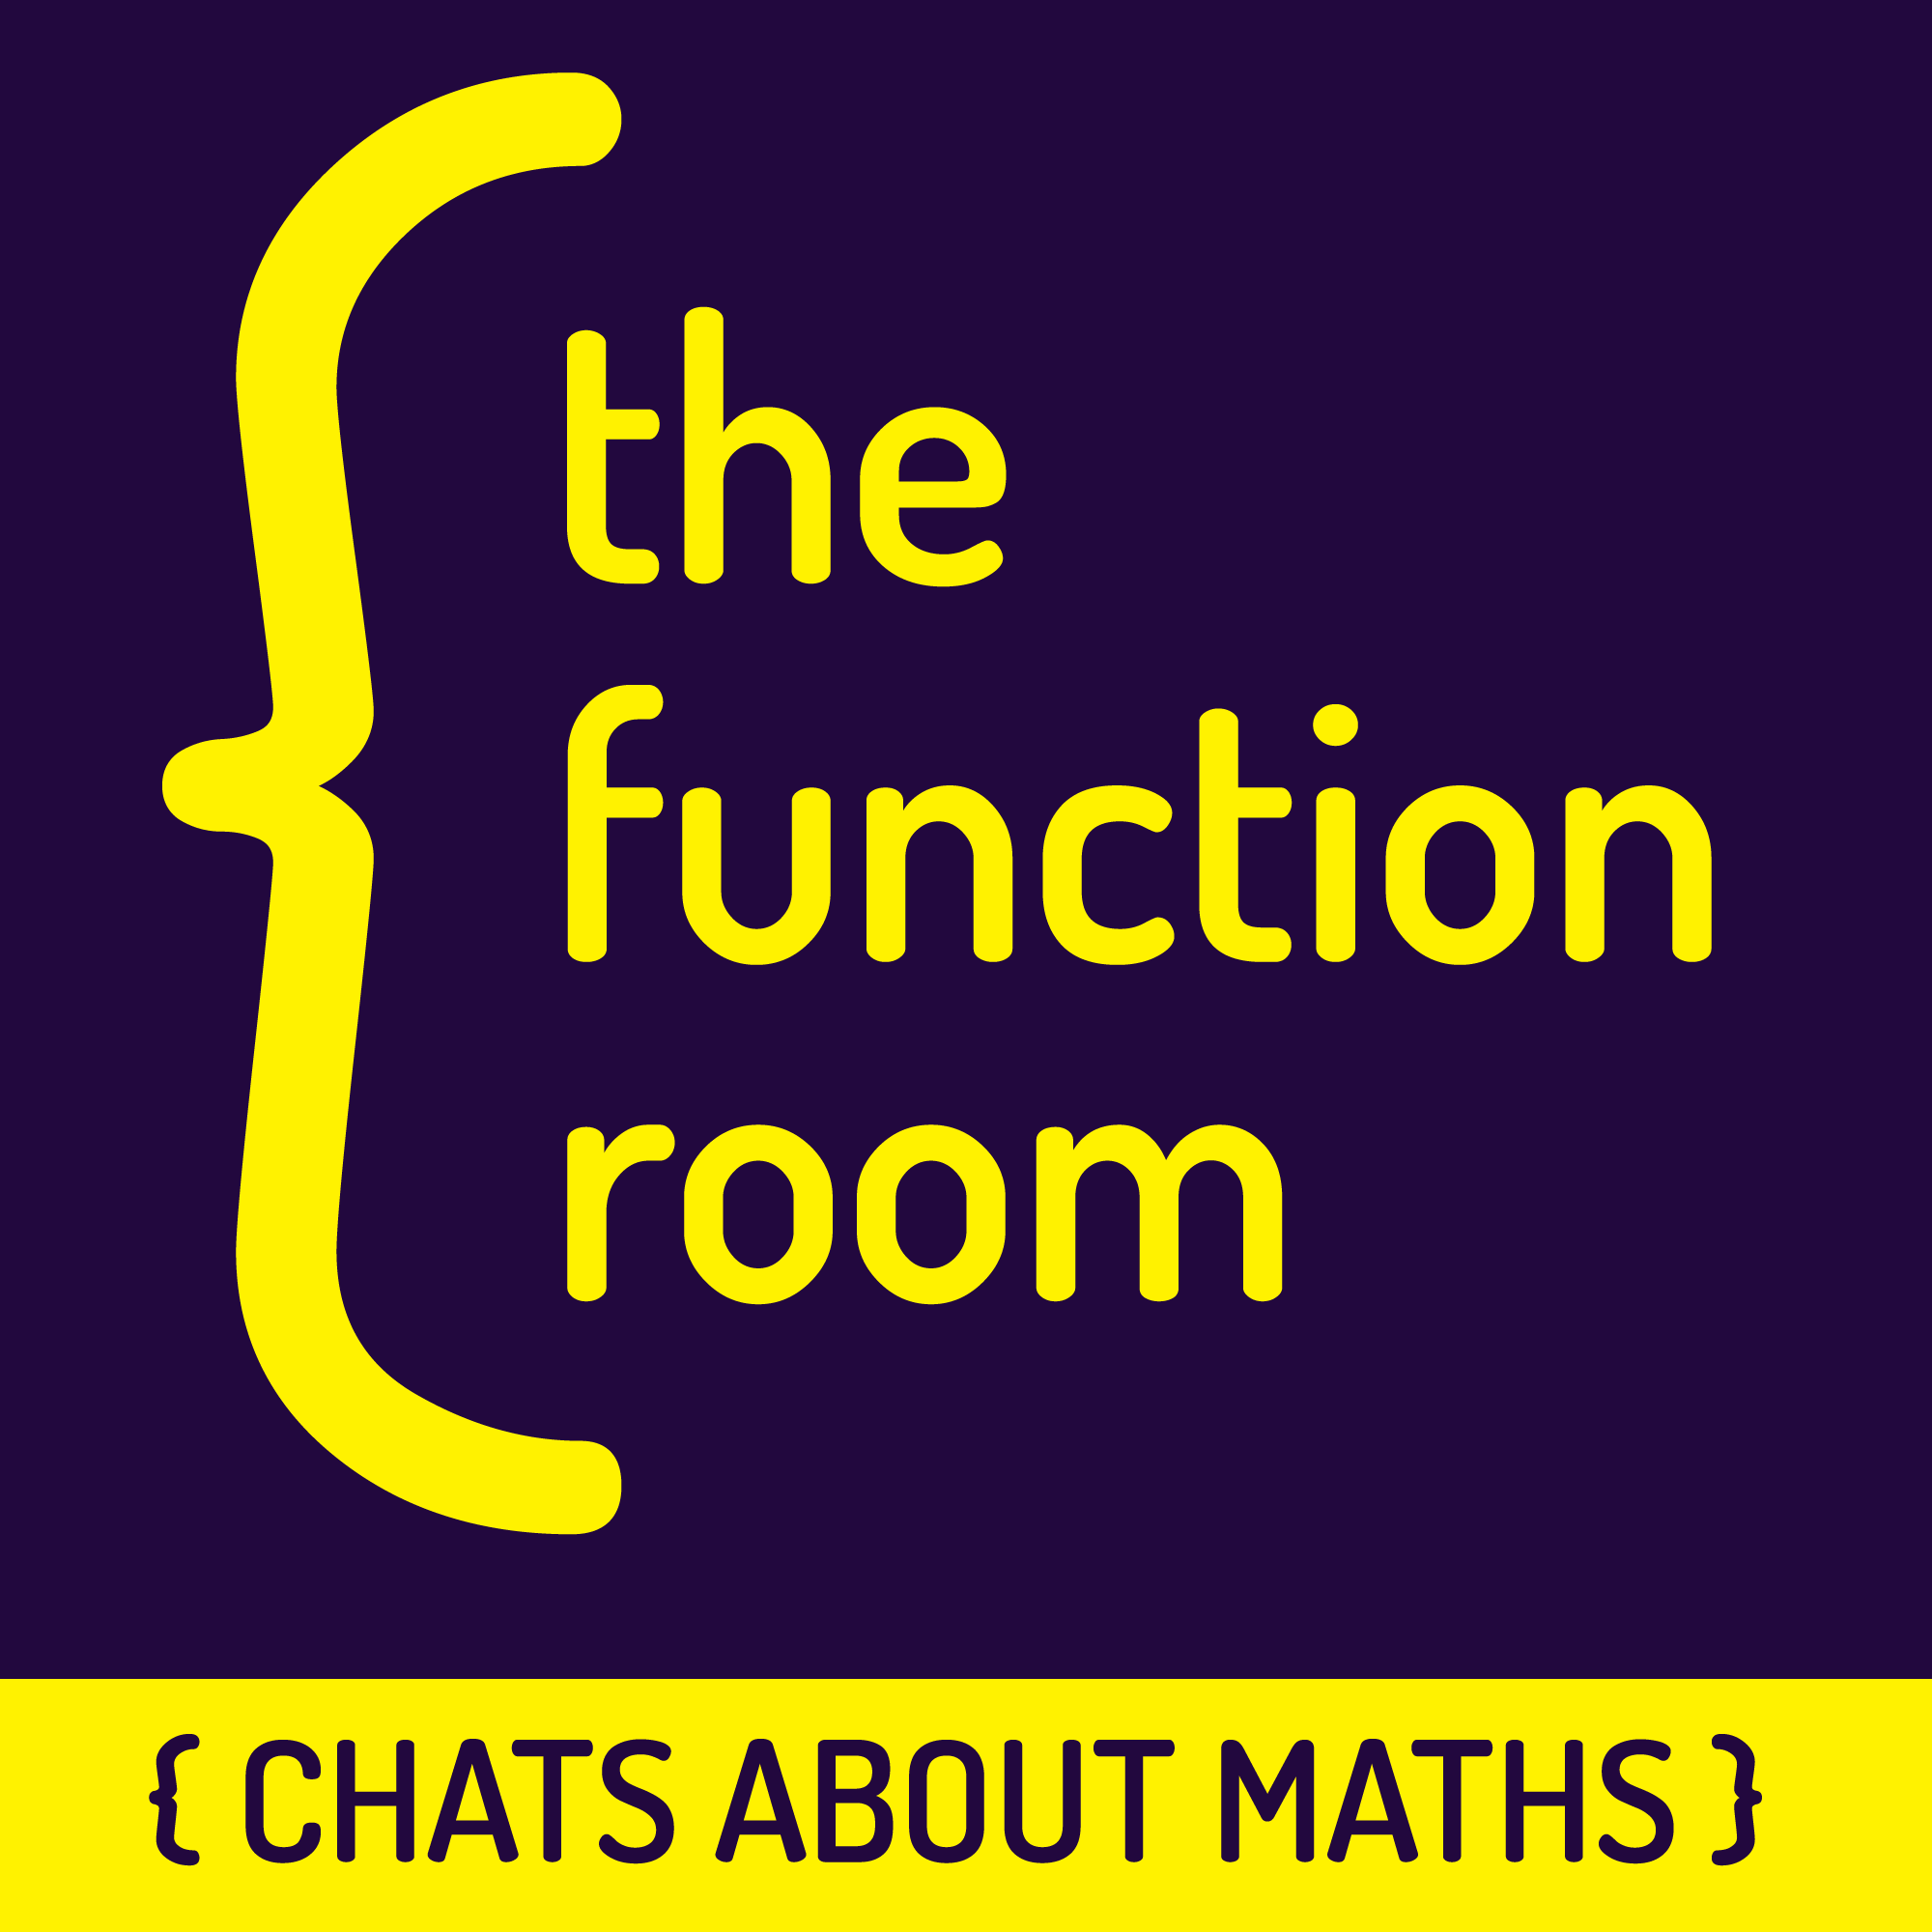
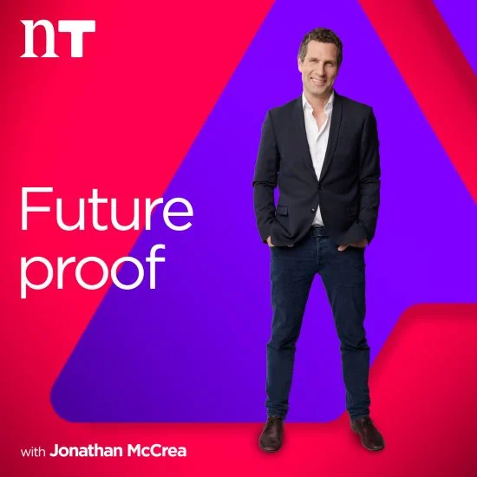
Maths Week 2023
Podcast Recommendations

Slide 6
Not so Standard Deviations with Roger Peng and Hilary Parker
The Function Room, Colm O’Regan chats about maths
Future proof with Jonathan McCrea

Slide 7
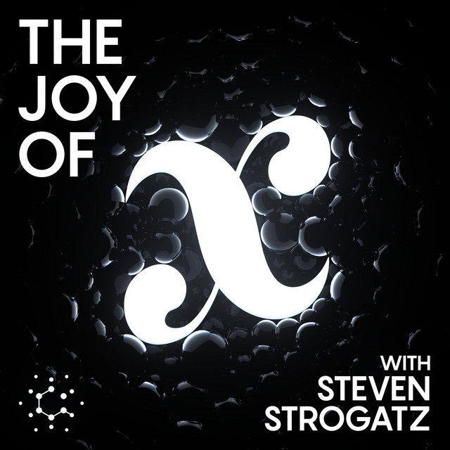
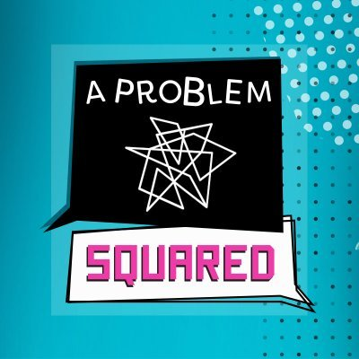
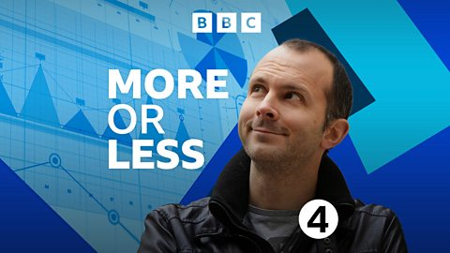
Maths Week 2022
Podcast Recommendations

Slide 8
More or Less
The Joy of X
A Problem Squared

