Slide 1
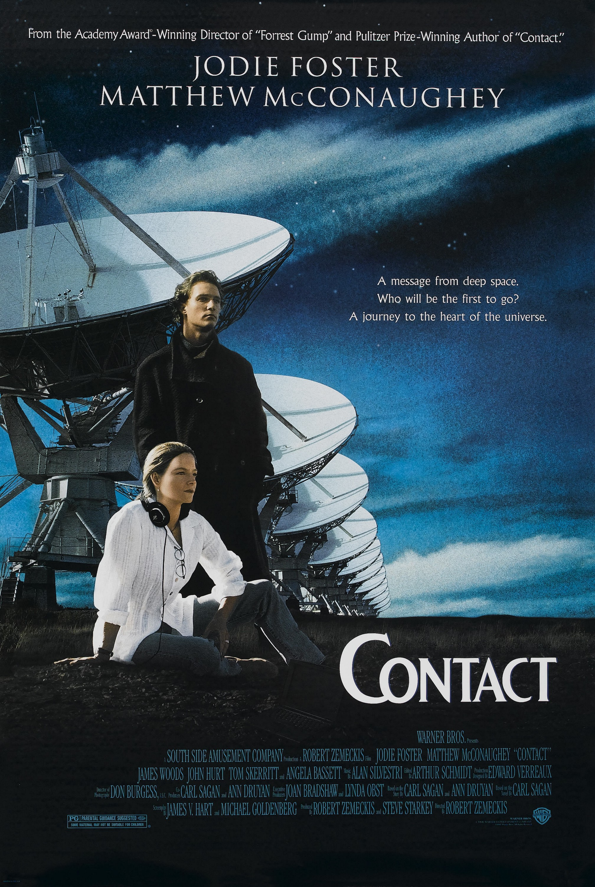

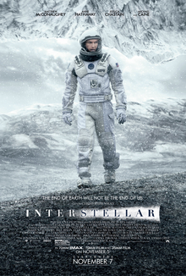

Films and TV for Maths Week 2025

Slide 2


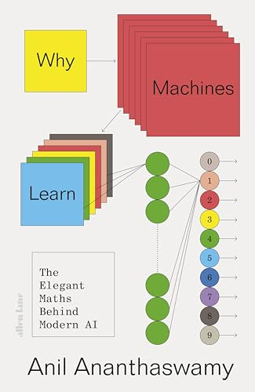

Books for Maths Week 2025

Slide 3


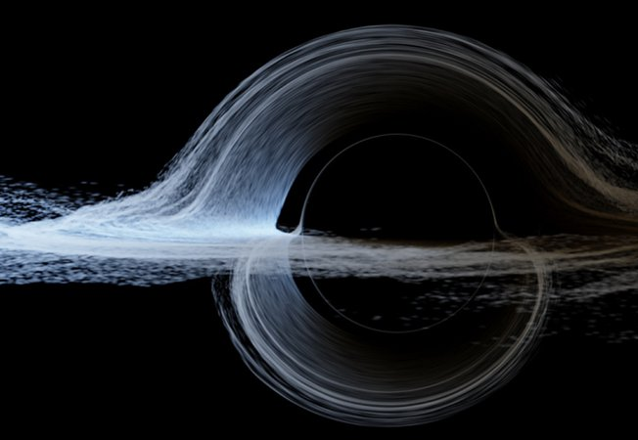
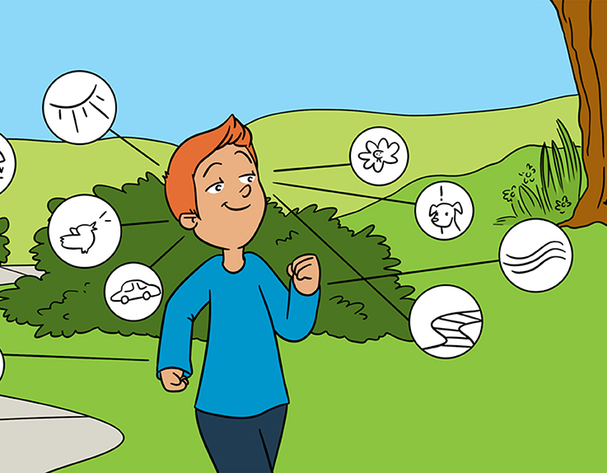
Maths Research for All Maths Week 2025
Will Learning Machines Take Over the World?
How Does Math Keep Secrets?
“Feeling” Ourselves Move: A Team Effort by Our Senses
Astrophysics in Interstellar

